Slide 1



Putting Your Best Foot Forward
Appropriate Attire and Decision Making
for Middle and High School Students
Melinda Miller, Kate Whiting, Allie Griner
University of Georgia Cooperative Extension
Presentation created by Megan Powell
AmeriCorps VISTA Member - SW District 4-H
Notes:
Melinda, Kate and Allie – do a little acting introduction. Allie starts pulling all kinds of items out of her suitcase and says, hey what am I going to wear to school today? She pulls out a shirt and Kate says, “no that’s too…(make up something)” and Melinda says, “yeah sure that looks good – looking at her watch as if it’s taking too much time.” Allie is frustrated b/c Kate and Melinda make her nuts and she finally just says – “I give up, I’m going to cry! I have NOTHING TO WEAR!”
Melinda – do you ever feel this way? I know I sure do. I can remember being in middle and high school thinking that nothing I had in my closet was cool enough, looked good enough or would ever make me look and feel awesome… middle and high schoolers are no different today. More often than not, young people tend to dress in styles that are trendy and not necessarily the best look for them. Regardless of their body type or budget, today we are excited to share a lesson plan with you that can help students better understand themselves and how to dress appropriately for any setting. As we’ve all heard before, you only get one chance to make a good first impression.

Slide 2
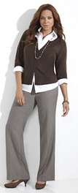
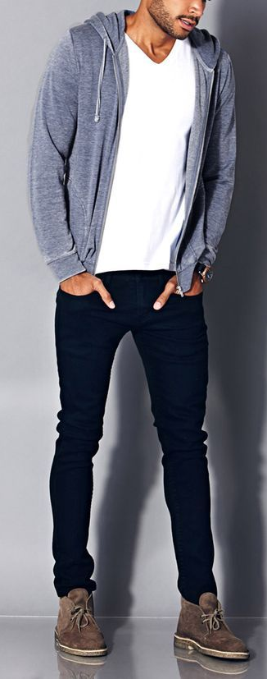
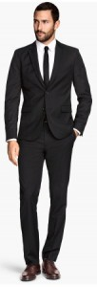
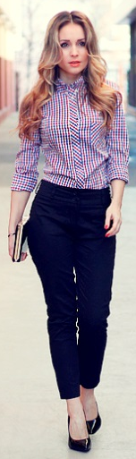
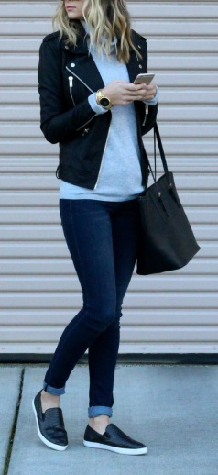
Appropriate Attire
DON’Ts for all occasions
Casual
Business Casual
Professional
Notes:
Melinda – Introduce myself and what I do, experience working with youth.
Learning to dress for all types of occasions is a very important skill! As a middle or high school student, we know the goal is to be comfortable – but being comfortable is more about appropriate styles and fit and less about wearing yoga pants and a way too big t-shirt. That attire is only appropriate for exercising, as pajamas or lounging around at home!
Whether going to a wedding, funeral, club competition or an awards program; middle and high school youth need to be well informed so that they can build confidence and feel a sense of belonging in any setting. It’s a terrible feeling to walk in to any room or setting and realize you were not prepared. And for some youth, it may never even hit them until someone says something rude because of their appearance.
Last, we’ll drop nuggets to youth about making wise choices without over spending, yet another very important life skill.
Ref: Texas Education Agency 2014 http://cte.sfasu.edu/wp-content/uploads/2014/04/Dress-For-Success-Presentation-Notes.pdf

Slide 3
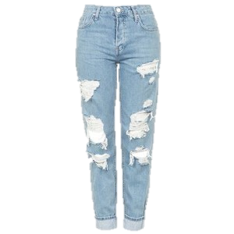
DON’Ts: Men & Women
Do Not Wear:
Clothes that are:
ripped or torn
extremely tight or loose
wrinkled
too long or too short
strapless or have spaghetti straps
transparent
Notes:
Kate – what NOT to wear

Slide 4
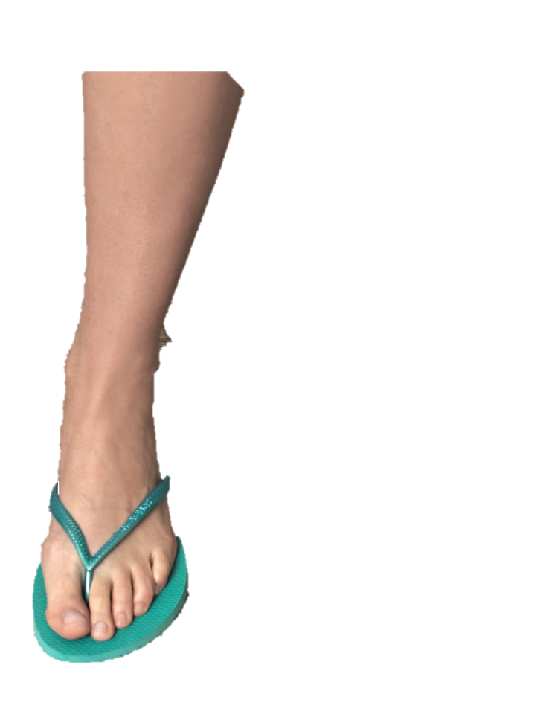
DON’Ts: Men & Women
Do Not Wear:
Anything that shows excessive amounts of skin
Athletic shorts
Lounge pants
Opened toe shoes
Rubber sandals or slippers
Notes:
Kate – more what NOT to wear
Offer a funny story! ☺

Slide 5
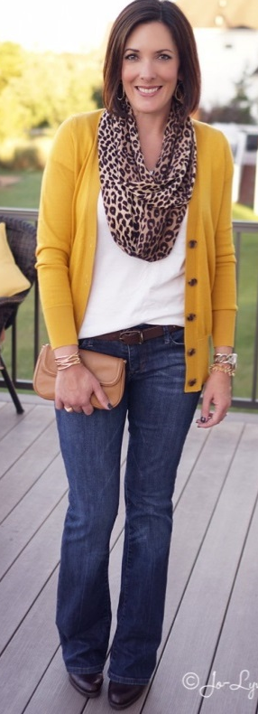
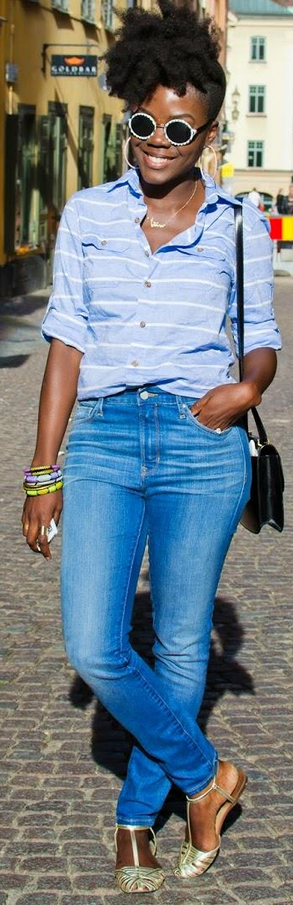
Casual for Women
Appropriate length sundress or skirt
Khakis or nice jeans
Shorts
Depending on occasion and climate
Plain T-shirt (no slogans), polo shirt, turtleneck
Casual button-down blouse
Flats, sandals, appropriate sneakers
Notes:
Kate - Appropriate for: shopping, going out to a casual, family style dinner, movies, informal parties, school.

Slide 6
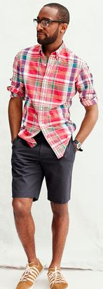
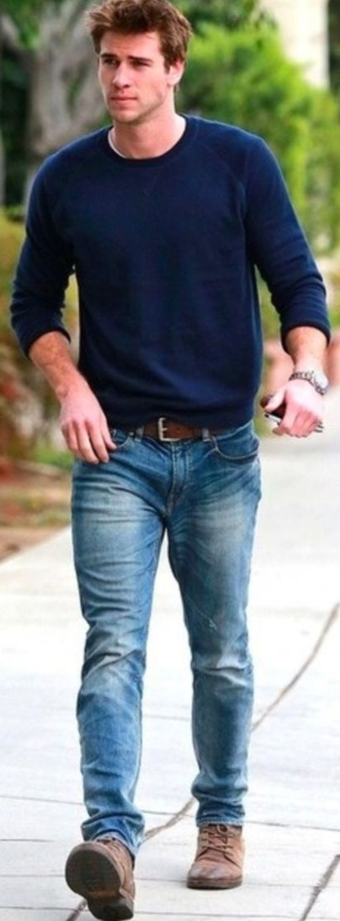
Casual for Men
Khakis or good jeans (clean, no holes)
Cargo or Bermuda shorts
Depending on occasion and climate
Plain T-shirt (no slogans), polo shirt, turtleneck
Casual button-down shirt and/or sweater
Loafers, sneakers (with or without socks), sandals
Notes:
Kate -

Slide 7
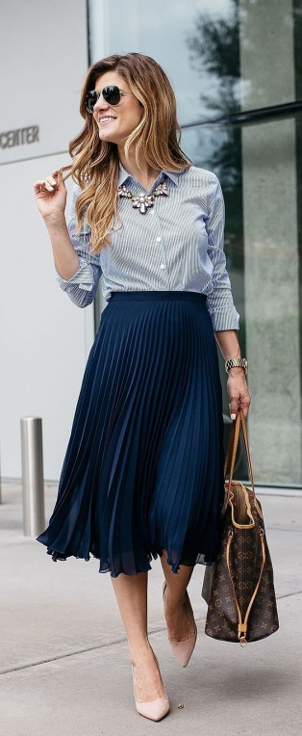
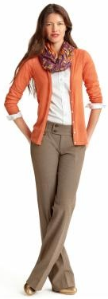
Business Casual for Women
Skirt, khakis, or pants
Open-collar shirt, knit shirt or sweater
No spaghetti straps or revealing tops
Dress
Notes:
Kate - What settings might this look be appropriate?
Office wear, teaching, extension agent, retail department store, church, awards program, club contest/presentation. Could be worn to a wedding, funeral/wake, other dressier settings that are non-formal or professional in nature.

Slide 8
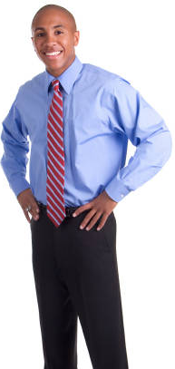

Business Casual for Men
Not a suit
Slacks or khakis
Dress shirt, casual button-down shirt, open-collar or polo shirt
Optional tie
Seasonal sport coat or blazer
Loafers or loafer-style shoes
Socks
Notes:
Kate

Slide 9

Professional Dress for Interviews
Dress for the job
Ask questions and do research
Better to overdress than underdress
Notes:
Allie

Slide 10
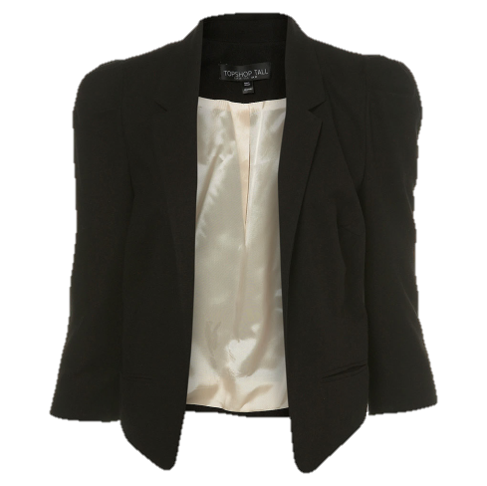
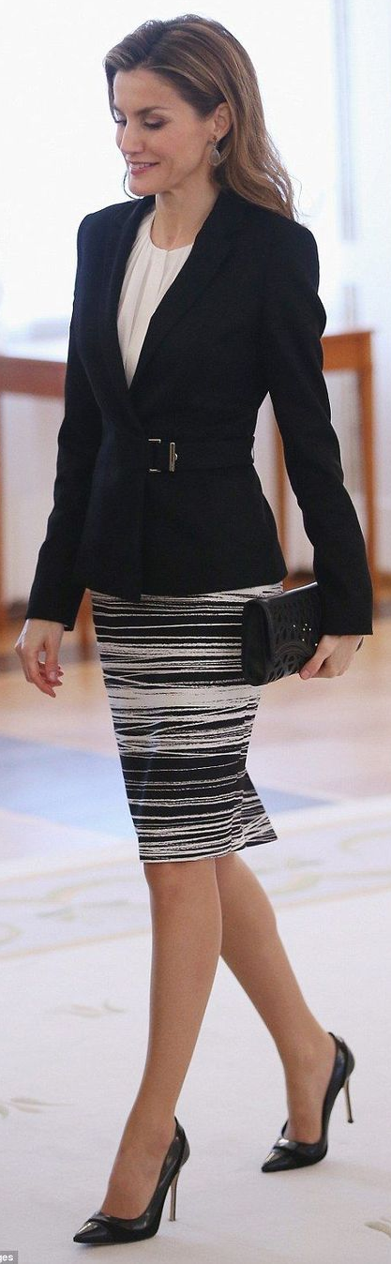
Professional for Women
Dark neutral colored blazer/suit jacket
Slacks to coordinate with blazer color
Skirts at or below the knee
Shirt with appropriate neckline
Small prints or simple colors
Closed toe and Closed heel dress shoes
Flats
2 to 3 inch heel
Plain hose
Well groomed hair and nails
Minimal jewelry and tasteful makeup
Notes:
Allie

Slide 11
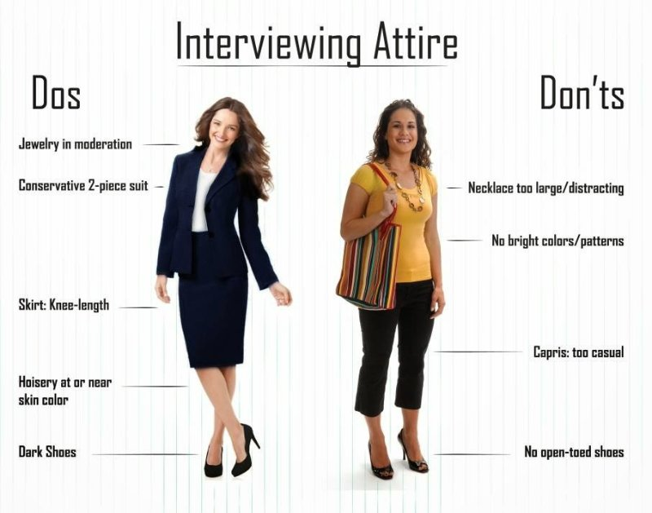
Notes:
Allie

Slide 12
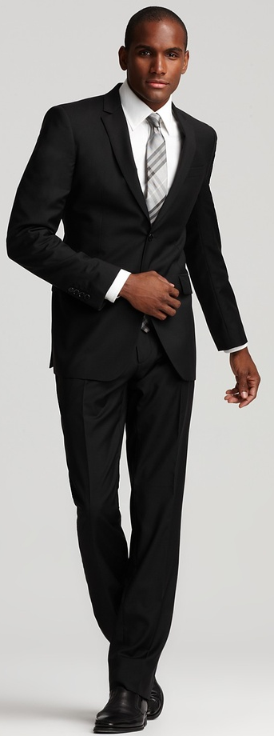
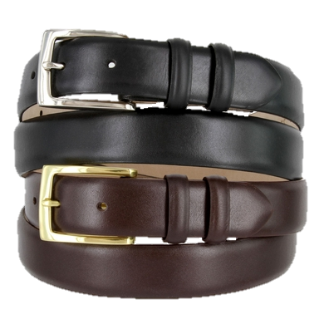
Professional for Men
Wear dark neutral colors
Pants and jackets should coordinate
Simple button down collared shirts
Pants that fit at the waist
Ties
Approximately at or right about belt buckle
Choose appropriate patterns
Belt and shoes match
Tall socks
Brown or black leather shoes
Notes:
Allie

Slide 13
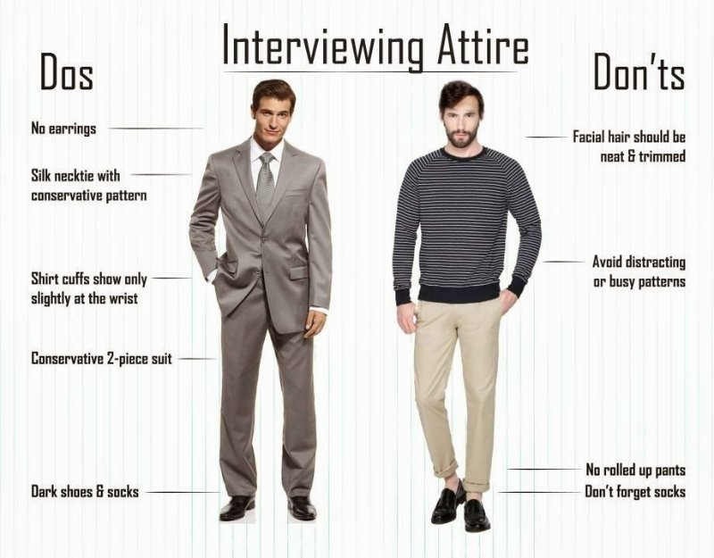
Notes:
Allie

Slide 14
Now you try!
As each picture appears, choose which category it is in:
Hold up the correct color card to show your answer!
Light Blue- Casual
Green- Business Casual
Red- Professional
Notes:
Allie - Hold up colorful cards to case your vote! casual (light blue), business casual (green), professional (red). (Melinda will provide)

Slide 15
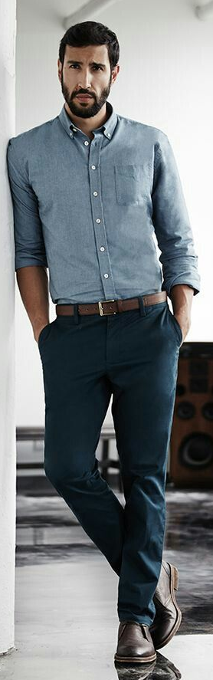
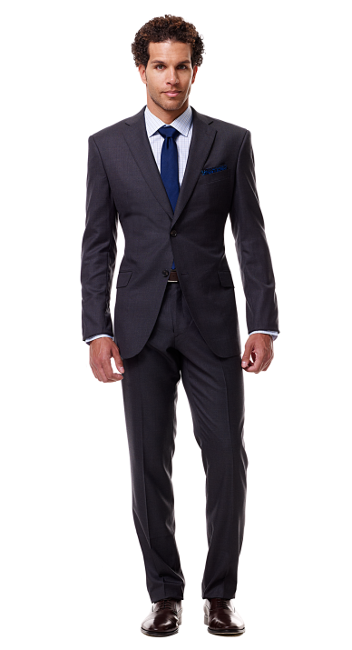
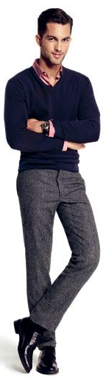
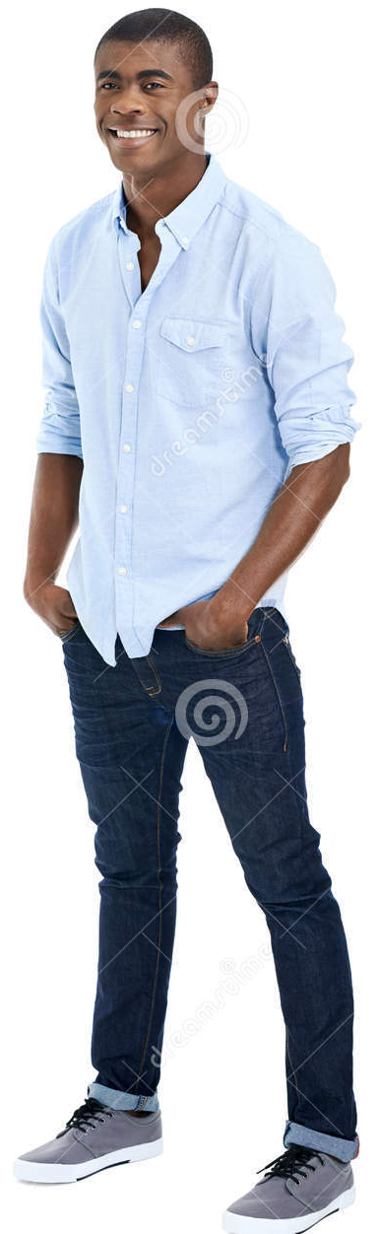
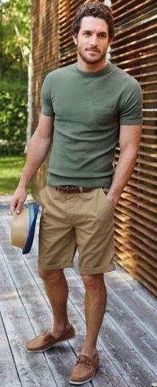

2
3
5
4
1
6
Notes:
Allie
1- Business Casual
2- Casual
3- Professional
4- Casual
5- Business Casual
6- Casual

Slide 16
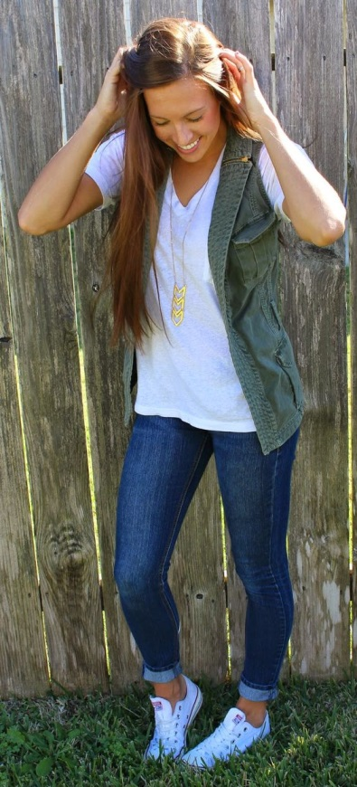
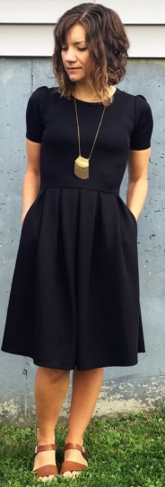
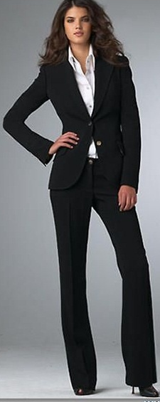
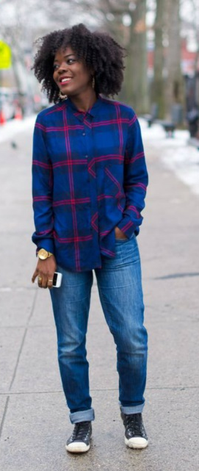
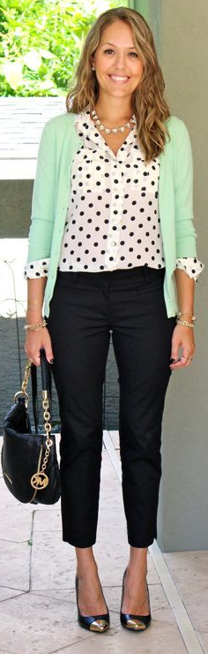
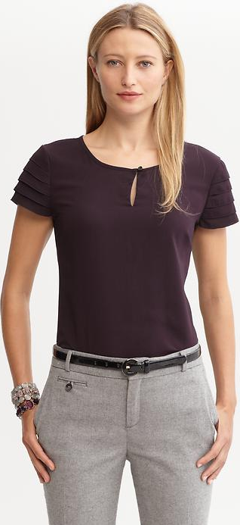
2
1
3
6
4
5
Notes:
Allie
1- Casual
2- Casual
3- Business Casual
4- Casual
5- Business Casual
6- Professional

Slide 17

Decision Making
Notes:
Allie – here you could play This or That or do it after the group does the classes of apparel.

Slide 18
Use your decision making skills to:
Compare products
Purchase affordable clothes
Figure out what you need for the occasion
Be sure to:
Always understand the situation carefully
Notes:
Melinda– explain importance of using dress as an opportunity to teach decision making skills and strategies

Slide 19
Identify
Choose
Analyze
Compare
Examine
Notes:
Melinda

Slide 20
Identify
Situation
Notes:
Melinda The first step is to identify the situation. For example - - - I need to choose an outfit to wear at 4-H camp.

Slide 21
Analyze
Situation
Notes:
Melinda The second step is to analyze the situation. 4-H events have a dress code. Underwear must be worn, but not seen. All sandals must have a heel strap. No short shorts. Clothing must not have slogans that violate the code of conduct.

Slide 22
Examine
Alternatives
Notes:
Melinda Let’s see what clothing is in my drawers and my closet.

Slide 23
Compare
Alternatives
Notes:
Melinda
I really love this shirt. Oops, it refers to a bar. The 4-H Code of Conduct says NO use of alcohol. This outfit is the bomb, but the only shoes I have to wear are flip flops. They don’t have heel straps. If I take this outfit, I have to buy new shoes.

Slide 24
Choose
Best
Alternative
Notes:
Melinda You continue to compare the alternatives to your analysis of the situation until you finally choose an outfit that meets the dress code requirements.

Slide 25
Identify
Situation
Choose
Best
Alternative
Analyze
Situation
Compare
Alternatives
Examine
Alternatives
Notes:
Melinda

Slide 26
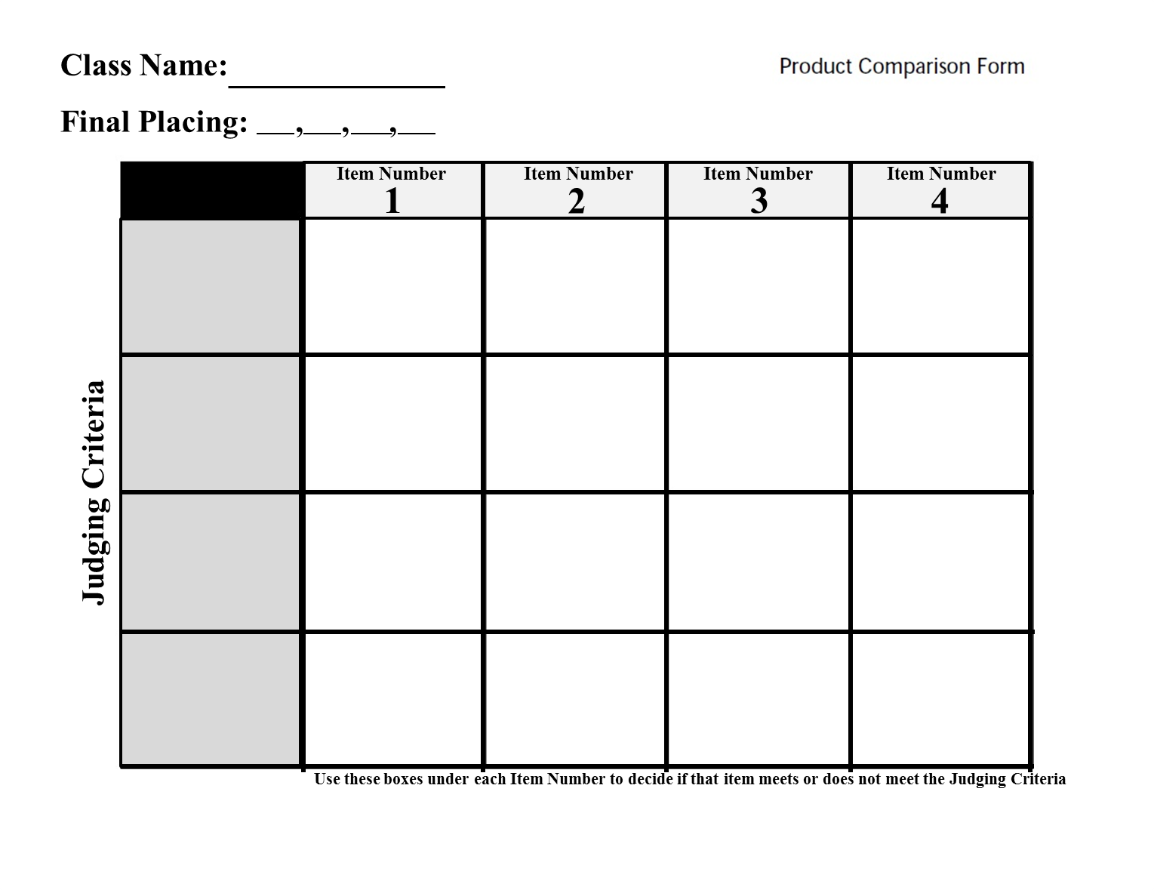
Product Comparison Forms
Notes:
Kate - Share a copy of the form and state it’s purpose. (Sometimes when making a big decision – it’s good to take notes. This is a tool to help with important decision making and comparing options.)
Flip it over to Allie to lead the Women’s Blazer activity.

Slide 27
Example: Women’s Blazers
Cindy has an interview next week. She has a black skirt and a white blouse already in her closet. She needs to buy a new blazer for the interview. She likes simple buttons and needs the blazer to be under $50.
Notes:
Kate

Slide 28
Women’s Blazers
Cindy has an interview next week. She has a black skirt and a white blouse already in her closet. She needs to buy a new blazer for the interview. She likes simple buttons and needs the blazer to be under $50.
Notes:
Kate

Slide 29
Women’s Blazers
1 2 3 4
Professional for interview
Black to match skirt
Simple buttons
Under $50
Notes:
Kate

Slide 30

Now let’s practice our decision making skills!
Women’s Shoes Class 1
Men’s Ties Class 2
Women’s Tops Class 3
Men’s Pants Class 4
Notes:
Allie – break participants in groups – any way you’d like and let them run through the Shoes & Blouses (Ladies), Ties & Pants (Gentlemen) classes and place them. Each group can report back out on 1 set.
If there is time, lead them in developing their own scenario as a group that we will add to the teaching materials for everyone. Maybe give them options for a dress or suit for an awards program or a wedding. Those are 2 items we did not judge today.

Slide 31
Team Time
Write a situation statement
Include need for an apparel item
State budget limitations
Other things to consider
Occasion for wear
Color, fabric or seasonal preferences
Time constraints
Anything else?
Notes:
Melinda- If there is time, lead them in developing their own scenario as a group that we will add to the teaching materials for everyone. Maybe give them options for a dress or suit for an awards program or a wedding. Those are 2 items we did not judge today. Allow each group to report out. Collect their situations and state that we will include in the materials available for download.
Allie or Kate – One take notes and offer to post ideas on the web site after the session.

Slide 32
Putting Your Best Foot Forward
Appropriate Attire and Decision Making
for Middle and High School Students
Melinda Miller, Kate Whiting, Allie Griner
University of Georgia Cooperative Extension
Presentation created by Megan Powell
AmeriCorps VISTA Member - SW District 4-H
Notes:
Kate – give sticky notes and ask each participant to list 1 thing they liked and 1 thing they would change about the workshop.
All – thank them for attending. Share business cards.

