Slide 1

Housing Tax Credits
March 29, 2022
Meagan Cutler, Housing Policy Analyst
Housing Finance and Development Division

Slide 2
Housing Tax Credit 101

Slide 3
What is the Housing Tax Credit?
“an indirect federal subsidy used to finance the construction and rehabilitation of low-income affordable rental housing.”
- Novogradac

Slide 4
Housing Tax Credit
(HTC / LIHTC)
Largest Producer of Affordable Housing in the US
3 million affordable homes (~90,000 per year) since 1986
30-year affordability
Income- and rent-restricted
Income: 20 – 80% median income (property average ~60% AMI)
Rent: ~30% of designated AMI
Competitive process
Notes:
Wherever zoning allows it, lihtc can be built

Slide 5

How does the LIHTC Program work?
Application
Tax Credits
Developer

Slide 6

How does the LIHTC Program work?
Application
Tax Credits
Tax Credits
Equity ($)
Developer
Investor

Slide 7

How does the LIHTC Program work?
Application
Tax Credits
Tax Credits
Equity ($)
Equity ($)
Affordable Housing
Developer
Investor

Slide 8
Debt-to-Equity Ratio
~20 – 30%
~70 – 80%
~20 – 30%

Slide 9
Debt-to-Equity Ratio
Less debt
=
Lower costs
=
Less rental revenue required
=
Affordable rents
~20 – 30%
~70 – 80%
~20 – 30%

Slide 10




DCA Roles
Policy Team writes and finalizes QAP (Governor Signs)
Office of Housing Finance reviews applications
Office of Housing Finance monitors construction, issues 8609s
Office of Portfolio Management monitors occupied properties until end of 30-year period

Slide 11






Funding Round Snapshot
Applications
Received
93
Properties
Funded
39
Units Created / Preserved
2,699
Preservation
13%
Rural
49%
Senior
31%

Slide 12
Impacts & Benefits

Slide 13

Housing Credit Impact
Addresses critical need for safe, decent housing for:
Seniors seeking independent living
Georgia working families with low and moderate incomes
Individuals with disabilities
Residents at Lone Mountain Village
Ringgold, GA

Slide 14
Economic Development & Job Creation Estimated 1-Year Impact on Locality per 100 Tax Credit Units:
$7.9M in Income
$827,000 in Government Taxes and Revenue
122 Jobs

Slide 15
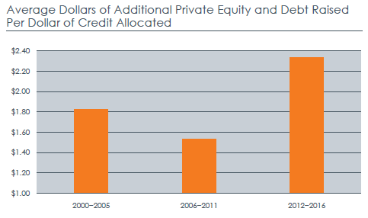
Attracts Additional Private Capital

Slide 16
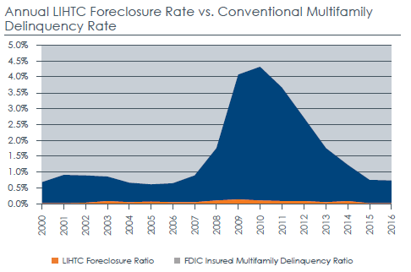
Low Foreclosure Rate

Slide 17
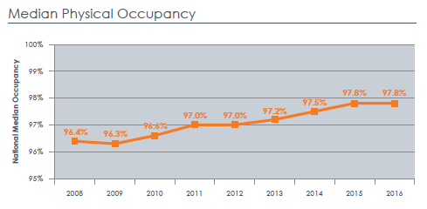
Low Vacancy

Slide 18
HTC in Your Community

Slide 19
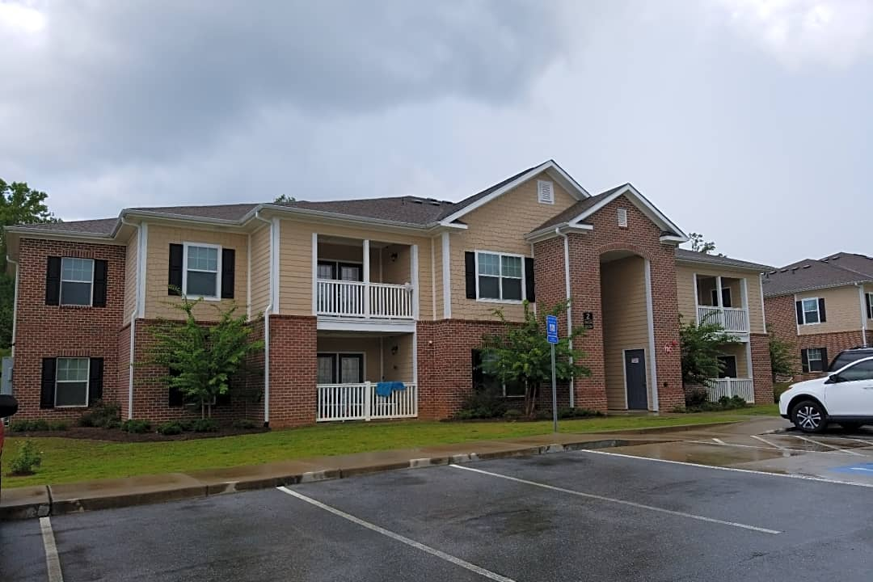
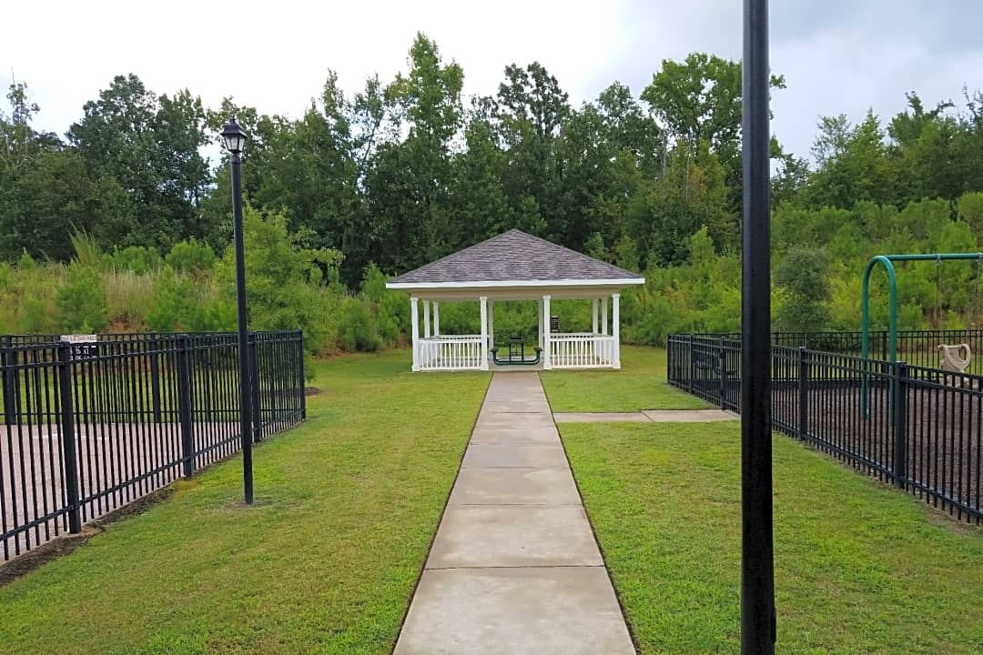
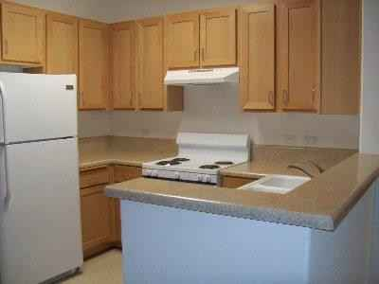
Heritage Vista, Baldwin County
New Construction
Family Tenancy
63 Units
13 at 50%
50 at 60%
Amenities: pool, playground
Awarded 2011, completed 2013

Slide 20
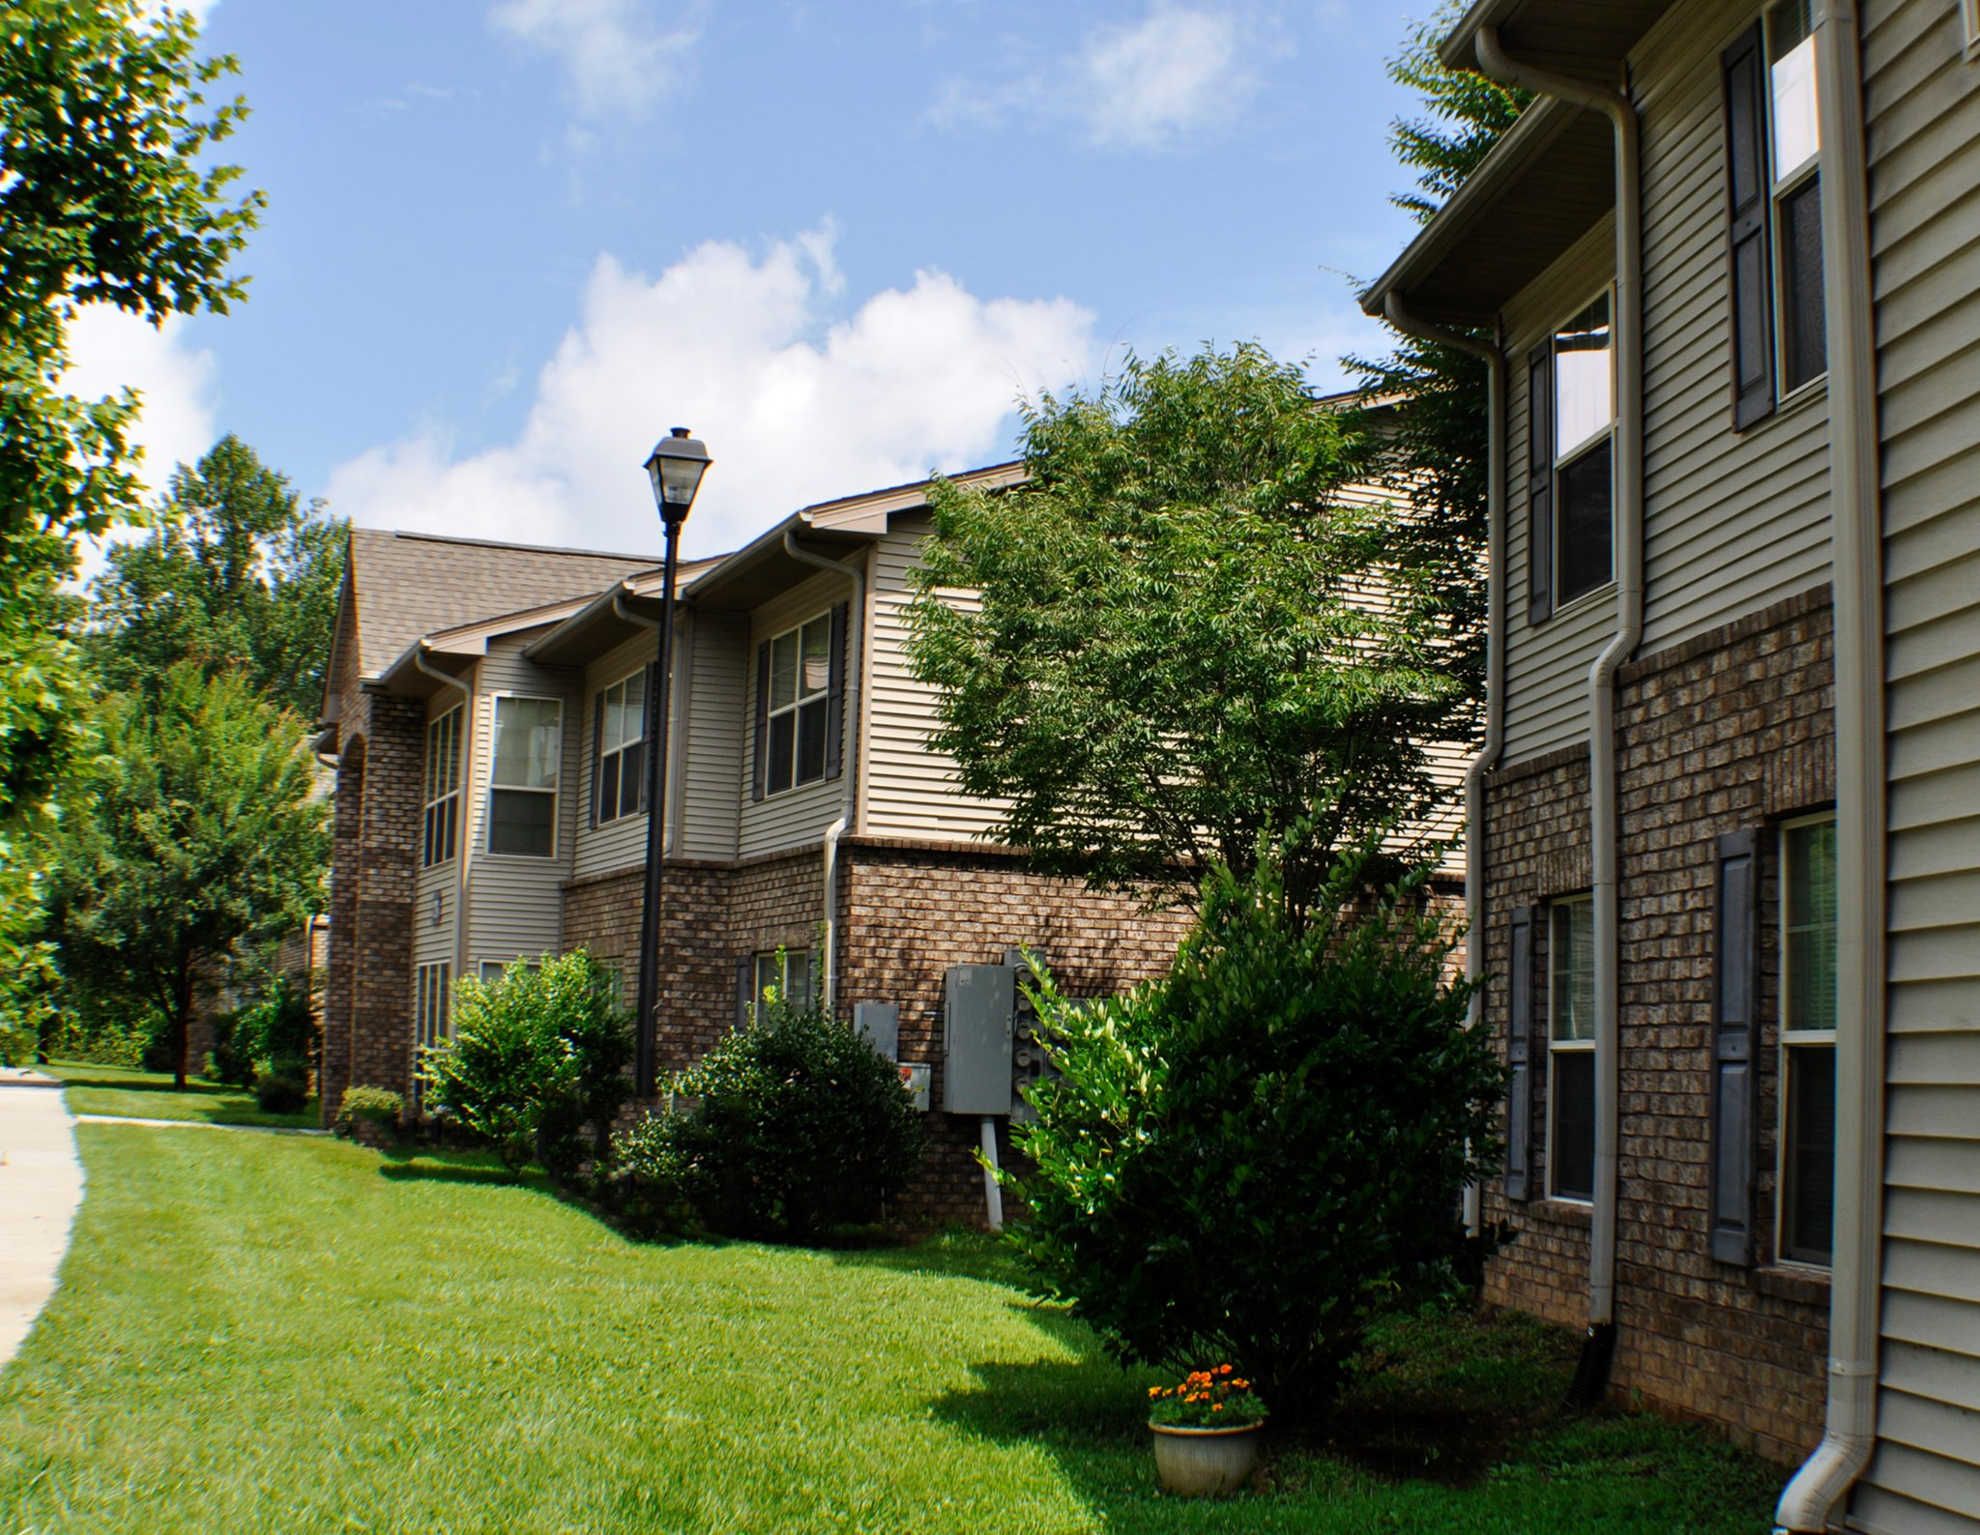
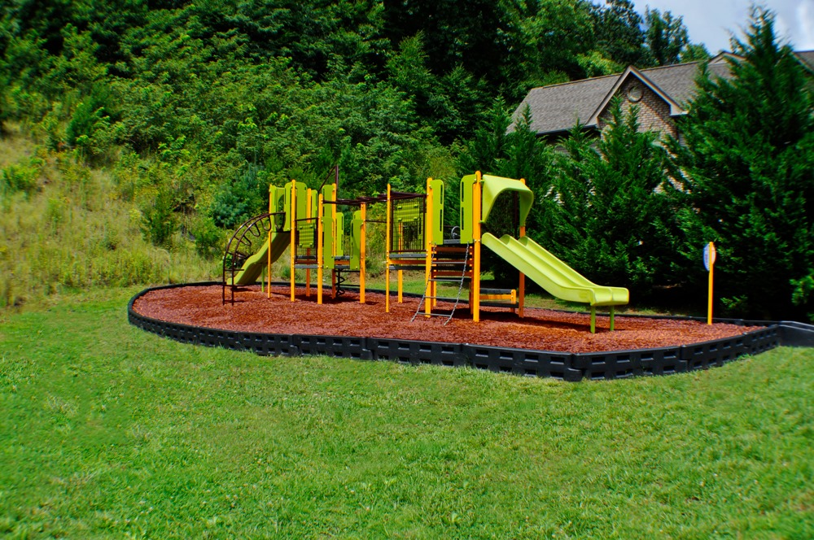
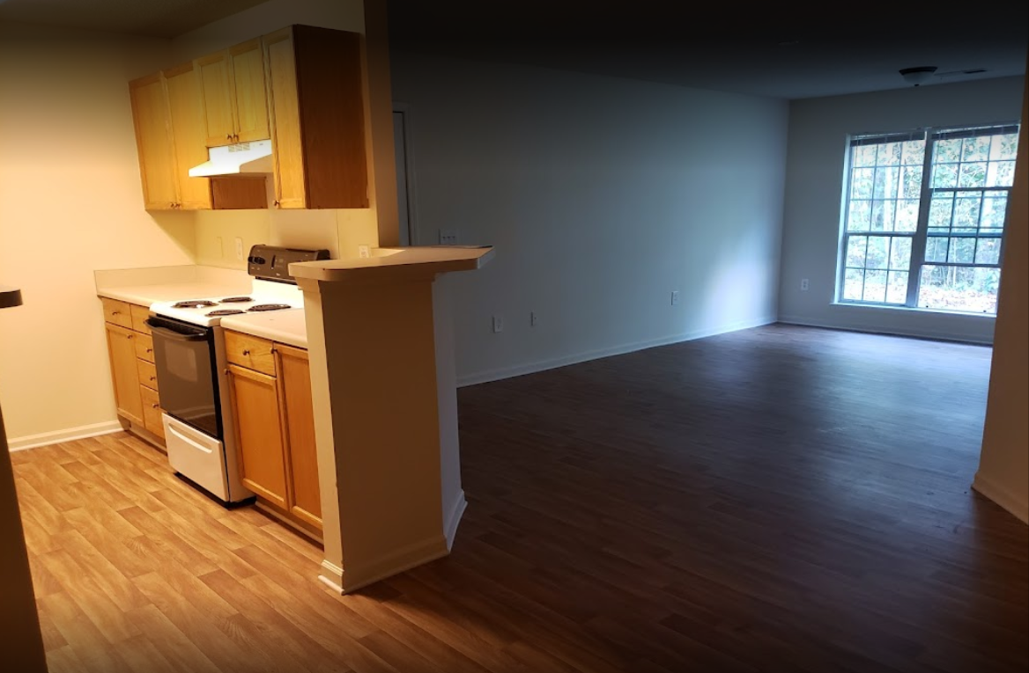
Vista Ridge, Rabun Gap, Rabun County
New Construction
Family Tenancy
64 Units
18 at 60%
34 at 50%
5 at 30%
7 market-rate
Amenities: pool, playground, fitness center, grill, picnic area
Awarded 2002, completed 2005

Slide 21
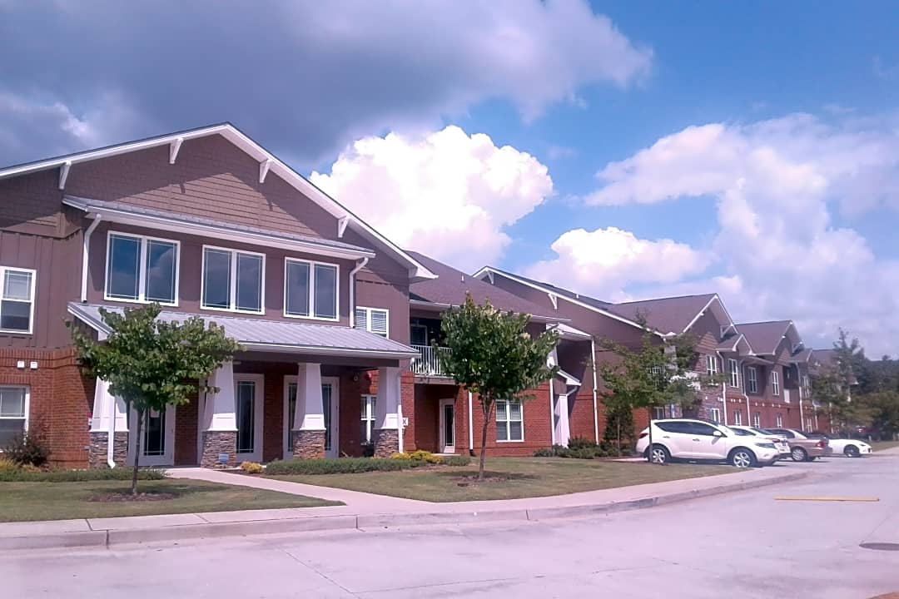
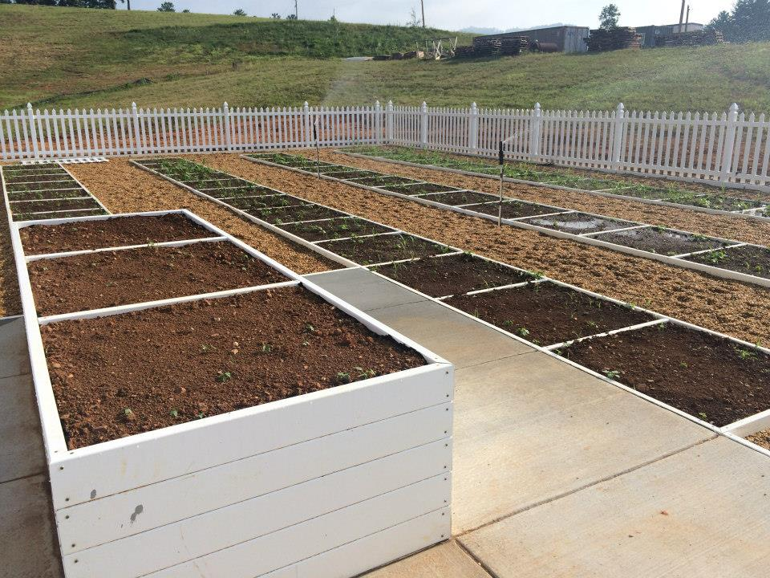
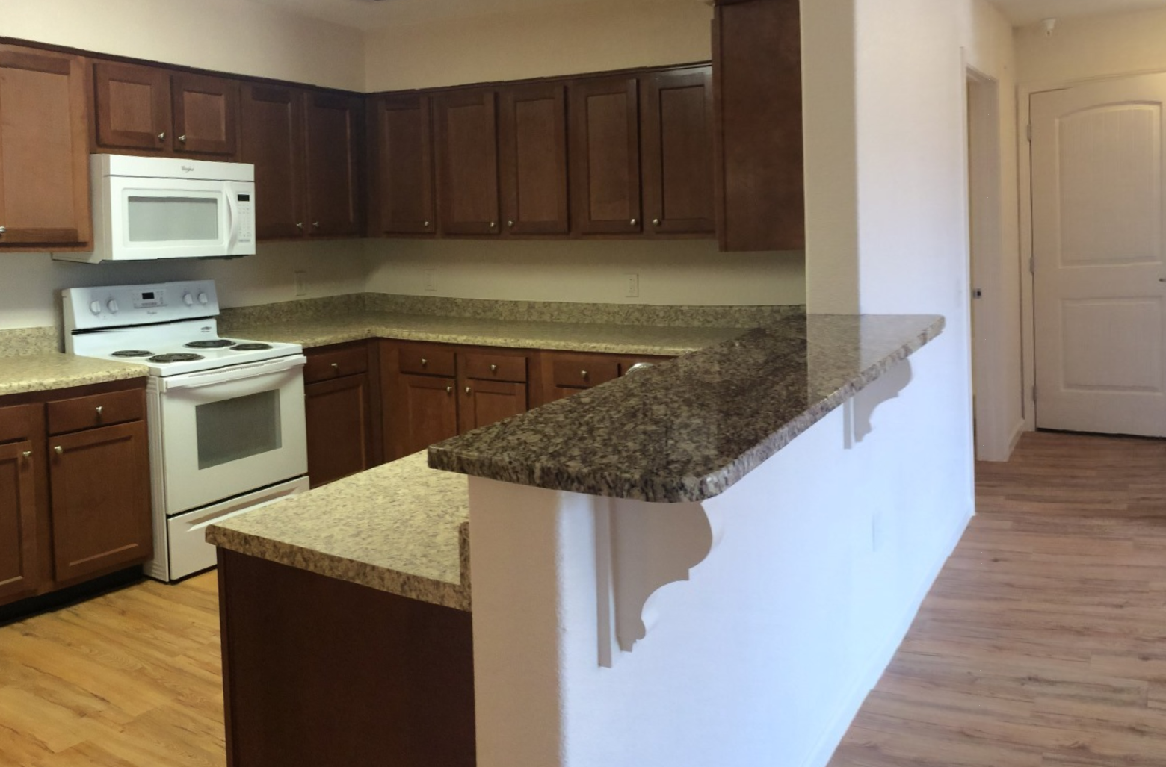
Gardens Young Harris, Young Harris, Towns County
New Construction
Senior Tenancy
50 Units
41 at 60%
9 at 50%
Amenities: business center, clubhouse, fitness center, laundry facility
Awarded 2013, completed 2015

Slide 22
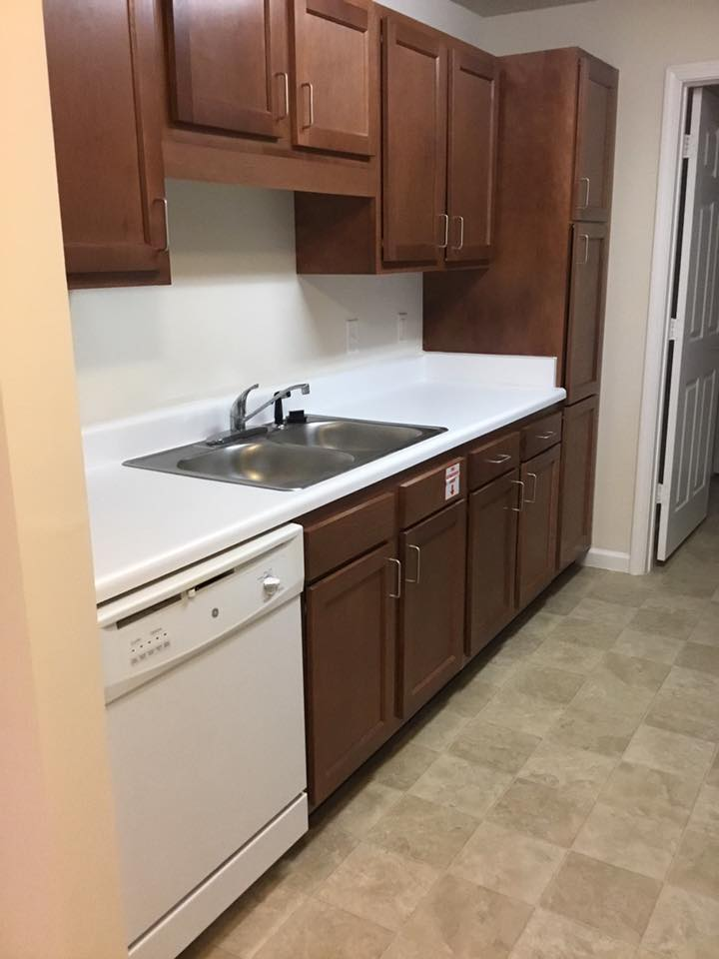
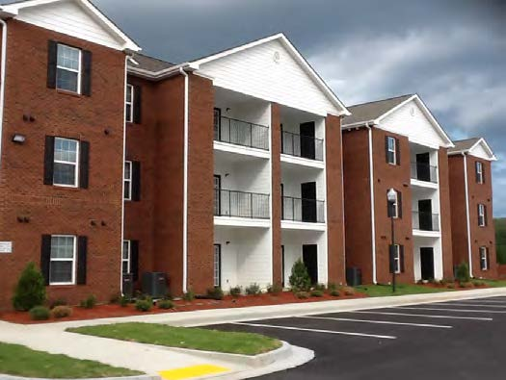
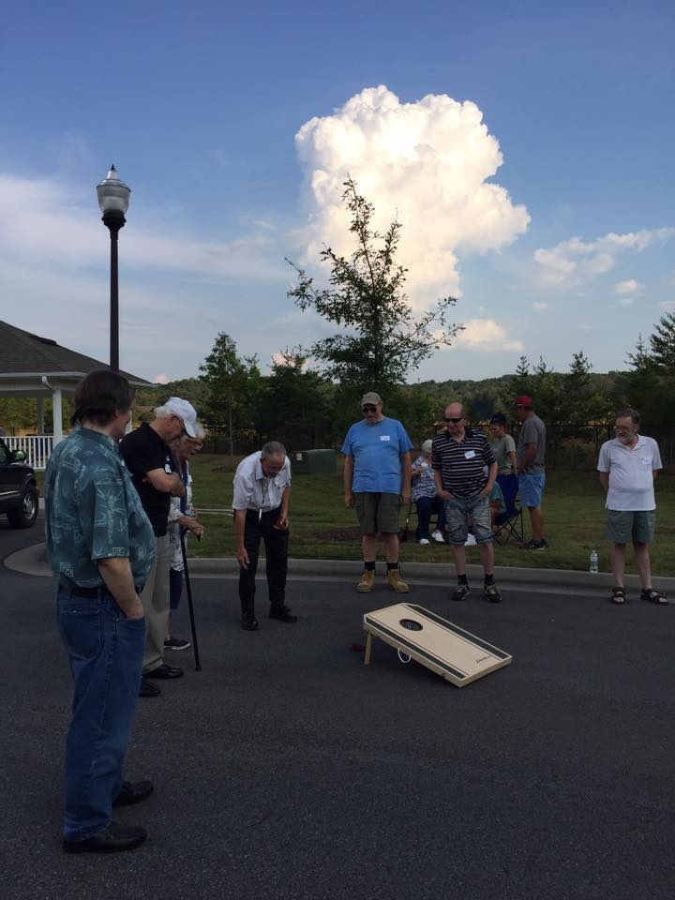
Broadview Cove, Fannin County
Nearest to Gilmer County
New Construction
Senior Tenancy
60 Units
48 at 60%
12 at 50%
Amenities: clubhouse, fitness center, computer center
Awarded 2013, completed 2015

Slide 23
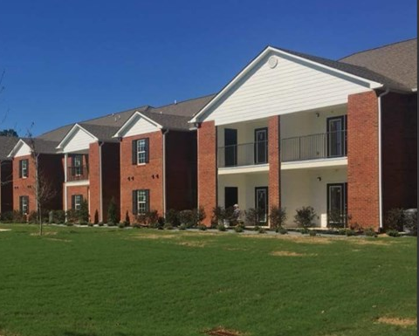
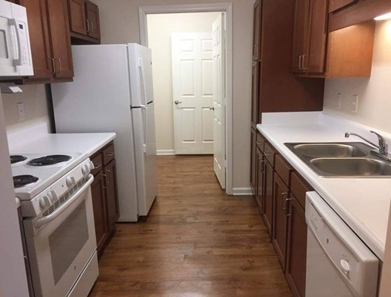
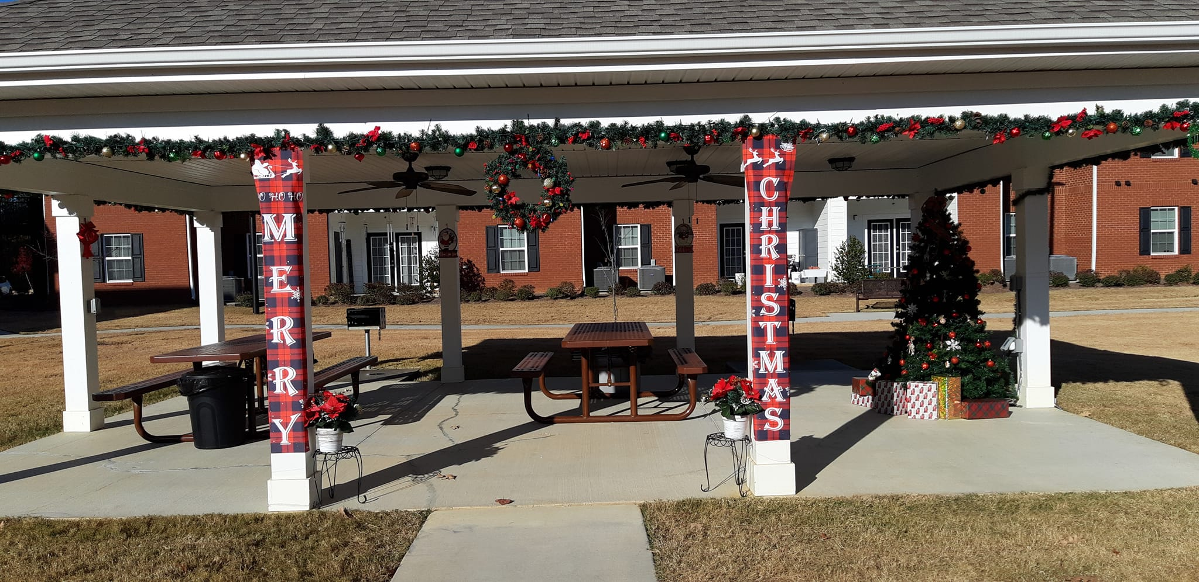
Breakers at Trion, Trion, Chattooga County
New Construction
Senior Tenancy
68 Units
37 at 60%
14 at 50%
17 market-rate
Amenities: fitness center, community garden, computer center, health & wellness center, clubhouse
Awarded 2017, completed 2019

Slide 24
How do I get more HTC properties in my community?

Slide 25
Advice from current and former GICH communities
Review/adjust zoning
RFI/RFP/RFQ
Local incentives
Community buy-in
Explain plans and benefits
Discuss potential concerns

Slide 26
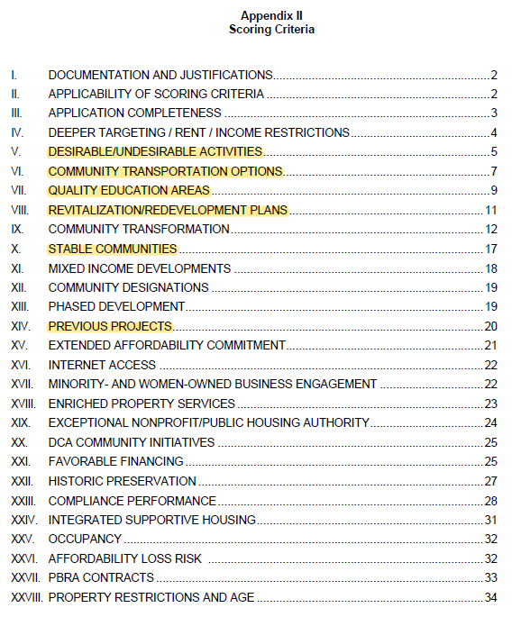
Identify competitive sites
Qualified Allocation Plan
Threshold: Minimum requirements
Scoring: Competitive evaluation criteria
Place-based criteria

Slide 27
Desirable/Undesirable Activities
Incentivizes locating sites near desirable activities & characteristics:
Grocery store
Pharmacy
Hospital
Library
Childcare
Disincentivizes locating sites near undesirable activities & characteristics:
Junkyard, landfill
Environmental hazards
USDA “food desert”

Slide 28
Community Transportation Options
Incentivizes locating sites near public transit:
Transit hub
Bus stop
On-call service

Slide 29
Quality Education Areas
Incentivizes locating sites in attendance zone of high-performing schools:
College and Career Readiness Performance Index (CCRPI)
Based on standardized test scores, attendance, graduation rates
“Beating the Odds” designation
Based on CCRPI scores
School performs better than schools with similar characteristics around the state

Slide 30
Revitalization/Redevelopment Plans
Incentivizes locating sites:
Within the targeted area of a Community Revitalization Plan (CRP)
Local government solicited public input and engagement during creation
Local government demonstrates financial commitment to advance CRP (funds raised or allocated, tax incentives, fee waivers)
Within a Qualified Census Tract (QCT)
At least 50% of households with incomes below 60% of area median income
Near place-based improvement by unrelated party
Community assets (parks, trails, community center)
Infrastructure improvements (water, sewer, streets)
Other

Slide 31
Stable Communities
Incentivizes locating sites in census tracts with:
Low percentage of residents below poverty level
Designated middle or upper income level

Slide 32
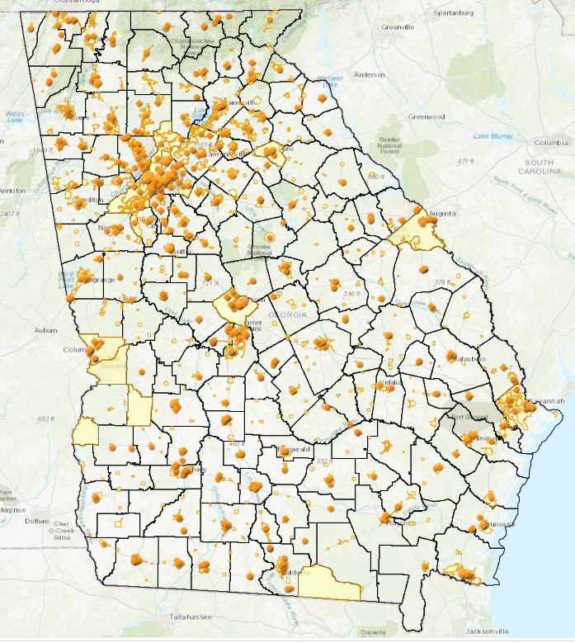
Previous Projects
Incentivizes locating sites in areas which have not received Tax Credits recently

Slide 33
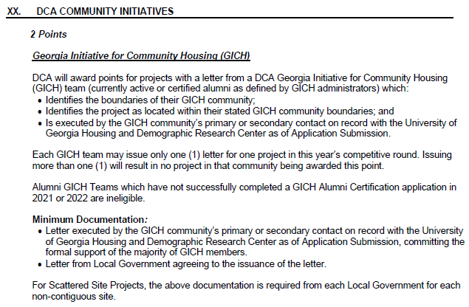
Be a GICH Community!

Slide 34
Questions? What else would you like to know about HTC?

Slide 35
Announcement
Georgia Statewide Housing Needs Assessment
Identifying opportunities to better meet needs
PHA survey
Statewide inventory of PHAs
Deadline April 28
(click here)

Slide 36
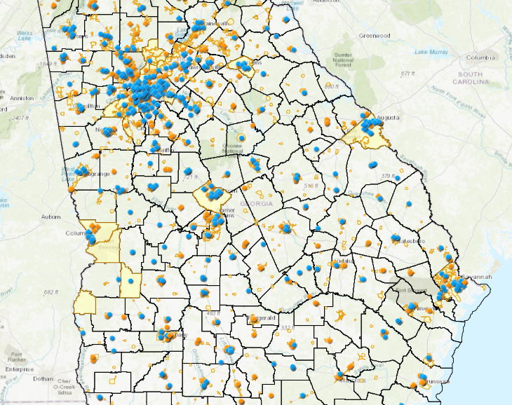
Resources
HTC program page
(click here)
QAPs and Related Documents (click here)
Selected applications
(click here)
Housing Tax Credit properties map (click here)
Program overview flyer
(click here)
Contact list (click here)
Join our email list! (click here)
Email:
Jack Popper, Housing Policy Manager
Jack.Popper@dca.ga.gov
Meagan Cutler, Housing Policy Analyst
Meagan.Cutler@dca.ga.gov

Slide 37
Thank you! Meagan Cutler Meagan.Cutler@dca.ga.gov

