Slide 1
Alumni Certification Overview
Austin Chancy, Housing Policy Analyst, DCA

Slide 2
What is Alumni Certification?
Alumni Certification is a process GICH Communities can choose to go through every two years after their graduation in order to maintain their certification as alumni
All GICH communities that fully complete the program are alumni, but only communities that reapply for alumni certification every two years will have the “certified alumni” status

Slide 3
Why Should My Community Want Certification?
Alumni Certification serves two functions, one for GICH program and one for the GICH communities:
For the GICH program, it demonstrates that your team is still meeting and working to solve the housing issues in your community through your housing work plan
For the GICH communities, it allows you to continue to receive 2 bonus points on LIHTC applications and apply for CBDG every year

Slide 4
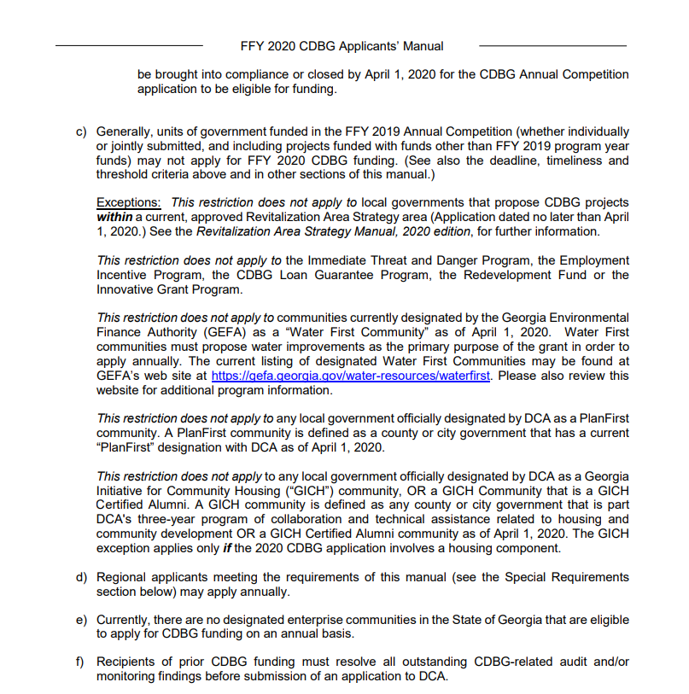
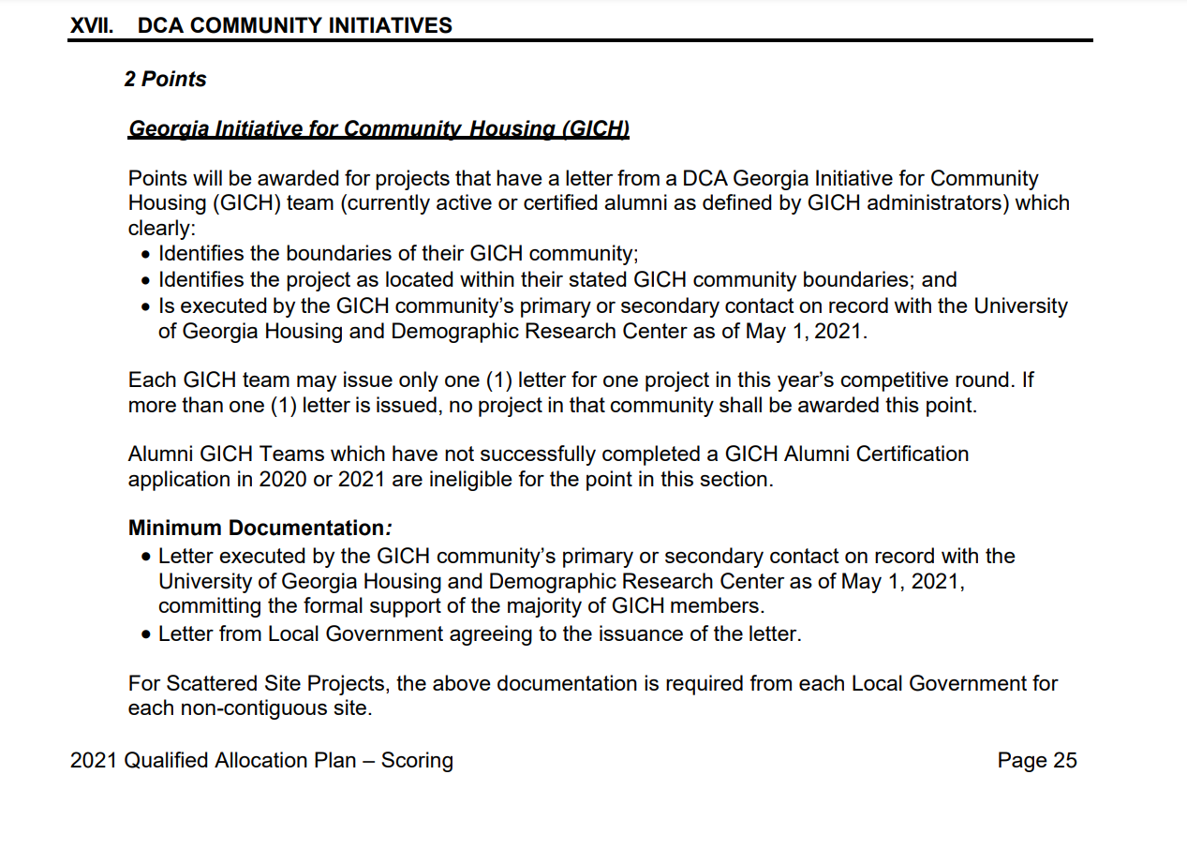
Why Should My Community Want Certification?

Slide 5
Who should apply for Certification this cycle?
For the 2022 application cycle, you should apply if:
You were last certified in 2020 (Your certification will expire at the end of 2021)
You graduated in 2019 and were not certified last year
You have never been certified and wish to receive the LIHTC and CDBG benefits

Slide 6
What are the requirements?
There are 5 requirements for certification:
Team Continuity
GICH Retreat Attendance
Continuing Education
Team Meetings
Updated Housing Plan

Slide 7
Requirement 1: Team Continuity
The GICH team must submit an updated team roster to demonstrate who the active members of the team are
It is critical that the primary and secondary contact be up to date, because if there are discrepancies in what we have in our records and what you submit, it could disqualify your CDBG and LIHTC applications from receiving their benefits

Slide 8
Requirement 2: Retreat Attendance
For this requirement, GICH teams must submit the name of at least one team member who attended at least 1 retreat in the past two years
For the 2022 application cycle, this means someone from your team must have attended a retreat in both 2020 and 2021
To meet this requirement, you must provide documentation that proves the team member reported back to the full team (meeting minutes, email summary, etc)

Slide 9
Requirement 3: Continuing Education
GICH teams must have at least four members attend continuing education events related to affordable housing in both past two years (2020 and 2021)
These events can be free or complimentary
GICH retreats do not count
Team members can attend these events together or individually

Slide 10
Requirement 4: Annual Meetings
GICH teams must submit proof of meeting together at least once in both of the past two years (2020 and 2021)
The team must submit meeting minutes and/or an agenda to show proof
The majority of the team must be present to count

Slide 11
Requirement 5: Updated housing Plan
GICH teams must submit a housing plan that has been updated within the past 3 years
OR communities that have formalized their GICH Work Plans into local planning documents may submit the housing or GICH-related elements of the plan if they have been updated in the past 3 years.

Slide 12
When should I apply?
GICH teams that graduate in 2021 will apply in the 2024 cycle
GICH Teams that graduated in 2020 or were certified in 2021 will apply in the 2023 cycle
GICH teams that were certified in 2020 should apply in the 2022 cycle
GICH teams that have never been certified should apply in any cycle they want so long as they meet the criteria

Slide 13
What is the application timeline?
GICH teams will be notified about the application release in late November/early December
The application will be released in December
The application will be due at the end of March
The formal announcement of the results will be released in April
Applications are processed as they are received, so teams that submit early will get their results quicker than those who submit later

Slide 14
Questions?
For follow up, I can be reached at austin.chancy@dca.ga.gov

