Slide 1

GICH
CLASS OF 2019
Georgia Department of Community Affairs
Georgia Initiative for Community Housing (GICH)
Alumni Report Back Spring 2022

Slide 2
OUR TEAM:
Community Members
Brad Cowart – Realtor, Real Estate Advisors Group
Delmos Stone – NWGA Regional Commission
Cindy Williams – CEO, Cartersville Bartow Chamber
Doug Belisle – Director, Bartow Collaborative (GA Family Connection)
Jessica Mitcham – Director, Good Neighbor Homeless Shelter
Matt Warren – Crosspoint City Church
Janet Queen – Great Promise Partnership
Bartow County Government
Commissioner Steve Taylor
Brandon Johnson –Community Development
Valerie Gilreath – Grant Writing Director
Brielle Shinall – Grant Writing
Patrick Nelson –Redevelopment Coordinator

Slide 3
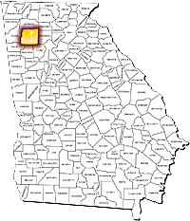
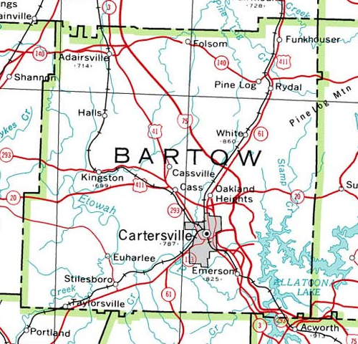
Bartow County and Target area:

Slide 4
Target Area Statistics: Allatoona Community
3,000 Residents
28% below the Poverty Line
Over 50% of 18-24 year olds and 22% of 25 years old and older don’t have a High School Diploma
66% Of Homes in the Area are Mobile Homes
37% of Homes are Valued at Less than $50,000

Slide 5
Since beginning the gich program
Bartow County Government Efforts:
135 Unfit Structures Demolished Countywide since 2017
Improvements to Junk Ordinance
201 Active Code Enforcement cases countywide
Minimum Square Footage for all Single Family units to 1200 sq. ft.
Increased Permit Fees and penalties
Minimum 5:12 roof pitch required on all homes including Mobile Homes
Solid surface underpinning required for Mobile Homes

Slide 6
Bartow County Government Efforts Continued:
Allatoona Center serving area residents with Resources, Recreation and Trash/Recycling
$3M sewer project completed in 2018 serving the target area, $1M+ expansion in 2021
Road improvement removing dangerous curve and adding sidewalks
GDOT Grant to increase sidewalk access from Allatoona Center to Allatoona Elementary

Slide 7

Officially Formed in 2018
The Landbank to date has 2 lots actively being marketed for sale.
In 2021 the Landbank sold an infill lot within the city of Cartersville for redevelopment as well as a commercial lot in the county.
The Landbank is currently pursuing opportunities to help develop some workforce housing.

Slide 8

In 2019, Bartow County received a Rural Economic Development Innovation Initiative (REDI) Grant from the USDA
Partnership with Purdue University and the University of Kentucky for Strategic Planning focused on:
Rural Broadband Connectivity
Workforce Development
Workforce Housing
Bartow is the only community in the State of Georgia and one of 47 in the nation
An effort for community collaboration through the USDA Faith and Opportunity Council

Slide 9




Purpose: To provide the leadership of Bartow County, its cities, and local institutions interested in sustainable economic development with an in-depth look at the county’s current housing conditions. • Georgia Conservancy brought on board to lead county-wide examination of current housing conditions • Ft. Valley State University was selected to be the technical advisor for the effort • University of Georgia brought on as technical partner to study workforce housing in the county AS WELL AS A STUDY OF EXTENDED STAY HOTELS
HOUSING STUDY

Slide 10
It’s Not all about housing
Ensuring the current residents have the skills and opportunities to benefit from the growth
Working to move residents from survival to sustaining to thriving
Allatoona Resource Center provides direct services as well as many other resources for education and employment.
Serve Saturday each month includes BLESS General Store, Book Mobile, Red Door Mobile Food Pantry
Annual Large Outreach programs include Supplies 4 Success, Hope 4 Christmas

Slide 11

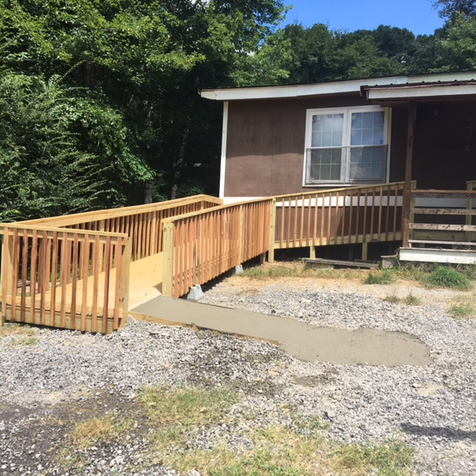
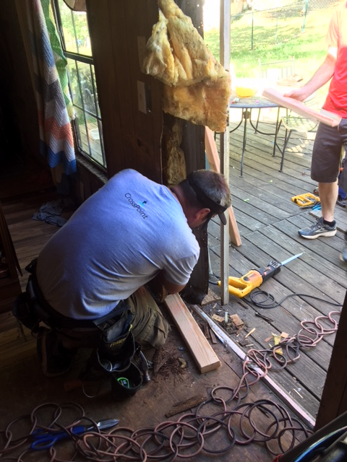
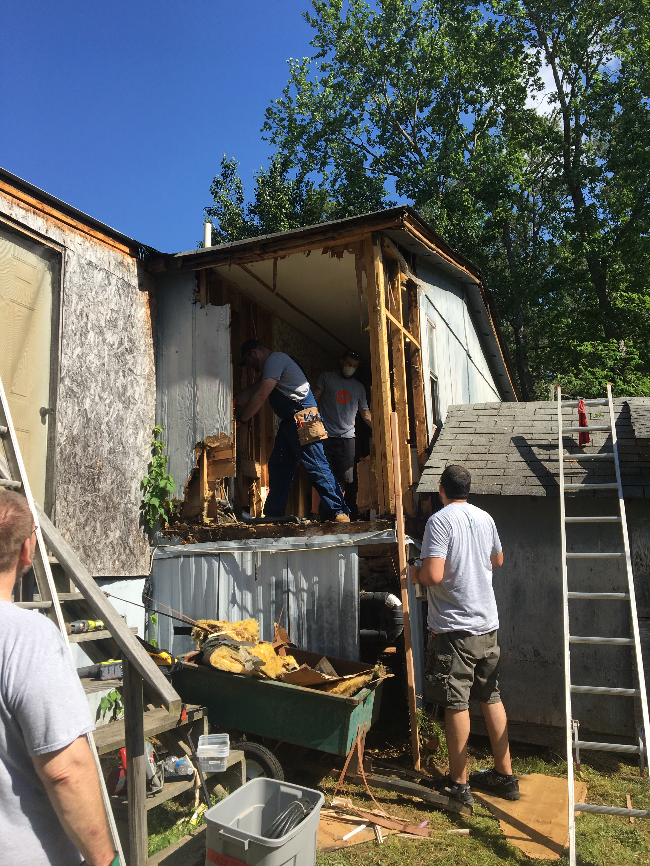
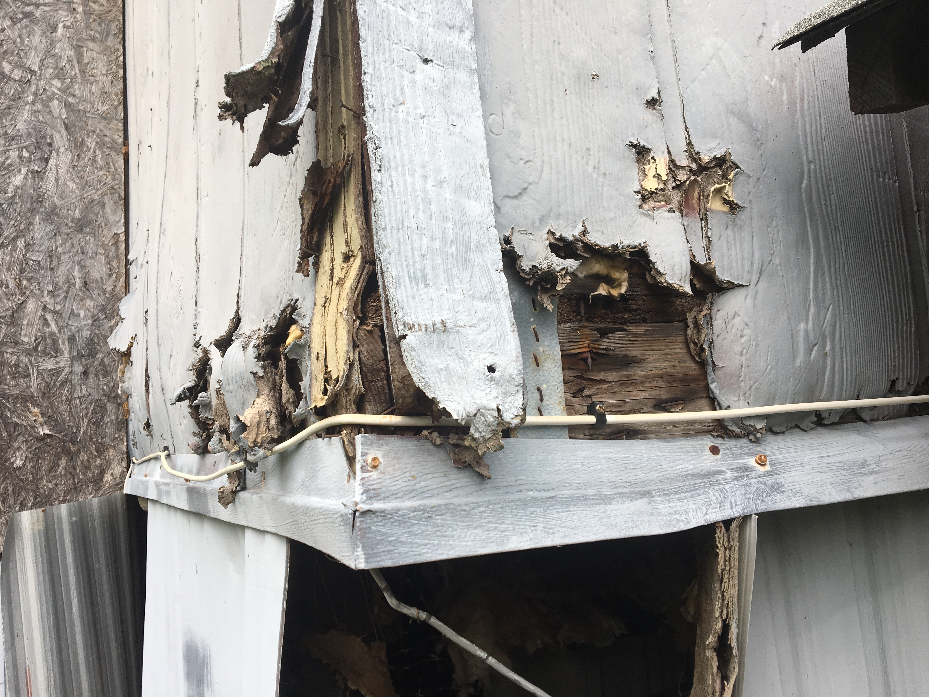
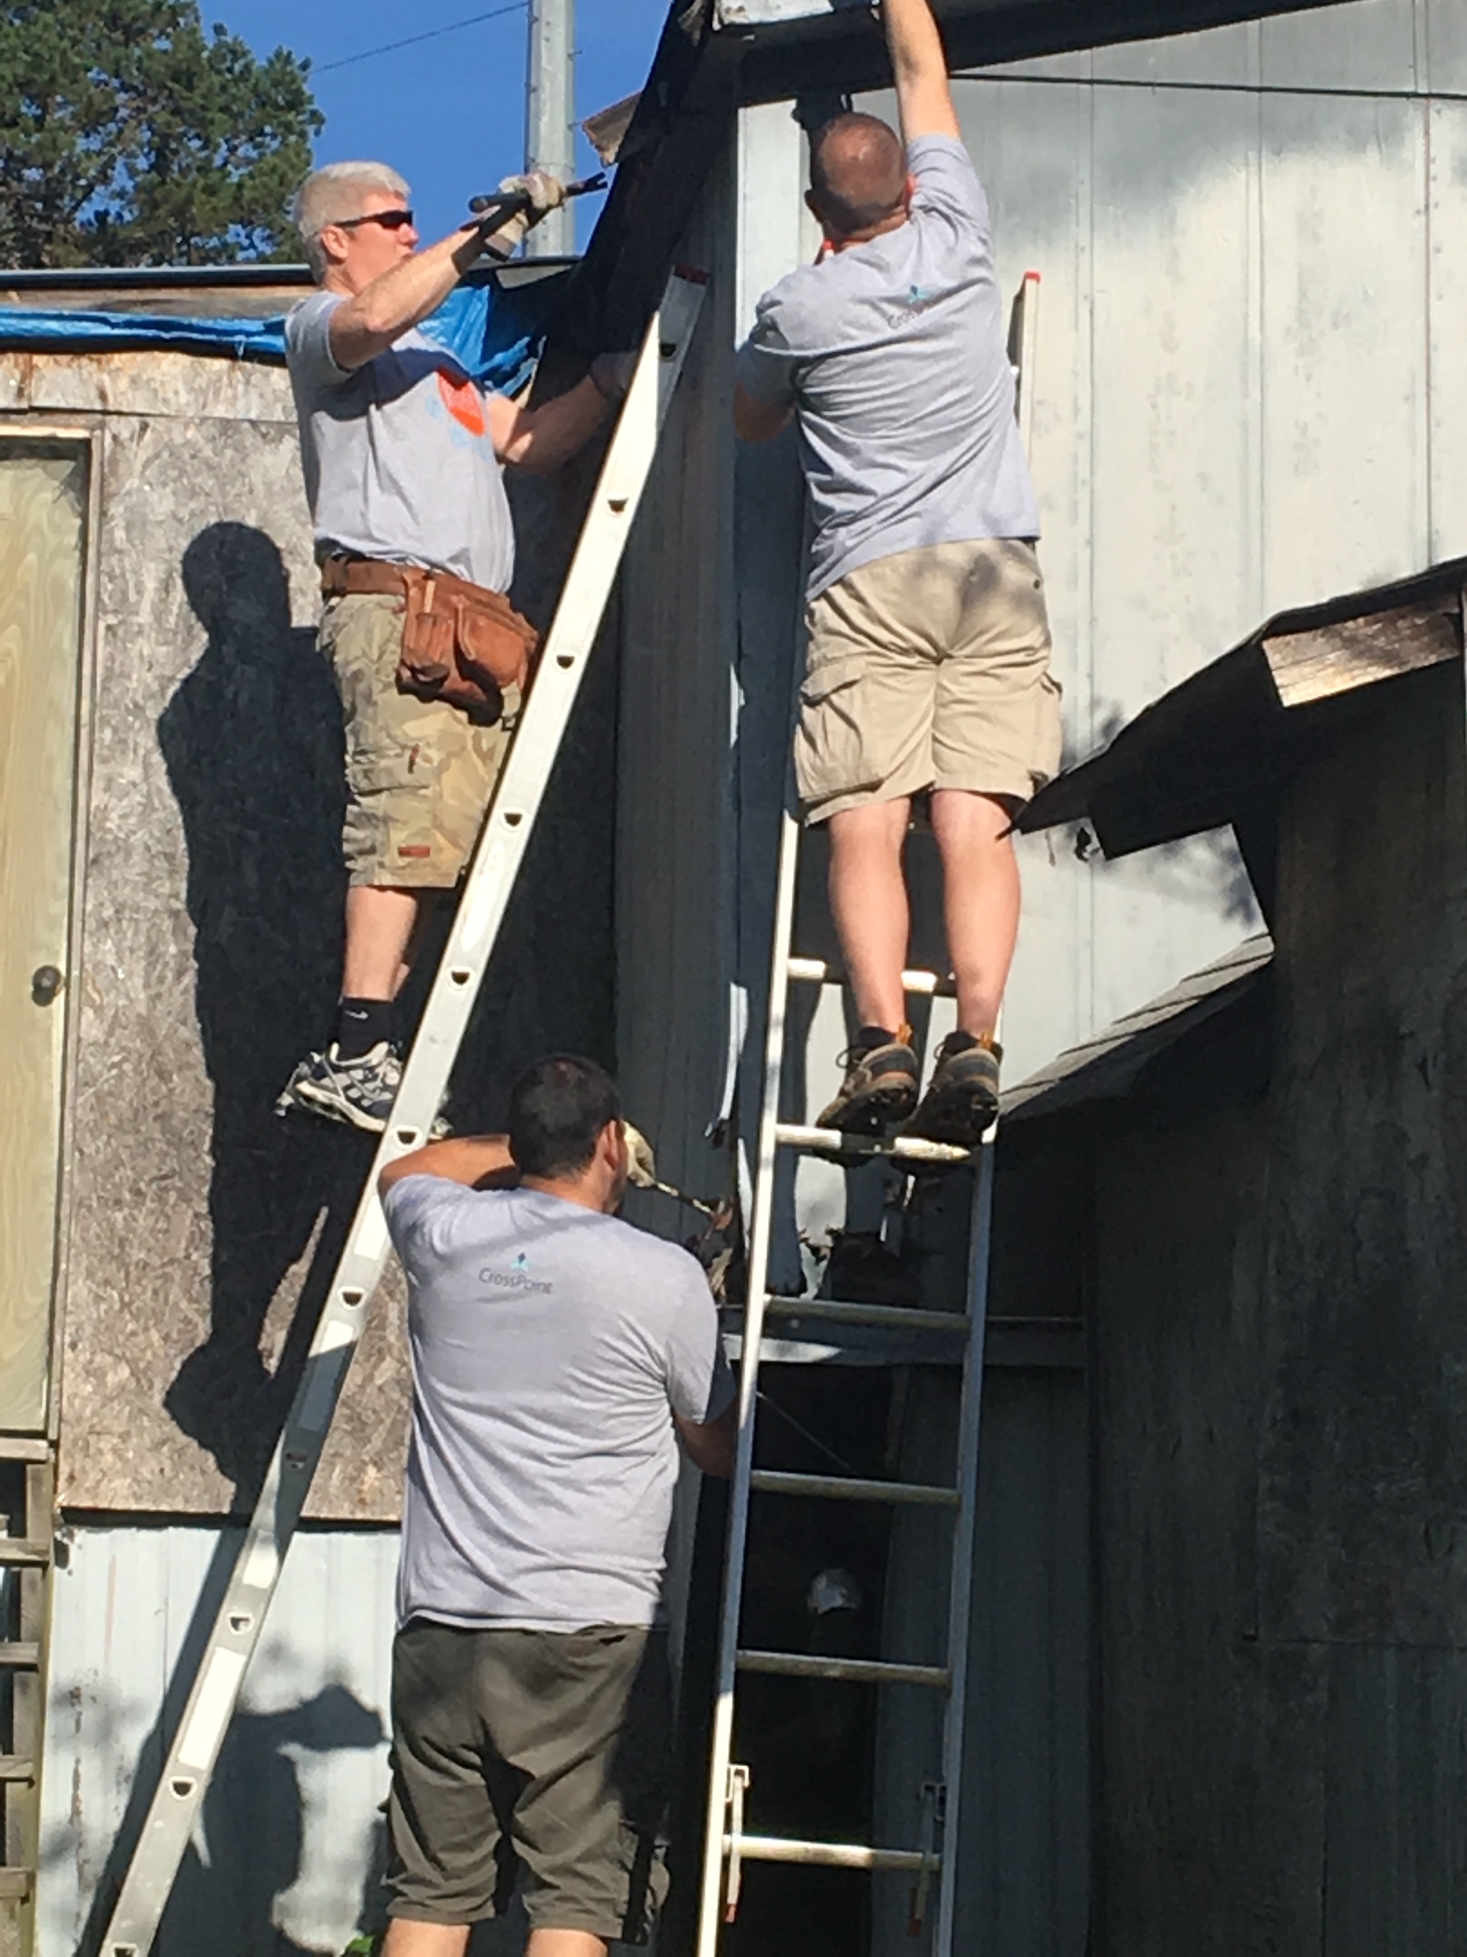
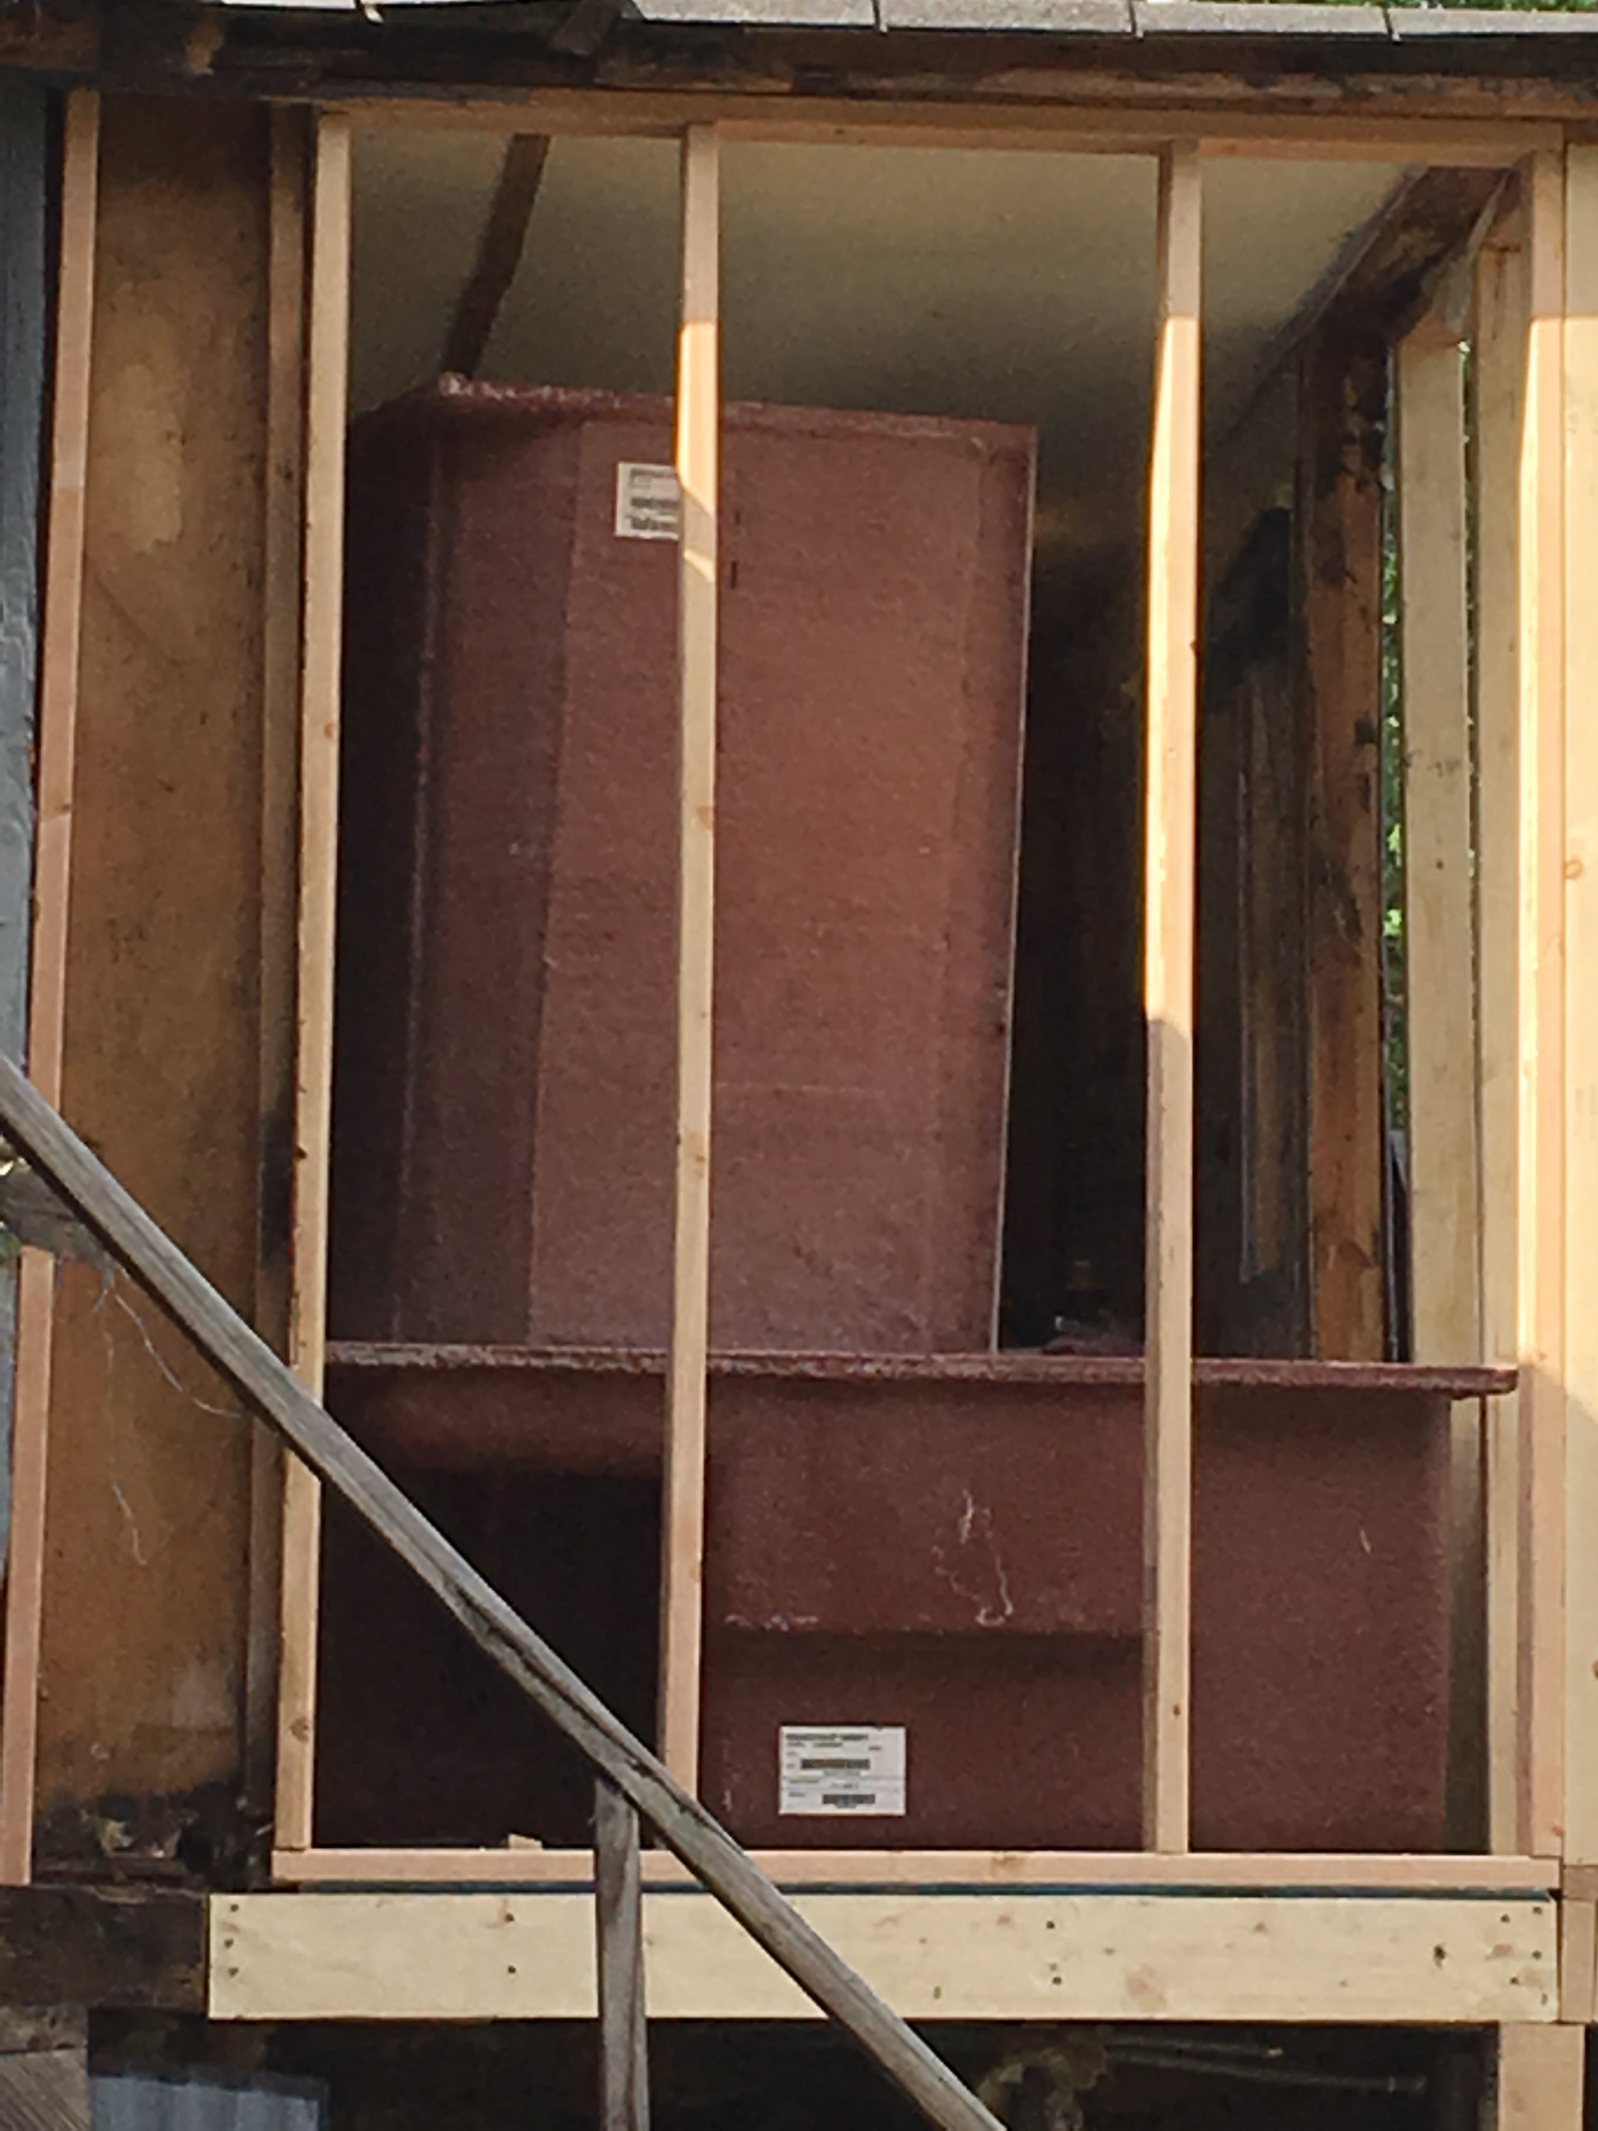
36 Home Improvement projects in the Target Area since 2017
Owner Occupied Only
Includes Minor repairs and cleanup to major improvements such as walls, floors, and bathrooms
All Volunteer led

Slide 12

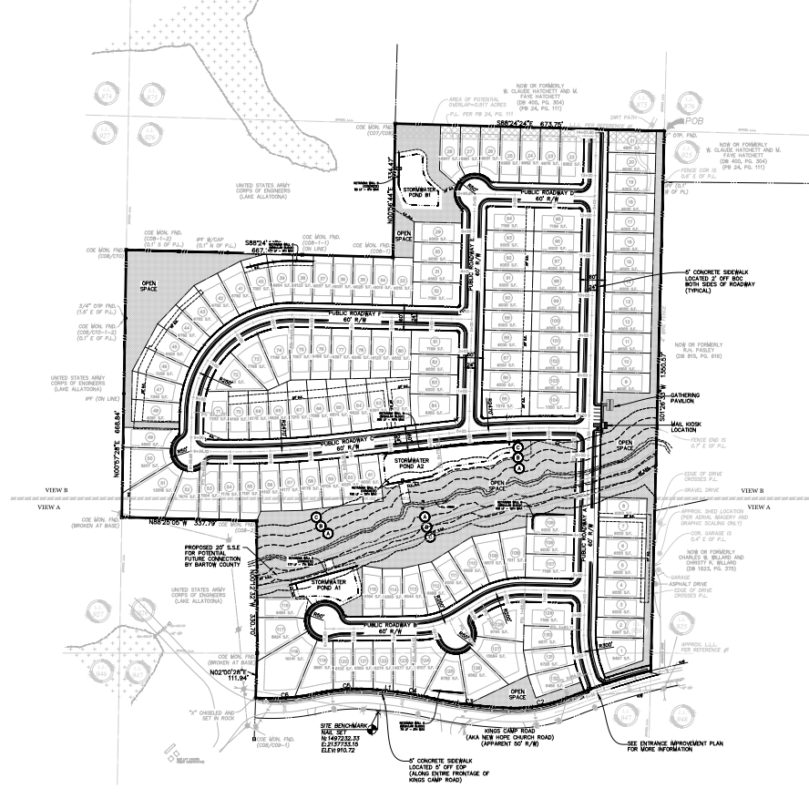
$25 million investment
130 Single Family homes in our target area.
Homes starting around $300,000
Breaking ground April/May 2022

Slide 13

PATRICK NELSON
REDEVELOPMENT COORDINATOR
770-974-0570
NELSONP@BARTOWCOUNTYGA.GOV

Slide 14

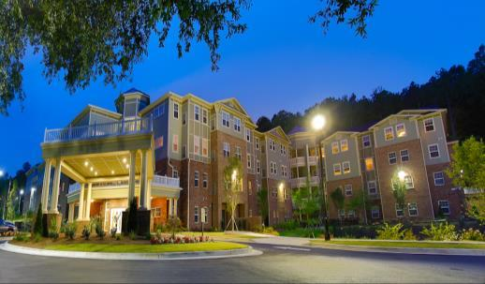
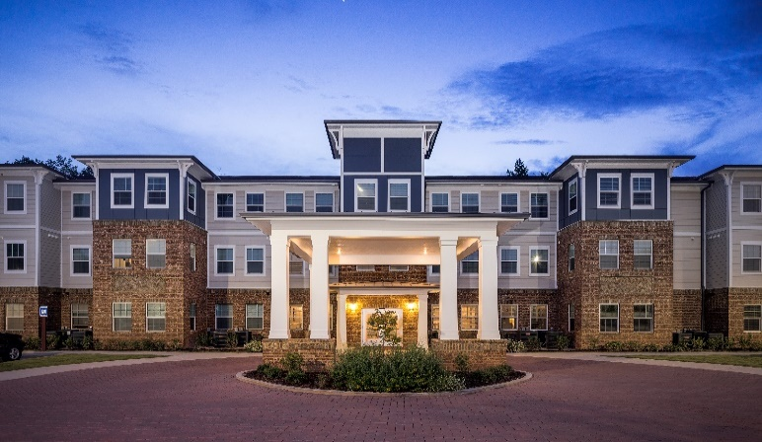
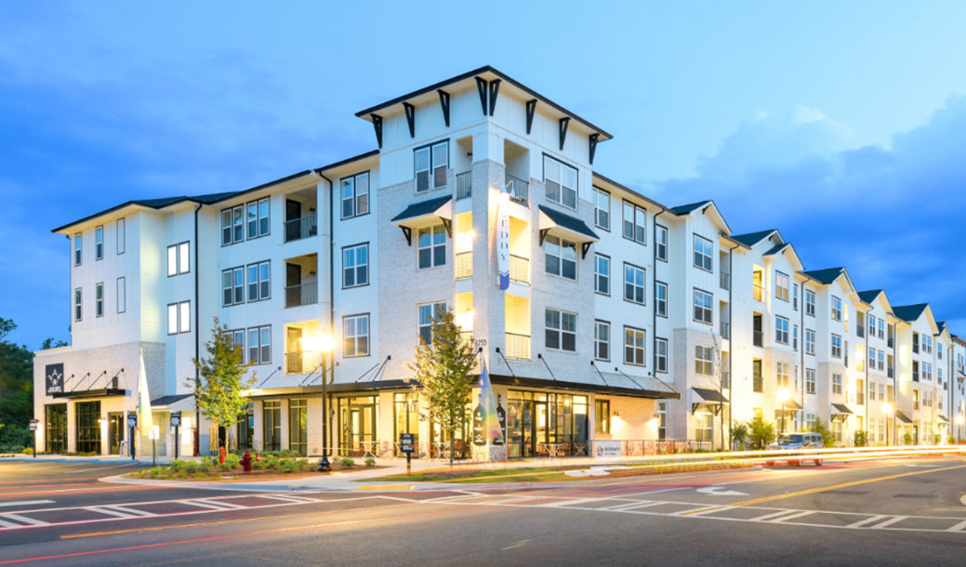
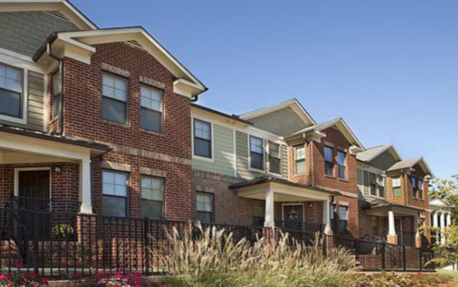
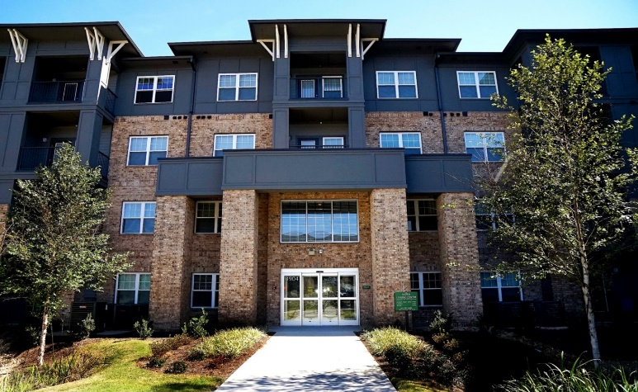
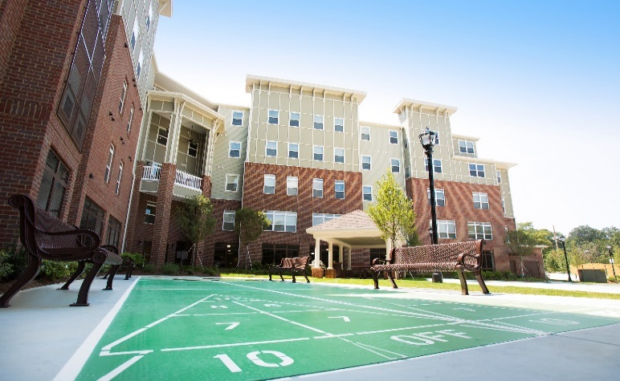
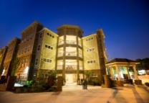
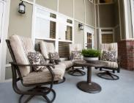
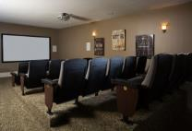
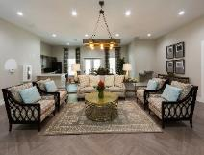
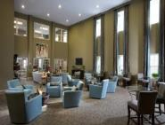
Prestwick Development Company
Prestwick Development Company

Slide 15
Company Overview
Prestwick Companies is a development and real estate investment group that specializes in tax credit and market rate multifamily housing. Prestwick develops and renovates both family and senior housing communities. The company is located in the Southeastern United States and has completed 50+ communities since 2008. Prestwick has completed approximately 6,000 units in the state of Georgia.

Slide 16
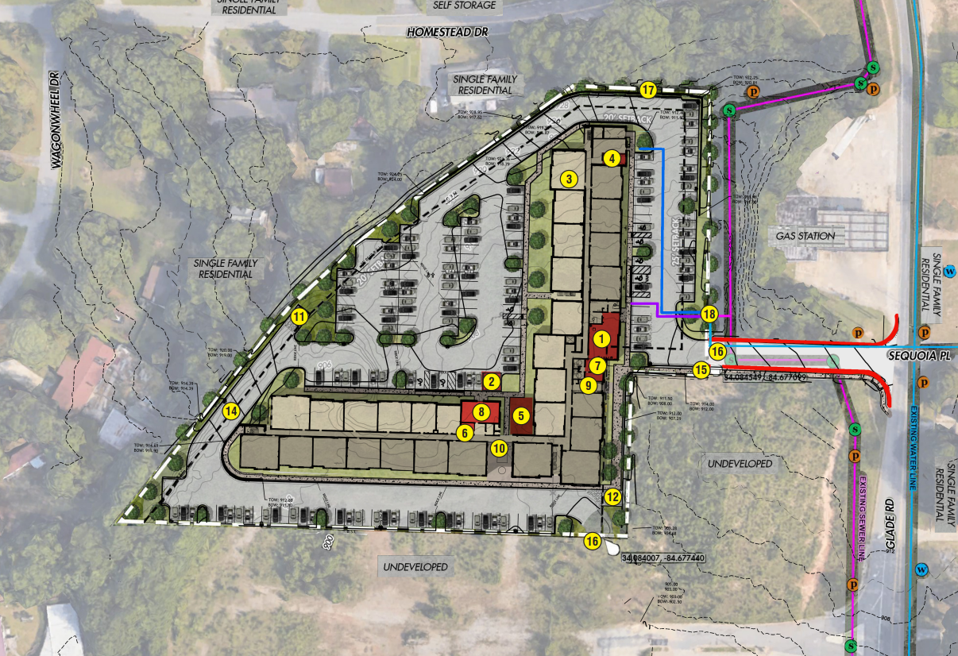
Chadwick
Chadwick
150 Affordable/Workforce Units
$40M TDC
Rents $680-$1,200
Construction Completion 2023
Tax Exempt Bonds and 4% LIHTC

Slide 17
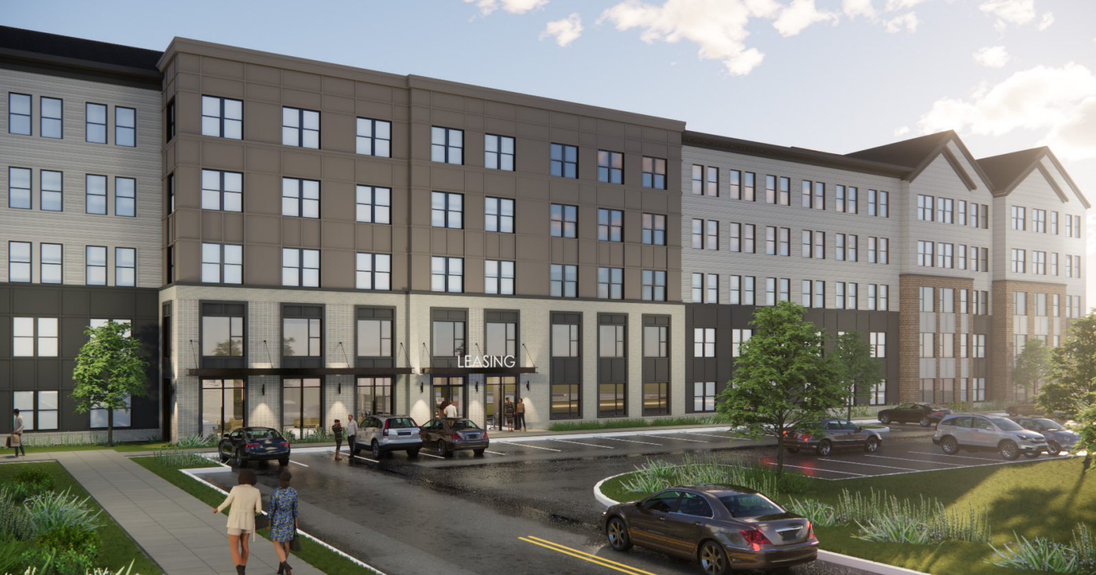
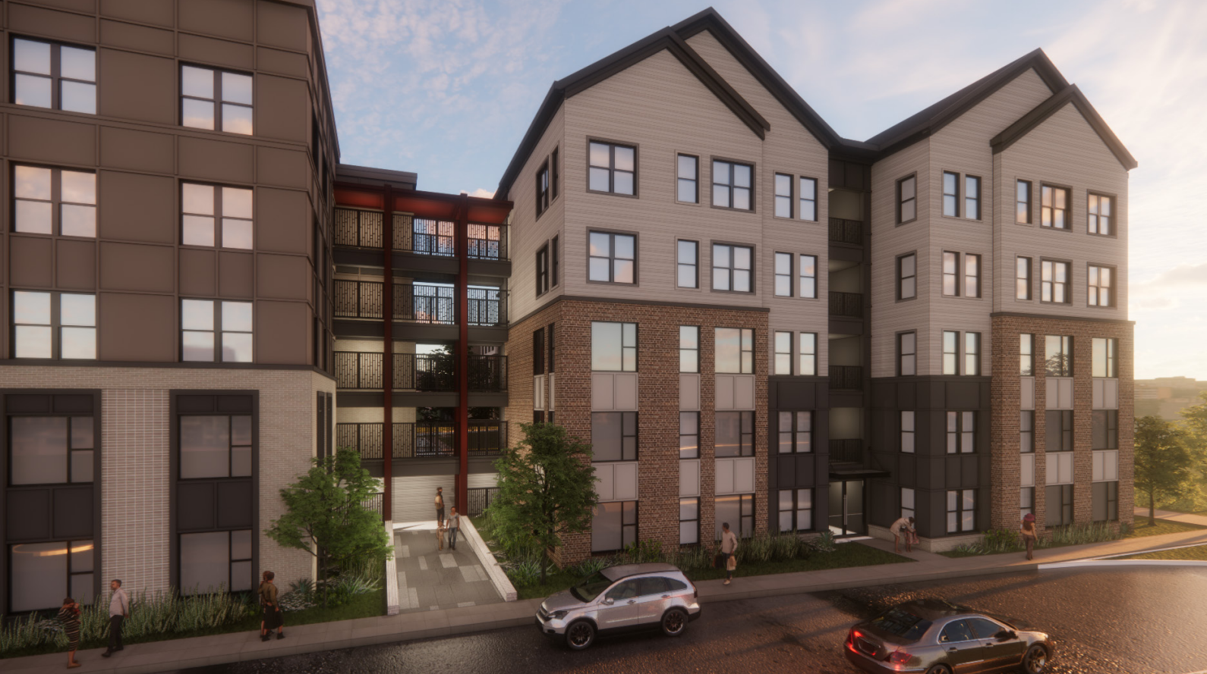

Slide 18
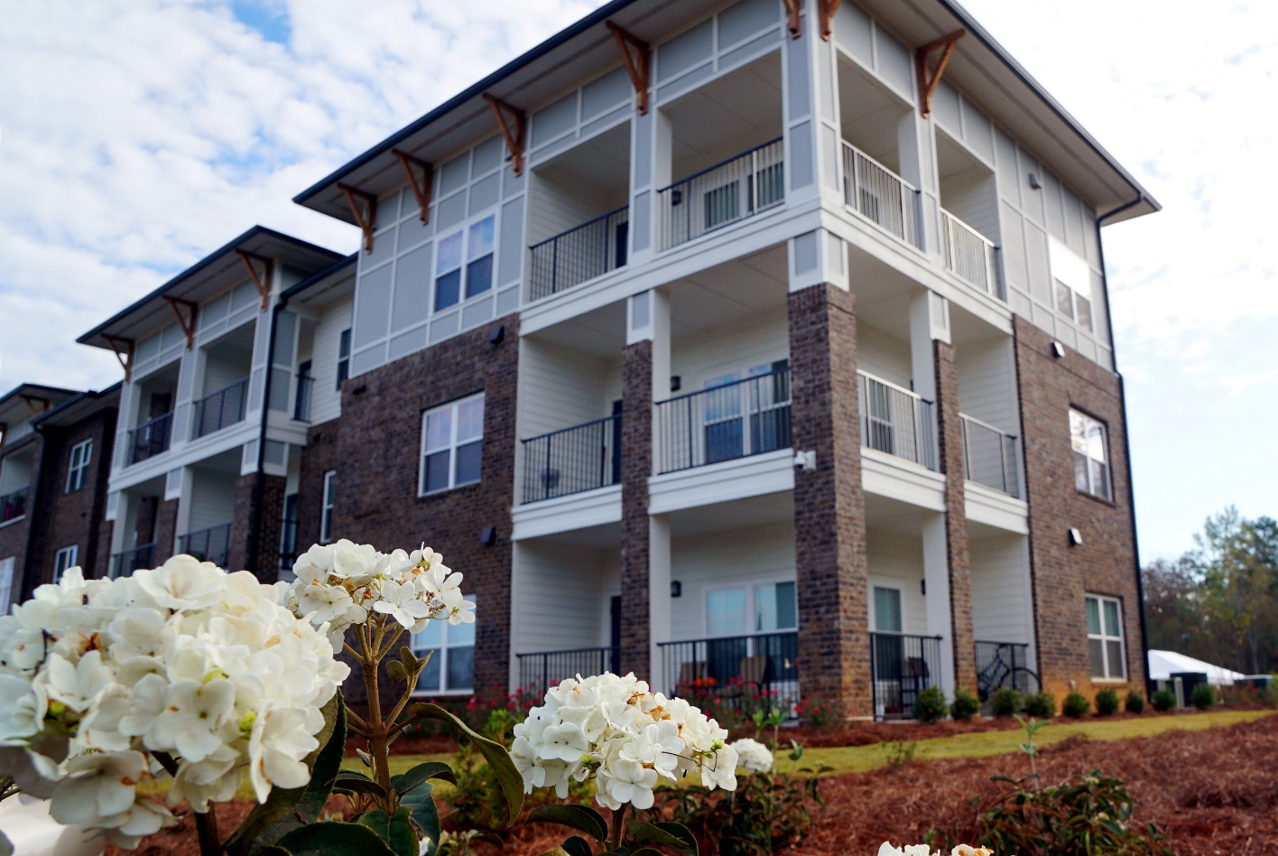
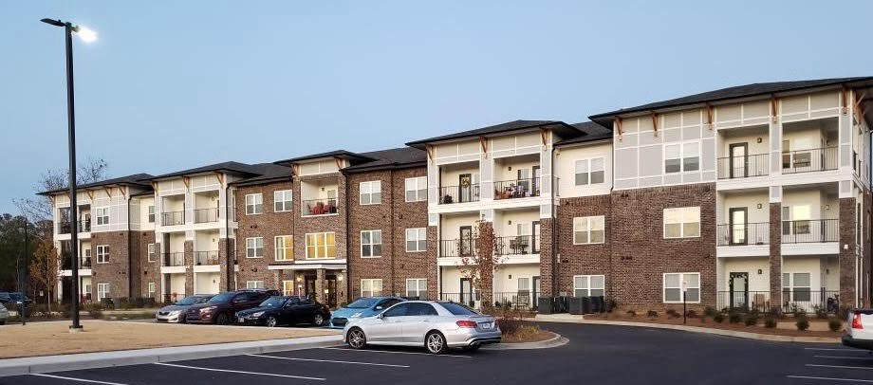
Brentwood

Slide 19
Edrick Harris ~ edrick@prestwickcompanies.com ~ 404.317.7597 cell

