Slide 1

The Community Development Block Grant Program
Aprch 16, 2024
Malisa Thompson

Slide 2
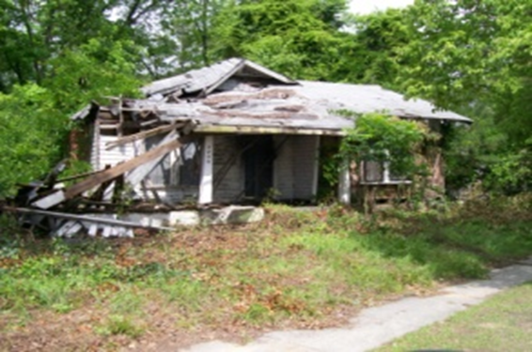
Look familiar???
Notes:
Dilapidated housing structures

Slide 3
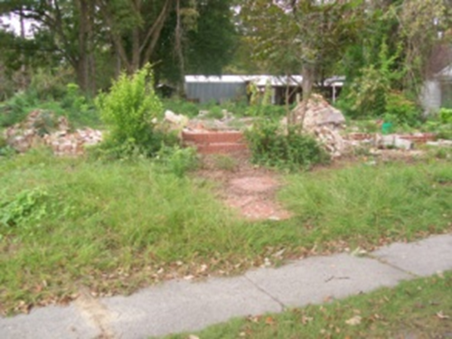
Notes:
Vacant lots

Slide 4
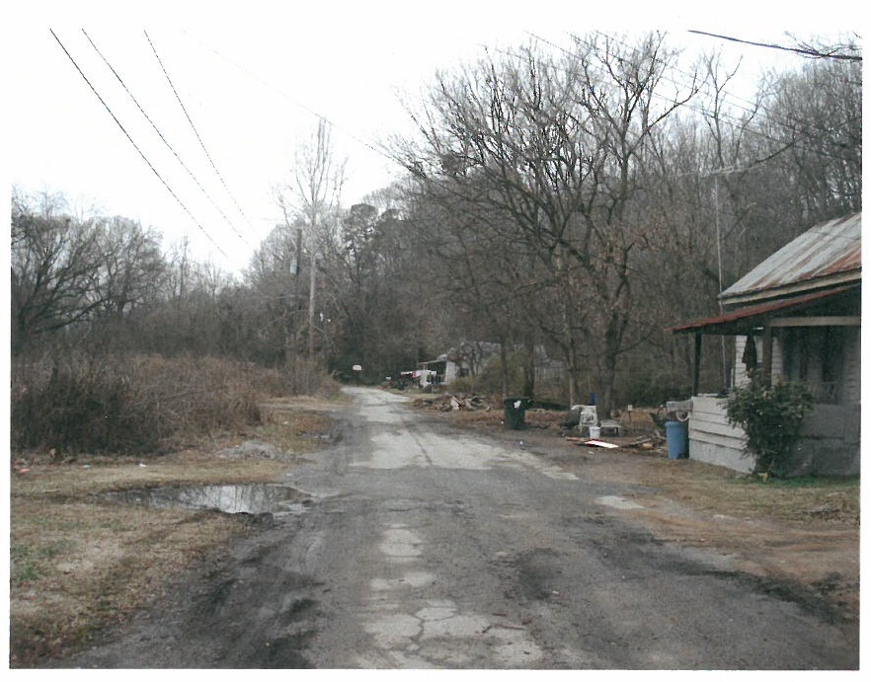
Notes:
Deteriorated roads/streets within neighborhoods

Slide 5
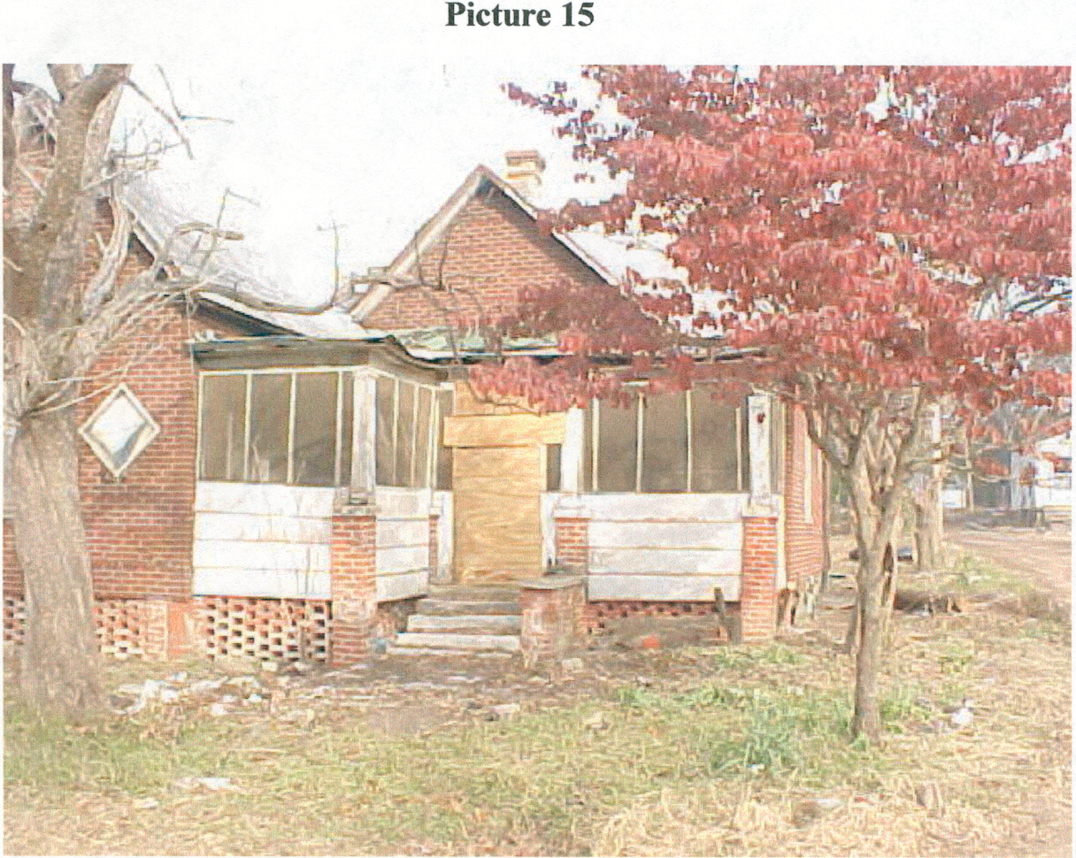

Slide 6
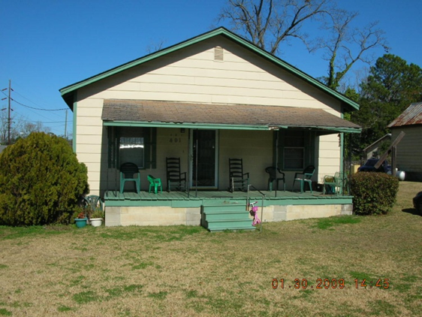

Slide 7
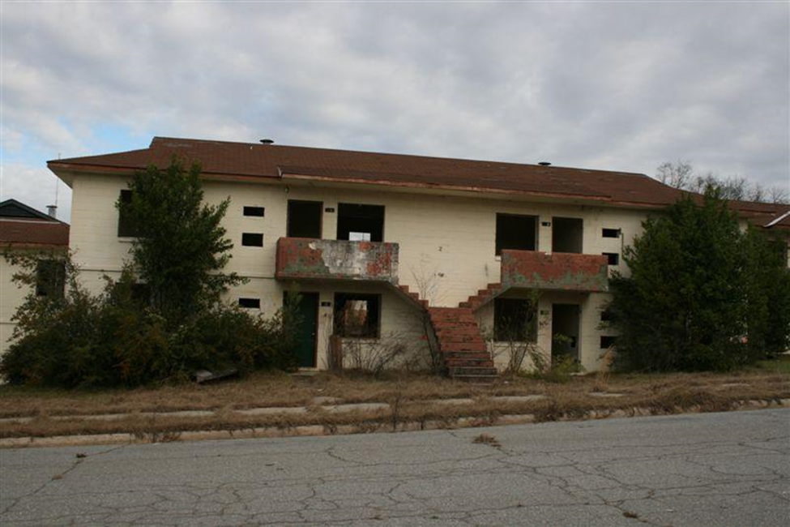
Notes:
Later in the presentation we will see how CDBG was used to transform problems like this.

Slide 8
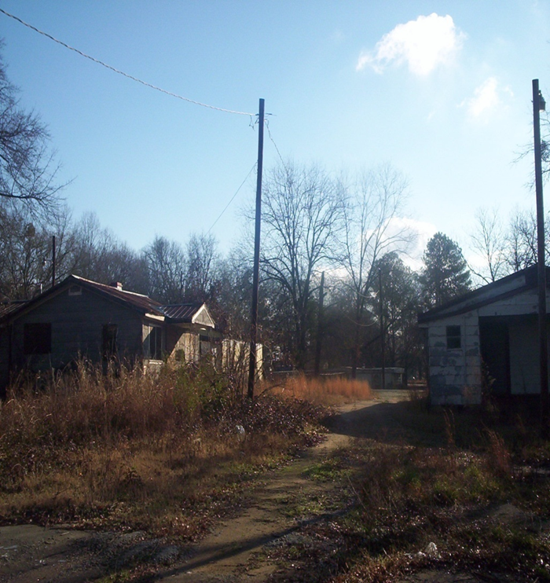

Slide 9
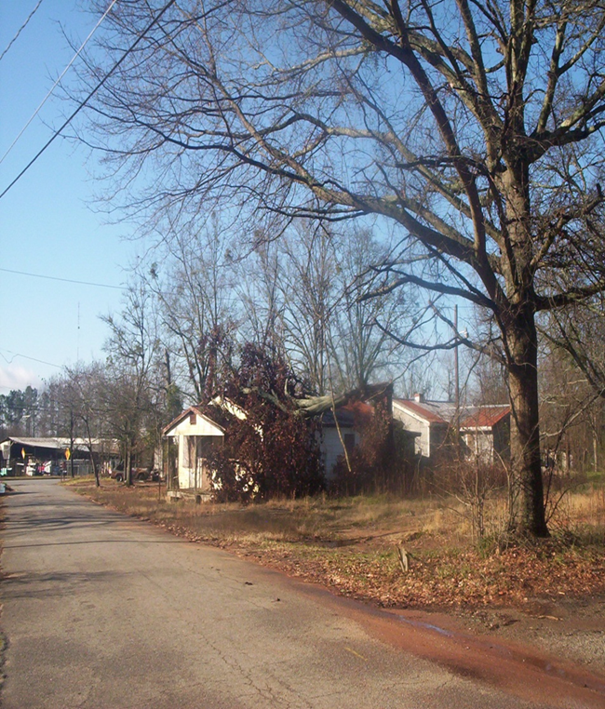

Slide 10
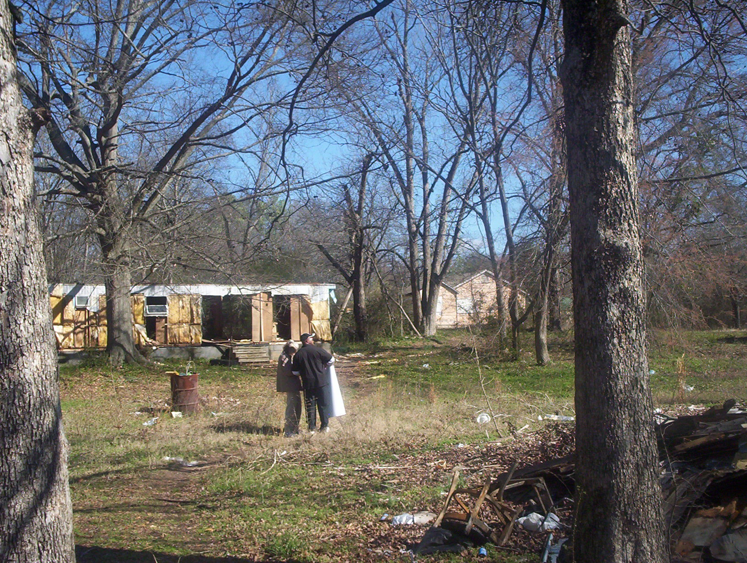

Slide 11
Notes:
Unpaved roads

Slide 13
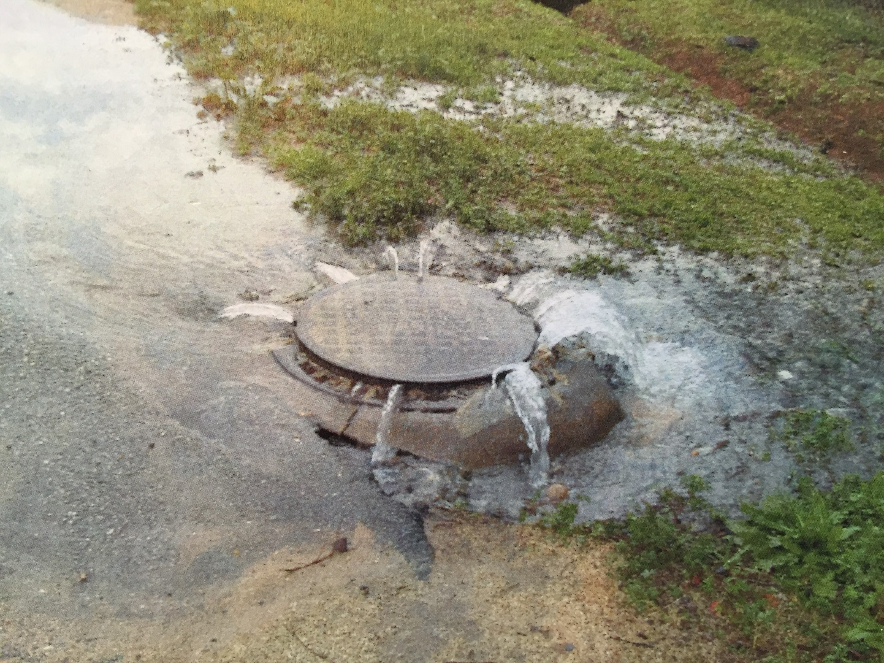

Slide 14
One tool that can help…….CDBG
Community Development Block Grant (CDBG) enacted by Congress as Title I of Housing and Community Development Act of 1974
The primary objective of CDBG is “the development of viable communities through improvement of living conditions, housing and the expansion of economic opportunities in cities and counties, principally for persons of low-and moderate income.”

Slide 15
CDBG
Local governments can implement a broad range of activities as long as they further the National Objectives of the Act
National Objectives are:
Majority benefit to low and moderate income persons through services and job creation
Prevention or elimination of slums and blight
Meeting urgent needs that pose a threat to the health and welfare of the community

Slide 16
CDBG Annual Competition
Funding Available
Single Activity CDBG (Annual Competition)
Employment Incentive Program* $1,000,000
Redevelopment Fund Program*
Immediate Threat and Danger*
*Set-aside programs
Multi-Activity ------------------------------------ $1,250,000
Notes:
These programs have a annual rolling application one may apply throughout the year.
EIP- provides incentives for businesses that will create jobs
RFP: Addresses slum and blight
ITAD-provides funding to meet the urgent needs of a community
Due each year First Friday in June. PER, Procurement for Architect/Engineer, public hearings regarding citizen participation and environmental review.

Slide 17
Local Match Requirements
Local Match Requirements (except single-activity housing projects):
​
0% match requirement for grant requests of $300,000 and less​
5% match requirement for grant requests of $300,001 to $750,000
​
10% match requirement for grant requests of $750,001 to $1,000,000
​
15% match requirement for grant requests of $1,000,001 or more​
Notes:
The match must be cash, whether loans, bond proceeds, grants, or appropriated funds. The source can be either private or other non-CDBG public funds. “In Kind” Services are not considered cash. (CHIP funds are not eligible for match)​
$750,000 required match of $22,500​
$1,000,000 required match of $22,500 + 25,000 = $47,500​

Slide 18
CDBG
Apply for Annual Competition
– Applications due First Friday in April
Set–aside programs accept applications year-round
Applicant must be Local Government
Grant application writing/Administration
- Local Government
- RC’s
- Private Administrators
Funds may be channeled through Development Authorities, Non-Profits or other CBO’s

Slide 19
CDBG
Types of Grants – Annual Competition
Single Activity: up to $1,000,000
Neighborhood Revitalization
Rehabilitation
Reconstruction
Acquisition
Relocation
Demolition
Infrastructure Improvements
Sewer
Water
Streets
Drainage

Slide 20
CDBG
Types of Grants – Annual Competition
Single Activity: up to $1,000,000
Public Buildings
Health Departments
Senior Centers
Community Centers
Head start
Notes:
Buildings that will provide services for low to moderate income person. A building for local government use is not eligible.
Multi activity consists of Public infrastructure and housing or a building and housing is eligible.

Slide 21
Eligible Activities Single Activity Neighborhood Revitalization Maximum $1,000,000.
Rehabilitation – To repair and/or bring to Code existing substandard housing unit – Owner or Renter*
*Requires 50/50 match from landlord & rental agreement
Reconstruction – Where unfeasible to Rehab, Demolish and construct new unit on same site – Owner Occupied ONLY.
Acquisition - of Real Property
Disposition – Costs Incidental to Disposing of Property Acquired with CDBG Funds
Code Enforcement – but…
Notes:
CDBG funds can only be used to pay for Code enforcement-salaries of employees who perform activities in a Targeted area and the CDBG funds must be expended within 2 years. There more than likely will be a need for continued Code Enforcement for your community, Therefore the local government should consider budgeting and finding additional funding for code enforcement.

Slide 22
Eligible Activities Single Activity Neighborhood Revitalization Maximum $1,000,000.
Clearance – Of Dilapidated Structures, out-buildings, etc.
Interim Assistance
Relocation – Temporary or Permanent
Temp Relocation is NOT mandatory for Owner occupied units
Removal of Architectural Barriers
Notes:
Interim asst items which are ineligible and low cost such as over grown lots along with an area that has a lot of debri that needs removing before you can actually began working in the area. potholes, lighting fencing etc.
Architectural Barriers –those barriers that restrict the mobility and accessibility of a public facility or privately owned bldgs

Slide 23
Eligible Activities Single Activity Neighborhood Revitalization Maximum $1,000,000
Home Buyer Assistance
Down Payment
Closing costs
Principle Reduction Payment
Interest buy-down
NOTE: DCA policy mandates use of fixed rate mortgages on all CDBG funded projects

Slide 24
Multi-Activity: up to $1,250,000 Neighborhood Revitalization PLUS Infrastructure/Building Activities
Multi-Activity
“Comprehensive Neighborhood Revitalization”
Includes Housing AND Public Facilities Activities
Limit of $1,250,000
Inter-related Activities
Same Target Area
Comprehensive (Meets all/most of the Needs in the Target Area)
Notes:
May not be able to get everything done through one application therefore you would want to consider phasing.

Slide 25
Revitalization Area Strategies DCA designation that rewards efforts demonstrating:
Long-term vision for the area
Well-defined area that included comprehensive activities
Grassroots involvement from area residents
Commitment from other funding partners
Documented commitment from funders and stakeholders

Slide 26
Revitalization Area Strategies
Officially adopt a local Redevelopment Plan in accordance with the Urban Redevelopment Act O.C.G.A. 36-61
Eligible area of Census Block Group(s) of 20% or greater poverty level.
Develop strong local partnerships focusing local resources within the Revitalization Area.
CDBG Citizen Participation process
Submit application for designation to DCA.
Must be designated by DCA through application
Due no later than April 5, 2024 (Tentative)

Slide 27
RAS Rewards:
Can apply for CDBG every year, provided that current CDBG project meets timeliness criteria
Provides up to 20 bonus points on CDBG Annual Competition applications that are proposed within the RAS area
Designation is effective for 3 years

Slide 28
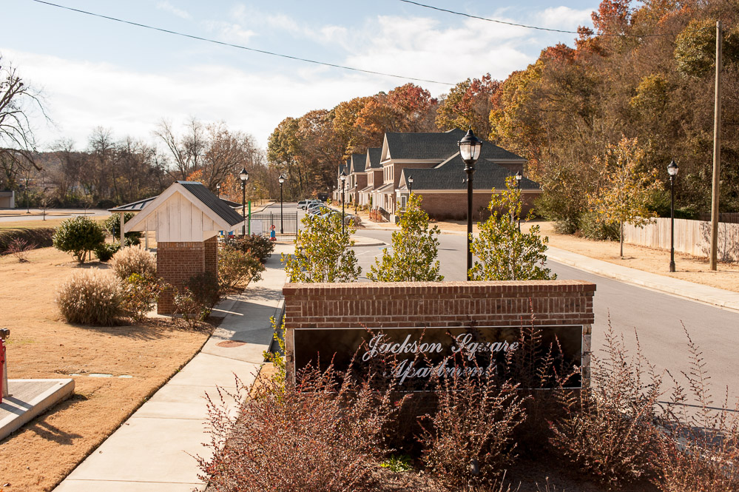
Results…………
Rockmart:
Jackson Square Apts.

Slide 29

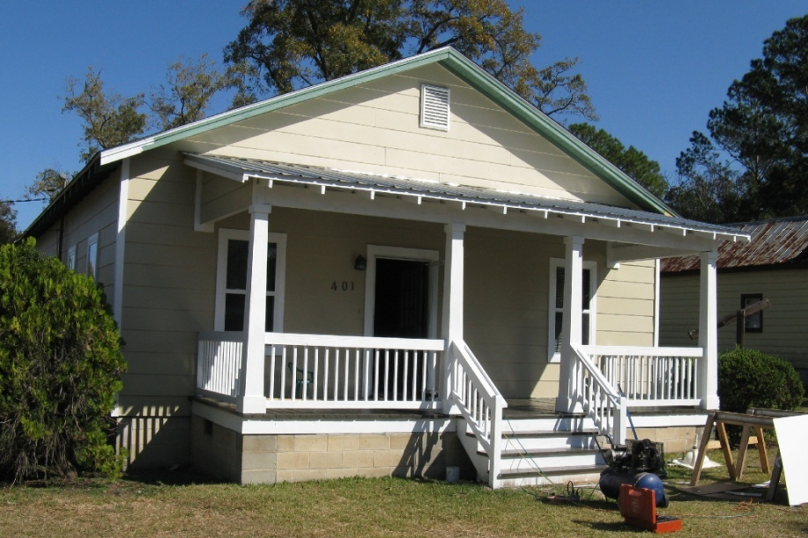
Thomasville:
Victoria Place Revitalization Area

Slide 30

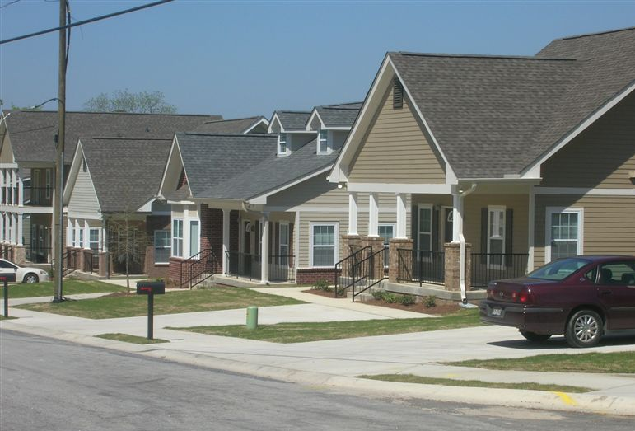
It CAN be done!
The former Macon Homes—now Bartlett’s Crossing

Slide 31
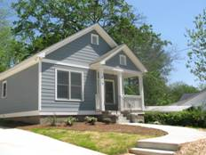
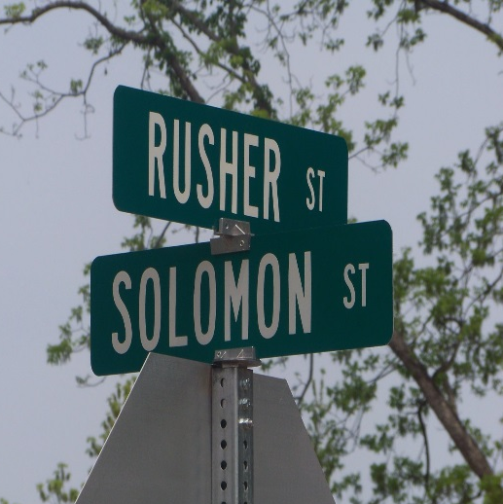
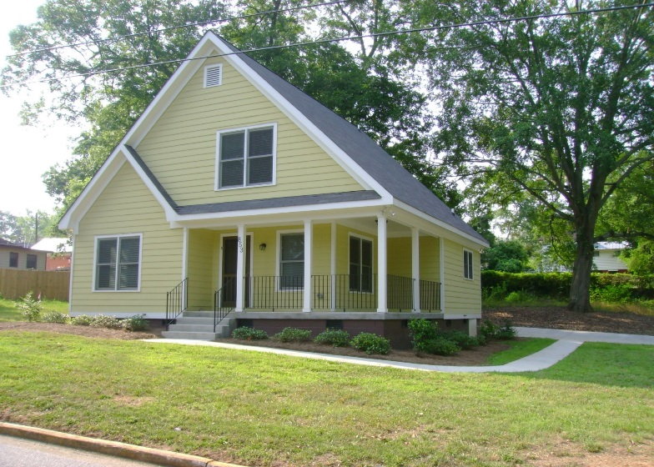
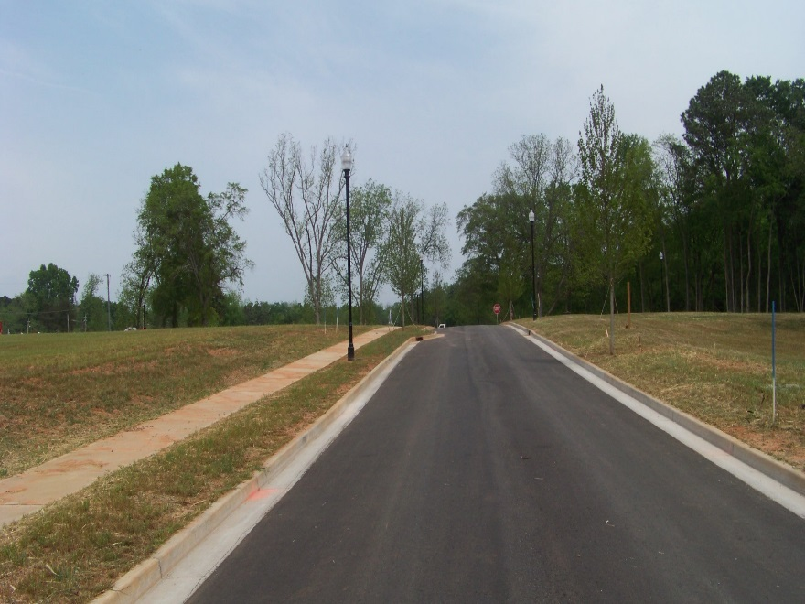
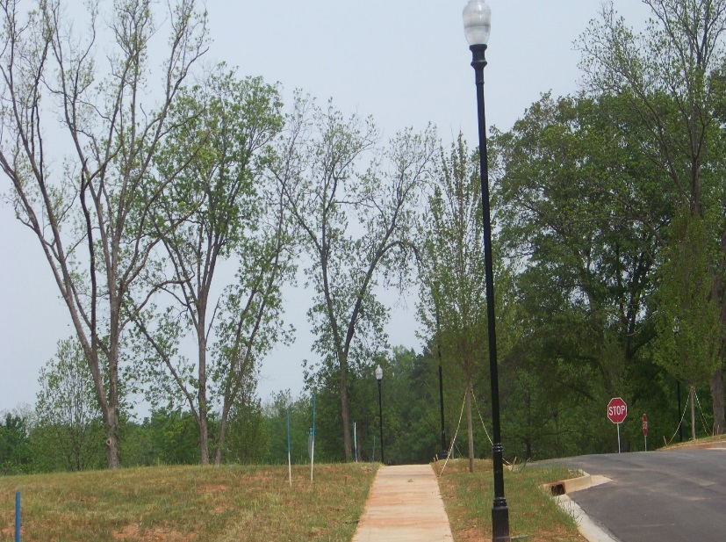
City of Washington - Rusher Street

Slide 32
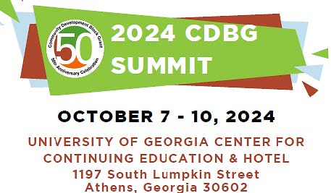

Slide 33
Thank You!
Glenn Misner(404) 679-3138 Malisa Thompson (404)326-1048
glenn.misner@dca.ga.gov Malisa.Thompson@dca.ga.gov

