Slide 1
Community HOME Investment Program
(CHIP)
Grant Writing Strategies

Slide 2

Hello!
My Name is DaTonya Lewis and I joined Department of Community Affairs as the new Community Housing Program Manager in January, 2020. I am responsible for overseeing the CHIP Program, which awards owner occupied housing rehab and new construction grants to grantees across the state.
You can contact me at datonya.lewis@dca.ga.gov

Slide 3
What Is CHIP?

Slide 4
Community HOME Investment Program
Funded with Federal HOME dollars from HUD
Homeowners/homebuyers household income cannot exceed 80% of AMI for the county
Not a direct beneficiary program
Average 10-15 grant awards per year
Awards $3-7 million statewide annually

Slide 5
2020 CHIP Awards
Cities | CHIP Award | Activity
City of Blakely, ( Early County) | $300,000 | Owner-Occupied Housing Rehabilitation
City of Madison, (Morgan County) | $ 300,000 | Owner-Occupied Housing Rehabilitation
City of Ocilla, (Irwin County) | $300,000 | Owner-Occupied Housing Rehabilitation
City of Pembroke (Bryan County) | $ 600,000 | New Construction of Single Family Homes
City of Perry (Houston County) | $ 300,000 | Owner-Occupied Housing Rehabilitation
Sylvester (Worth County) | $300,000 | Owner-Occupied Housing Rehabilitation
Counties
Dougherty County | $ 300,000 | Owner-Occupied Housing Rehabilitation
Nonprofits
Family Community Housing Association (Covington and Newton County) | $300,000 | Owner-Occupied Housing Rehabilitation
Gwinnett HC (Lawrenceville, GA) | $300,000 | Owner-Occupied Housing Rehabilitation
JC Vision and Associates ( Walthourville, GA ) | $600,000 | New Construction of Single Family Homes
New Foundations Development (Calhoun GA, and Gordon County) | $300,000 | Owner-Occupied Housing Rehabilitation
NW Metro Atlanta Habitat For Humanity (Douglasville) | $600,000 | New Construction of Single Family Homes
Public Housing Authorities
Covington Housing Authority ( Covington, GA) | $ 600,000 | New Construction of Single Family Homes

Slide 6
Owner–Occupied Housing Rehabilitation
$300,000 for owner-occupied housing rehabilitation/ reconstruction
Before
After

Slide 7
New Construction/ Reconstruction Development Rehabilitation
$600,000 for New Construction/Reconstruction of Homes for Income Eligible Homebuyers
Before
After

Slide 8
2021 Application
Two Application Forms:
Owner-Occupied Housing Rehabilitation
Single-Family New Construction for Homeownership
Applicants may apply for both but only one will be selected
Submit the application form and attachments by email

Slide 9
2021 Application- Budget/Leverage
Match points:
Match = cash or in-kind sources (land values, waived permit fees, staff .)
Bonus Points:
Applicants with highest number of proposed units
Financing must be reasonable

Slide 10
2021 Application- Capacity
Applicant’s Experience
Applicants must demonstrate the projects were completed on budget and met the performance objectives.
Staff Experience
Applicants receive more points provided for grant administrator experience

Slide 11


2021 Application- Need
Owner-Occupied Home Repair Applications:
Is there a need for owner-occupied home repairs in the target area?
New Construction of Single-Family Homes:
Should the State invest in creating single-family affordable
housing in your target area?

Slide 12
2021 Application- Planning
Up to 5 points for participation in GICH Program
Affordable Housing Plan: 10 pts for meeting all criteria

Slide 13
2021 Application- Submission
Applications due January 31, 2019
$250 application fee by mail to mailing address
Scoring: February-March
Award in March
Awardee training in April
Contracting phase April-July
Grant activities start August 1
2-year program (Aug 1, 2020-July 31, 2022)

Slide 14
Grant Writing Tips
Start early
01
Do Your Homework-Know what you’re getting into
02
Review the Application Carefully
03
Begin collecting your attachment information
04
Schedule meetings or public hearings as needed
05

Slide 15
Grant Writing Tips
1. Do your research:
a. Understand the federal/state requirements
b. Review program manuals
c. Call former grantees for advice
2. Attend workshops and webinars
3. Call the grantor and ask lots of questions
4. Does this grant make sense for your needs?

Slide 16
DCA’s role:
Meet affordable housing needs of Georgians
Need to know where the need is
Fund successful projects
Act on HUD’s behalf
Must meet all federal requirements
Provide oversight for federal compliance
Must meet performance and expenditure benchmarks
Limited capacity
Cannot carry out activities at state level
Must fund grantees with high capacity

Slide 17
CHIP Contact Information
DaTonya Lewis, Community Housing Program Manager
Datonya.Lewis@dca.ga.gov 404-852-2160
Samanta Carvalho, Director, Office of Community Housing Development Samanta.Carvalho@dca.ga.gov
(404) 679-0567
Application submission email: CHIP@dca.ga.gov
CHIP website:
https://www.dca.ga.gov/housing/housingdevelopment/programs/homeinvestment.asp

Slide 18
Key Takeaway
WE WANT YOU TO SUCCEED!

Slide 19
Any questions?
Thank you!
You can find me at: datonya.lewis@dca.ga.gov

Slide 20
GA DCA

Slide 21

The Community Development Block Grant Program
September 8, 2020
Glenn Misner

Slide 22
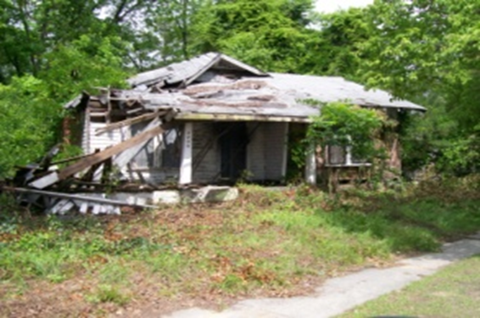
Look familiar???

Slide 23
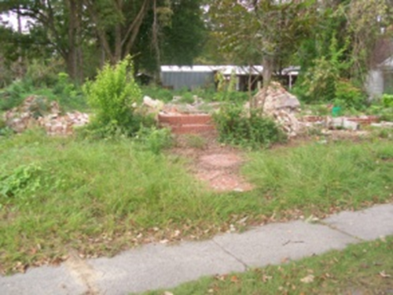

Slide 24
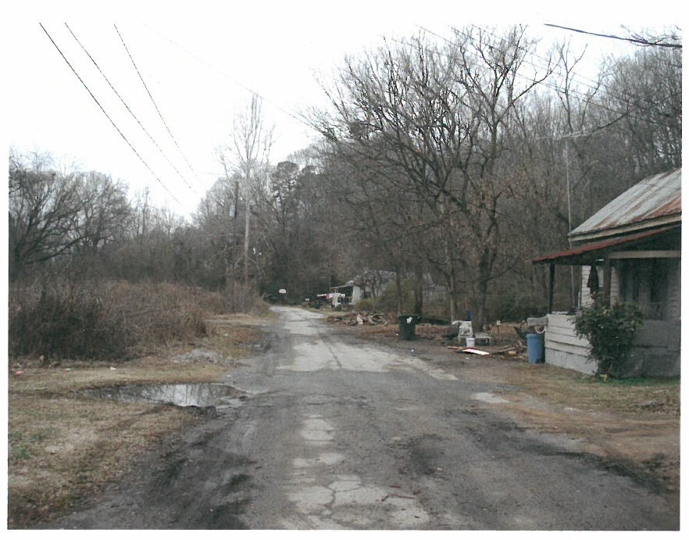

Slide 25
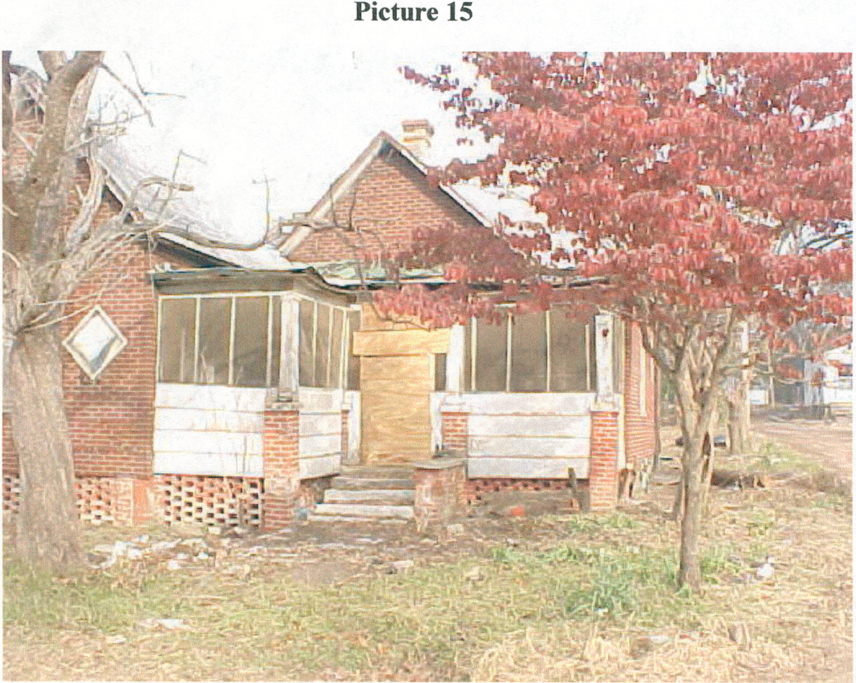

Slide 26
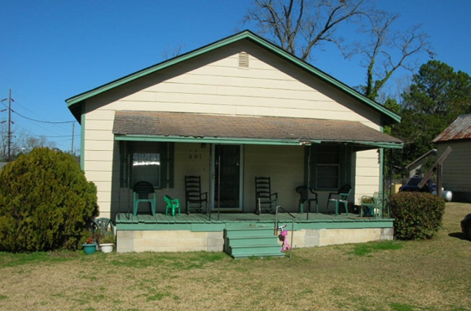

Slide 27
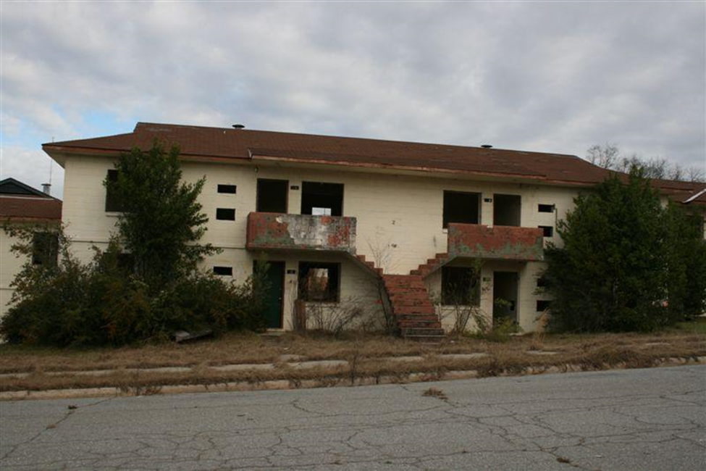

Slide 28
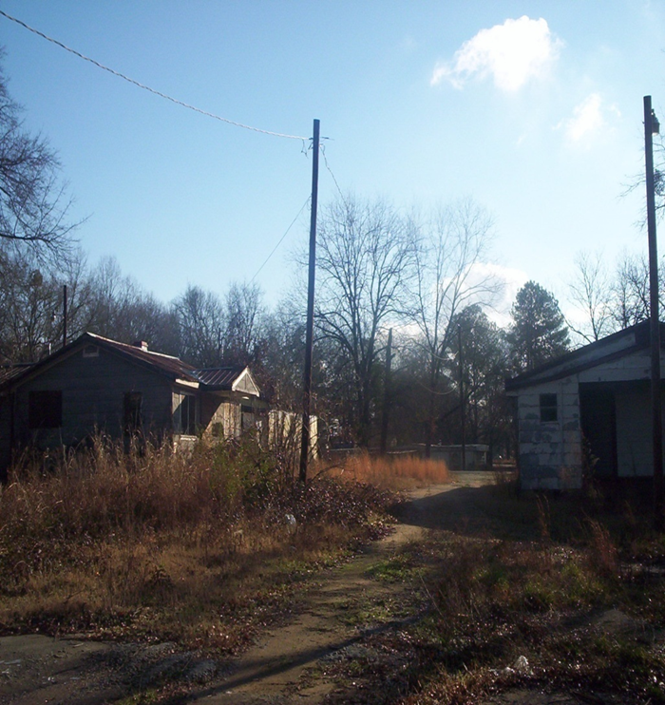

Slide 29
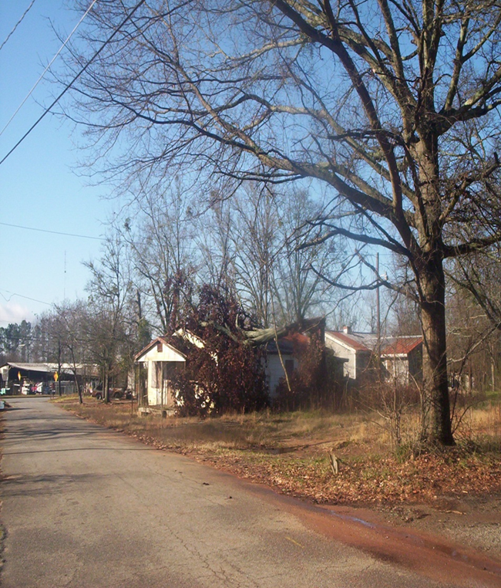

Slide 30
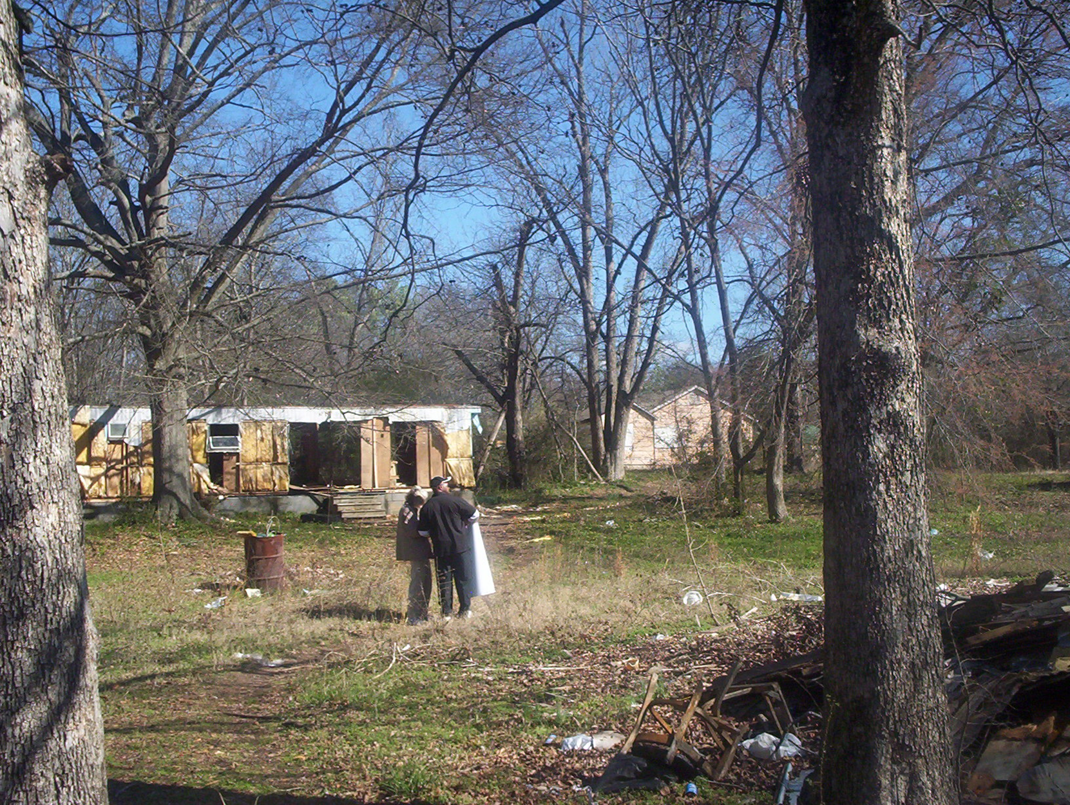

Slide 33
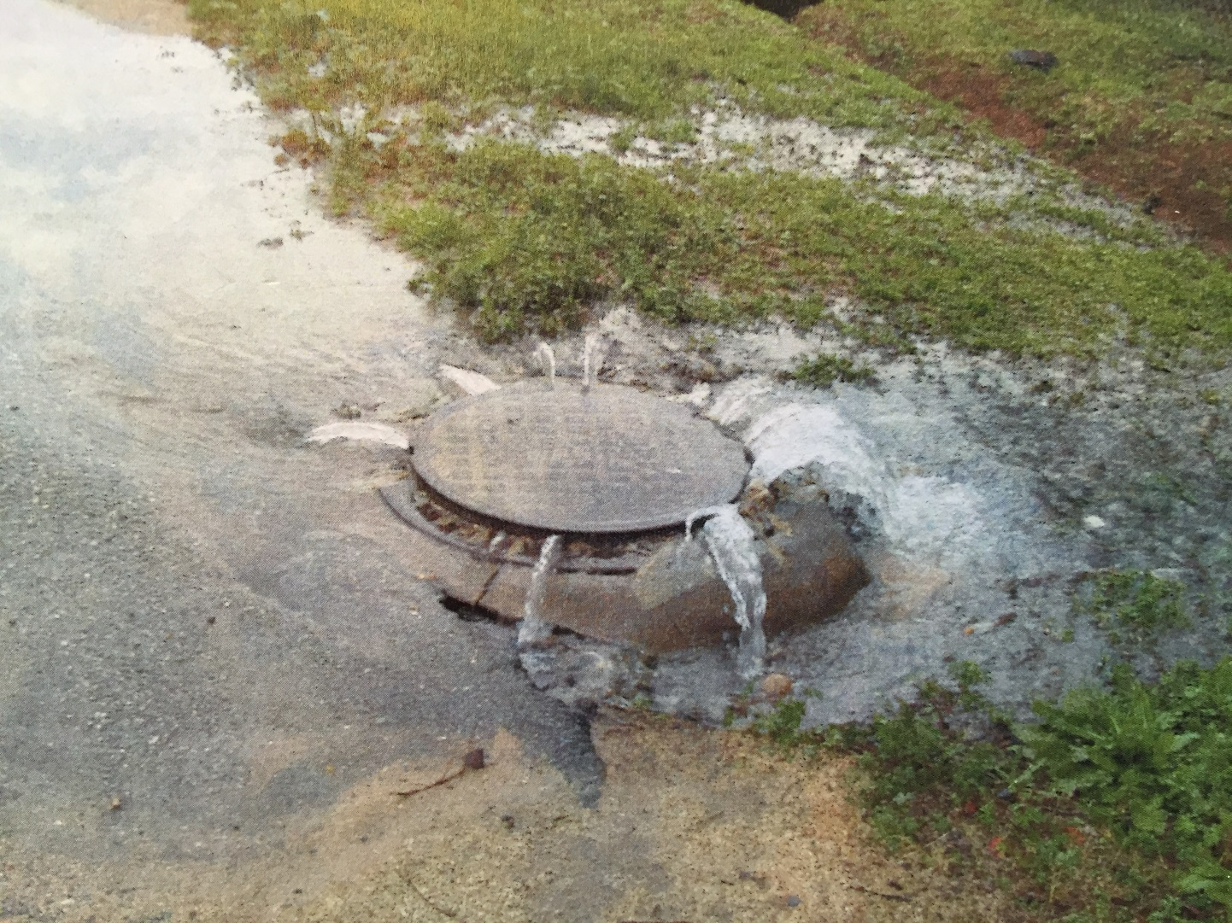

Slide 34
One tool that can help…….CDBG
Community Development Block Grant (CDBG) enacted by Congress as Title I of Housing and Community Development Act of 1974
The primary objective of CDBG is “the development of viable communities through improvement of living conditions, housing and the expansion of economic opportunities in cities and counties, principally for persons of low-and moderate income.”

Slide 35
State CDBG Program
Any NON-ENTITLEMENT local government (in good standing) may apply for funding through the state program
Local governments can implement a broad range of activities as long as they further the National Objectives of the Act
National Objectives are:
Majority benefit to low and moderate income persons through services and job creation
Prevention or elimination of slums and blight
Meeting urgent needs that pose a threat to the health and welfare of the community

Slide 36
CDBG Annual Competition
Funding Available:
Single Activity CDBG (Annual Competition)
Employment Incentive Program* $750,000
Redevelopment Fund Program*
* CDBG “Set Aside” programs
Multi-Activity ------------------------------------ $1,000,000
Innovative Award – Details to come

Slide 37
CDBG
Types of Grants – Annual Competition
Single Activity: up to $750,000
Neighborhood Revitalization
Rehabilitation
Reconstruction
Acquisition
Relocation
Demolition
Infrastructure Improvements
Sewer
Water
Streets
Drainage

Slide 38
CDBG
Types of Grants – Annual Competition
Single Activity: up to $750,000
Public Buildings
Health Departments
Senior Centers
Community Centers
Head start
Multi-Activity: up to $1,000,000
Neighborhood Revitalization PLUS Infrastructure/Building Activities

Slide 39
CDBG
Apply for Annual Competition
– Applications due April 5, 2021
Set–aside programs accept applications year-round
Applicant must be Local Government
Grant application writing/Administration
- Local Government
- RC’s
- Private Administrators
Funds may be channeled through Development Authorities, Non-Profits or other CBO’s

Slide 40
Eligible Activities Single Activity Neighborhood Revitalization Maximum $750,000.
Rehabilitation – To repair and/or bring to Code existing substandard housing unit – Owner or Renter*
*Requires 50/50 match from landlord & rental agreement
Reconstruction – Where unfeasible to Rehab, Demolish and construct new unit on same site – Owner Occupied ONLY.
Acquisition - of Real Property
Disposition – Costs Incidental to Disposing of Property Acquired with CDBG Funds
Code Enforcement – but…

Slide 41
Eligible Activities Single Activity Neighborhood Revitalization Maximum $750,000.
Clearance – Of Dilapidated Structures, out-buildings, etc.
Interim Assistance
Relocation – Temporary or Permanent
Temp Relocation is NOT mandatory for Owner occupied units
Removal of Architectural Barriers

Slide 42
Eligible Activities Single Activity Neighborhood Revitalization Maximum $750,000.
Home Buyer Assistance
Down Payment
Closing costs
Principle Reduction Payment
Interest buy-down
NOTE: DCA policy mandates use of fixed rate mortgages on all CDBG funded projects

Slide 43
Multi-Activity Maximum $1,000,000.
Multi-Activity
“Comprehensive Neighborhood Revitalization”
Includes Housing AND Public Facilities Activities
Limit of $1,000,000
Inter-related Activities
Same Target Area
Comprehensive (Meets all/most of the Needs in the Target Area)

Slide 44
Attend the
CDBG Applicants’ Workshop
Dates/Location TBA

Slide 45
Revitalization Area Strategies DCA designation that rewards efforts demonstrating:
Long-term vision for the area
Well-defined area that included comprehensive activities
Grassroots involvement from area residents
Commitment from other funding partners
Documented commitment from funders and stakeholders

Slide 46
Revitalization Area Strategies
Officially adopt a local Redevelopment Plan in accordance with the Urban Redevelopment Act O.C.G.A. 36-61
Eligible area of Census Block Group(s) of 20% or greater poverty level.
Develop strong local partnerships focusing local resources within the Revitalization Area.
CDBG Public Participation process
Submit application for designation to DCA.
Must be designated by DCA through application
Due at same time as CDBG Annual Competition

Slide 47
RAS Rewards:
Can apply for CDBG every year, provided that current CDBG project meets timeliness criteria
Provides up to 20 bonus points on CDBG Annual Competition applications that are proposed within the RAS area
Designation is effective for 3 years

Slide 48
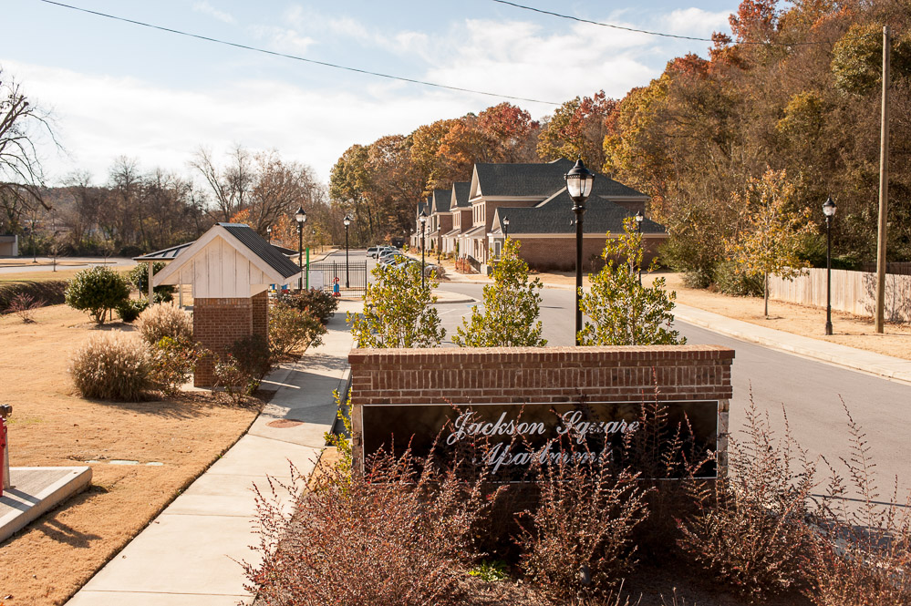
Results…………
Rockmart:
Jackson Square Apts.

Slide 49

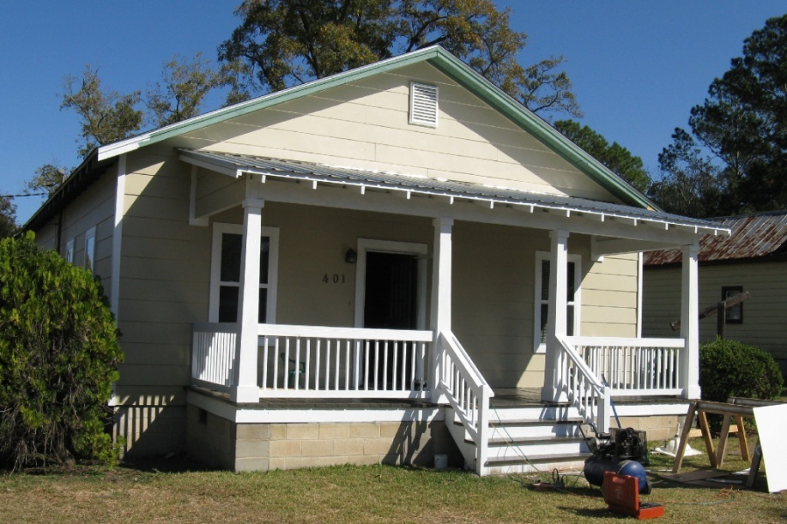
Thomasville: Victoria Place Revitalization Area

Slide 50

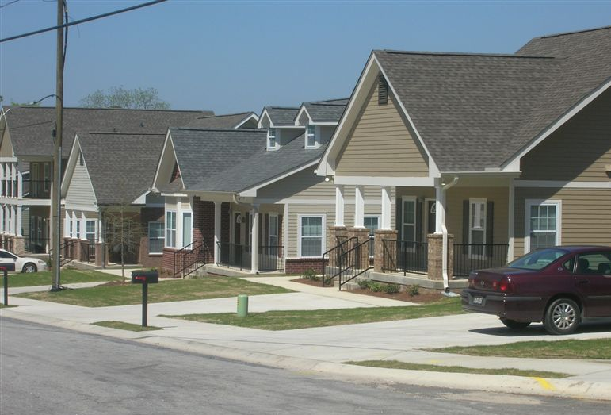
It CAN be done!
The former Macon Homes—now Bartlett’s Crossing

Slide 51
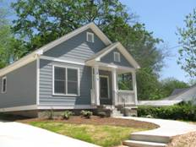
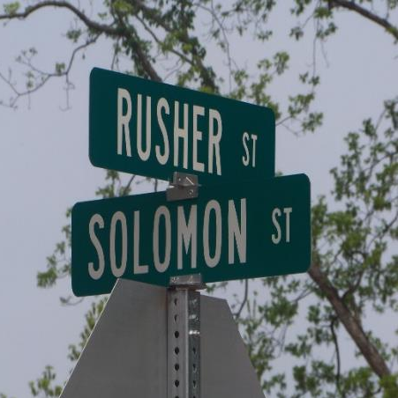
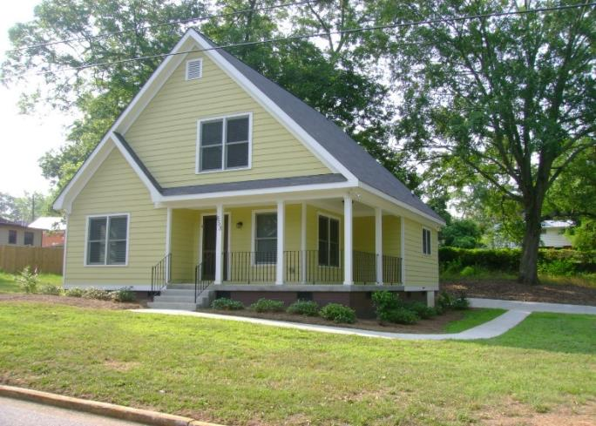
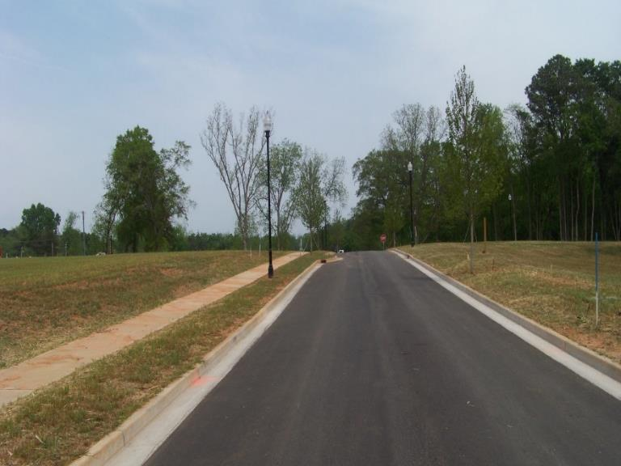
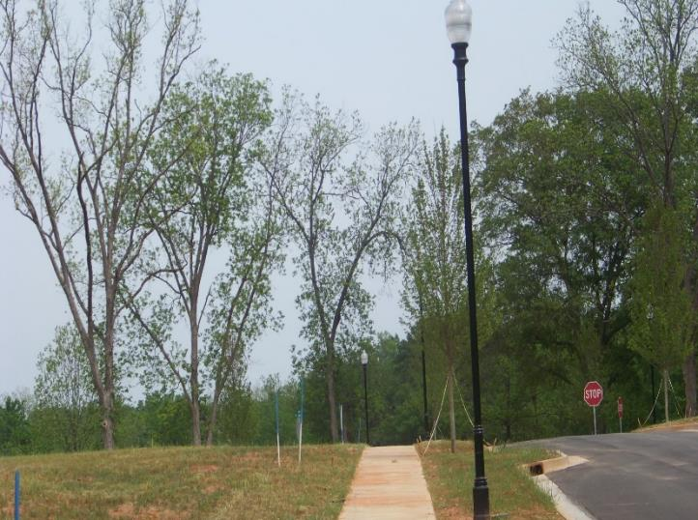
City of Washington - Rusher Street

Slide 52
CDBG
Events - 2020
DCA Fall Conference
October 5 - 8, 2020
Online
CDBG Applicants’ Workshop
TBA
Registration information
dca.ga.gov

Slide 53
Thank you!
Glenn Misner (404)679-3138
glenn.misner@dca.ga.gov

