Slide 1
LAND BANKING 101 OVERVIEW GICH RETREAT – Athens, GA
OCTOBER 7, 2021
presented by:
Christopher Norman
President – Georgia Association of Land Bank Authorities, Inc.
Executive Director – Metro Atlanta Land Bank

Slide 2

Land Bank Authorities (LBA) in Georgia
Land Bank 101
2012 Georgia Land Bank Act Review
Establishing LBA
Development Considerations
Questions

Slide 3
Land Bank 101

Slide 4
Blighted
Tax Delinquent
Distressed
Non-Tax Producing
Foreclosed
Abandoned

Slide 5
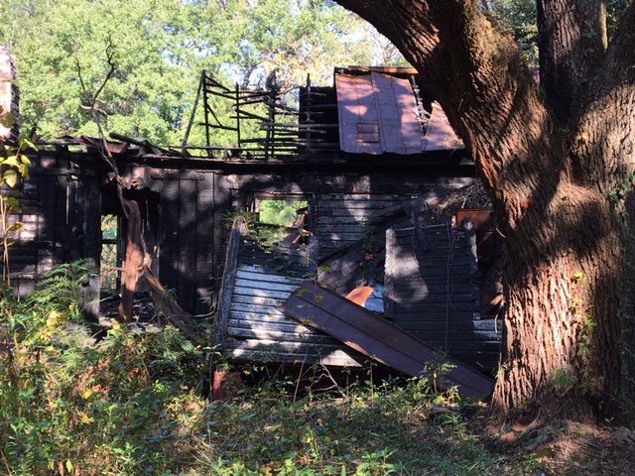

Slide 6
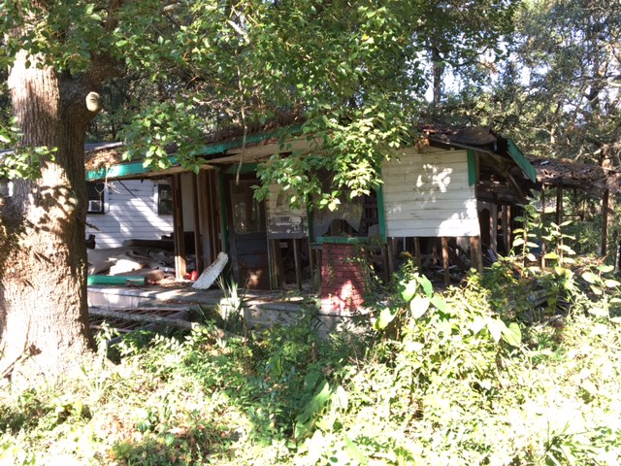

Slide 7
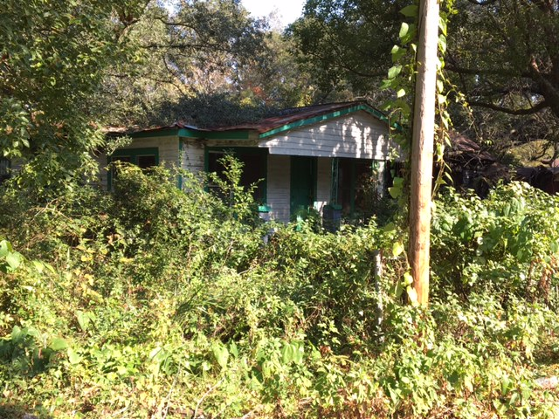

Slide 8
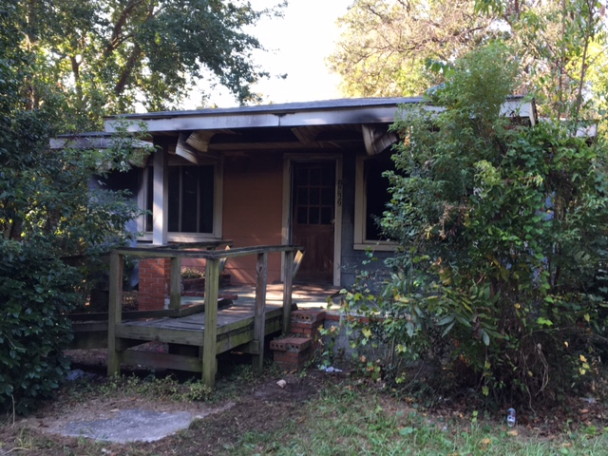

Slide 9
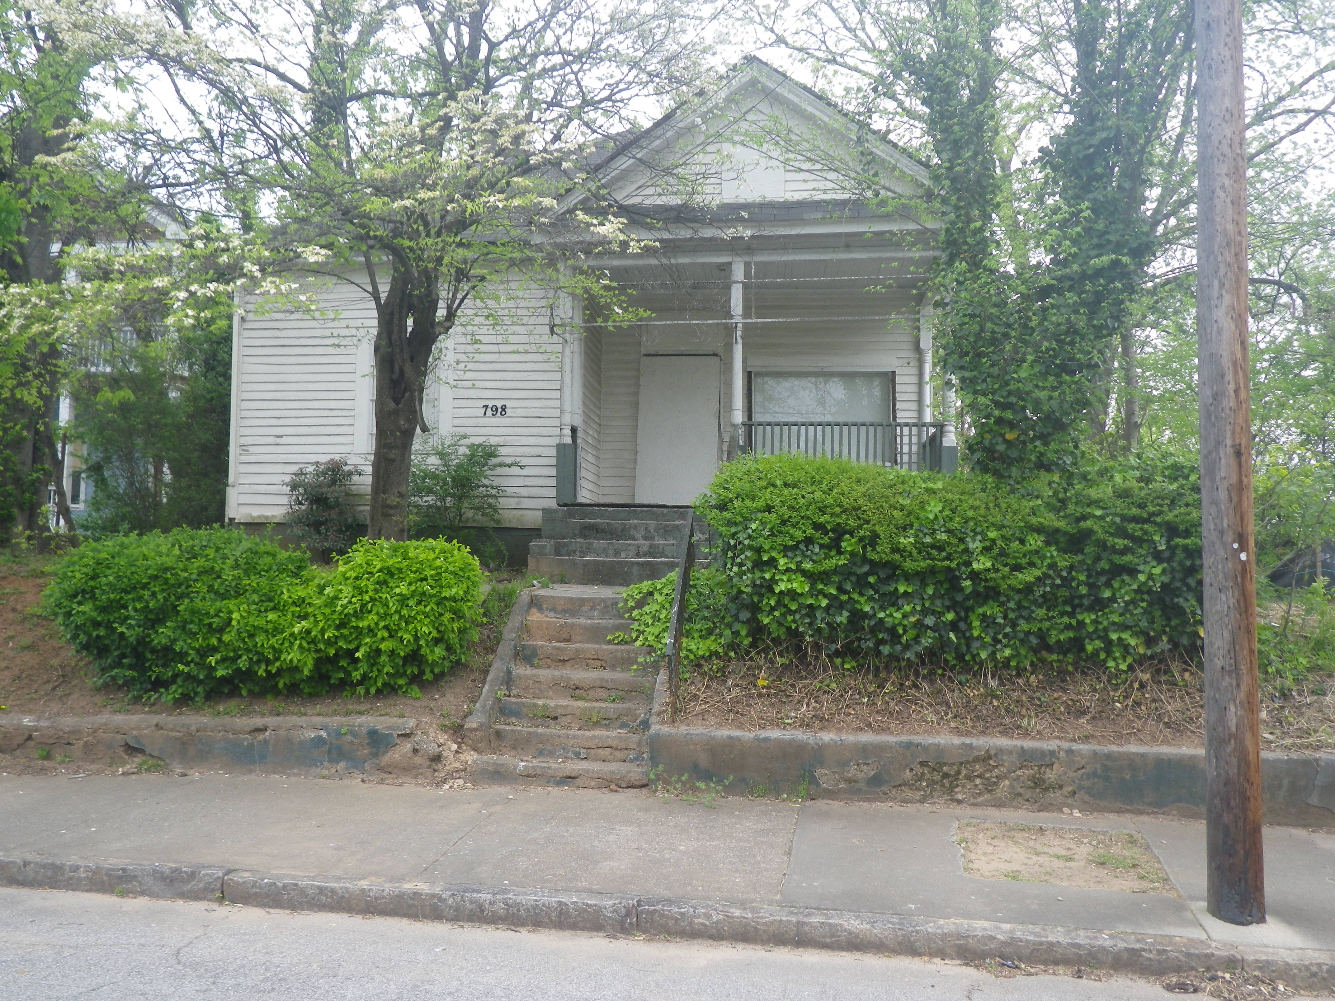

Slide 10
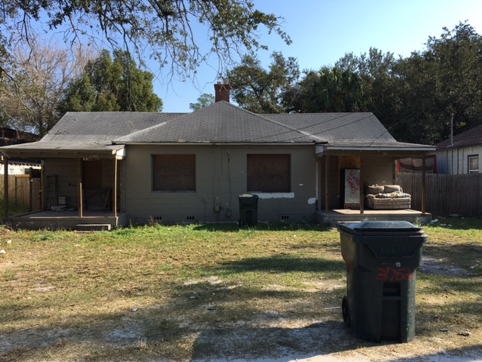

Slide 11
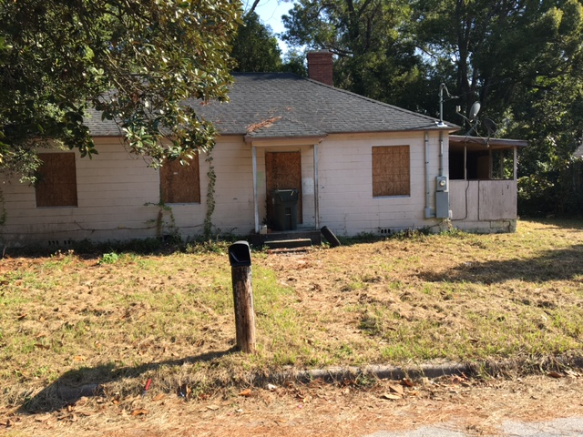

Slide 12
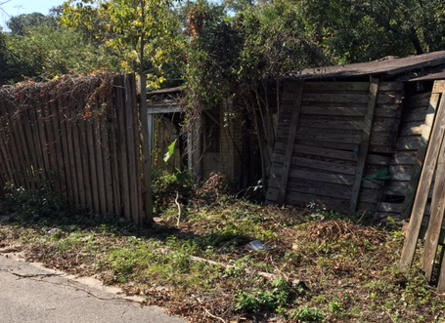

Slide 13
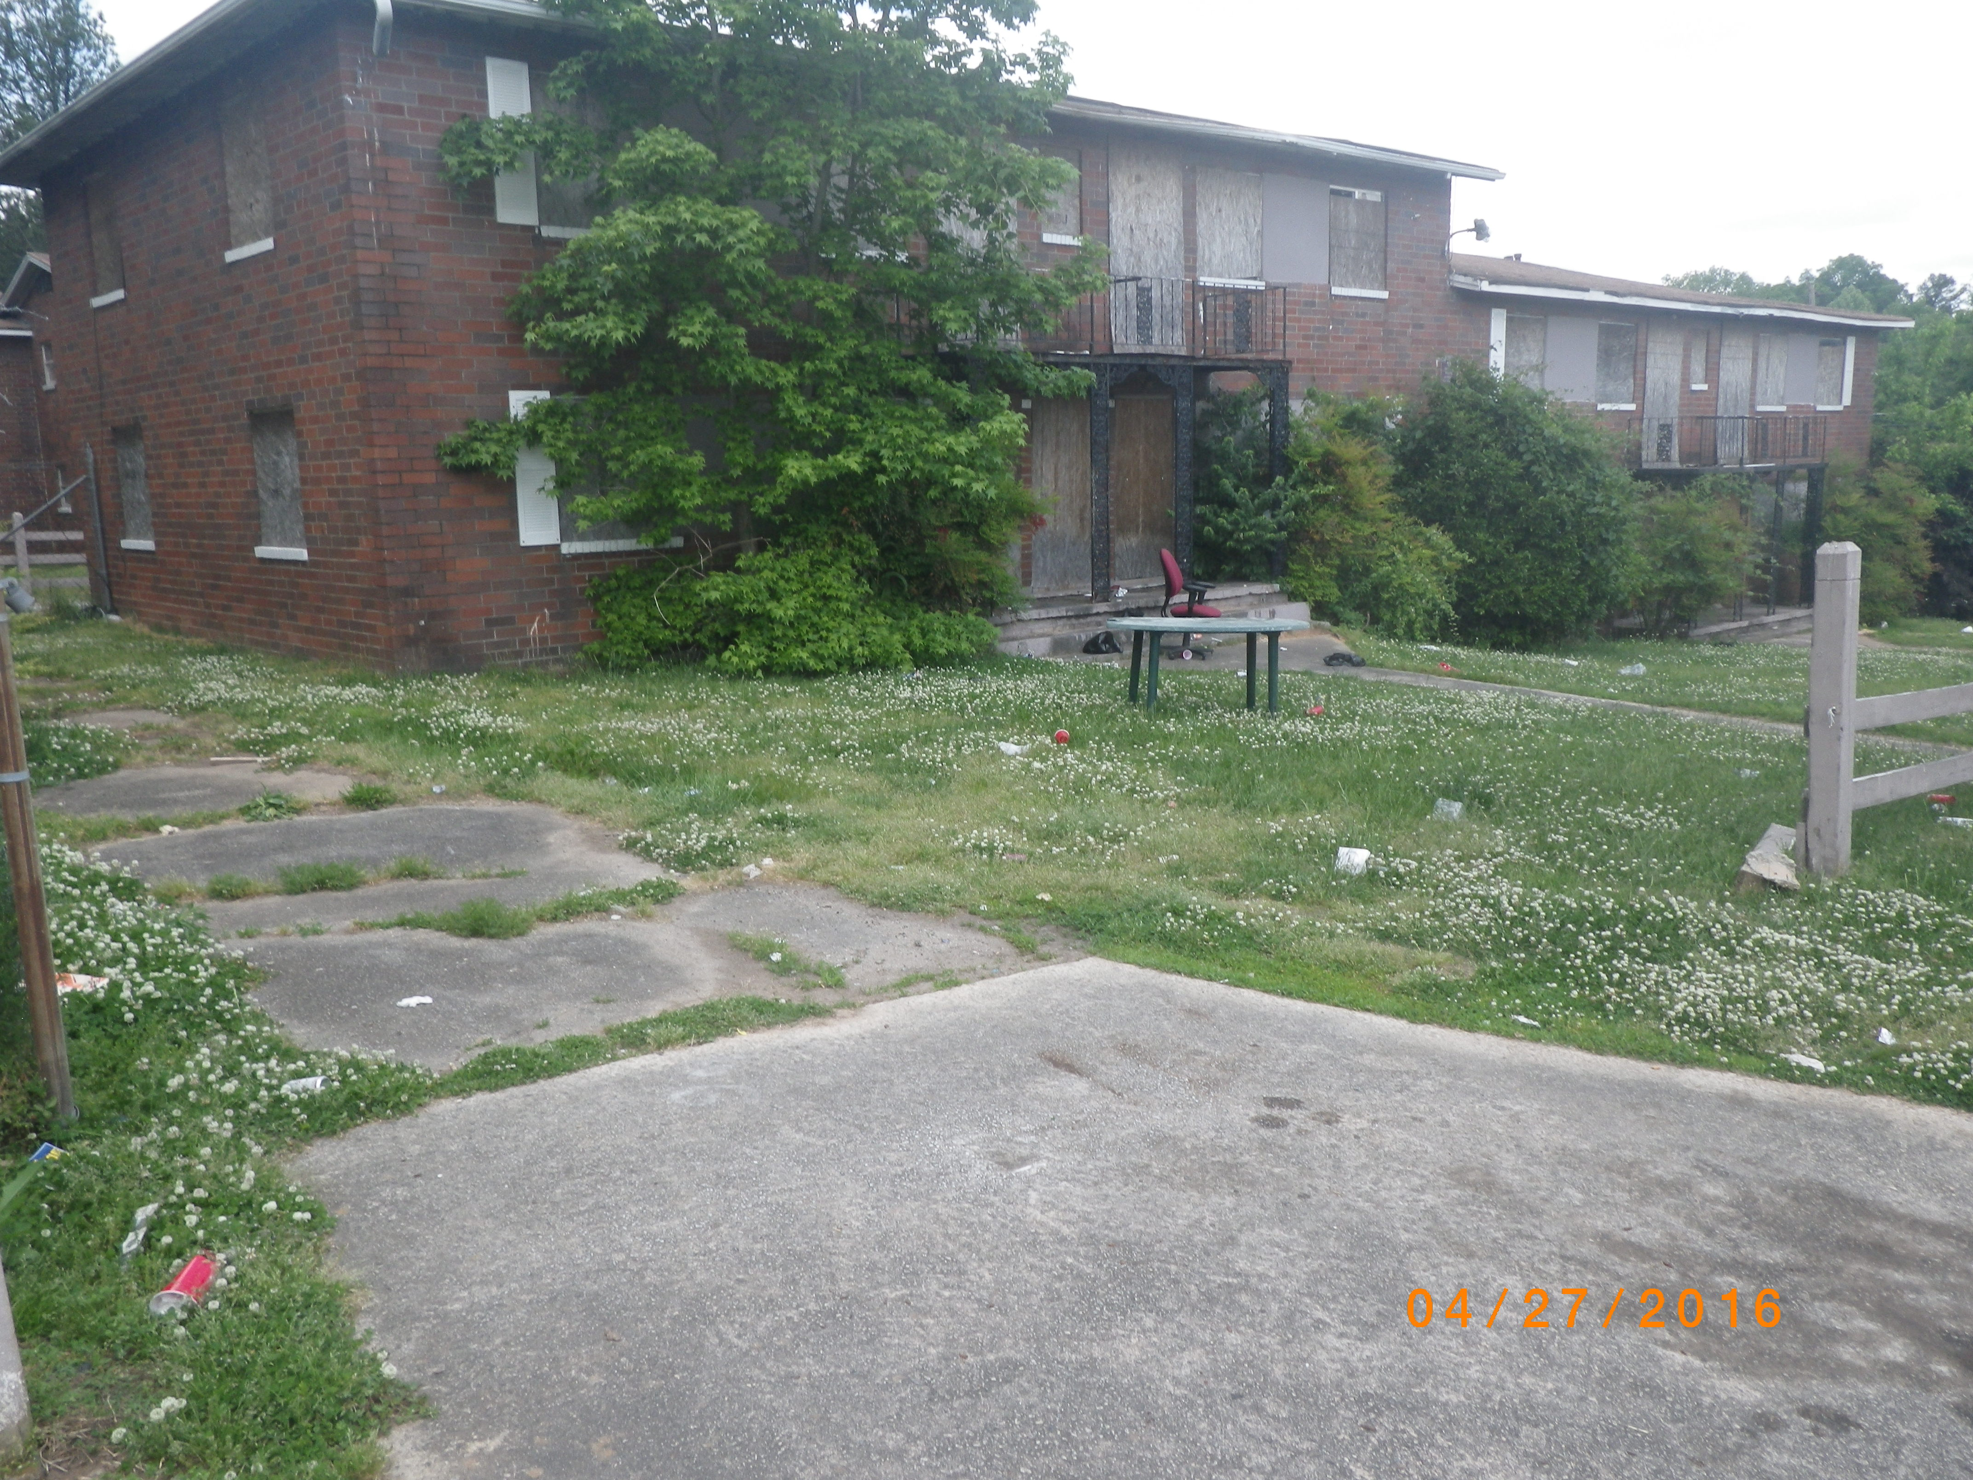

Slide 14
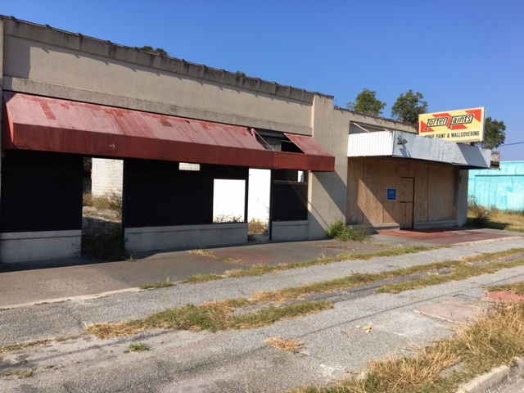

Slide 15
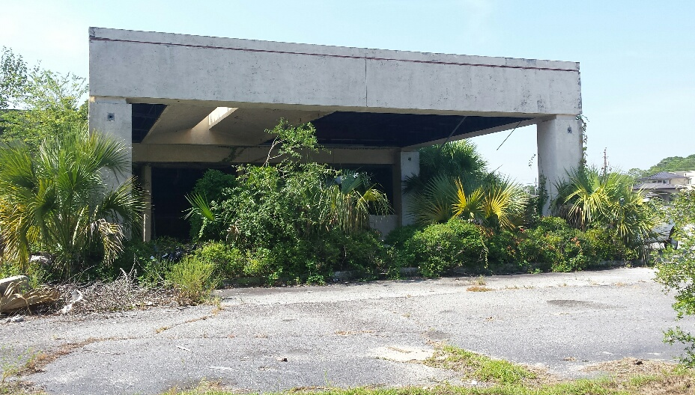

Slide 16
Desired Property Outcomes
Code Compliant Property
Tax Producing Property
Occupied Structures
Maintained Property and Structures
Shared Community Space
Vibrant and Safe Communities

Slide 17
What is a Land Bank
Land Banks are public or nonprofit entities created by local governments to acquire, manage, maintain and facilitate the redevelopment of underutilized, vacant blighted, tax delinquent properties.

Slide 18
What is a Land Bank
Tool for converting vacant, abandoned, or distressed property into productive use. This includes residential, commercial, industrial and greenspace purposes.
Core competency is acquisition and disposition of troubled, surplus, or vacant property.
Does NOT have eminent domain or taxing authority.
Steps in where market does not or cannot work due to administrative/legal barriers.

Slide 19
History of Land Banks
St. Louis 1971
Cleveland 1976
Louisville 1989
Atlanta 1991 (State law updated 2012)
Genessee 2002
Cuyahoga 2008
New York 2011
Philadelphia 2014
Virginia 2016
Currently over 200 land banks in the US

Slide 20
Some Existing Georgia Land Banks
Jurisdiction | County Population | City Population
Fulton County-Atlanta | 1,066,710 | 498,715
DeKalb County-Decatur-Lithonia | 764,382 | 24,928 | 2,299
Chatham County-Savannah | 295,291 | 147,780
Muscogee County-Columbus | 206,922 | 206,922
Richmond County-Augusta | 199,614 | 199,614
Bibb County-Macon | 157,346 | 157,346
Clarke County-Athens | 129,025 | 129,025
Lowndes County-Valdosta | 118,251 | 55,378
Whitfield County-Dalton | 102,864 | 34,417
Floyd County-Rome | 98,584 | 36,940
Spalding County-Griffin | 67,306 | 23,478
Thomas County–Thomasville | 45,798 | 18,881

Slide 21
Land Bank Focus
Broad Usage Categories
Residential
Commercial
Industrial
Green space
Surplus Public Property
Foreclosed Properties
Abandoned Properties
Tax delinquent Properties
Land Banks focus on properties that are underutilized.

Slide 22
Determination of Need for Land Bank

Slide 23
Strat • e • gy
1 a (1) : the science of employing the political, economic, psychological, and military forces of a nation or group of nations to afford the maximum support to adopted policies in peace or war (2) : the science and art of military command exercised to meet the enemy in combat under advantageous conditions
B : a variety of or instance of the use of strategy
2 a : a careful plan or method : a clever stratagem
b : the art of devising or employing plans or stratagems
towards a goal
3 : an adaption or complex of adaptations (as of behavior, metabolism, or structure) that serves or appears to serve an important function in achieving evolutionary success <foraging strategies of insects>
Source: Merriam-Webster Dictionary

Slide 24
Determination of Need for Land Bank
Why?
Problem Definition
What?
Solutions and Desired Outcomes
Scale
How?
Financial and Operational Capacity
Who?
Leadership

Slide 25
Triggers for Creating a Land Bank:
Significant (based on local market conditions) inventories of abandoned/vacant property with little market value
Ineffective tax foreclosure procedures – failed auctions
Chronic code violations – need for new approach
Title problems – need for clear title
Restrictive property disposition requirements – municipal rules vs land bank flexibility
Need for local control – ability to influence disposition

Slide 26
Establishing a Land Bank

Slide 27
Georgia Land Banks: O.C.G.A. § 48-4-60 et seq.(SB 284)
Independent Tax Exempt Authority
Independent Board
Broad Acquisition & Disposition Authority

Slide 28
Creation and Powers
Parties that may create a Georgia Land Bank…..
1 County + participating city located in county
Multiple counties + participating cities in each county
1 Consolidated government
Consolidated government/s + county/counties + participating city/cities

Slide 29
Creation and Powers
Steps to create a Georgia Land Bank….
Passage of ordinance and IGA (if consolidated government alone then no IGA)
Appointment of board members
Adoption of by-laws and policies and procedures

Slide 30
Governance: Intergovernmental Agreement
Adopted by resolution of one county and at least one city
Outlines board responsibilities
Lists land bank powers
Provides dissolution process

Slide 31
Governance: Board
5-11 member board (odd number)
Public officers eligible to serve
Members serve without compensation
Majority of Board is quorum for conduct of business
Certain matters require approval of entire board such as disposition of property over 50k

Slide 32
Governance: Board Membership
Who should serve?
Tax Commissioner?
Code Enforcement Officials?
Zoning Officials?
Elected Officials?
Private citizens?
Backgrounds
Finance
Law
Real Estate
Banking
Community/Economic Development

Slide 33
Funding Considerations
City Contribution – General Fund
County Contribution – General Fund
Bond issues
Federal funds
Staffing – Direct or Shared/Loaned
Legal support
Property maintenance – Municipal or vendor
Insurance – Corporate and Property

Slide 34
Georgia Land Bank Resource Manual Review
Released in June 2013—Free How To Manual for Creation of Georgia Land Banks http://www.communityprogress.net/georgia-land-bank-resource-manual-pages-402.php
Sponsored by GALBA, Habitat for Humanity, GMA, ACCG, Enterprise and Center for Community Progress
Key Appendices
Template Intergovernmental Agreement
Template Resolution Creating Land Bank
Sample administrative policies
Sample tax extinguishment resolution

Slide 35
2012 Georgia Land Bank Act Review

Slide 36
GALBA
Land banks throughout State created Georgia Association of Land Bank Authorities, Inc. (GALBA) in August 2011
President – Christopher Norman
Purpose:
To promote and market the concept and utility of land bank authorities to local governments, citizens and other stakeholders in the State of Georgia.
To educate interested local governments, citizens and other stakeholders in Georgia regarding the establishment and operation of land bank authorities in their respective communities.
To foster and promote the sharing of information amongst land bank authorities in Georgia and throughout the nation.
To provide technical assistance to land bank authorities in Georgia
To provide and support governmental relations to benefit and foster the mission of land bank authorities in Georgia.

Slide 37
Georgia Land Bank Act: SB 284
Introduced Senate Bill 284 in 2012 Georgia Legislative Session for reform of existing 1990 Georgia land bank statute
Sponsor: Senate - Sen. Tim Golden (R), Valdosta; House - Rep. Alan Powell (R), Hartwell
Law became effective on July 1, 2012

Slide 38
Georgia Land Bank Act: SB 284 Highlights
Acquire property through tax sales, donation, market-purchase
Contract, invest, borrow money
Manage, maintain and hold property
Extinguish delinquent taxes with school board consent
Dispose of property in accordance with local priorities
No eminent domain or taxing power
Competitive Bidding at tax foreclosures sales
Land Banks to effectively use tax recapture to benefit from its activities and value of its inventory and to become less reliant on government funding

Slide 39
Development Considerations

Slide 40
Do Vacant Properties Affect Property Values?
A vacant or delinquent property can lower property values within 500 feet by 2.1%
A vacant and delinquent property can lower property values by 2.7%
A foreclosed (not delinquent or vacant) can lower property values by 3.9%
A foreclosed and vacant or delinquent property can lower property values by 6.1%
A foreclosed, vacant and delinquent property can lower property values by 9.4%
(Source: Stephen Whitaker and Thomas J. Fitzpatrick, IV, The Impact of Vacant, Tax-Delinquent and Foreclosed Property on Sales Prices of Neighboring Homes, Federal Reserve Bank of Cleveland)

Slide 41
How Do Land Banks Acquire Property?
Acquire Property through Non-Judicial or Judicial In Rem Tax Foreclosures
(Judicial In Rem Tax Foreclosures preferred)
Acquire Property through Donations
Acquire Property through Direct Market Purchases
Acquire Property directly from local government transfers
Includes Eminent Domain for Blight (HB 434 – 2017)

Slide 42
Disposition of Property
Georgia Law requires a public bidding for local government property transfers
Local government can convey properties to the Land Bank as a governmental transfer without the bidding process
Land Banks allow for greater flexibility in the terms and conditions of transferring properties to new owners

Slide 43
Pricing Flexibility
Land Banks have full discretion in determining the sales price of a property
Land Banks can sell, trade or otherwise dispose of property on the terms and conditions determined in the sole discretion of the Authority at the local level
It is very important that there is consistency and transparency in acquisition & disposition of property

Slide 44
Land Bank Priorities for Disposition
Land Banks may establish a hierarchical ranking of priorities for the use of real property conveyed or the new law includes a list of priorities that will be used if not established, including:
Public spaces and places
Affordable and/or market housing
Retail, commercial, and industrial activities
Community land trusts or other public entities

Slide 45
Questions
??????

Slide 46

Contact
Christopher Norman
President - GALBA
Direct 404-525-9130
cnorman@metroatlantalandbank.org

