Slide 1
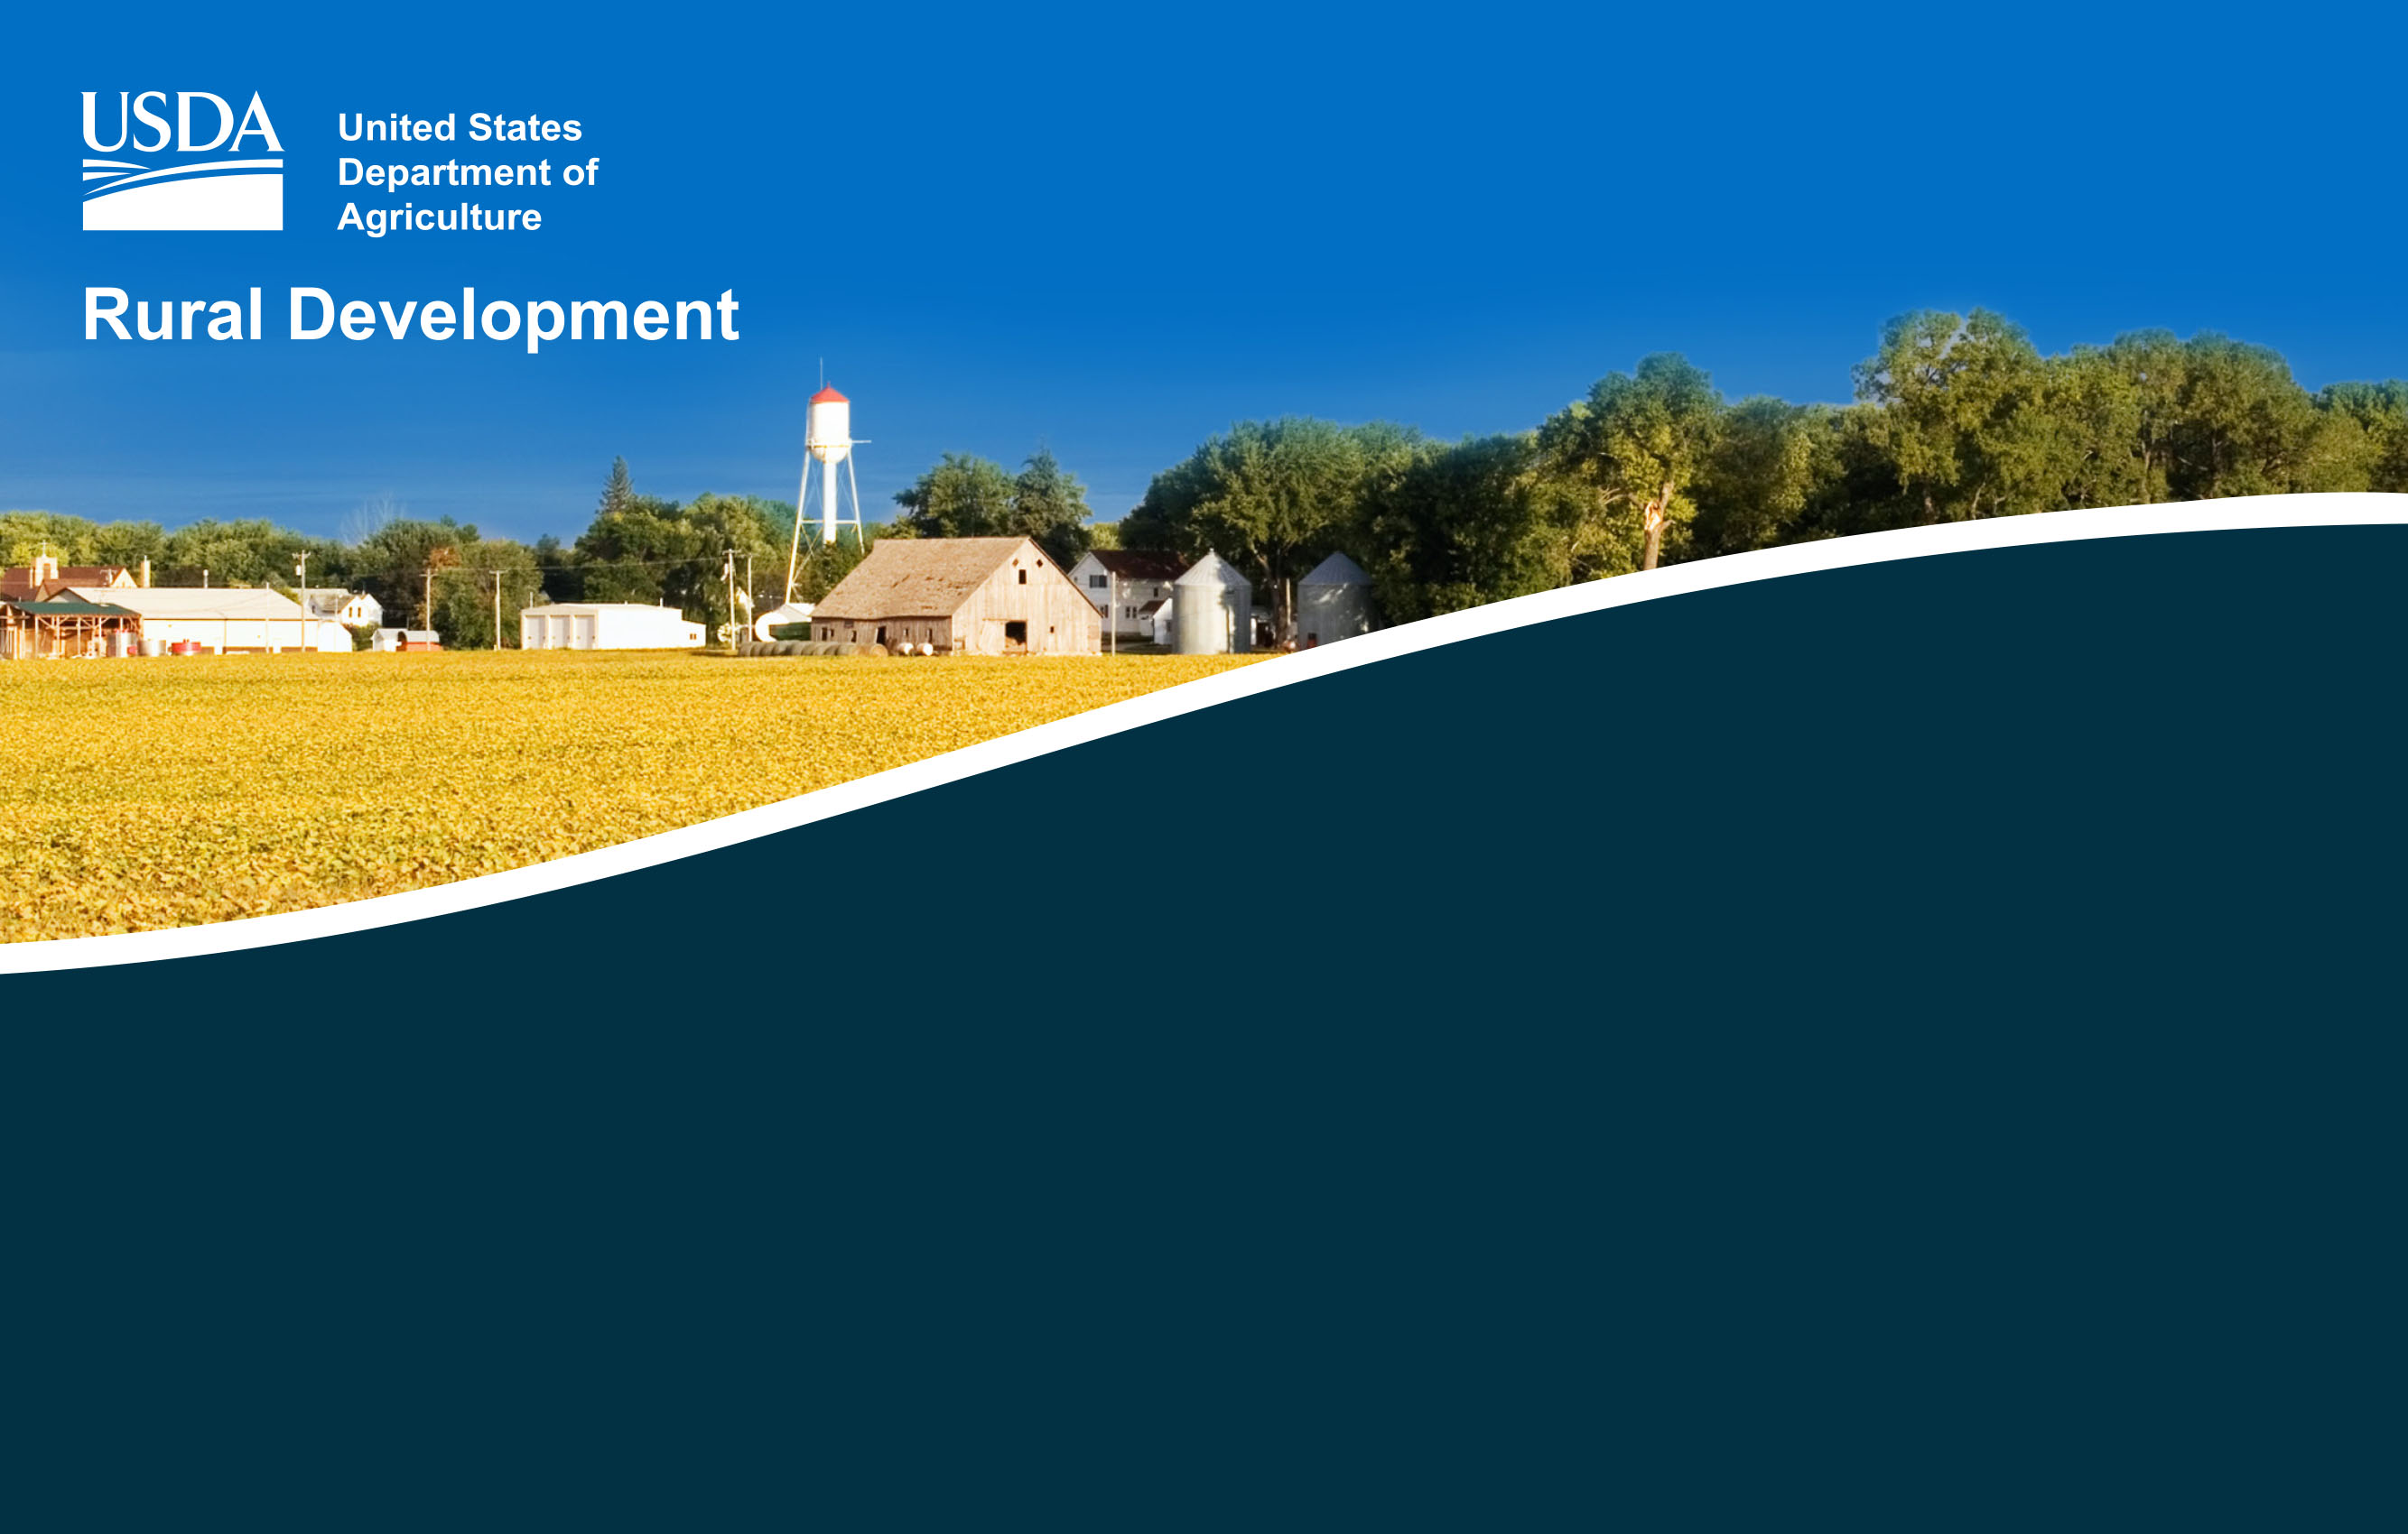
Section 502 Direct Loan Program Overview
Presented by David Griffin
Single Family Housing Direct Loan Division
Revision Date: October 4, 2021
Notes:
The purpose of this presentation is to provide a basic overview of the Section 502 direct loan program. Through this presentation, you will be briefly introduced to this program and pointed to resources where you can learn more about the program. Please refer to program regulations and handbooks for the most recent information.

Slide 2


We Make It Easy To Purchase Or Build A Home
Notes:
Our 502 Direct Loan Homeownership program offers:
• No Down Payment
• Monthly Payments based on Income
• 100% Percent Affordable Loans
Fixed Rate Financing
• Closing Costs and Repairs may be included in the loan
• No Private Mortgage Insurance (PMI) Required
• No Prepayment Penalties

Slide 3
7 CFR 3550 Regulation
The direct loan program’s regulation is found in the Code of Federal Regulations (CFR) at 7 CFR Part 3550. The program’s regulation and guidelines can be found using the following link:
https://www.rd.usda.gov/resources/regulations/program-regulations
Notes:
The Single Family Housing Direct Loan Division was established with the Housing Act of 1949. Regulation manual 7 CFR 3550 governs the direct loan program. This regulation provides the overarching requirements of the program and is supplemented by Handbook-1-3550, Administrative Notices, Procedure Notices, Unnumbered Letters, and Forms. Additionally, there are RD Instructions which Agency staff must be aware of and follow when delivering the program. Applicable RD Instructions include but are not limited to:
RD Instruction 1924-A, Planning and Performing Construction and Other Development
RD Instruction 1924-C, Planning and Performing Site Development Work
RD Instruction 1901-E, Civil Rights Compliance Requirements
RD Instruction 1970 series, Environmental

Slide 4
Section 502 Direct Loan Program Overview
Authorized by the Housing Act of 1949
Provides affordable housing loans to eligible low- and very low-income applicants who wish to obtain modest housing in rural areas
https://eligibility/sc.egov.usda.gov/eligibility/welcomeAction.do
Rural Development (RD or Agency) is the lender and servicer
Notes:
The Section 502 Direct loan program provides affordable housing loans to eligible low- and very-low income applicants who wish to obtain modest housing in rural areas. Using the eligibility website on this slide, you can find income limits and eligible areas.
In addition to meeting the program’s income limits, applicants must meet the program’s eligibility requirements related to:
Citizenship status – The applicant must be a U.S. citizen or a noncitizen who qualifies as a legal alien.
Primary residence – The applicant must agree to and have the ability to occupy the home on a permanent basis.
Current homeownership – An applicant who owns adequate housing is generally not eligible. A current homeowner may receive a RD loan in limited circumstances.
Legal capacity – The applicant must have legal capacity to incur the loan.
Suspension/debarment – The applicant cannot be suspended or debarred from participating in federal programs.
Repayment ability – The applicant must show adequate repayment ability for the loan based on the program’s qualifying ratios.
Credit qualifications – The applicant must have a credit history that indicates a reasonable ability and willingness to meet their debt obligations. While the Agency uses credit scores to potentially expedite the creditworthiness analysis, there isn’t a credit score eligibility requirement.
Homeownership education – First-time homebuyers are required to take an approved homeownership education course.
Modest housing is defined as a property that:
Is considered modest for the area.
Does not have a market value in excess of the applicable area loan limit.
Generally does not exceed 2,000 square feet living area (above grade).
Does not have income producing structures or land.
The land must be minimally adequate and not large enough to subdivide under local zoning rules. In some places, this might be 5 acres. In other places, it might be 0.25 acre or less. There is no “one size fits all” definition.
Rural areas are defined as open country and places with a population of 10,000 or less and, under certain conditions, towns and cities between 10,000 and 35,000 population. Use the property eligibility website to determine if a property is in a rural area: https://eligibility.sc.egov.usda.gov/eligibility/welcomeAction.do
Direct loans are subsidized loans funded by the government and serviced by RD’s National Financial and Accounting Operations Center.

Slide 5
100% Financing
100% financing without private mortgage insurance
Eligible loan purposes and uses include site-related costs, dwelling-related costs, and fees/related costs
Eligible loan amount is limited by the applicant’s repayment ability and the home’s appraised value
Notes:
502 loans typically provide 100% financing without private mortgage insurance or a down payment. A down payment is only required if the cash value of the applicant’s non-retirement assets is greater than $15,000 for non-elderly households or $20,000 for elderly households. Assets aside, the Agency will limit the financing to 90% of the home’s value if the construction quality of a new home cannot be adequately documented.
The appraisal fee, tax service fee, and initial contribution to fund the escrow account can exceed the appraised value. For first-time homebuyers, who are required to take a homeownership education course, the fee for the course can also exceed the appraised value.

Slide 6
Loan Terms
Standard loan term is 33 years
Loans up to 38 years is permitted when the household’s adjusted income doesn’t exceed 60% of the area median and a longer term is needed for repayment
Manufactured homes have a maximum 30 year term
Notes:
The standard 502 direct loan term is 33 years.
However, loans up to 38 years are permitted when the household’s
adjusted income does not exceed 60% of the area median and a longer
term is needed for repayment.
Manufactured homes have a maximum term of 30 years.

Slide 7
Interest Rates and Payment Assistance
Interest rate is fixed
www.rd.usda.gov/programs-services/single-family-housing-direct-home-loans
Borrowers may be eligible for payment subsidies that reduce their effective interest rate and their monthly mortgage payment
Depending on the home’s value, subsidies received may be repaid at the time of sale or non-occupancy
Notes:
The program’s interest rate is posted at the beginning of each month on the Agency’s website under Single Family Housing Direct Home Loans (see the “To Apply” tab).
www.rd.usda.gov/programs-services/single-family-housing-direct-home-loans
The applicant’s loan will have an interest rate that is the lower of the interest rate at the time of loan approval or the interest rate at the time of loan closing. The lower of these two interest rates is fixed for the life of the loan and is referred to as the applicant’s full note rate.
Applicants eligible for payment subsidies have a reduced monthly payment which is the greater of:
At least 24 percent of the household’s adjusted monthly income, or
An equivalent interest rate of 1 percent.
Household income changes affect this subsidy. Regardless of changes, USDA re-verifies household income each year.
All or part of this subsidy is repaid when the borrower transfers title or does not occupy the home. The subsidy repaid never exceeds the home’s increased value or the amount received.

Slide 8
Roles and Responsibilities
Headquarters (HQ) Office
Issues nationwide loan making guidance
Provides technical assistance
Conducts program and compliance reviews
Manages nationwide funding allocations
Markets program to nationwide partners
State Office
Issues state specific guidance, which must be approved by HQ
Liaison between HQ and Field Offices
Manages statewide funding allocations
Markets program to statewide partners
Conducts statewide program and compliance reviews
Provides feedback to HQ regarding program guidance and delivery
Field Office
Delivers the program to the customers
Markets the program locally
Accepts and processes applications
Provides feedback to State Office regarding program guidance and delivery
Works with NFAOC to assist with servicing actions when needed
National Financial and Accounting Operations Center (NFAOC)
Issues nationwide servicing guidance
Services loans after closing
Requests Field Office assistance when needed
Notes:
Several RD offices are responsible for administering the direct loan program.
This slide shows the relationship between Headquarters (HQ), the National Financial and Accounting Operations Center (NFAOC),the State Office, and the Field Office. The work performed by each RD office is critical in creating homeownership opportunities as well as successful homeownership following loan closing.

Slide 9
Loan Application Packaging
A loan application packager, who does not work for or represent RD, provides an optional service to parties seeking a housing loan by helping them navigate the loan application process.
Certified Packager
Non-Certified Packager
Notes:
A loan application packager can help determine if the Section 502 direct loan program is a good fit for a prospective homebuyer, and if so, help them assemble a complete loan application package for consideration by the local RD office.
A loan application packager generally charges a fee for their service. The amount of the packaging fee and whether it can be included in the RD loan varies depending on the packaging type.
Applicants are not required to work with a loan application packager to receive assistance from RD; they may work directly with a local RD office.

Slide 10

USDA is an equal opportunity provider, employer, and lender
To file a program discrimination complaint, complete the USDA Program Discrimination Complaint Form, AD 3027, found online at http://www.ascr.usda.gov/complaint_filing_cust.html and at any USDA office or write a letter addressed to USDA and provide in the letter all of the information requested in the form. To request a copy of the complaint form, call (866) 632-9992. Submit your completed form or letter to USDA by mail at: U.S. Department of Agriculture, Office of the Assistant Secretary for Civil Rights, 1400 Independence Avenue, S.W., Washington, D.C. 20250-9410; by fax (202) 690-7442; or email at program.intake@usda.gov.
Notes:
USDA is an equal opportunity provider, employer, and lender. To file a program discrimination complaint, use the information on this slide.

Slide 11
Are you interested in learning more about the Section 502
Direct Loan Program?
Please contact your applicable RD State Office.
https://www.rd.usda.gov/contact-us/state-offices
Notes:
Contact information can be found at https://www.rd.usda.gov/contact-us/state-office
Finally, please note that the contents of this training are current as of this presentation’s revision date. Please refer to Handbook-1-3550 for the most recent program guidance.

