Slide 1

Federal Homeless Programs
Joshua Gray
Balance of State Continuum of Care Program Manager
LaDrina M. Jones
Emergency Solutions Grants Program Manager

Slide 2
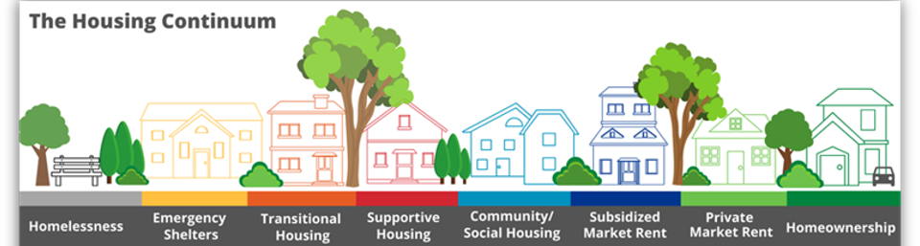

Slide 3

Continuum of Care (CoC) 101
Georgia Department of Community Affairs
3

Slide 4
U.S. Department of Housing and Urban Development (HUD) Continuum of Care Overvieww
A Continuum of Care (CoC) is established by representatives of relevant organizations within a geographic area to carry out the responsibilities set forth in the CoC Program interim rule.
Georgia Balance of State CoC has 152 counties.
Notes:
The CoC is the convening and planning body for a set geographic area responsible for carrying out and implementing the requirements of the Interim Rule

Slide 5
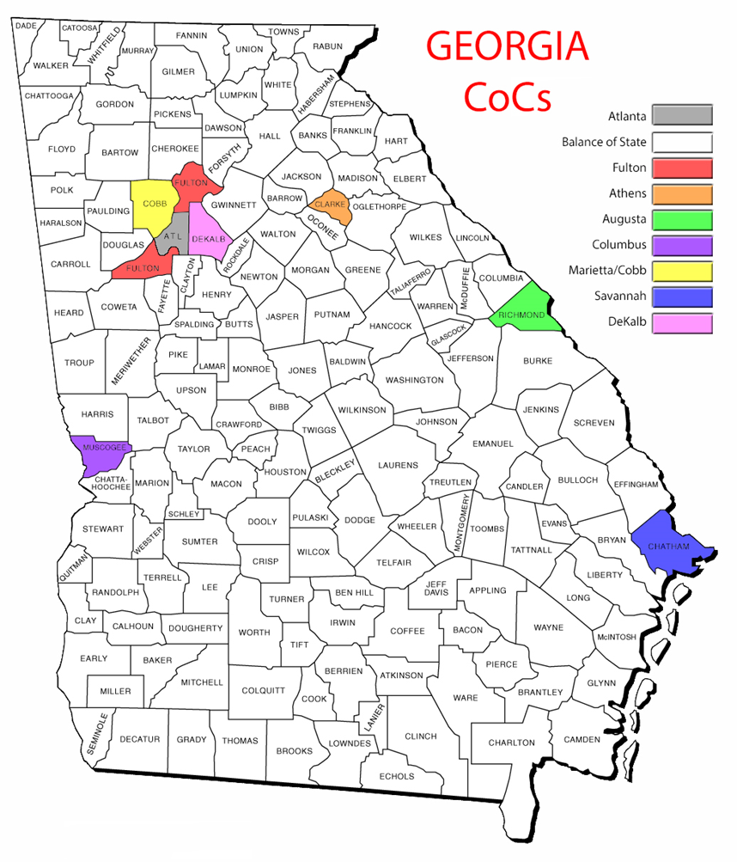
Balance of State
Augusta Richmond
Athens
Clarke County
Columbus
Muscogee
City of Atlanta
Savannah
Cobb
DeKalb
Fulton (Excluding Atlanta)
Local Planning for Local Needs
Georgia’s Nine Continuums of Care

Slide 6
HUD Continuum of Care Program
The CoC Program is designed to assist individuals and families experiencing homelessness and to provide the services needed to help them move into permanent housing with the goal of long-term stability.
Board Governance
To have an independent Board of Directors, maintain a written Governance Charter, set and meet goals to prevent and end homelessness, and implement all other requirements of the HEARTH Act.
Applying for Grants
To prepare an application for McKinney-Vento Homeless Assistance Act (McKinney-Vento) competitive grants
To develop a long-term strategic plan and manage a year-round planning effort
Strategic Planning
Strategic Planning
The strategic plan should address:
the needs of homeless individuals and households;
the availability and accessibility of existing housing and services; and
the opportunities for linkages with mainstream housing and services resources

Slide 7
CoC Funding
FY 2023 CoC Awards Georgia $58,200,367
Balance of State (DCA)(152 Counties): $24,124,030
Atlanta: $13,236,404
Fulton: $2,814,593
Athens/Clarke: $993,659
Augusta: $699,292
Columbus: $1,968,896
Marietta/Cobb: $2,649,972
Savannah: $4,104,782
DeKalb: $7,608,739

Slide 8
Balance of State Funds
Annual CoC Competition
$24,124,030
Youth Homelessness Demonstration Program
$11,699,223
$2,349,194 matching funds
Rural Homeless Assistance
$4,868,915

Slide 9
Continuum of Care Program
CoC Program Common Uses of Funds:
DCA’s Permanent Supportive Housing
Permanent Supportive Housing
Rapid Rehousing
Supportive Services (Few CoCs) (Not BoS)

Slide 10
Permanent Supportive Housing
Permanent Supportive Housing (PSH) projects provide community‐based housing and supportive services, without a predetermined length of stay, to assist homeless persons with a disability to live independently. The project will provide safe, affordable housing that meets participants’ needs in accordance with HUD guidelines for permanent supportive housing projects.
In order to be served in a CoC‐funded PSH project (individuals or family households) participants must meet the following project eligibility requirements:
Participants must meet the applicable HUD definition of homelessness (category 1 or category 4)
PSH can only provide assistance to individuals with disabilities and families in which at least one adult or child has a disability.
Non-dedicated and dedicated beds. Prioritize chronically homeless

Slide 11
Rapid Re-Housing as a Housing Solution
Allows for fast placement in permanent housing.
Provides tenant based rental assistance maximizing client choice.
Lease must be in the client's name. Length of assistance is equitable.
Helping clients get on their feet in their own permanent housing is empowering.
Notes:
Rents paid for a limited duration. Up to 12 months usually. Goal is to increase income etc so that person can eventually be self sufficient. Person must be homeless under HUD.

Slide 12

Emergency Solutions Grants Program Overview

Slide 13

Emergency Solutions Grants Program (ESG)
Federal U.S. Department of Housing & Urban Development (HUD) formula grant program
Provides funding for individuals or households identified as homeless or “at risk of homelessness”
Grants are awarded in the following program components:
Street Outreach (SO)
Emergency Shelter (ES)
Rapid Re-housing (RRH)
Homeless Prevention (HP)
Homeless Management Information System (HMIS)
Additionally, the State Housing Trust Fund provides state funding for the following program components:
Hotel/Motel Voucher
Supportive Services

Slide 14
ESG Program Components
Street Outreach
Outreach Services to Engage and Serve Unsheltered Homeless Individuals or Households
Emergency Shelter
Funds Shelter Activities (Services and Operations)
Rapid Re-Housing
Places Homeless Persons into Permanent Housing with Services
Homeless Prevention
Rental Assistance for Eviction Prevention
Hotel/Motel Voucher
Temporary Lodging
Supportive Services
Case Management, Childcare, Transportation

Slide 15

Hotel/Motel Vouchers
Exclusively for homeless clients who need immediate shelter and NO APPROPRIATE shelter is available.
Will have to provide evidence/justification about shelter availability
Intended primarily for clients served by RRH and outreach projects.

Slide 16
Hotel/Motel Vouchers (cont.)
Can be used for challenges such as:
Needing to place someone quickly
Households with special needs
High barrier clients that will be turned away from current shelters
No shelter available for participants who have been through coordinated assessment
Short stays until preferred housing option becomes available; no longer than 45 days.
Case management service dollars available.

Slide 17
ESG Entitlements
The DCA Entitlement covers all areas of the State not covered by one of the other ESG Entitlements (151 counties)
Each Entitlement conducts their own competition. DCA funds state-wide, with most monies being reserved for its Entitlement area (75% currently)
DCA
Augusta Richmond
Clayton
Macon-Bibb
City of Atlanta
Savannah-Chatham
Cobb
DeKalb
Gwinnett

Slide 18
2023 ESG Allocations by Entitlement Area
DCA: $4,770,022
Atlanta: $615,584
Augusta: $151,645
Clayton: $208,774
Cobb: $277,436
DeKalb: $394,840
Gwinnett: $460,622
Macon: $159,452
Savannah: $194,935

Slide 19
Eligible Applicants
Local or regional entities including:
Nonprofits (secular and faith-based)
Local governments
Local government entities (community service boards, etc.)
Community action agencies
Nonprofit applicants for emergency shelter must receive approval of local government(s) where the project is located.
Nonprofit applicants, including religious organizations, must have 501(c)(3). Religious activities can be offered but cannot be required.

Slide 20
ESG Application Process
Annually, usually between mid to late February, the State of Georgia commences the competitive application process, with the competition typically beginning in early to mid April.
For this FFY 23 (SFY 24), we received 183 requests totaling $12.3 million across all seven projects.
Of the requests, $5.8 million was awarded to 110 projects.
Match: 100% In-Kind or Cash

Slide 21
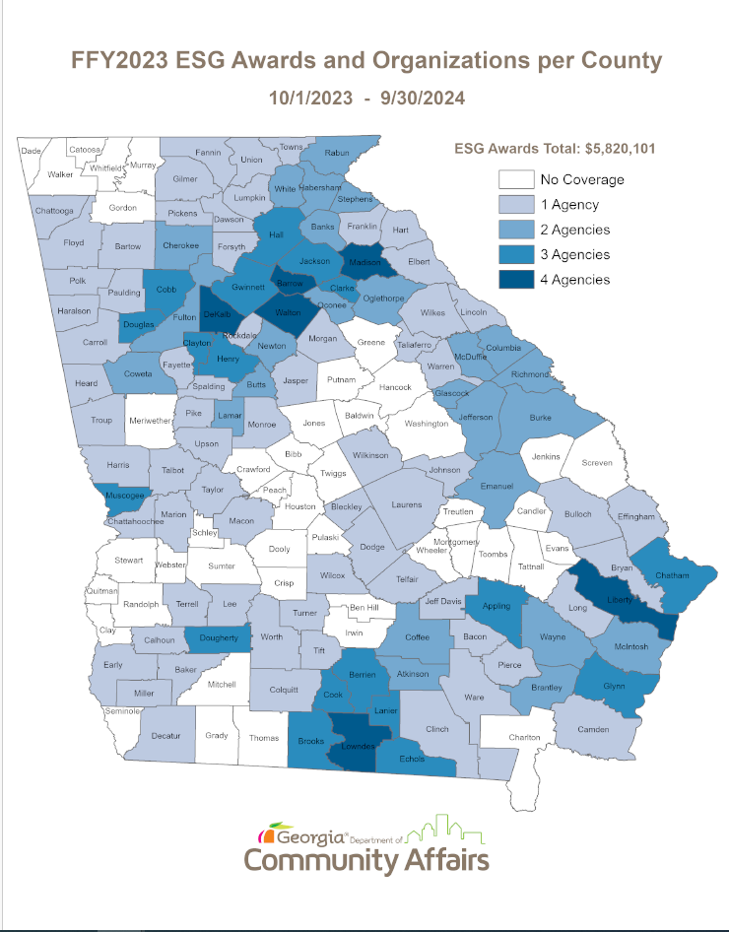

Slide 22
Minimum and Maximum Funding Awards by Project Type
Type of Funding | Minimum – Maximum Award Amounts
Emergency Shelter | No Minimum - $70,000
Supportive Services Only | No Minimum - $30,000
Homelessness Prevention | $30,00 – No Limit
Rapid Re-Housing | $30,000 – No Limit
Street Outreach | $30,000 - $50,000
Hotel/Motel Voucher | No Minimum - $20,000
HMIS | No Minimum - $40,000

Slide 23



Get Your Local Government To Apply!
HMIS – $30,000
Hotel/Motel – $12,500
Rapid Rehousing – $30,000
Supportive Services - $20,677
Rapid Rehousing- $51,000
Notes:
Here are two Georgia cities that apply for and use ESG funds. You could ask your local government to apply and use funds for homeless DV survivors or other populations you serve.

Slide 24
2024 ESG Program Applications
Applications opened on Monday,
April 8, 2024
Conducting four Q & A webinars for applicants
Applications close on Friday, May 3, 2024, at 2:00 pm
Scoring of submitted applications will start in May
Awards will be posted on the ESG Page on the DCA website
Awarded contracts are for one year for FFY 24 (SFY 25)

Slide 25

Questions

Slide 26


Slide 27
Contact Information
Joshua Gray
Balance of State CoC Program Manager
Josh.Gray@dca.ga.gov
404.327.6811
LaDrina M. Jones
ESG Program Manager
LaDrina.Jones@dca.ga.gov

