Slide 1


Adel GICH Team Freshman Report-Back

Slide 2
Adel GICH Team Mission Statement: To develop and implement creative community-based strategies to enhance economic opportunity, build strong neighborhoods, and ensure a framework for quality growth and development. Adel GICH Team Vision Statement: To foster a vibrant, prosperous and growing City through community development.

Slide 3
Adel GICH Team Members
Councilperson Vivian Sharpe
Councilperson Jody Green
Mrs. Altheia Paige
Heather Greene- Director Adel-Cook County Chamber of Commerce
Commissioner Audie Rowe- Cook County Commissioner, District 4
Brandie Dame- Main Street Director
Dr. Joi Williams, Cook Board of Education
Colonel Ron & Gloria Mitchell
Katrina Laurel- UGA Extension/4-H Youth Cook County Extension Agent
Mike Fox- Adel City Marshal
Randy Lane- Community Development Director/GICH Team Leader

Slide 4
2019 Housing Study Information
1,588 of the 2,353 housing units in Adel were built before 1979 (67.5%)
13 housing units in Adel use wood or no fuel for heating
41.5% of houses with mortgages have a monthly owner cost of over 30% of their income
17% of houses in Adel do not have adequate kitchen areas
55 year old and older group will dramatically increase in the future
Median Household income in Adel is $29,601

Slide 5
City Marshal Position
The City and the GICH team wanted to be pro-active instead of reactive with code enforcement complaints.
The City Marshal was created and approved by Council about a year ago and a Marshal was hired and began working on housing issues.
A Code Enforcement Complaint Form was created and placed on our City web site
The City Marshal has worked pro-actively with property owners to remove dilapidated structures within the three target areas.

Slide 6
Dilapidated Structures
The City Marshal worked with owners to tear down 8 dilapidated structures within our three target areas
Plan on using the Urban Redevelopment Plan
and the International Property Maintenance Code to
continue tearing down dilapidated homes in the city

Slide 7
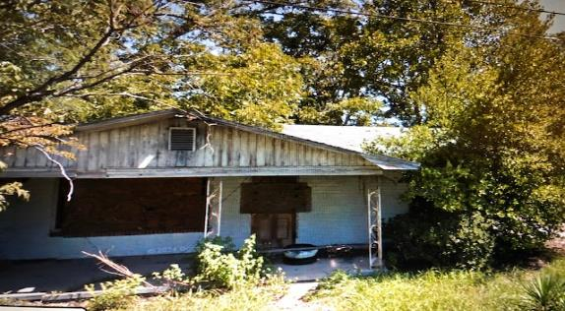
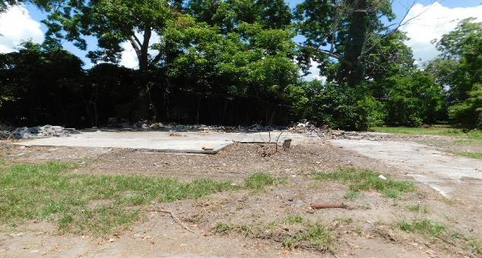
Dilapidated Home on Mill Street torn down

Slide 8
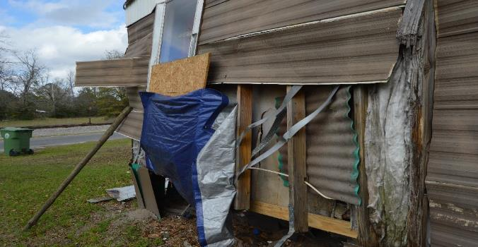
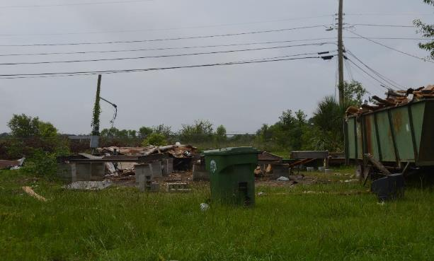
Dilapidated Mobile Home on W. 9th Street torn down

Slide 9
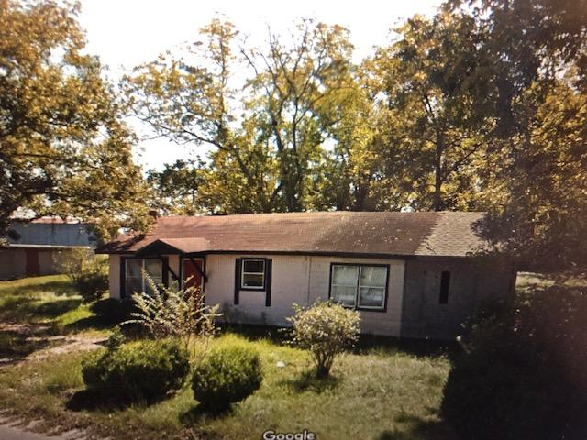
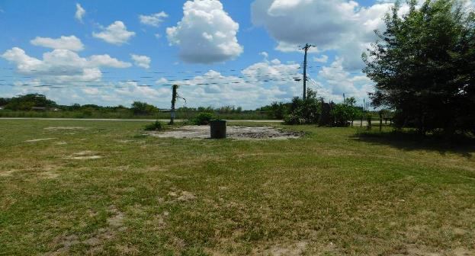
Dilapidated Home on W. 9th Street torn down

Slide 10
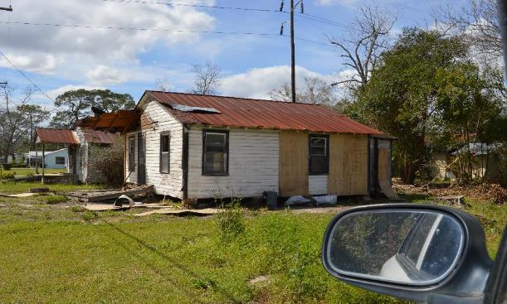
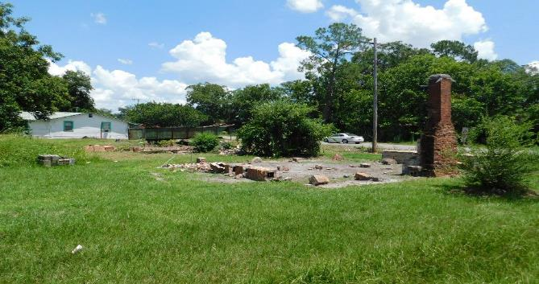
2 Dilapidated Homes on 1st Street torn down

Slide 11
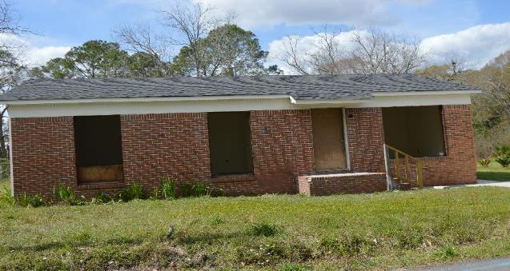
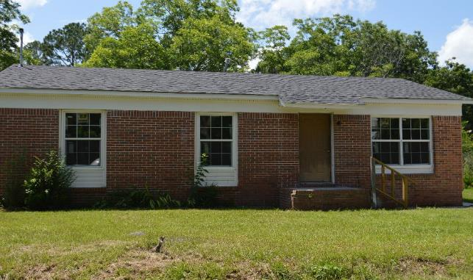
Dilapidated Home on Debbie Drive Refurbished

Slide 12
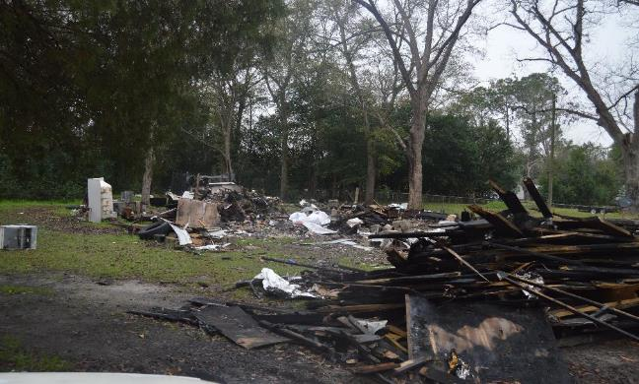
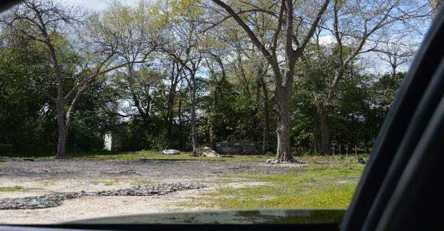
2 Dilapidated/Burnt Mobile Homes on W. 9th Street

Slide 13
Target Area #1/CHIP Area
Total Homes in Area- 140 (12 Block Area)
Single Family/MH Dilapidated- 41 (29%)
Single Family/MH Deteriorated- 49 (35%)
Boundaries:
North- W. Meeting Street
South- W. Third Street
East- N. Popular Street
West- N. Elm Street

Slide 14
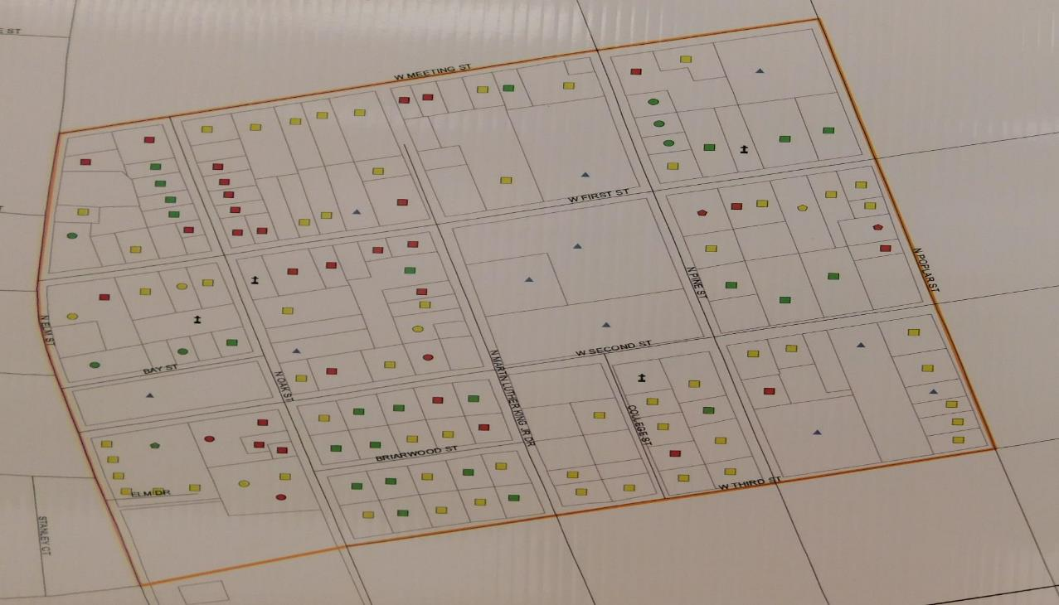

Slide 15
Target Area #2
Total Homes in Area- 120 (15 Block Area)
Single Family/MH Dilapidated- 35 (29%)
Single Family/MH Deteriorated- 43 (36%)
Boundaries:
North- W. Fifth Street
South- W. Eighth Street
East- S. Elm Street
West- Railroad Tracks

Slide 16
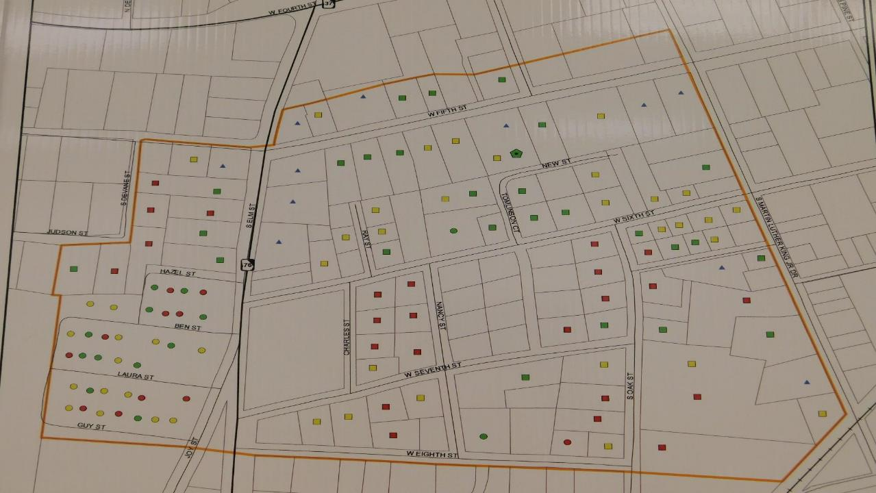

Slide 17
Target Area #3
Total Homes in Area- 130 (12 Block Area)
Single Family/MH Dilapidated- 45 (35%)
Single Family/MH Deteriorated- 46 (35%)
Boundaries:
North- W. Fifth Street
South- Railroad tracks
East- Railroad tracks
West- Martin Luther King Jr. Drive

Slide 18
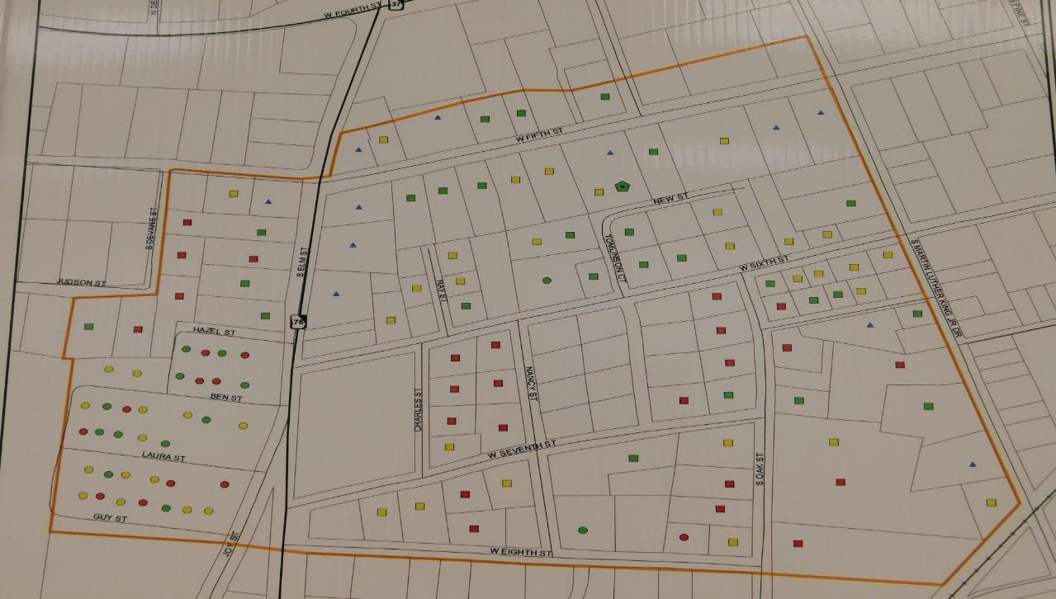

Slide 19
Total of all three Target Areas
The 3 Target Areas consists of 39 Square Blocks
Total Housing Units- 390
Single family/MH Good Condition- 131 (34%)
Single Family/MH Dilapidated- 121 (31%)
Single Family/MH Deteriorated- 138 (35%)
Total Housing stock in Adel- 2,353

Slide 20
Challenges for our GICH Team
1. Heir Property- Unable to submit a CDBG-Housing in 2020 due to Heir Property problems
2. 67.5% of homes in Adel were built before 1979 (Lead Paint)
3. Code Enforcement was never considered a priority by city or the citizens
Code enforcement was complaint driven prior to full-time City Marshal position
Now City Marshal patrols the city being pro-active and people are noticing
4. Covid-19/Close Down

Slide 21
QUESTIONS? Adel GICH Team- 229-237-8983

Slide 22


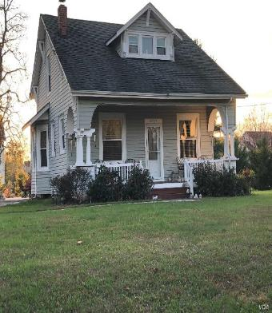

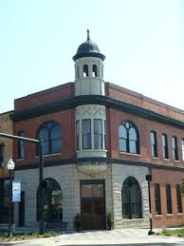

Hartwell GICH Team
2020 Housing in COVID time-Patience and progress

Slide 23
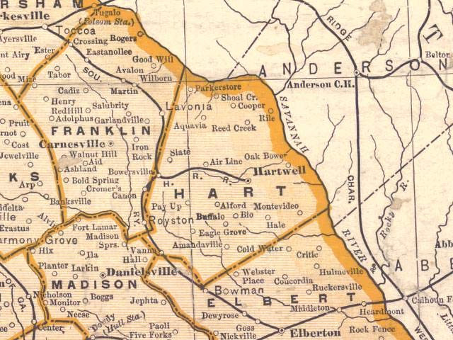
Timeline - June 2017 – Housing task force formed through Archway - June 2018 – City postpones application to GICH - June 2019 – City approves application to GICH, fundraising begins, team recruitment begins - October 2019 – Accepted into GICH - January 2020 – First team meeting - February 2020 – First Retreat - March 2020 – COVID…..

Slide 24

Large image
We reel in a developer!

Slide 25

From the 1st retreat: The Vantage Group from Alabama comes to visit, selects a site, executes a contract, we assist with application to DCA…..
And now we wait for DCA’s announcement in December……

Slide 26
From the first retreat….. 1. We develop our plan of action –
Organizational Development | Develop mission, vision, and brand/tagline Establish subcommittees Expand GICH Team Increase awareness of GICH Team
Comprehensive Code Enforcement | Establish a Land Bank Conduct city-wide housing assessment Update local codes
Improve Existing Housing Stock | Revitalize Leard St./Richardson St. Revitalize Rome St.
Access to Housing | Attract developers, contractors, subcontractors

Slide 27
Then COVID-19 happens………
So we sign up for Zoom and start trying to wade through the unknown.
1. Mission is developed in small group –
The Hartwell GICH team will plan and advocate for life-long housing options
2. Our plan to inventory the housing stock is on hold.
Currently working with UGA to develop training program and implementation with other community groups.
3. Additions to committee – County water authority member is added along with another local builder, Chamber incoming Chairman
4. City updates several housing codes, more review is underway

Slide 28
Continued….
5. Rome/Richardson/Leard Street program – Community planning underway
Beginning to plan small group meetings instead of the large one envisioned.
Through census work, potential local leaders are identified and a sub-committee is formed
for this project.

Slide 29
A lot of work is ahead, but we continue to face the challenges…….. Questions?

Slide 30


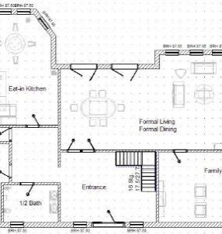
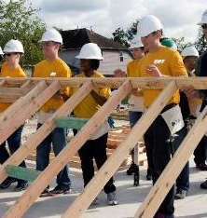
Thank You
The Hartwell GICH Team
porteryork@yahoo.com

Slide 31

Ocilla GICH Report Back Fall Retreat 2020
Home of the 2019 Class A HS Football Champions

Slide 32
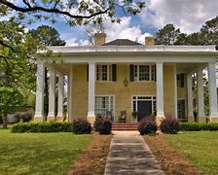
Overview
Who we are
Where we were
Where we are
What’s Ahead

Slide 33
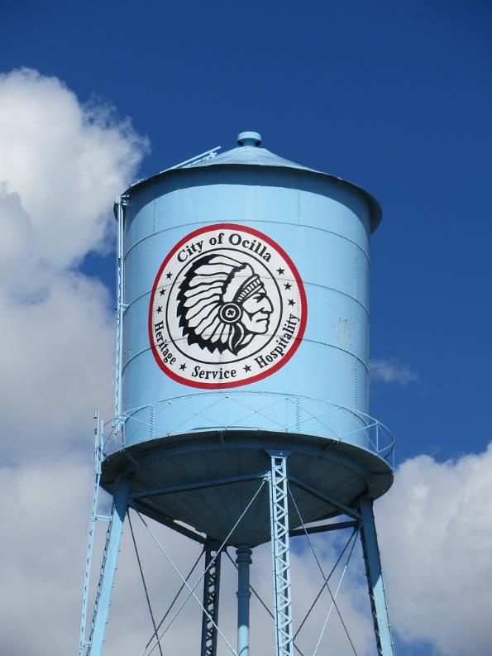
Who We Are
Population of 3,595
Median income of $21,850
Total housing units 1205
City limits roughly 2.5 square miles

Slide 34
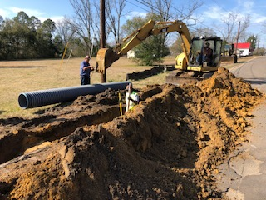
Where We Were
CDBG Recipient
2017
Replace water & sewer lines
New water meters
2018
Sewer lines
Storm water drainage

Slide 35
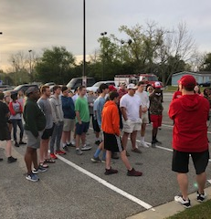
Where We Were
Established Community Day
Litter control and beautification
Part-time code enforcement

Slide 36
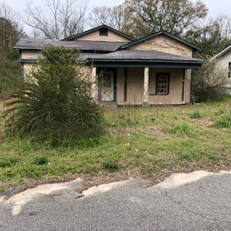
Where We Are
CHIP
Land Bank
Historic Preservation
Community Day
GICH

Slide 37
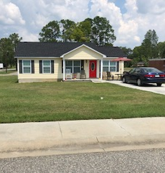
What The Future Holds
GICH
Comprehensive Plan
Housing Assessment
Land Bank
Historic Preservation
Stronger code enforcement
Diversity of housing

Slide 38
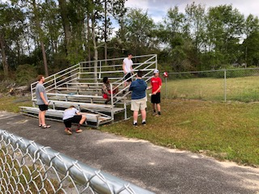
What The Future Holds
Other Activities
Community Day an annual event
Dave Prater birthday celebration and festival
Convert old drive through into an event center downtown

Slide 39
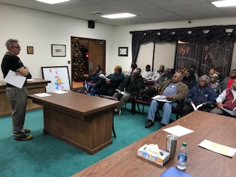
What The Future Holds
Comprehensive Plan
Consolidating efforts under the umbrella of GICH
Completing a housing assessment-Fall 2020
Land Bank more active

Slide 40
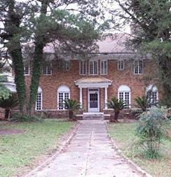
What The Future Holds
Historic Preservation
Preserve our heritage
Housing assessment
Completed in Fall 2020

Slide 41
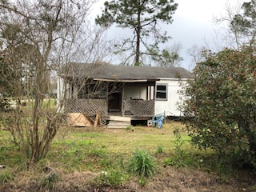
What The Future Holds
Stronger code enforcement
Diversity of housing
More multifamily housing

Slide 42
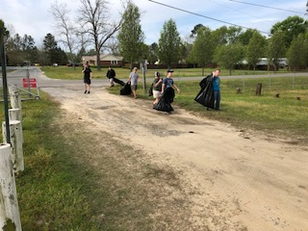
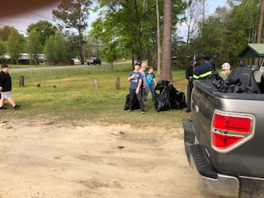
What The Future Holds

Slide 43


What The Future Holds

Slide 44
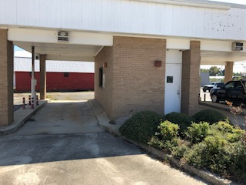
What The Future Holds
Convert drive through
Downtown event center

Slide 45
Conclusion
We’ve come a long way
With GICH as our catalyst we’ll meet our goals

Slide 46
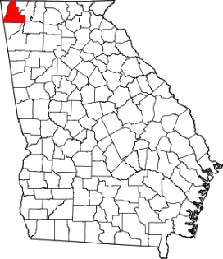
C I T Y O F
GICH
Georgia Initiative For Community Housing
L A F A Y E T T E
+
C I T Y O F
R O S S V I L L E
| Fall Retreat 2020 |
Freshman Report
A C O L L A B O R A T I V E A P P R O A C H T O H O U S I N G R E V I T A L I Z A T I O N

Slide 47
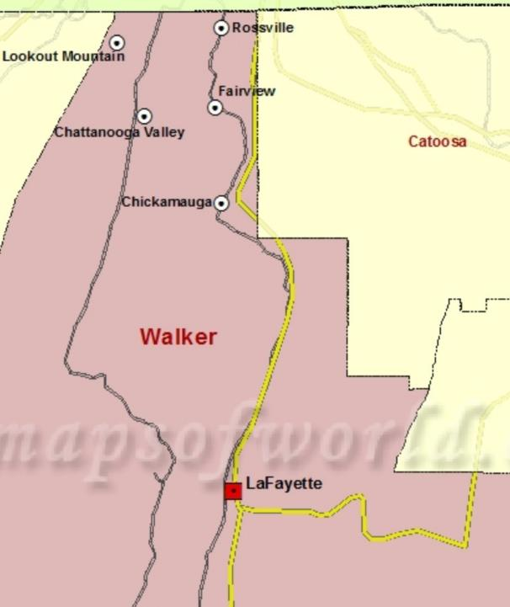

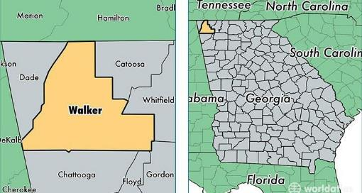

OUR COLLABORATIVE COMMUNITIES
The City of Rossville and City of LaFayette bookend Walker County to the North and the South.
Rossville is 1.8 sq mi w/ a population density of 1,930/sq mi
LaFayette is 8.1 sq mi w/ a population density of of 803/sq mi
The two communities are connected by 22.7 miles of GA Hwy. 27.
The two communities share an economic and community development consultant.

Slide 48
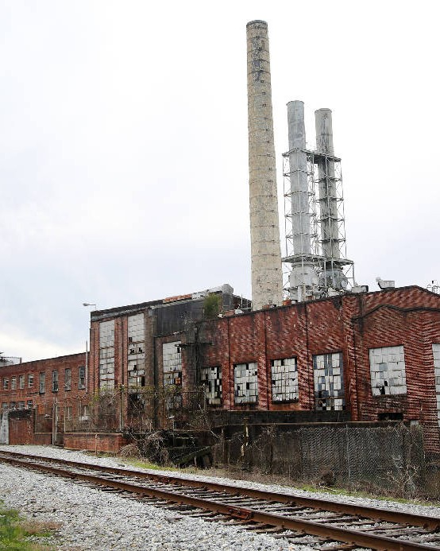
CITY OF ROSSVILLE
Challenges:
City of pervasive post industrial blight with over 2.5 million vacant square feet in its downtown
Experienced disinvestment for over half a Century
50 acres of vacant industrial brownfield
30+ % population living at or below the poverty line (city-wide)
Current unemployment rate is Almost 4X greater than the National Unemployment rate avg
Small City staff with capacity issues
Aging infrastructure
Border City: High Transient rates in both housing and local public schools
Absentee Landlords/ Slumlords
No public housing support or non-profit housing programs
Owns None of its utilities, so severely limited revenue streams
Large number of vacant and dilapidated housing units
Opportunities:
Major Revitalization Initiative underway Designated a Qualified Federal Opportunity Zone Designated a State of GA RURAL ZONE
Local Urban Design Workshop with Ryan Gravel: Designer of the Atlanta Beltline Partnership with the Office of Jonathan Tate: Global urban designer/architect Partnership with Georgia Tech's Enterprise Innovation Institute: EDRP
Close Proximity to the growth of Chattanooga (10 minute drive into center of city)
Ripe for [sub] Urban residential density/ walkable downtown
"Industrious Revolution": makers and artists are beginning to open studios and move into the City.
Fastest broadband in the Western Hemisphere built on an electric smart-grid Affordable

Slide 49
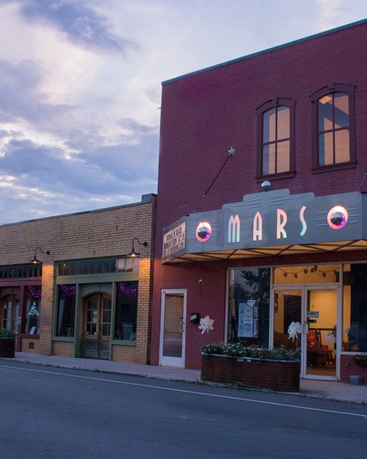
CITY OF LAFAYETTE
Challenges:
Proximity to major Interstate access
Blight creep and dilapidated post industrial properties
Major brownfield site in close proximity of residential/downtown/underdeveloped
45+ % population living at or below the poverty line in certain census block groups
Aging infrastructure/ Aging buildings falling down
Absentee Landlords/ Slumlords
Commercial Constriction and increasing vacancy
Increase in homeless population
By-pass cannibalizing of downtown retail
Lack of Multi-modal connectivity and lacks nodes of connectivity from the East Side to the West side of the city
Lack of Broadband
Opportunities:
County Seat
Major Downtown Development Initiative underway
Engaged, Dedicated, and Progressive City Leadership- High Capacity Closest proximity to the largest Industry cluster/ job creators in the County Electric Cities of Georgia partner Community
Proximity to Walker County's most abundant natural recreation assets Walkable downtown
Community desire for downtown residential development Dynamic independent Housing Authority
Owns all of its Utilities
Annual massive Community event: HONEY BEE FESTIVAL that brings 50,000+
people into the City.
Growing Arts & Culture corridor
Engaged citizenry

Slide 50
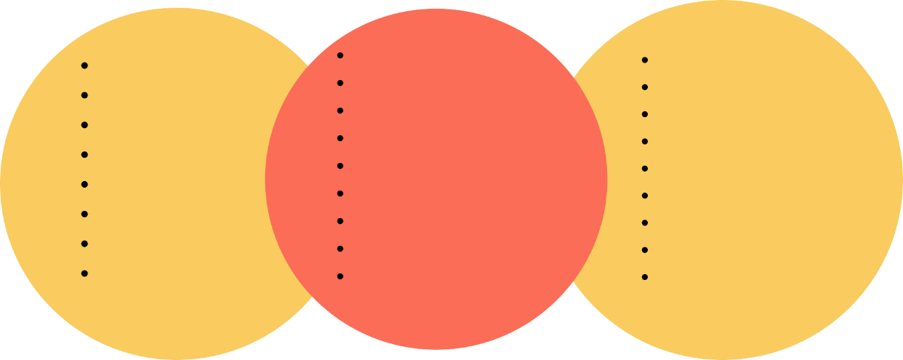
THE COMMUNITY HOUSING
TEAM
Chris Davis Phil Jeffers Jeremy Staton Matt Gann Daniel Silvers Penny Mahon Ruth Bass Steve Corbett
Lacey Wilson Wade Hutcheson
Laura-Beth Newsome Breck Parker
Annaka Woodruff Michael Hicks Cory Lowe
Ben Bradford Elijah Parker
Jeri Heiskell Joanna Jackson Paulina Martinez Solomon Killebrew Tom May
Delmos Stone Chris Spears Brandon Mosgrove Elizabeth Wells

Slide 51
THE COMMUNITY HOUSING TEAM
The Housing Team is made up of :
Elected Officials Educators Builders
Real Estate Professionals Housing Professionals Lenders
Entrepreneurs Developers
Community Developers Economic Developers Faith Based Leaders Extension Service
Family Connections Coordinator Attorneys
Education Administrators Social Workers
Chamber President Author

Slide 52
The mission of the LaFayette and Rossville neighborhood co- redevelopment team, in partnership with our communities, is to direct our focus on revitalizing and developing diversified-quality housing, and engaged neighborhoods, for all citizens in both communities
M I S S O N S T A T E M E N T .
T A G L I N E .
From Homes, to Neighborhoods, to Communities... building stronger housing in Walker County with two cities, one mission.

Slide 53
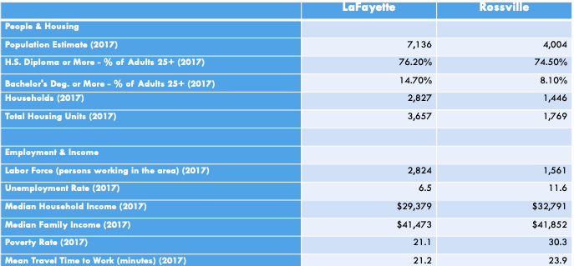
DEMOGRAPHIC DATA

Slide 54
DEMOGRAPHIC DATA

Slide 55
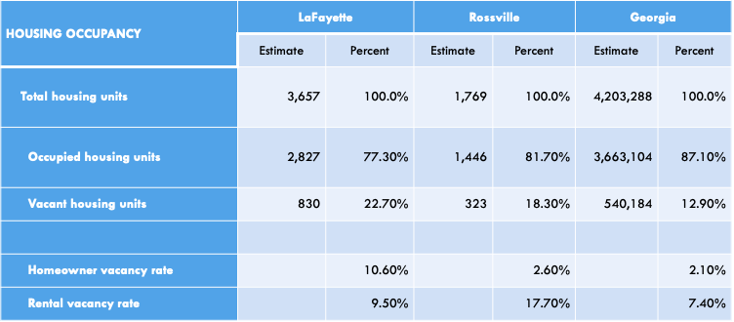
HOUSING OCCUPANCY STATUS

Slide 56
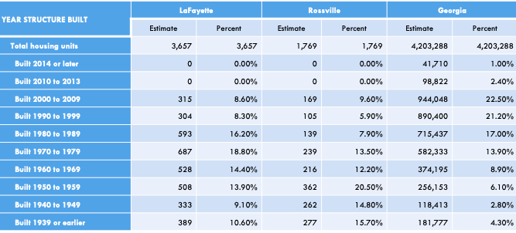
AGE OF HOUSING

Slide 57
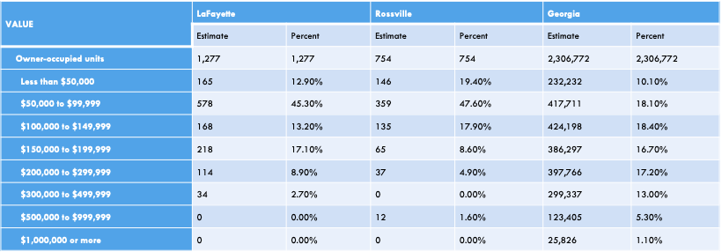
OWNER OCCUPIED HOME VALUE

Slide 58
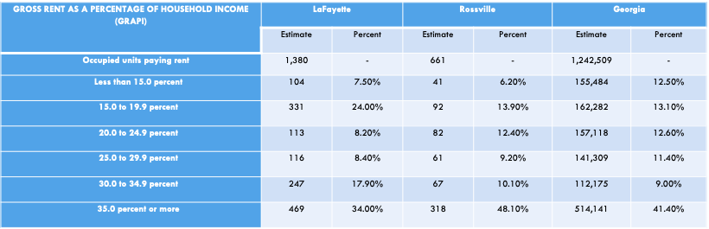
GROSS RENT AS A PERCENTAGE OF HOUSEHOLD INCOME (GRAPI)

Slide 59
Rossville has a population of 4,100
LaFayette has a population of 7,100
Unemployment Rate:
Rossville 11.6%
LaFayette 6.5%
Poverty Rate:
Rossville 30+ %
LaFayette 21% with census blocks at 45%
Total Housing Units:
Rossville 1,769
LaFayette 3,657
Rossville has 17% Vacancy Rate of it’s available Rental Units
Lafayette has 5X the GA State Average of Homeowner Vacancy Rate at 10.6%
A staggering 63% of Rossville’s housing stock was built over 50 years ago
and 30 % of our Housing Stock was built over 70 years ago.
LaFayette has 48% of its housing stock built over 50 years ago.
Both communities have almost 50% of their homes valued in the $50,000 - $99,000 Range
Rossville has over 48% of it’s population spending 35% or
more of its household income on Rent.
DATA SUMMARY

Slide 60
01
ROSSVILLE UPDATES
02
LAFAYETTE UPDATES
03
NEXT STEPS | GICH PRIORITIES

Slide 61
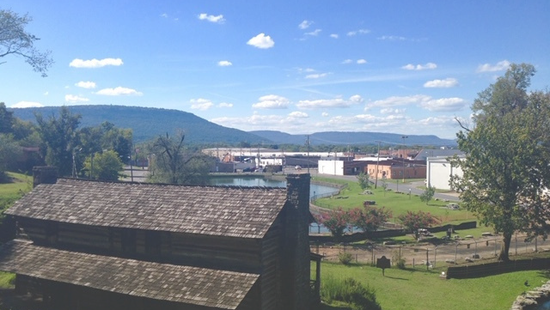
ROSSVILLE
01

Slide 62
ROSSVILLE UPDATES.
Zoning Text and Map Amendments- clarify live/work , align commercial and residential, allow more density in downtown
Yard of the Month Program Residential Abandoned Lot clearing SPLOST Passed
Multi-Family OZ investment Prospects
Full year completed with first Codes Officer ever hired

Slide 63
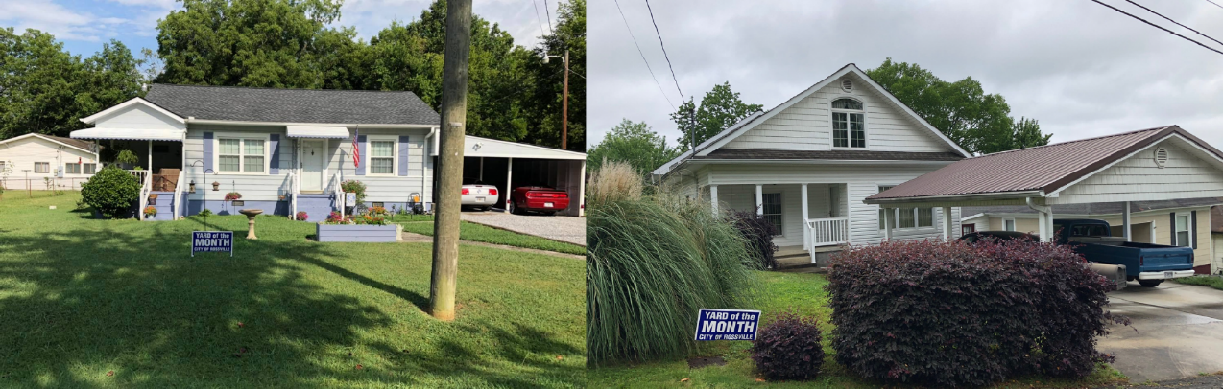
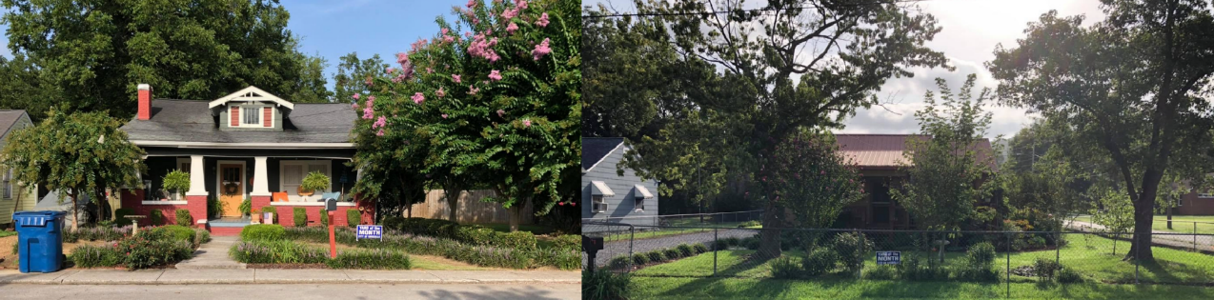

Slide 64
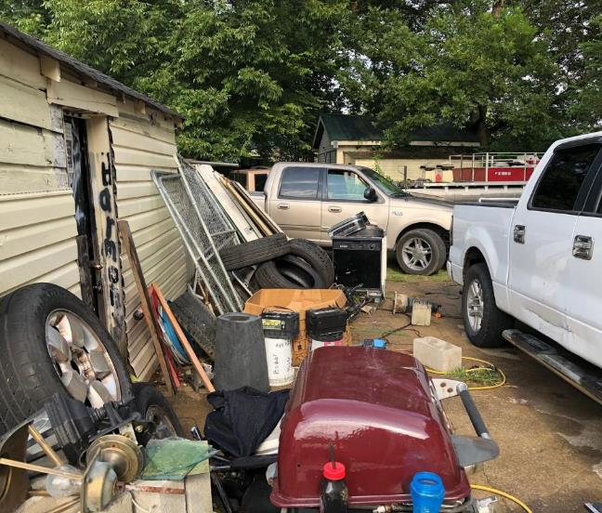
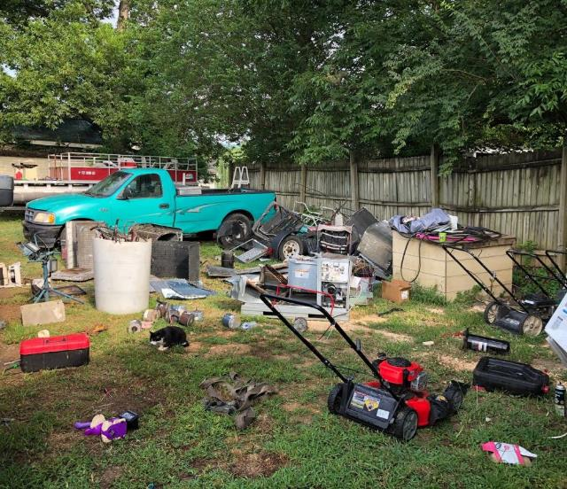
Before.

Slide 65
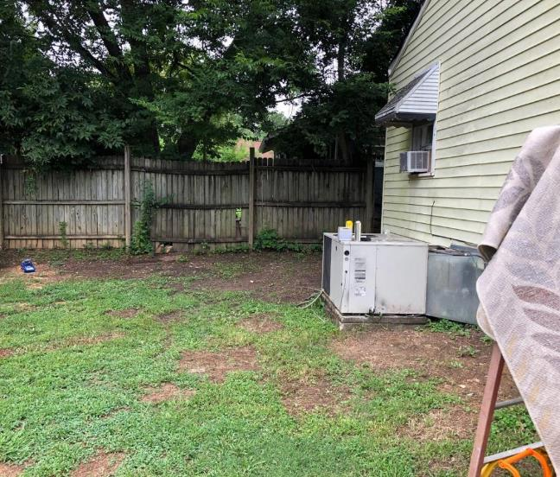

After.

Slide 66

Before.

Slide 67

After.

Slide 68

Before.

Slide 69

After.

Slide 70


LAFAYETTE
02

Slide 71
LAFAYETTE UPDATES.
10.8 mil…. 61 units, scattered site development Workforce Housing (Opened in June; ( 1 Bedroom $480-$560; 2 Bedroom/2BA $570 -$665; 3 Bedroom/2BA $646-$757
50 new market rate rental units finished SPLOST passed
Aggressive New Zoning that was recommended 3 years ago; GICH inspired us to revisit it creates density Took West LaFayette Transformation Plan and Hired a Planner.
New Zoning Allows for more density and more Walkability Allows for mixed used zoning (light commercial in residential)
Planner helped educate through virtual public hearings, zoning/planning commission meetings EDU sessions with mayor + council + Planner
Since we implemented the Planner's recommendations we have attracted new developers with
104 single family.units possible on North end of Town and 115 cottage style single family units on the South End of Town. Price Range $125k - $215k
This new Zoning has also attracted another new developer with a large tract of land purchased within the last 30 days
We have engaged our City of LaFayette Junior Council in being a part of GICH and will begin pulling them into the meetings after the fall retreat

Slide 72



Slide 73



Slide 74





Slide 75
THINGS WE HOPE TO LEARN ABOUT IMPROVING THIS YEAR IN GICH...
Need for more Mixed- Income Neighborhoods and housing developments Need for more Workforce Housing
More Diversified Housing Stock city-wide
Lack of access to mortgage credit, or poor credit scores, severely limits options for decent, clean, and affordable rural housing. How can we bring financial housing education to our community to create more home ownership? How do we provoke higher owner occupied to rental ratios?
Currently limited to poor quality housing. Homes that are available are often in need of extensive repair or improvements to just meet basic health and safety levels- how do we improve this?
Severely aged housing stock
Update and Modernization of Zoning ordinance to allow for affordable infill and downtown residential. How can we bring funding in to help our most resource insecure residents get their homes up to code?
How do we begin to plan for our aging population?
How do we create better housing programs for our disabled citizens
What State-Level incentives or funding are available to revitalize our housing? How can housing be play a part in both communities' revitalization strategy?
Slumlord/ Landlord Issues

Slide 76
Neighborhood Cleanup Day
NEXT STEPS | PRIORITIES.
Housing Survey Training and Implementation CDBG Application Development
Recruit OZ Residential Developers (Rossville) Designing Marketing Collateral to promote GICH
Build larger Neighborhood Revitalization Campaigns in each Community
Build GICH Team Sub-Committees
03

Slide 77
" That house was a perfect house, whether you like food or sleep, or story-telling or singing, or just sitting and thinking best, or a pleasant mixture of them all. Merely to be there was cure for weariness, fear, and
sadness."
Thank You!
_ J . R . R . T O L K I E N

Slide 78

City of Statesboro
Freshman report

Slide 79
Subcommittee A: Housing Development
The Statesboro Housing Authority is being codified. New members have also been appointed to the Authority as well. Currently the Authority is recruiting for a new Executive Director.
The Ordinance is currently being re-written to suit both a new lot size, but also a new type of housing which is currently not well regulated.
The Community is still undergoing the creation of an Urban Redevelopment Plan through the Coastal Regional Commission.

Slide 80
Subcommittee B: Precariously Housed
Non-Profit Organizations are still being recruited to assist with the housing needs of the local homeless populace.

Slide 81
Subcommittee C: Market-Based Housing
The Land Bank Authority is being codified, with a date for appointments to be made in the future.
Habitat for Humanity has begun capacity increase conversations with our Coastal Regional Commission in the hopes of driving up the number of houses that can be built every year.
The City is in preparation for a 2021 CHIP Grant, and a 2021 CDBG Grant.

Slide 82
Subcommittee D: Community Engagement
COVID-19 restrictions have limited the outreach efforts, but a Facebook page is being developed to push forward initiative information.
A community neighborhood event is being planned for the focus neighborhood, but this will have to coincide with the end of the pandemic.

Slide 83
Subcommittee E: Blight/Code
The City has drafted documents for the implementation of the 2015 International Property Maintenance Code.
Two Code Officers have been working with citizens to spur both voluntary demolitions throughout the community, and processing demolitions of vacant dilapidated property through the courts.

