Slide 1
Advanced LAND BANKING OVERVIEW
GICH RETREAT - virtual
SEPTEMBER 8, 2020
presented by:
Christopher Norman
President – Georgia Association of Land Bank Authorities, Inc.
Executive Director – Fulton/Atlanta Land Bank Authority, Inc.

Slide 2

Land Bank Authorities (LBA) in Georgia
“Quick” Land Bank 101
Development Considerations
Programmatic Initiatives
Questions

Slide 3
“Quick” Land Bank 101

Slide 4
Blighted
Tax Delinquent
Distressed
Non-Tax Producing
Foreclosed
Abandoned

Slide 5
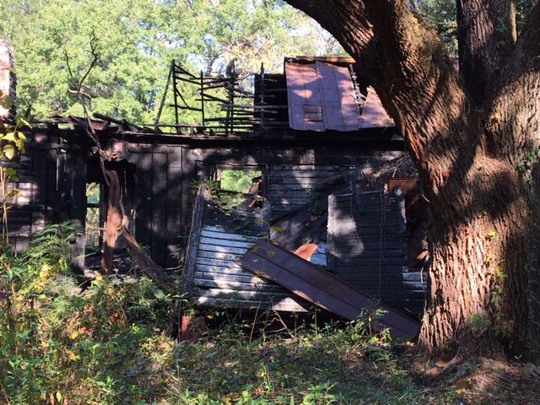

Slide 6
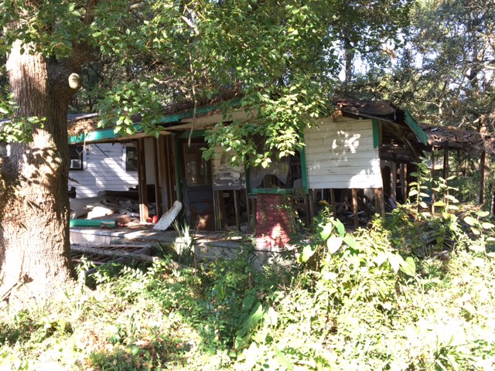

Slide 7
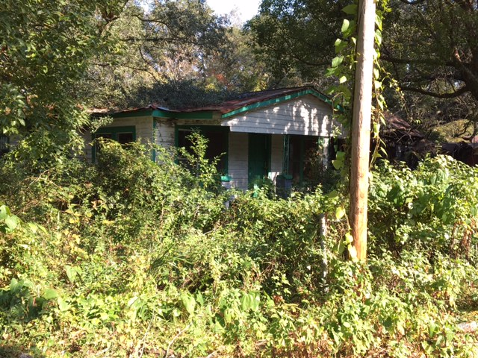

Slide 8
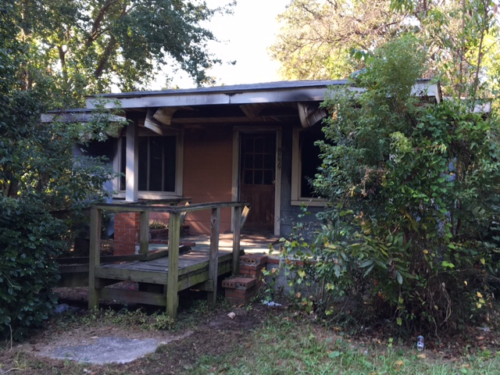

Slide 9
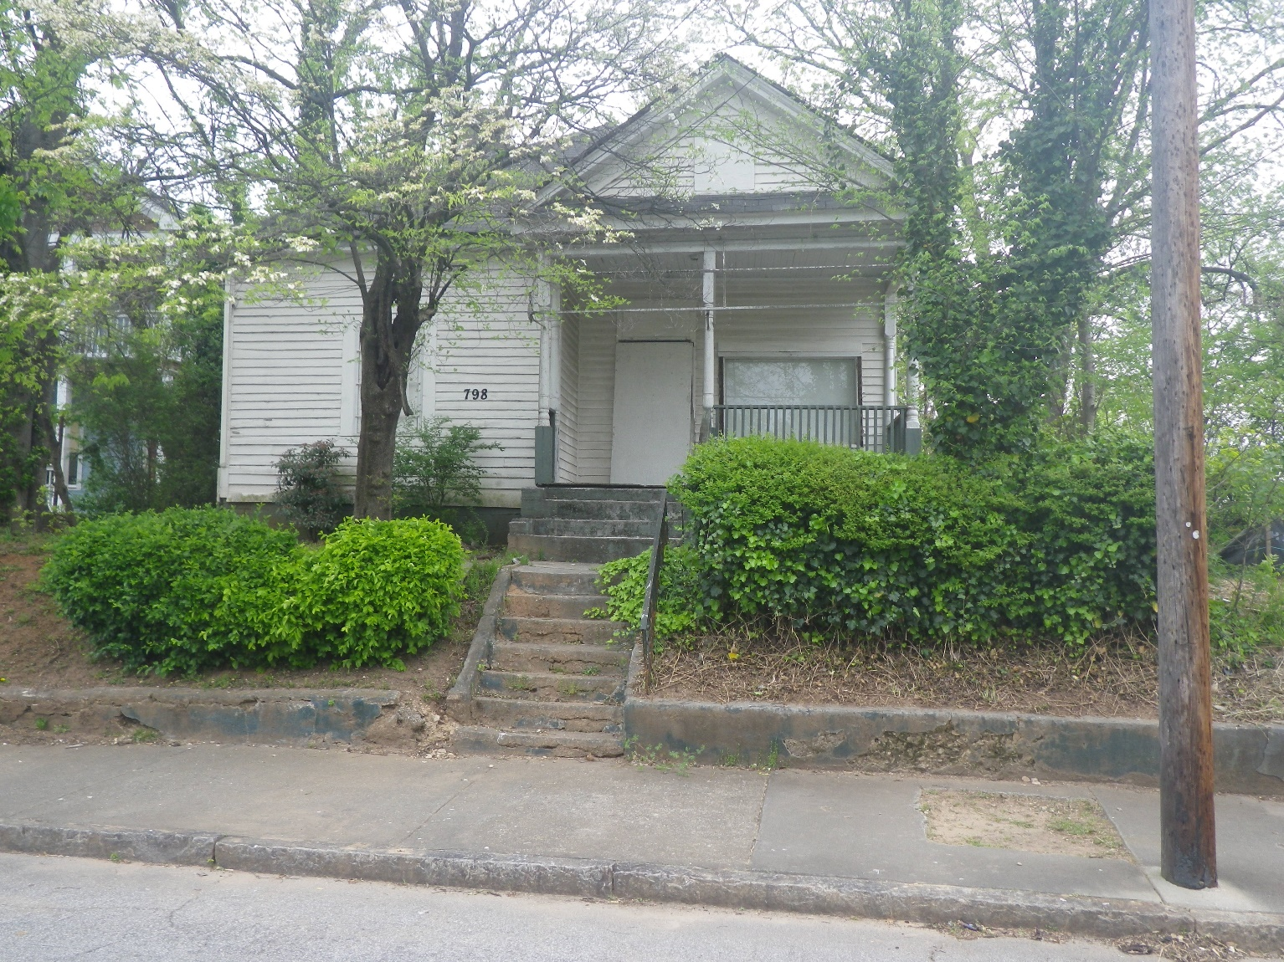

Slide 10
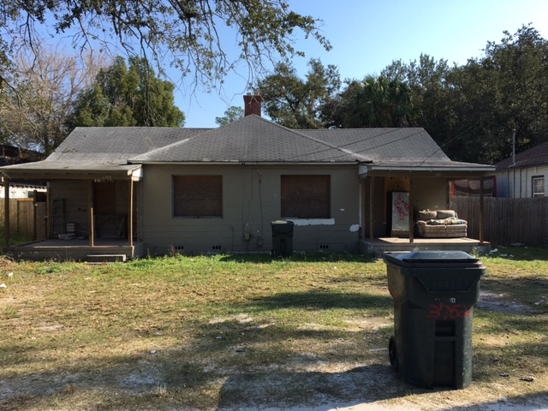

Slide 11
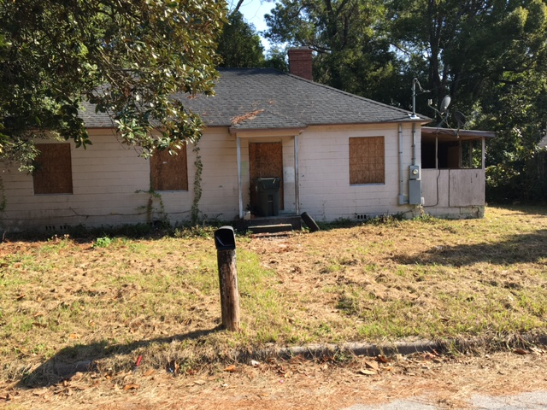

Slide 12
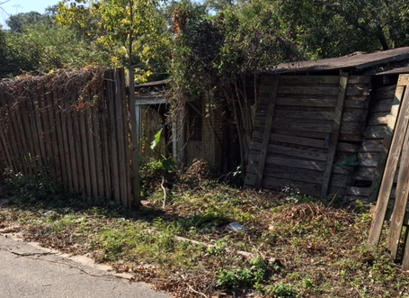

Slide 13
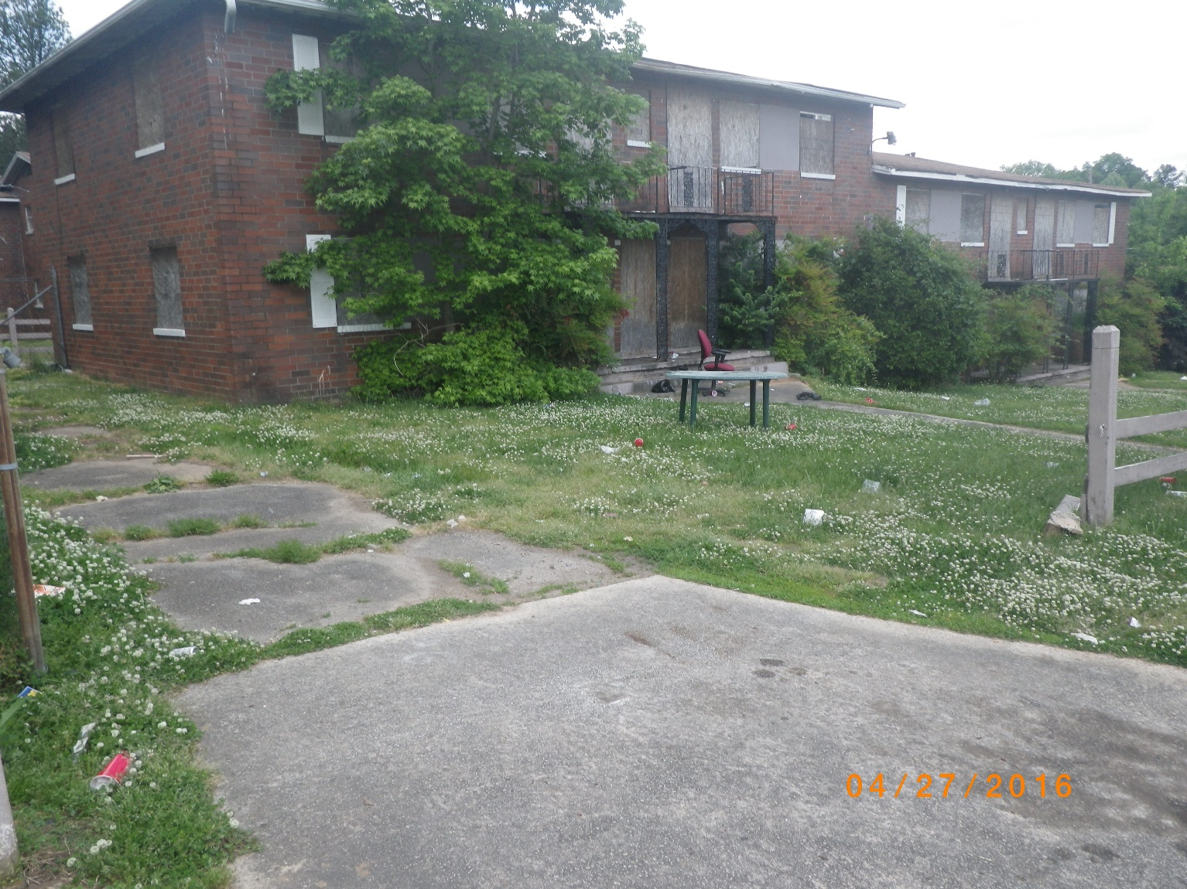

Slide 14
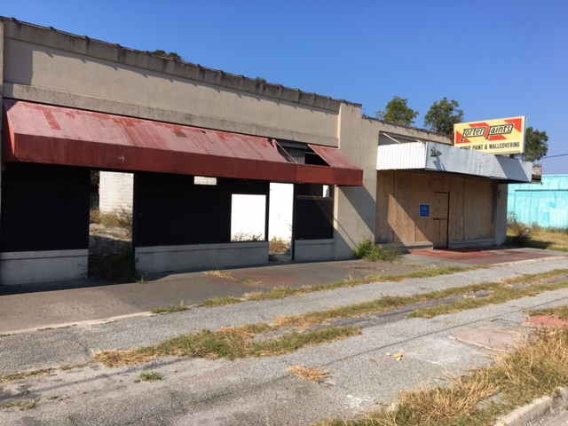

Slide 15
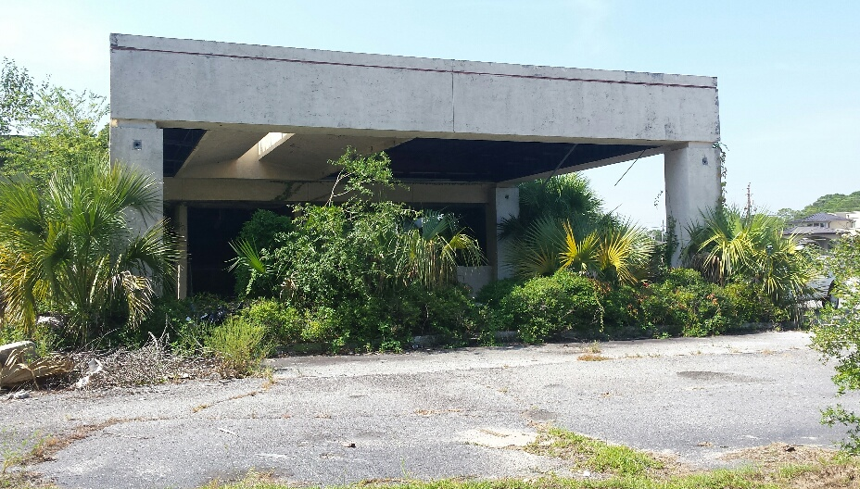

Slide 16
Desired Property Outcomes
Code Compliant Property
Tax Producing Property
Occupied Structures
Maintained Property and Structures
Shared Community Space
Vibrant and Safe Communities

Slide 17
What is a Land Bank
Clear Mission
  Land Banks are public or nonprofit entities created by local governments to acquire, manage, maintain and facilitate the redevelopment of underutilized, vacant blighted, tax delinquent properties.

Slide 18
What is a Land Bank
Tool for converting vacant, abandoned, or distressed property into productive use. This includes residential, commercial, industrial and greenspace purposes.
Core competency is acquisition and disposition of troubled, surplus, or vacant property.
Does NOT have eminent domain or taxing authority.
Steps in where market does not or cannot work due to administrative/legal barriers.

Slide 19
History of Land Banks
  St. Louis 1971
  Cleveland 1976
  Louisville 1989
  Atlanta 1991 (updated 2012)
  Genessee 2002
  Cuyahoga 2008
  New York 2011
  Philadelphia 2014

Slide 20
Some Existing Georgia Land Banks
Jurisdiction | County Population | City Population
Fulton County-Atlanta | 949,599 | 432,427
DeKalb County-Decatur-Lithonia | 699,893 | 19,555
Chatham County-Savannah | 271,544 | 139,491
Muscogee County-Columbus | 194,107 | 194,107
Richmond County-Augusta | 192,142 | 192,142
Bibb County-Macon | 156,433 | 91,856
Clarke County-Athens | 117,344 | 116,084
Lowndes County-Valdosta | 111,885 | 56,019
Whitfield County-Dalton | 103,184 | 33,313
Floyd County-Rome | 95,989 | 36,181
Spalding County-Griffin | 64,033 | 23,628
Thomas County–Thomasville | 44,702 | 18,407

Slide 21
Land Bank Focus
Broad Usage Categories
  Residential
  Commercial
  Industrial
  Green space
Surplus Public Property
Foreclosed Properties
Abandoned Properties
Tax delinquent Properties
Land Banks focus on properties that are underutilized.

Slide 22
Strat • e • gy
1 a (1) : the science of employing the political, economic, psychological, and military forces of a nation or group of nations to afford the maximum support to adopted policies in peace or war (2) : the science and art of military command exercised to meet the enemy in combat under advantageous conditions
B : a variety of or instance of the use of strategy
2 a : a careful plan or method : a clever stratagem
b : the art of devising or employing plans or stratagems toward
a goal
3 : an adaption or complex of adaptations (as of behavior, metabolism, or structure) that serves or appears to serve an important function in achieving evolutionary success <foraging strategies of insects>
Source: Merriam-Webster Dictionary

Slide 23
Code Enforcement and Land Banking

Slide 24
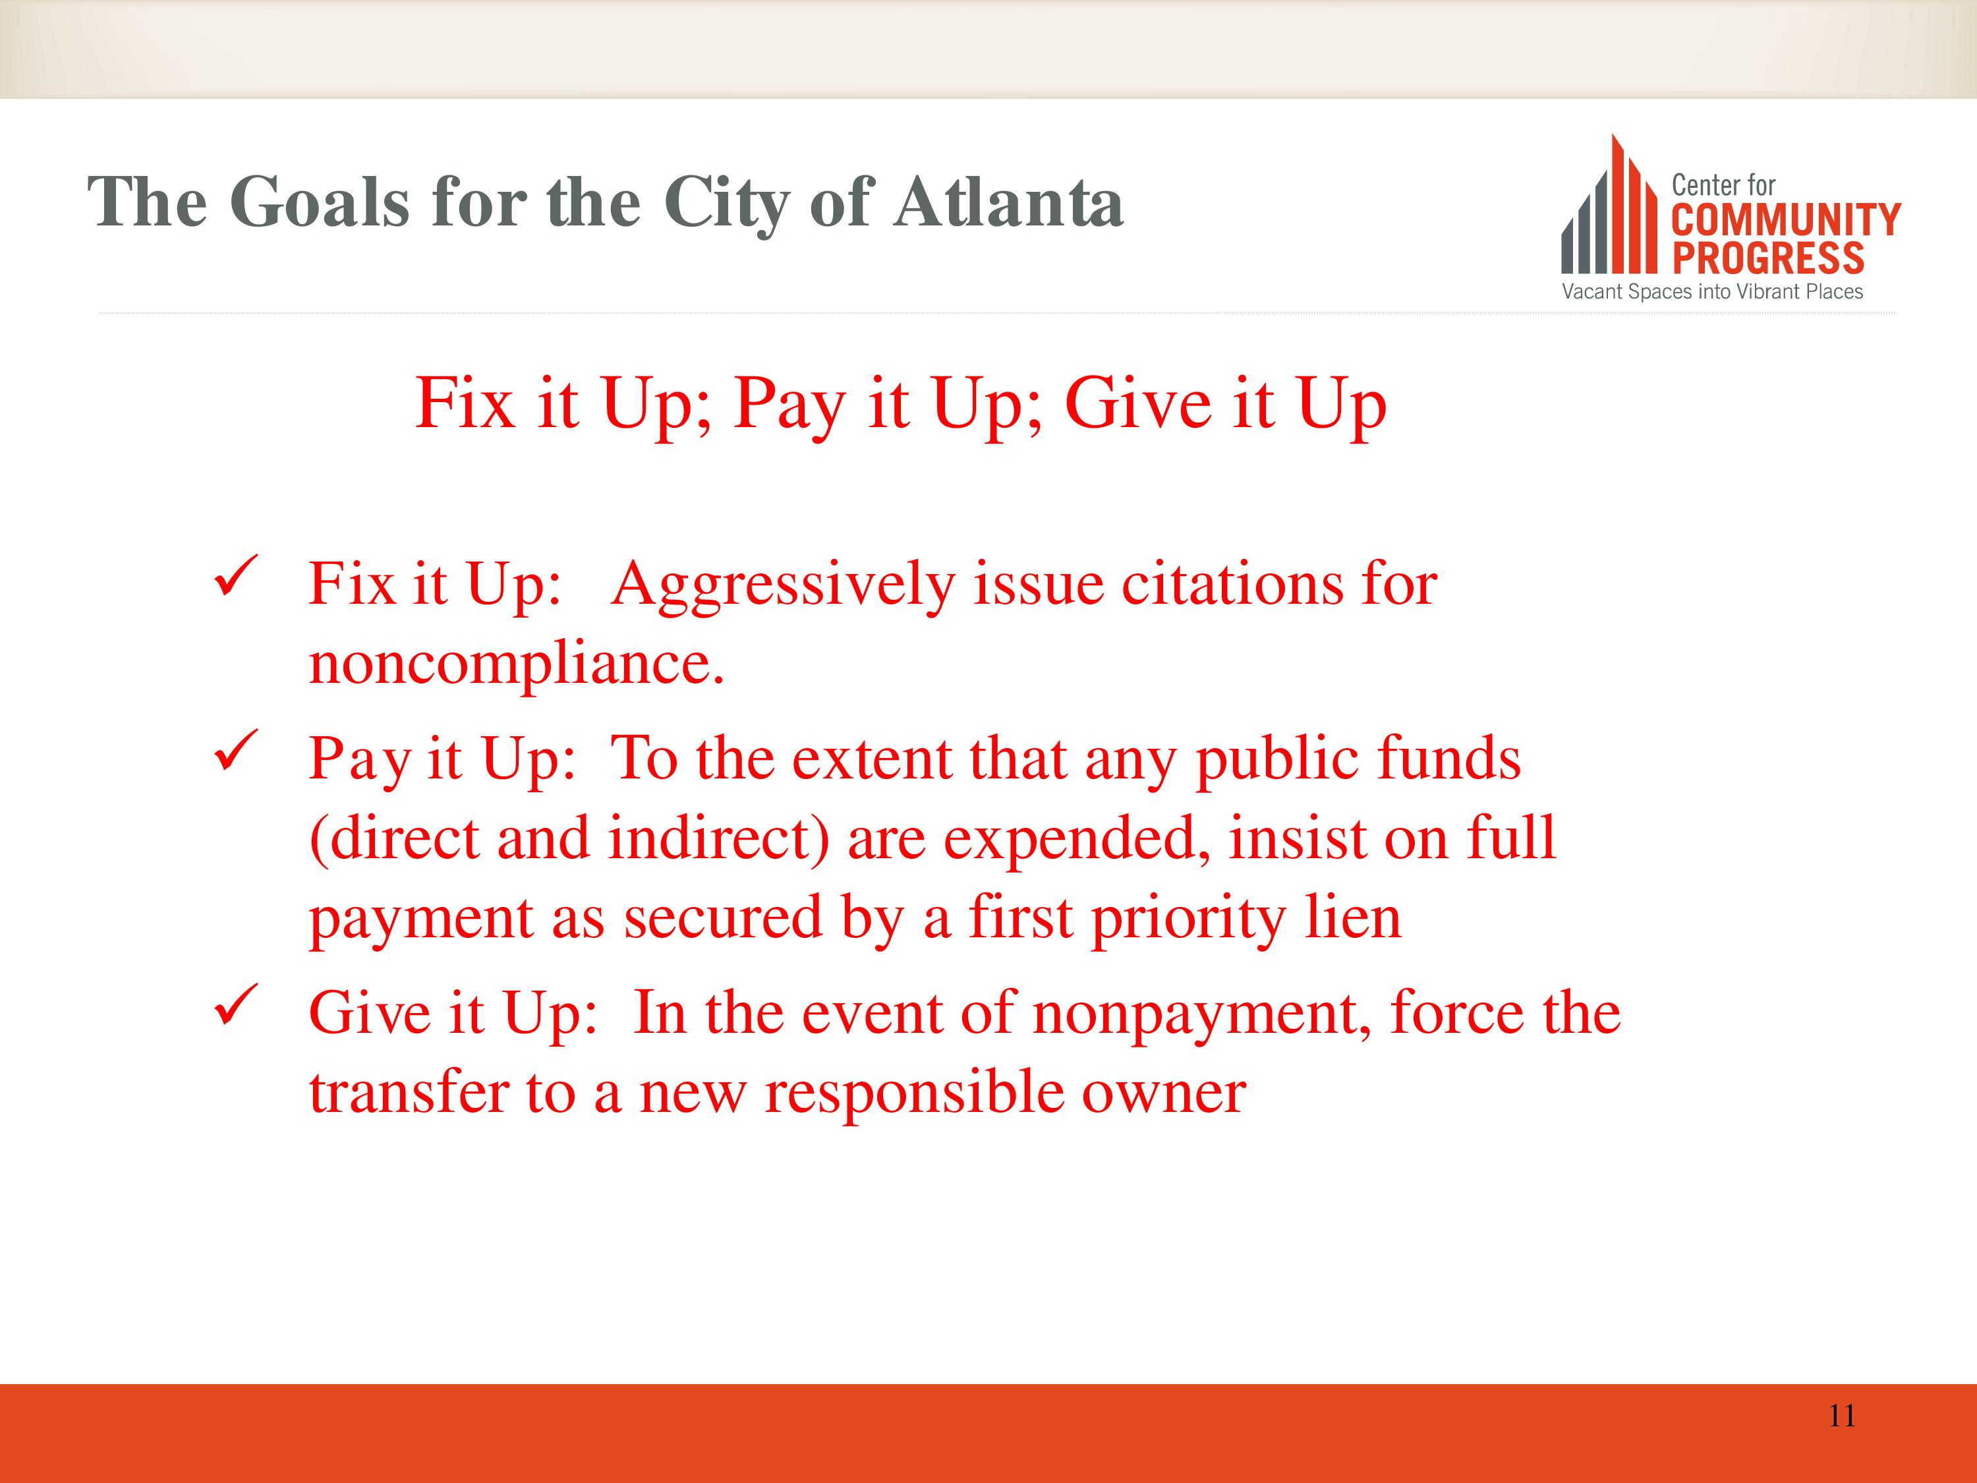

Slide 25
Development Considerations

Slide 26
Do Vacant Properties Affect Property Values?
A vacant or delinquent property can lower property values within 500 feet by 2.1%
A vacant and delinquent property can lower property values by 2.7%
A foreclosed (not delinquent or vacant) can lower property values by 3.9%
A foreclosed and vacant or delinquent property can lower property values by 6.1%
A foreclosed, vacant and delinquent property can lower property values by 9.4%
(Source: Stephen Whitaker and Thomas J. Fitzpatrick, IV, The Impact of Vacant, Tax-Delinquent and Foreclosed Property on Sales Prices of Neighboring Homes, Federal Reserve Bank of Cleveland)

Slide 27
Unique Challenges for Redevelopment
Disinvestment has occurred over decades
Code enforcement cannot keep up
Current crime/drugs, etc., or. . . .
The image of crime/drugs, etc.
The erosion of purchasing power – ownership challenges
Rental vs ownership
Shift in composition of purchasers – family vs single
Aging of population and corresponding needs

Slide 28
Properties are Not Always Easily Obtainable
Owners cannot be found, or
Owners can be found but do not have clear title, or
Owners can be found and they have clear title, but they want to hold on to property
Neighborhood redevelopment fails when we just get the properties that no one else wants
The importance of critical mass

Slide 29
How Do Land Banks Acquire Property?
Acquire Property through Tax Foreclosures
(Judicial In Rem Tax Foreclosures preferred)
Acquire Property through Donations
Acquire Property through Direct Market Purchases
Acquire Property directly from local government transfers

Slide 30

Comprehensive Chronic Distressed Property Strategy
prepared by
Fulton/Atlanta Land Bank Authority, Inc.
(Applicable to Strategic Development Area or City Wide)
As of March 10, 2015
“Bad” Property
Status
Tax Delinquent**
> 12 months
REO
Foreclosed
Code Violations/
Blighted
Criminal
Activity
**Assumes all tax liens held by Tax Commissioner
Article 5 Judicial
In-Rem Code
Enforcement:
Certified “Super
Priority “Lien
Conveyance
Action
Options
Voluntary
Donation
Judicial
In-Rem
Tax Foreclosure
Market
Negotiated
Purchase
Property
Seizure
Coordinating
Entity
LBA
Tax Commissioner/
LBA
LBA
Code Enforcement/
Solicitor’s Office/
Revenue Office
Solicitor’s
Office/DA/
US Attorney
Required
Resources
Acquisition Funds
Property Management Funds
Staff/Personnel Support
Demolition Funds
Funds for legal costs (closings, title, filings, etc.)
Funds for Judicial Tax Foreclosure Proceedings
Property Insurance
Disposition
Options
Application
RFP
Auction
“Good” and Productive
Property

Slide 31
Disposition of Property
Georgia Law requires a public bidding for local government property transfers
Local government can convey properties to the Land Bank as a governmental transfer without the bidding process
Land Banks allow for greater flexibility in the terms and conditions of transferring properties to new owners

Slide 32
Pricing Flexibility
Land Banks have full discretion in determining the sales price of a property
Land Banks can sell, trade or otherwise dispose of property on the terms and conditions determined in the sole discretion of the Authority at the local level
It is very important that there is consistency and transparency in acquisition & disposition of property

Slide 33
Land Bank Priorities for Disposition
Land Banks may establish a hierarchical ranking of priorities for the use of real property conveyed or the new law includes a list of priorities that will be used if not established, including:
  Public spaces and places
  Affordable and/or market housing
  Retail, commercial, and industrial activities
  Community land trusts or other public entities

Slide 34
Developer Requirements
Developers petition Land Banks for tax abatement and conveyance of a property. A petition requires:
  Developer Profile (Experience and Capacity)
  Development Proposal & Plan
  Development Cost Estimate
  Financial Ability- Funding Sources for the project
  Timeline for Development determined by the Land Bank

Slide 35
Developer Restrictions
LBA enters a contract for sale and disposition of the property with the developer
Developer is allowed a certain time to commence and complete the proposed redevelopment
Land Bank retains a right of reentry until the redevelopment is completed
Land Bank liens property for amount of any tax abatement until project is satisfactorily completed

Slide 36
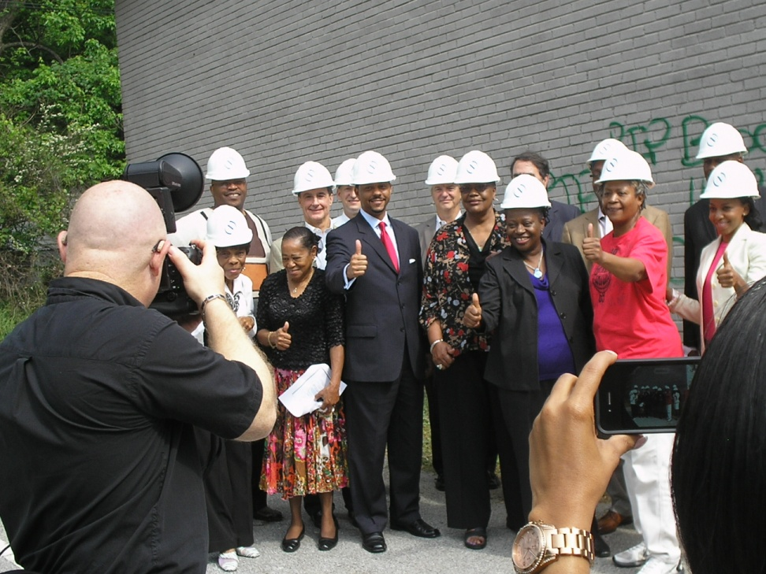
Public/Private Partnerships
ACoRA / 345 Ashwood Ave.
Purchased foreclosed 28 unit apartment building with ACoRA funds in Dec. 2009
  Partnering with National Church Residences to produce 48 affordable senior and lower income apartments
  Property has been demolished and property transferred to NCR

Slide 37
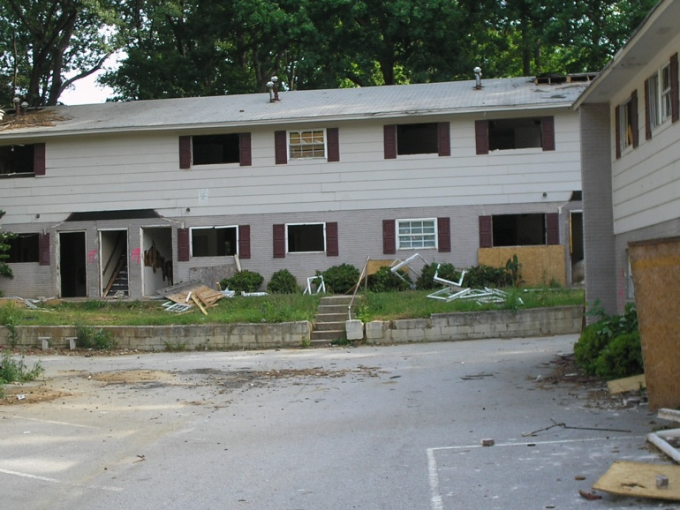
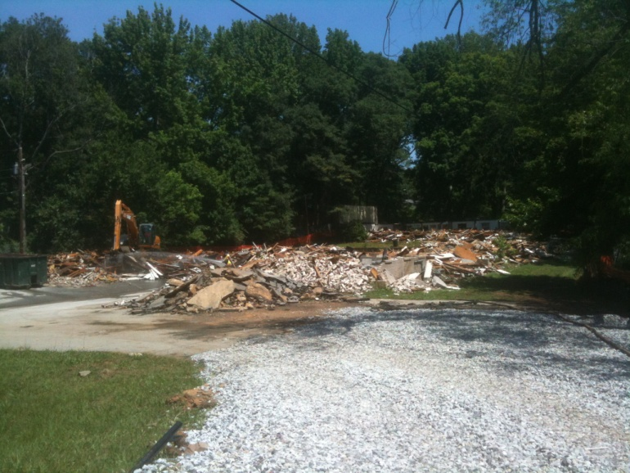
Public/Private Partnerships
ACoRA / 345 Ashwood Ave.
Allowed City of Atlanta Fire Department to conduct training exercises prior to demolition
Ground breaking for new project held on January 9, 2013

Slide 38
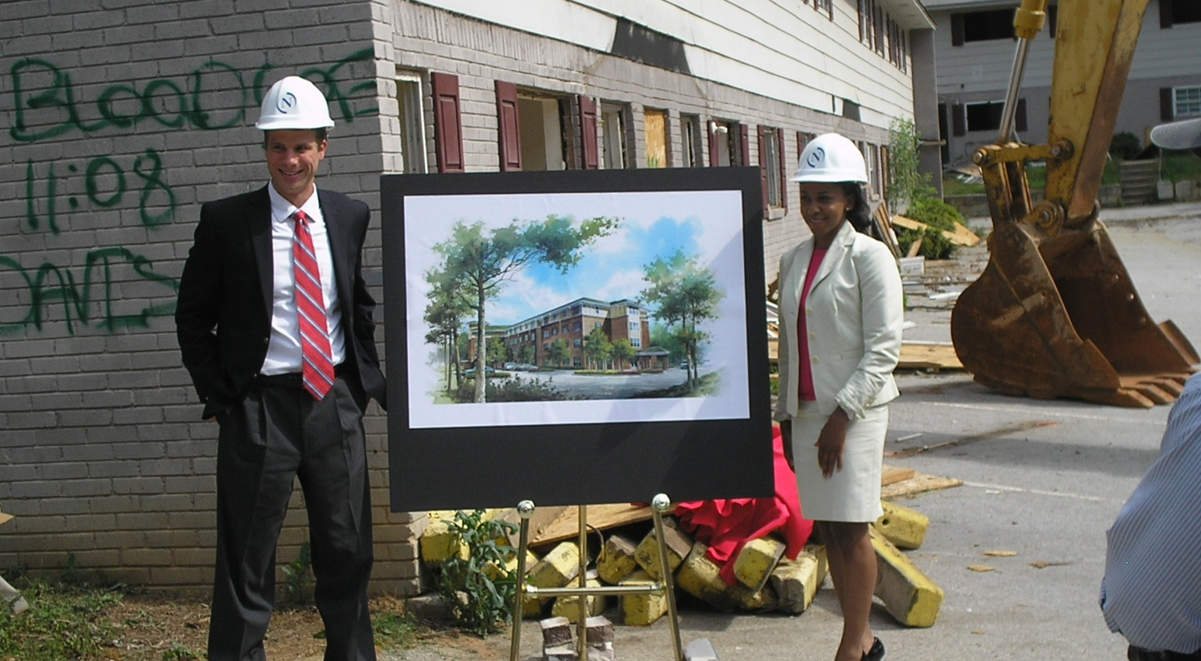
Public/Private Partnerships
ACoRA / 345 Ashwood Ave.

Slide 39
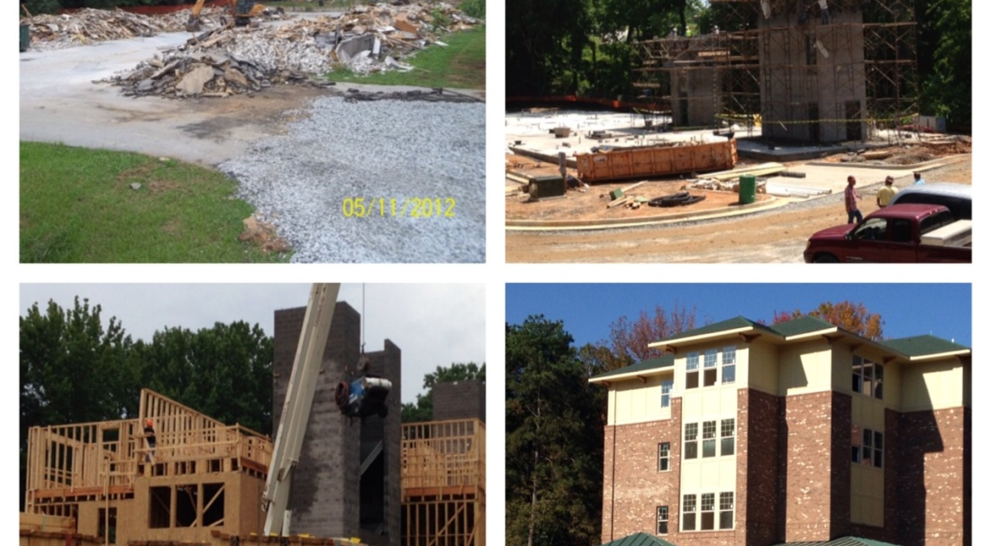
Public/Private Partnerships
ACoRA / 345 Ashwood Ave. – Betmar Village

Slide 40
Approved FCCALBA Programs – FY2020
Program | Role
Strategic Place Based Assemblage/Revitalization | Lead and/or Partner/Participant
Neighborhood Stabilization Program (NSP) | Partner/Participant
Troubled Asset Workouts | Lead
Land Banking | Lead
Secure Neighborhood Initiative | Partner/Participant
Municipal Joint Venture Projects | Partner/Participant
Community Land Trusts (Atlanta Land Trust Collaborative) | Partner/Participant

Slide 41
Approved FCCALBA Programs – FY2020
Program | Role
National Community Stabilization Trust/Neighborhood Stabilization Initiative | Partner/Participant
TransFormation Alliance | Participant
Greenspace Assemblage | Lead and/or Partner/Participant
Small Building Preservation | Partner/Participant

Slide 42
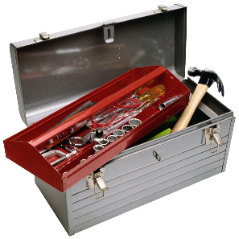
Tools
Demolition
Deed in Escrow Conveyance (to be potentially implemented)
Development Partner Bids/Partnerships
Environmental Review
In Rem Judicial Code Lien (potential for foreclosure of lien)
In Rem Judicial Tax Foreclosure
Intergovernmental Transfer
Property Donation
Property Management
Property Seizure – US Attorney/District Attorney/City Solicitor
Quiet Title Action
Real Estate Acquisition via Market Purchase
Tax Abatement
Title Research
Transaction Structuring

Slide 43
Augusta-Richmond Land Bank

Slide 44
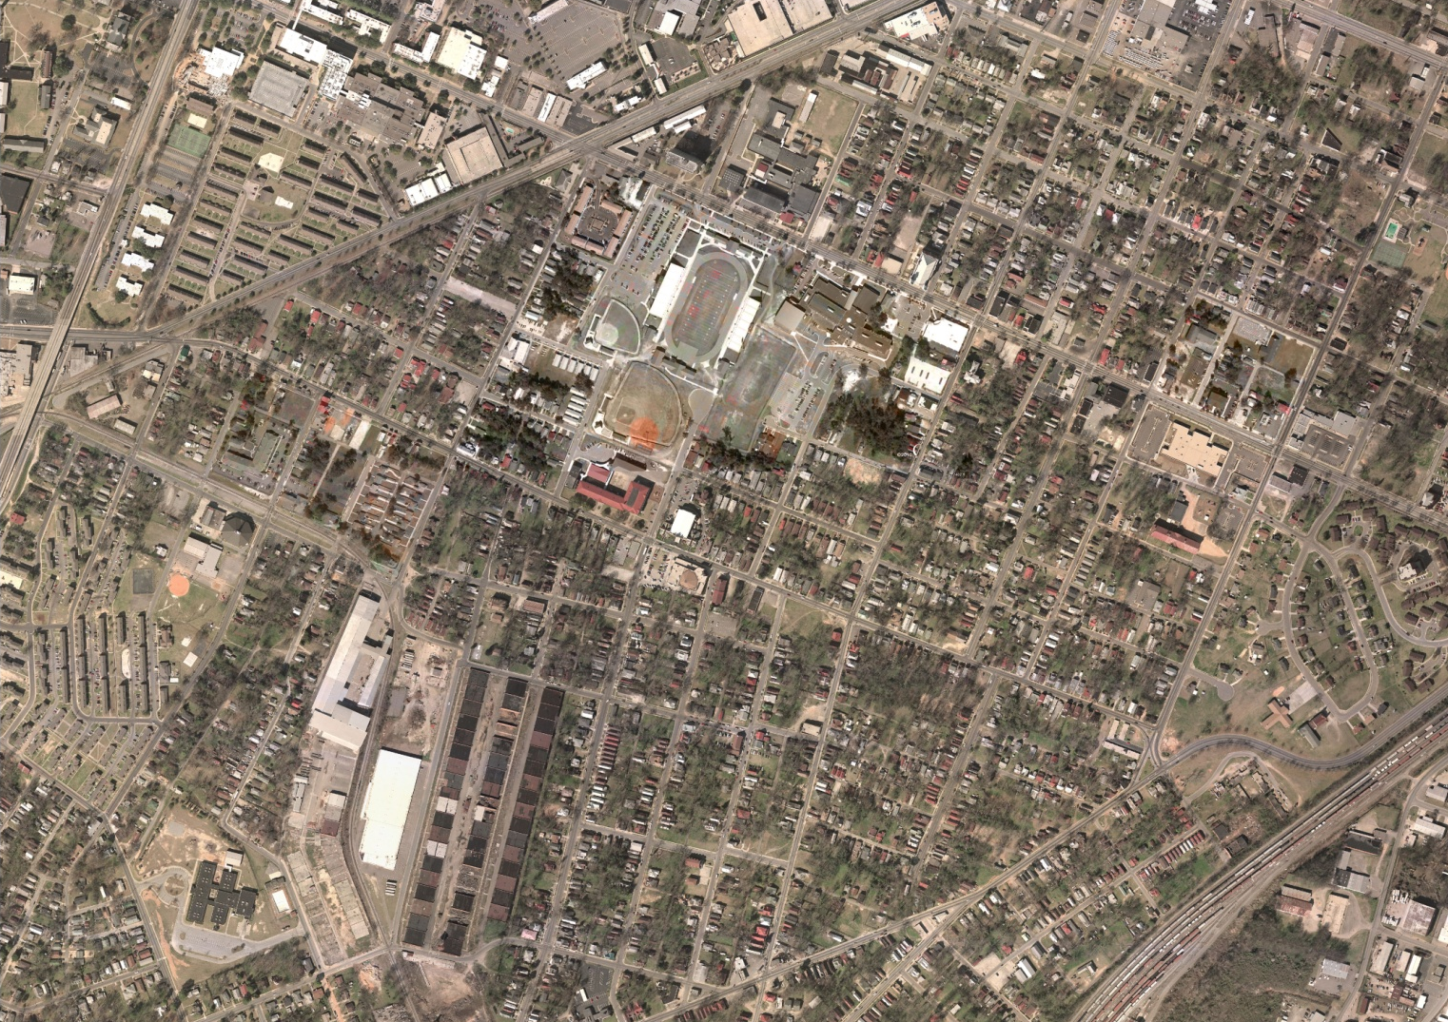
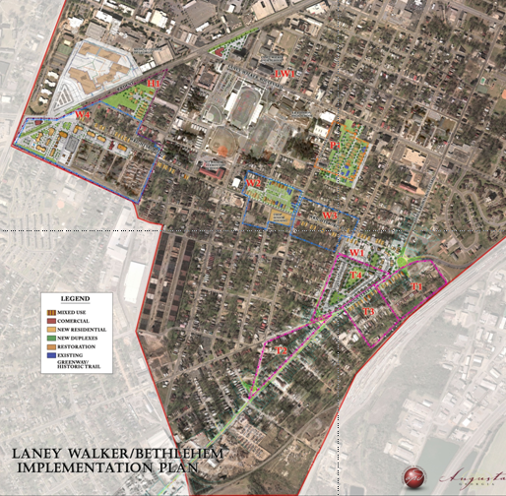
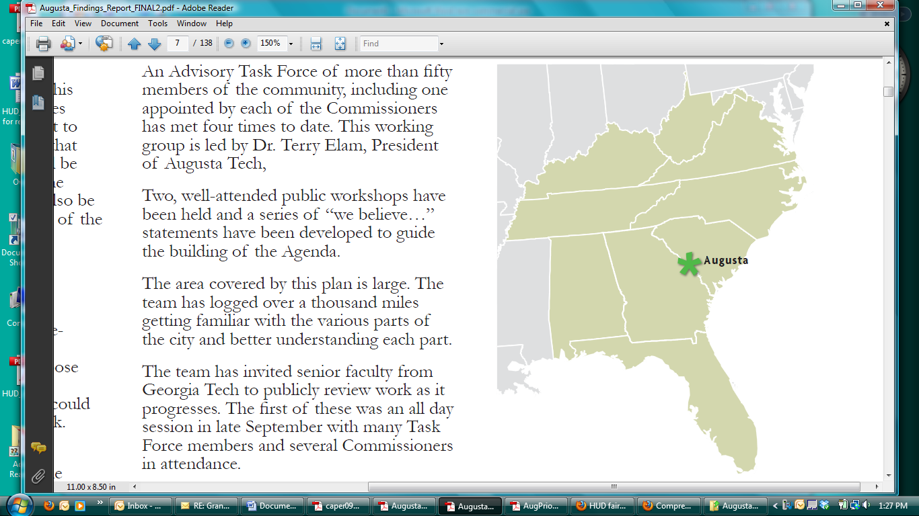
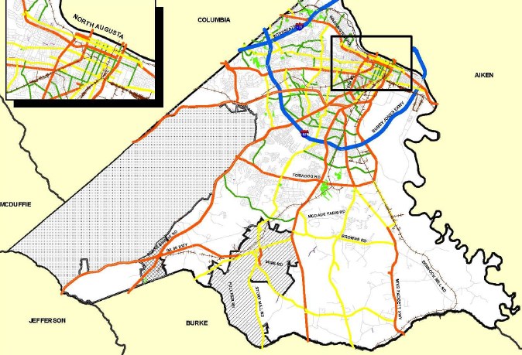
Transforming a Culturally Historic Community:
Augusta’s Laney Walker/Bethlehem

Slide 45


Transform Augusta’s urban core into a model city for the
21st Century.
Turn around decades of blight and disinvestment.
Regenerate two historic African American neighborhoods.
overview/ planning & devt/ risk mitigation / MARKETING, Branding & Communications / community OUTREACH
45

Slide 46
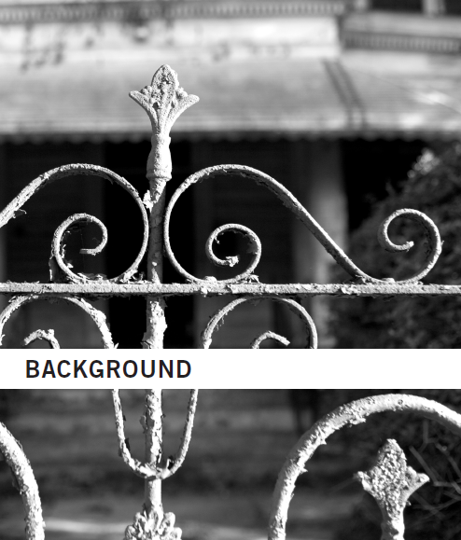
Overview/ planning & devt/ risk mitigation / MARKETING, Branding & Communications / community OUTREACH
46
Existing Conditions
  Laney Walker Neighborhood
    33% of housing in poor to
    dilapidated condition
    Over 20% of parcels vacant
  Bethlehem Neighborhood
    70% of housing in poor
    to dilapidated condition
    Over 30% of parcels vacant
Area = 1,020 acres (approx.)
Parcels = 3,500 (approx.)
Population = 4,707

Slide 47
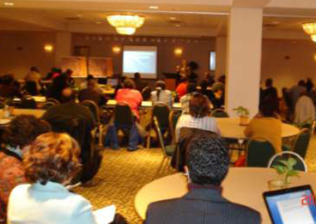
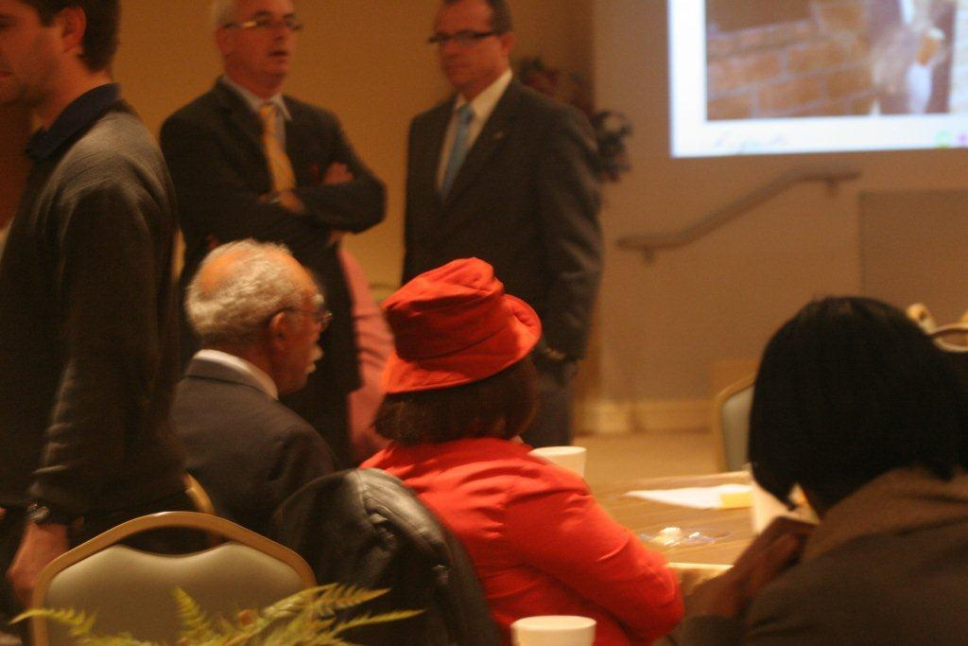
overview/ planning & devt/ risk mitigation / MARKETING, Branding & Communications / community OUTREACH
47
COMMUNITY INVOLVEMENT
    16-Month Neighborhood
    Planning Process
    Summary of recommendations:
      Eliminate blight
      New, affordable SF housing
      for homeownership
      Rental housing for seniors
      Rehabilitate vacant houses
      Create more green space
      Neighborhood retail and
      job opportunities
      Celebrate neighborhood's culture
      and African-American heritage
    Ongoing Dialogue –
    Quarterly and Annual Meetings

Slide 48
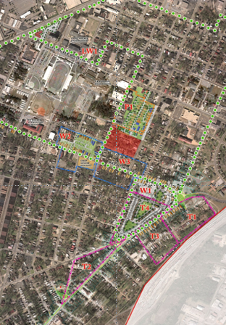
overview/ planning & devt/ risk mitigation / MARKETING, Branding & Communications / community OUTREACH
48
  TARGETS AND OBJECTIVES
  Acquisition of vacant and abandoned property in key development areas
  Quality construction, infrastructure improvements, social service support,
  and development incentives
  Preserve historic and cultural heritage
  by renovating owner-occupied homes
  Develop mixed income neighborhoods
  and attract new home buyers
  Use public funding to attract private investment to priority developments areas
  Use redevelopment initiatives to stimulate economic development

Slide 49
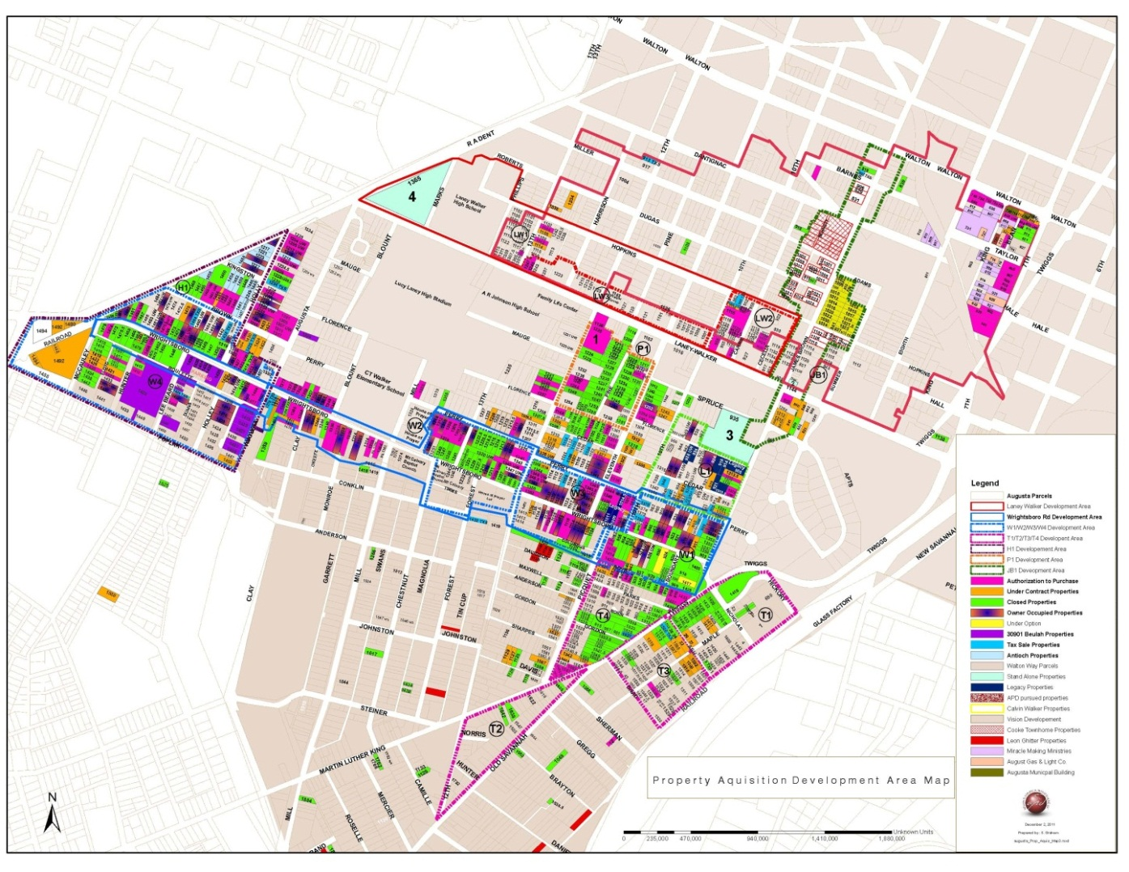
overview/ planning & devt/ risk mitigation / MARKETING, Branding & Communications / community OUTREACH
49
  PROPERTY ACQUISITION
  Over 1,000 property owners contacted
  Over $2m in
  property acquisition
  Over $1m
  under option
  to purchase
  or under contract

Slide 50
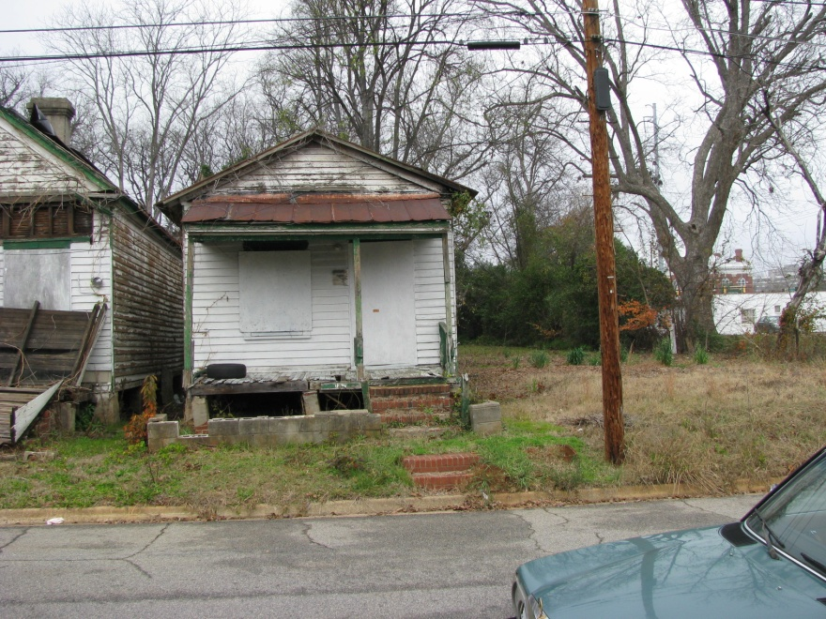
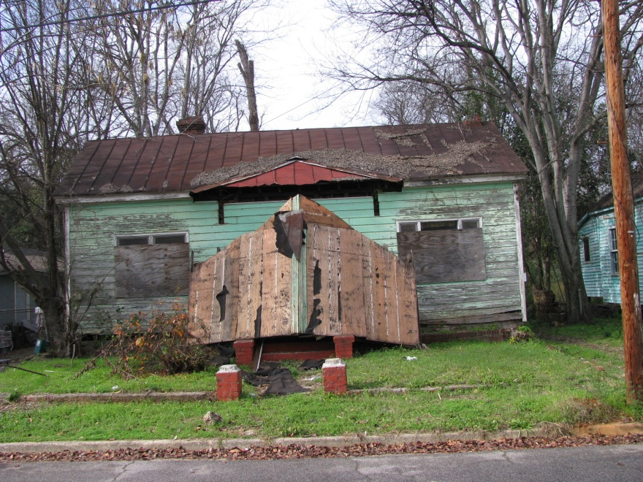
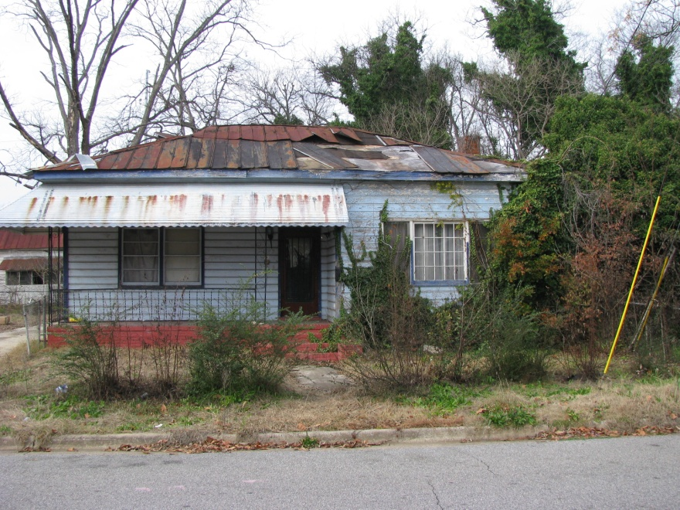
overview/ planning & devt/ risk mitigation / MARKETING, Branding & Communications / community OUTREACH
50
PINE STREET: BEFORE

Slide 51
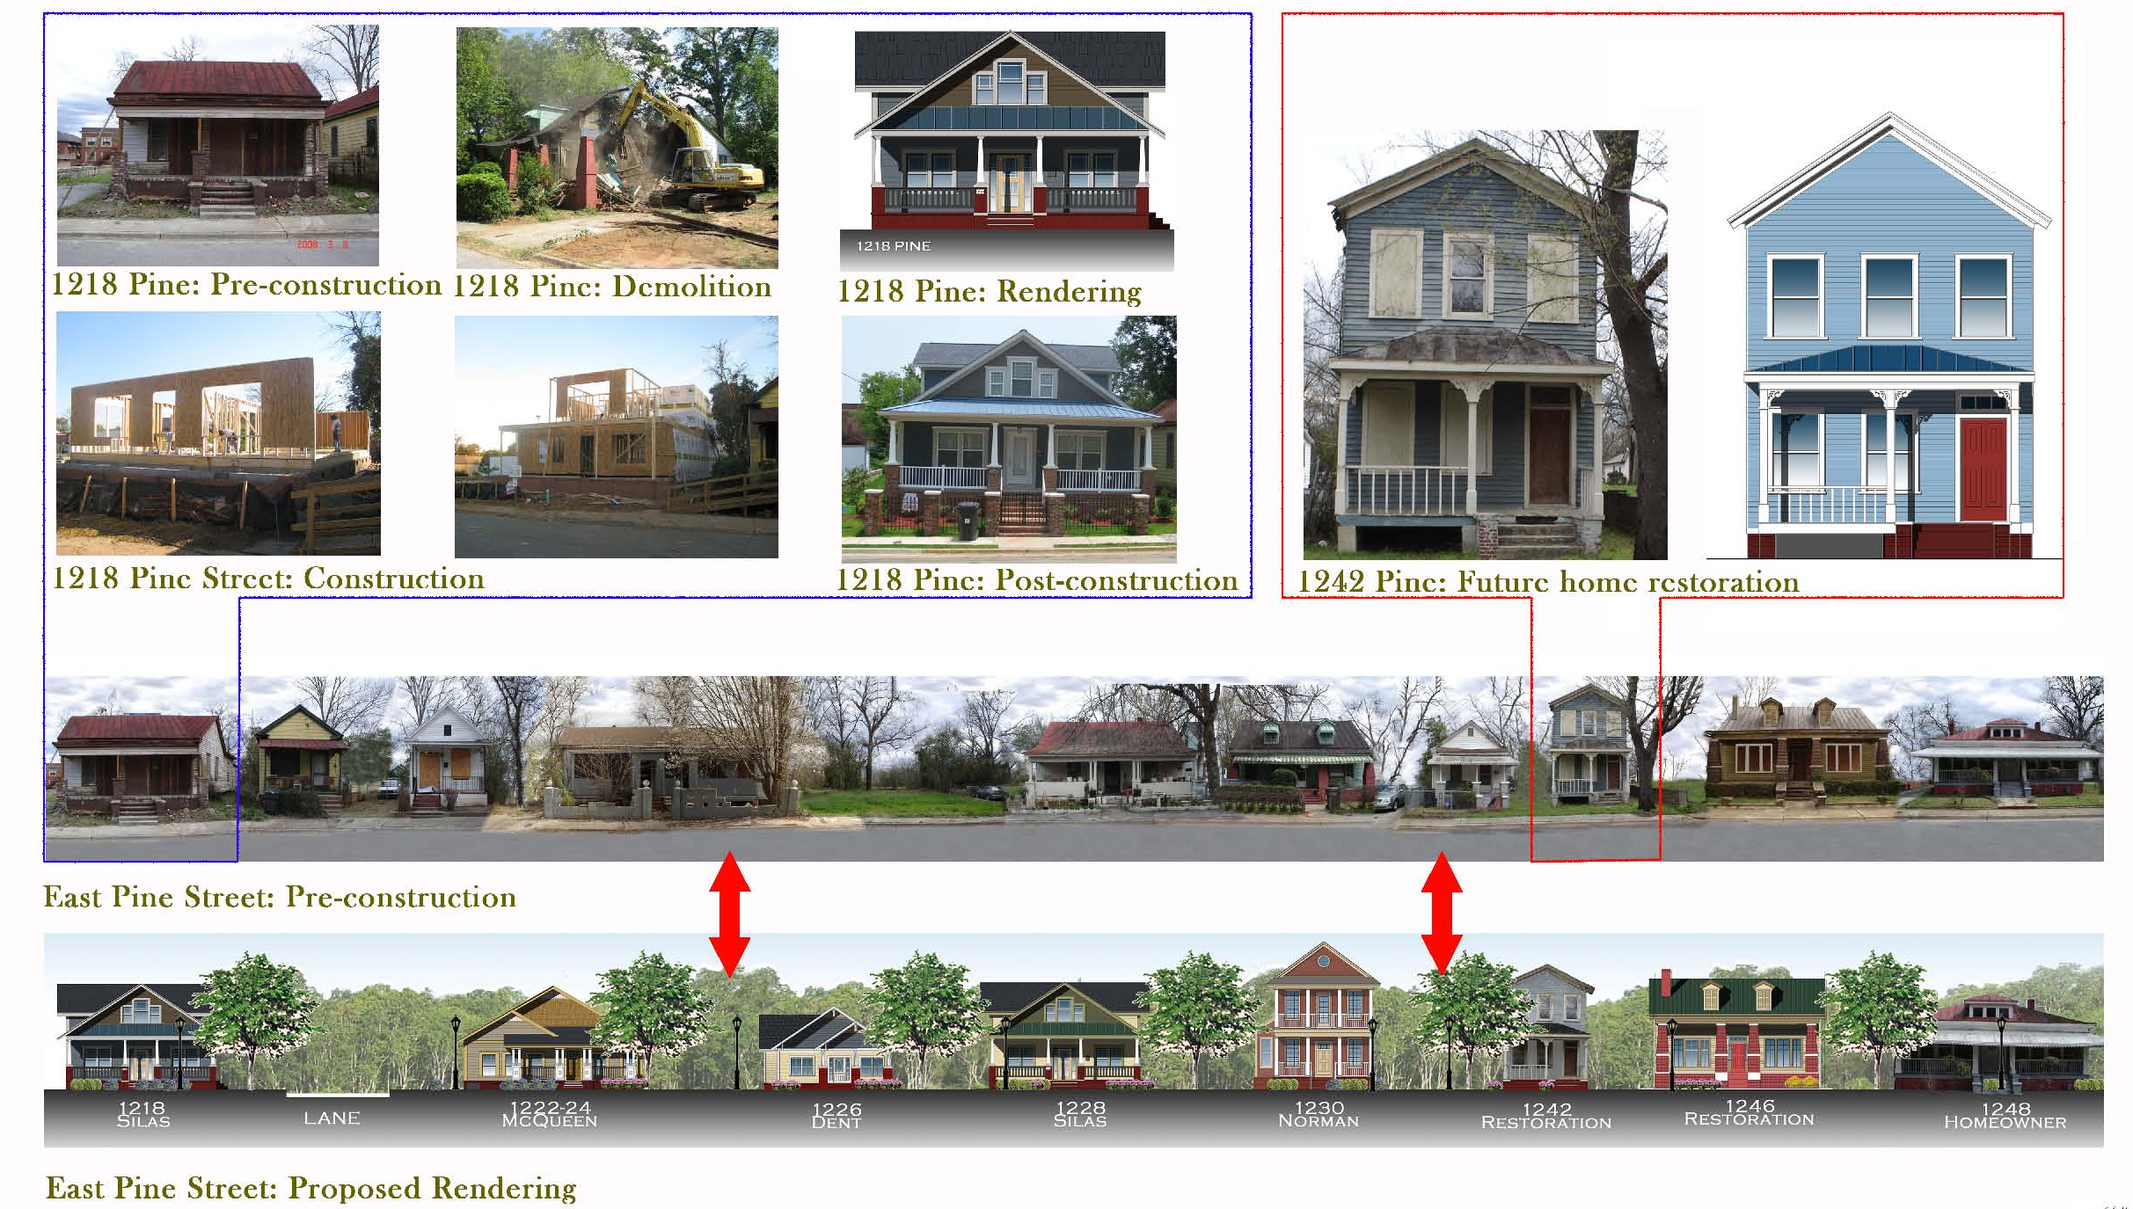
HERITAGE PINE:
Materials Reuse, Restoration, Blight Removal
overview/ planning & devt/ risk mitigation / MARKETING, Branding & Communications / community OUTREACH
51

Slide 52
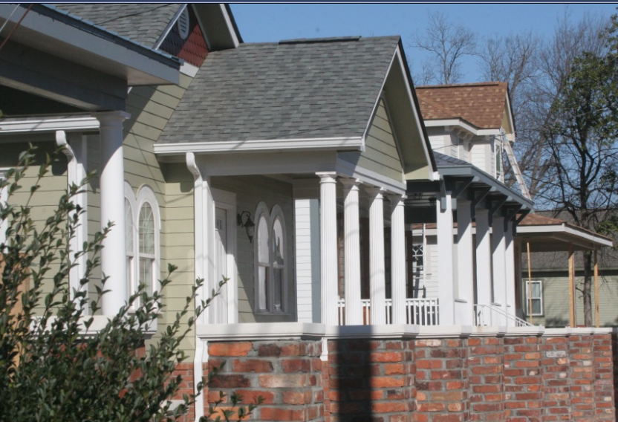
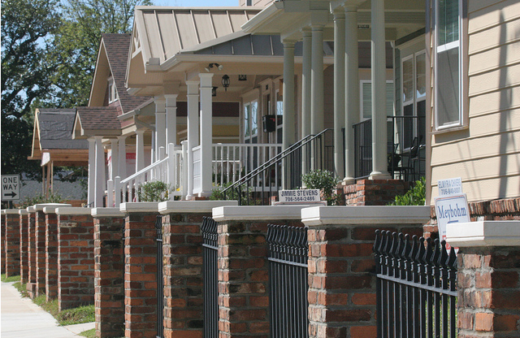
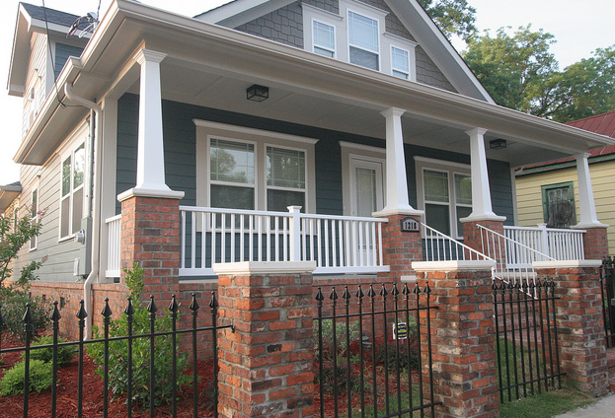
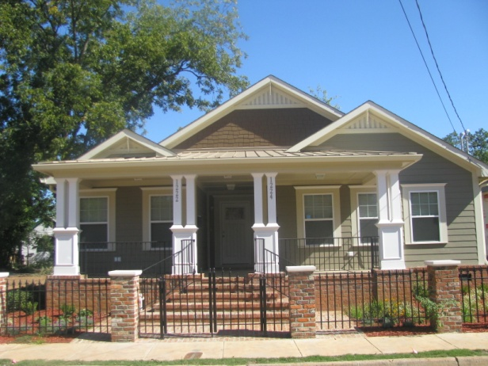
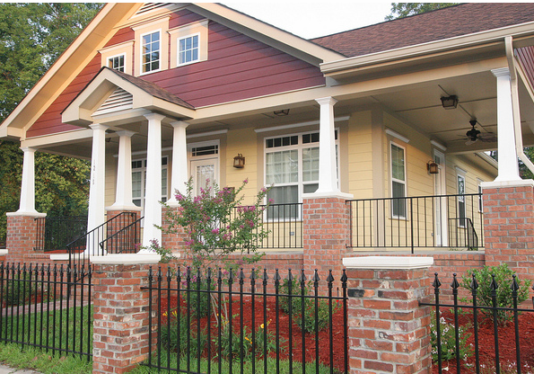
PINE STREET: TODAY
overview/ planning & devt/ risk mitigation / MARKETING, Branding & Communications / community OUTREACH
52

Slide 53
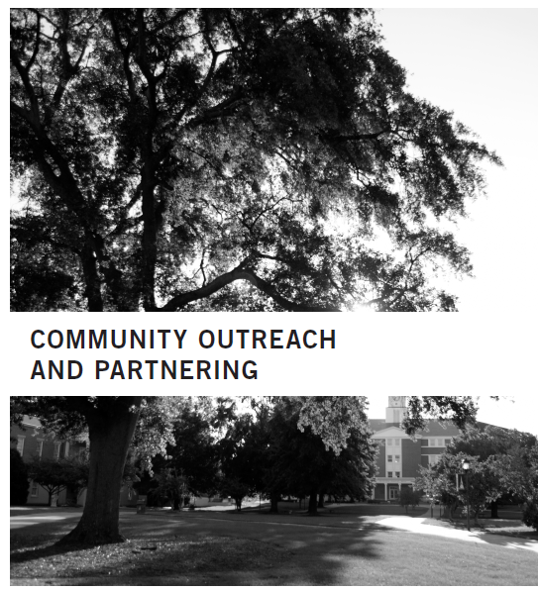
overview/ planning & devt/ risk mitigation / MARKETING, Branding & Communications / community OUTREACH
53
  PARTNERS
  Land Bank Authority, Urban Redevelopment Agency, P&Z, other city/county agencies
  Historic Augusta, Lucy Laney Museum of Black History, Augusta Canal Authority
  CHDOs, community centers, neighborhood associations, churches and schools
  Southface Energy Institute

Slide 54
Macon-Bibb Land Bank

Slide 55
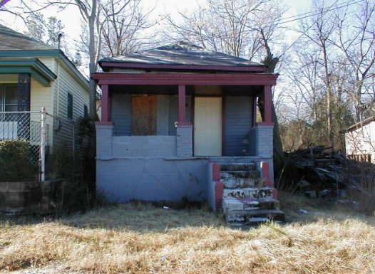
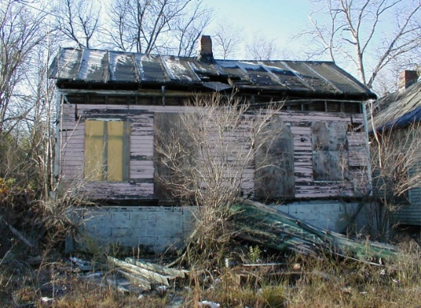
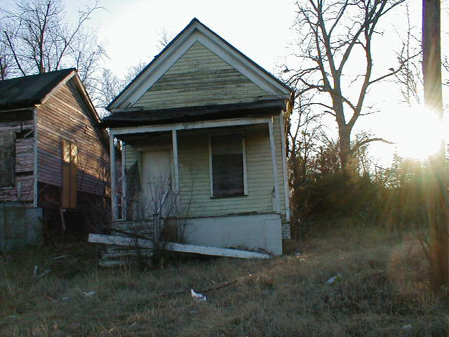
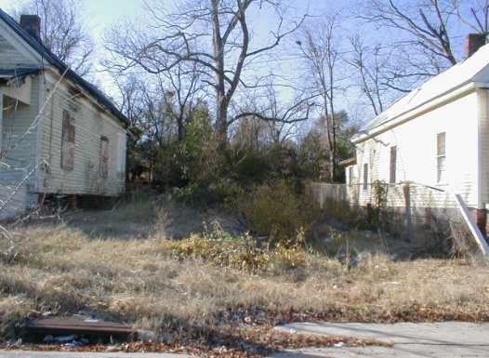
Prince Street-Before
Vacant, Dilapidated Structures

Slide 56
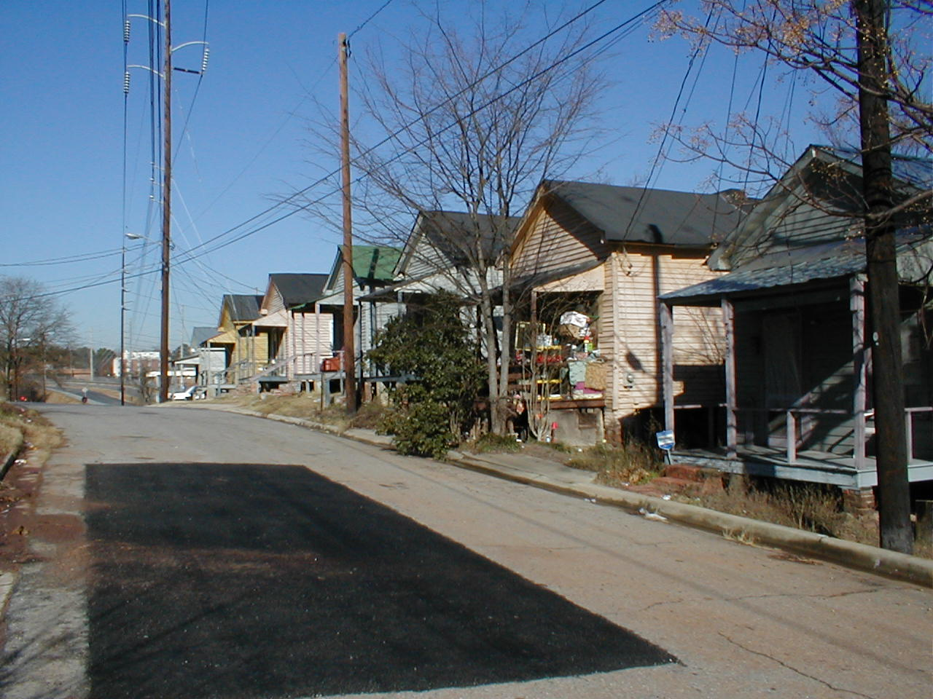
Prince Street Before - 2002

Slide 57
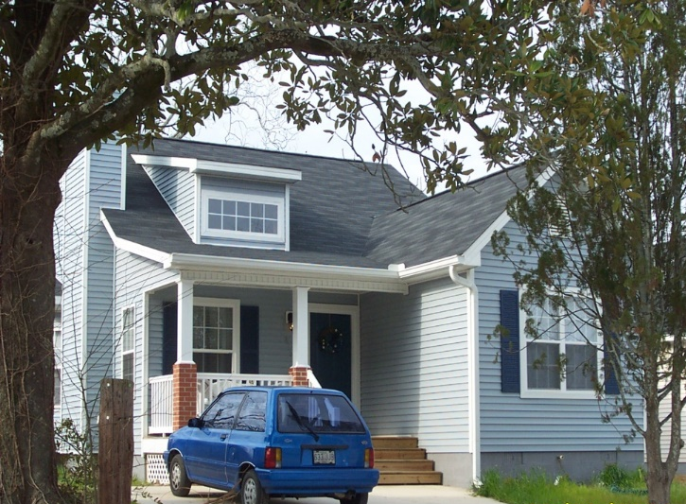
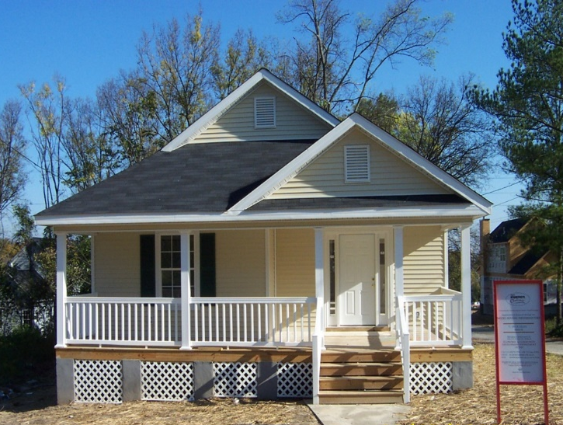
Prince Street Neighborhood-After

Slide 58
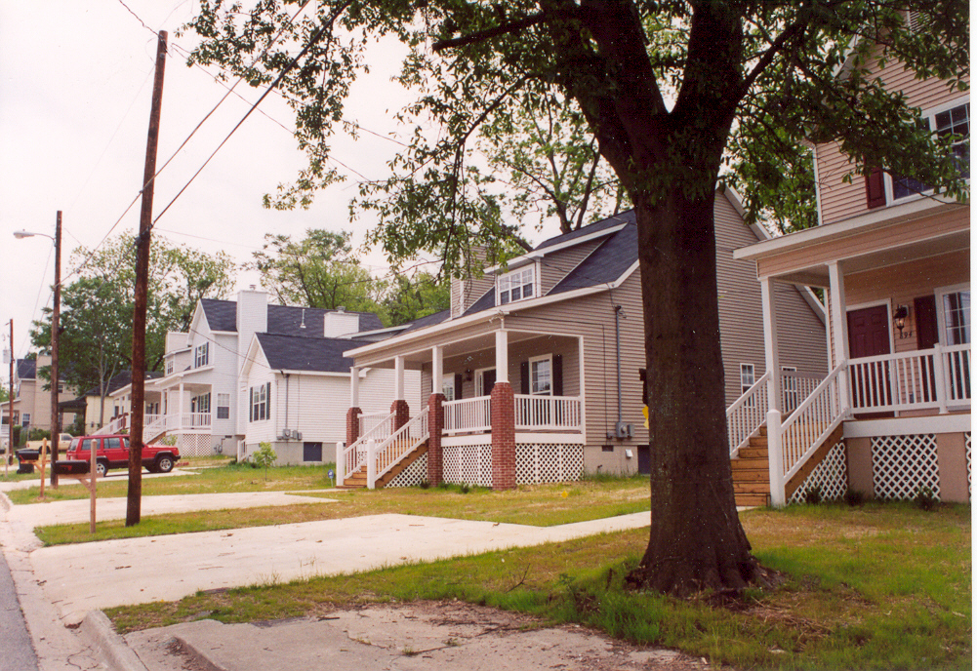
Prince Street- After

Slide 59
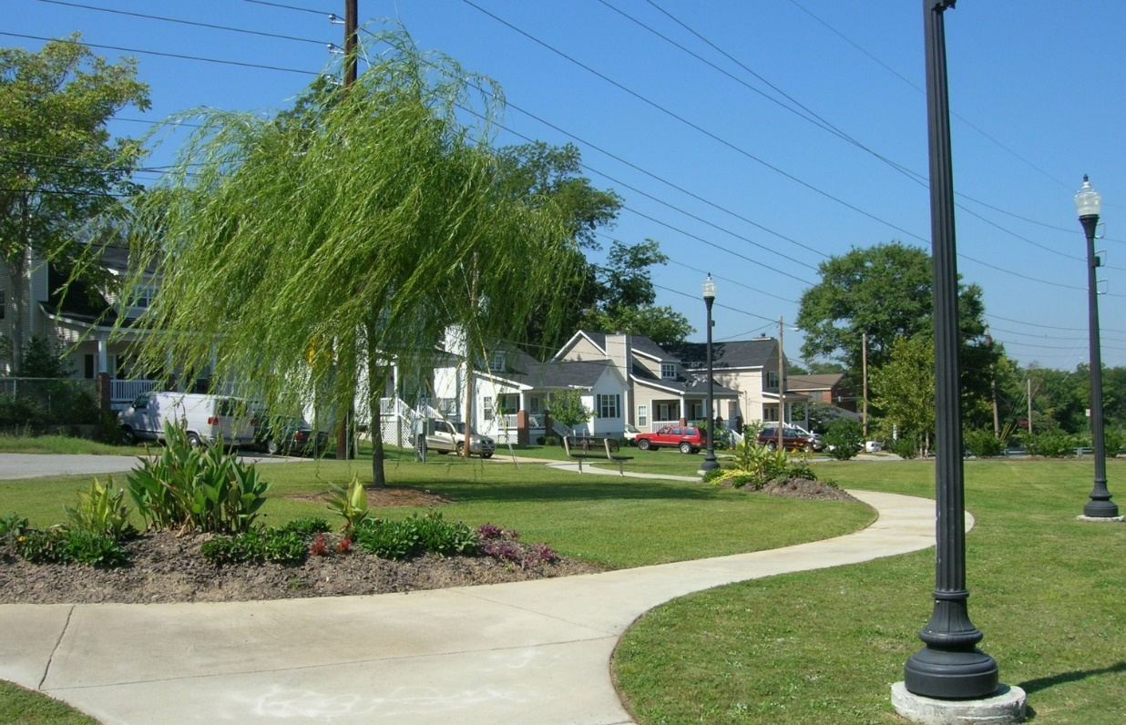
Prince Street- After

Slide 60
Beall’s Hill Neighborhood
The Revitalization of Beall’s Hill started as a partnership between the City of Macon, the Macon Housing Authority and Mercer University
The City provided $2 million dollars in HOME/Bond Funds
Mercer University wrote over $2 million in successful federal, foundation, and corporate grants to support the project
Knight Foundation in Community Building sponsored a design process in 2001 that became the basis for an ambitious revitalization plan
Formed the Beall’s Hill Development Corp to implement the plan, joined by the Land Bank and Historic Macon Foundation
Land Bank has acquired about 150 properties in the Beall’s Hill Neighborhood

Slide 61
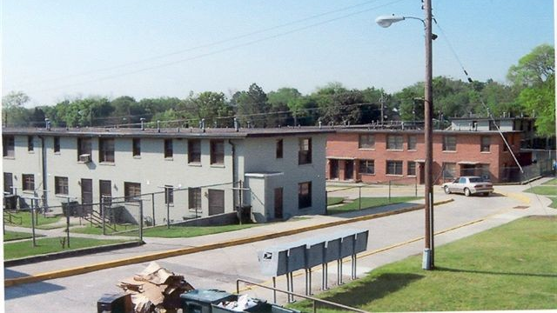
Obsolete Public Housing Demolished-HOPE VI Grant

Slide 62
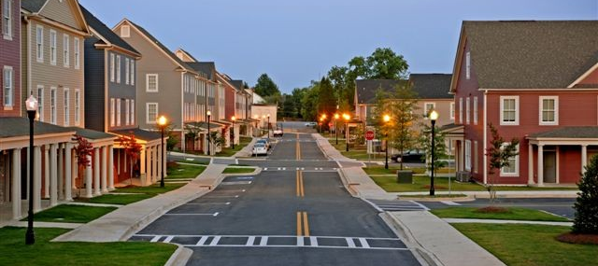
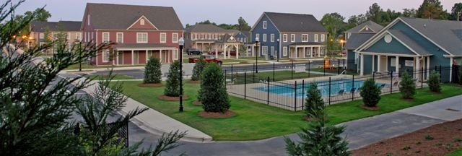
HOPE VI- Mixed Income Development
188 Units Demolished
97 Units of New Historically Compatible Townhomes
65 Units are Tax Credit Assisted-including 30 public housing units
32 Market Rate Units-No income restrictions
Opened up the Streets to include the surrounding Neighborhood
Clubhouse, Pool, Laundry Facilities
Land Bank Provided All Off-Site Housing Required for Grant Purposes

Slide 63
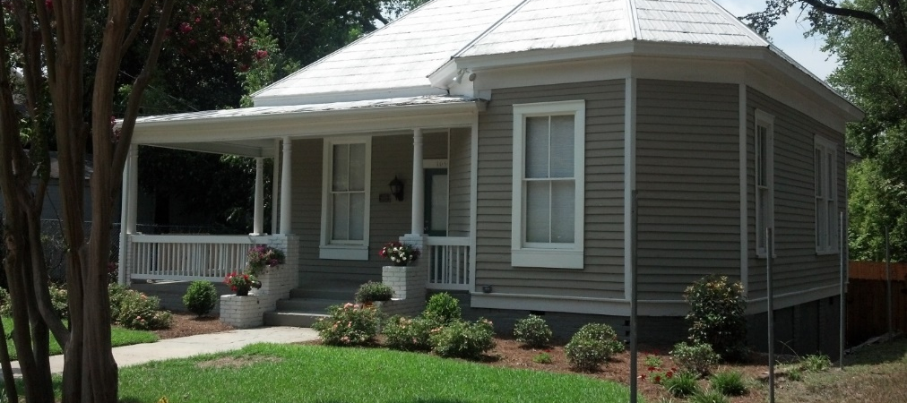


Land Banks & Historic Preservation?
Absolutely!!
44 Low Income Home Owners received financial assistance to improve existing homes
31 Historic Homes Rehabilitated
Home Ownership has increased 40%

Slide 64

New Homes On Vacant Lots

Slide 65


Attract Private Developers

Slide 66

Macon-Bibb County Blight Initiative
$14 million initiative using Bond Funds
$2 million for infrastructure & lighting in Beall’s Hill
$2 million for a multipurpose recreation field (Demo of 20 blighted structures)
$9 million divided by 9 Districts
County Contracted with Land Bank for all Acquisition, Holding and Disposition of property
Contracted with GBHS for all demolition
Funds for Capital Projects-infrastructure, parks, demolition for future development

Slide 67

Alexander IV-Vacant School
Blight Bond Funds used by Land Bank to acquire building from School District
Partnered with Historic Macon Foundation to manage RFP and Historic Preservation Tax Credits
Sold in December 2017 for redevelopment of market rate senior housing
$ 8.8 million project

Slide 68

Blight Initiative Results
165 Properties acquired across nine districts since summer 2016
Majority of Properties acquired through In Rem tax foreclosure
121 Properties demolished
65+ Properties remaining for acquisition & demolition
Community Center built in inner city neighborhood
Parks created and existing parks expanded or enhanced
Infrastructure and Lighting improvements
SPLOST funds planned for continuation of Blight Initiative

Slide 69
Questions
??????

Slide 70

Contact
Christopher Norman
President - GALBA
Direct 404-525-9130
cnorman@fccalandbank.org

