Slide 1
Housing Tax Credits and GICH
2/25/2021
Meagan Cutler, Housing Development Analyst
Notes:
Introduce ourselves
HFDD is the division of DCA that is responsible for:
writing policy for the housing tax credit program,
administering housing tax credits to housing developers,
and monitoring the development’s compliance throughout the program.

Slide 2
Overview
What is the Housing Tax Credit (LIHTC)?
Why would we want it in our community?
How does it work?
GICH advantages in the QAP
What about this GICH letter?
Case Studies
Notes:
What is the program?
Why might the program be beneficial in your communities?
How does the program work?
How can GICH teams interact with the program broadly? And how can GICH teams use the program to meet their communities’ housing needs?
How do GICH communities meet requirements in a GICH-specific portion of the program?
Case studies of some GICH alumni

Slide 3
What is the Housing Tax Credit?

Slide 4
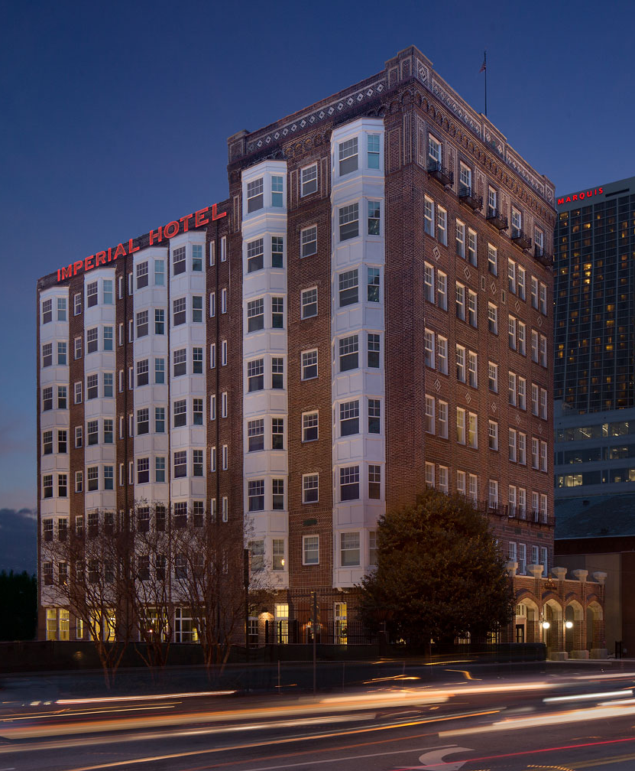
What is the Housing Tax Credit?
Enacted by Tax Reform Act of 1986 under Pres. Reagan
Largest producer of affordable housing in the country
(Commons at Imperial Hotel, Atlanta, GA)
Notes:
More frequently called LIHTC – Low Income Housing Tax Credit.
- program that provides tax incentives to entities willing to invest in construction or preservation of affordable rental housing.
Created to encourage private sector investment in creation of affordable rental housing
Offers a reduction in income tax liability in return for making a long-term investment in affordable rental housing.
State agencies (DCA) awards these credits to housing developers who sell them to investors in exchange for funding construction and rehab of affordable housing developments.
- Result, they can borrow less money and pass those savings on to renters.
Largest producer of AH in country
Has created over 3.3 million units since inception
Less than 1% foreclosures over 25 years
Picture - Imperial Hotel: Columbia Residential & National Church Residences (ATL - 90 units, PSH)

Slide 5
Why Would We Want This?
Notes:
What can affordable rental housing do for your community?
Human, and economic impact

Slide 6
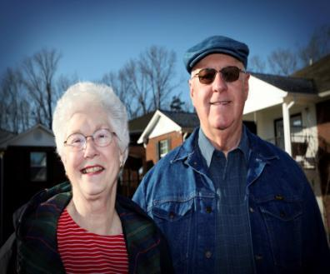
Housing Credit Impact
Addresses critical need for safe, decent housing for:
Seniors seeking independent living
Georgia working families with low and moderate incomes
Individuals with disabilities
Residents at Lone Mountain Village, Ringgold GA
Notes:
Common misconception re AH – only for ppl without jobs relying on govt
Addresses critical needs for housing for:
Seniors seeking independent living
Working families – ex: teachers, law enforcement, and other public servants
Individuals with disabilities – require affordable, accessible housing that accommodates needs
Over 330,000 Georgian households are spending more than 50% of their income on rent. https://www.jchs.harvard.edu/ARH_2017_cost_burdens_by_state_total
Standard acceptable amount is 30%

Slide 7
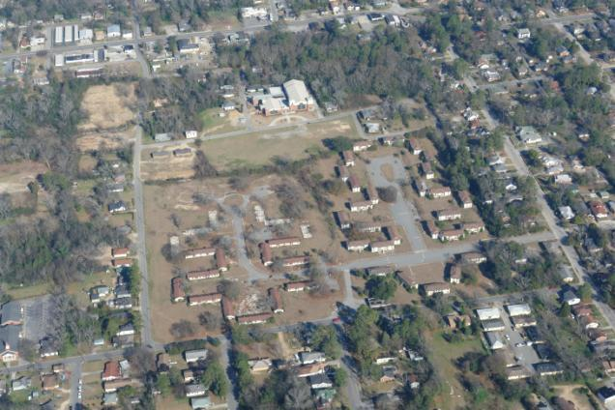
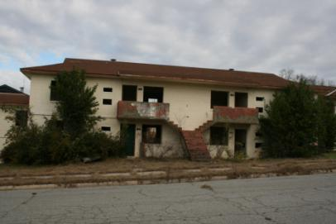
Bartlett Crossing, Macon
Notes:
20 acre site of former Macon Homes, public housing in core of Macon.
Long-vacant, run down, raised safety concerns for some in the community

Slide 8
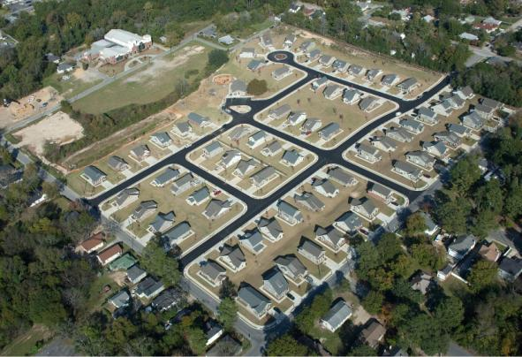
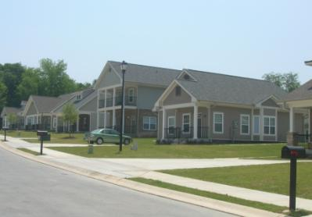
Bartlett Crossing (after)
Notes:
Bold vision for redevelopment.
Bartlett Crossing includes 75 single family home style units
$950K tax credit award led to $8.8 million raised in equity ($13.2 m TDC, also had NSP (Neighborhood Stabilization Program) funds and loan from city).
Characterized by collaboration: Macon Housing Authority, city Community Development Department, Lizzie Chapel Baptist Church, DCA

Slide 9
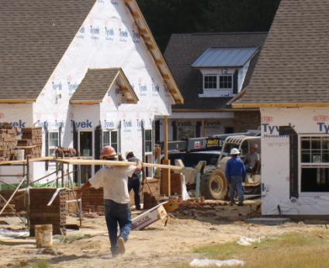
Housing Credit Impact (cont.)
First-year Economic Impact for every 1,000 tax credit units built:
1,130 jobs created
$107 million generated in local income
$42 million generated in tax revenue
Construction jobs created at Waterford Estates, Dublin, GA
Notes:
2016
https://www.novoco.com/notes-from-novogradac/housing-credit-improves-lives-boosts-economy-and-saves-government-money for 1000 units: first year impacts – 1,130 jobs, $107M in local wage and business income, $42M in tax revenue
2010
https://www.novoco.com/sites/default/files/atoms/files/nahb_jobs-report_2010.pdf - $7.9M in local income, $827,000 in taxes and other revenue for local gov’ts, 122 local jobs – all one-year impacts of 100 units
- annually recurring impacts of building 100 apartments: $2.4M in local income, $441,000 in taxes and other revenue for local gov’ts, 30 local jobs
2014:
https://www.housingfinance.com/policy-legislation/the-economic-impact-of-the-lihtc_o Nationally: 95,700 jobs, $3.5B in federal state and local taxes paid, $9.1B in economic income – all annually

Slide 10
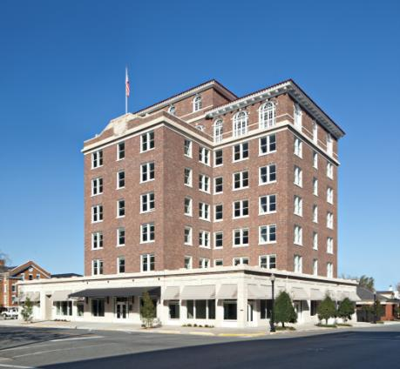
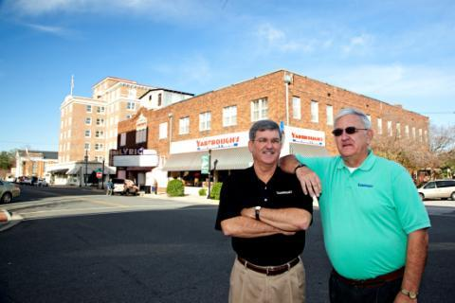
Ware Hotel, Waycross
Notes:
The Hotel Ware originally opened in 1929, and its re-opening provided 35 apartment homes to families
- pivotal moment in promoting economic development in downtown Waycross for small business owners like the Yarbrough brothers (seen here) and their multi-generation family owned business.

Slide 11
What About…
Property Values?
Several studies have shown that affordable housing generally has no adverse effects and may even have positive impacts
Design, Management, Location, and Dispersion
Traffic?
Studies show that affordable housing residents own fewer cars and drive less than residents of market-rate homes
Notes:
Fair share of tax base – density compared to single family homes
Stability allows kids to do even better in school
Stability in community reduces risk of crime, something that studies show does not increase with Housing Credit Development
https://ced.sog.unc.edu/does-affordable-housing-negatively-impact-nearby-property-values/
https://www.jtlu.org/index.php/jtlu/article/view/1129
https://www.transformca.org/transform-blog-post/can-affordable-housing-provide-traffic-and-climate-solution-san-jose
Design – DCA has architectural standards
- ensure properties not only comply with state and federal regulations, but in many aspects, require properties to go above and beyond the scope that market rate properties would – for example, sustainable building practices (particularly impacts on the surrounding area and aspects which affect quality of life for residents, such as air quality)
Management – DCA’s compliance team and monitoring
- DCA oversees compliance with state and fed regs
- although not directly managed by DCA, properties must follow DCA regs in mgmt
Location – DCA locates developments in both areas of opportunities and areas that are actively aiming to revitalize/redevelop
- market studies – must be need for development and will not overwhelm any area with AH units
- strike balance between high opportunity and revitalization – responsive to needs of state and differing needs and lifestyles of residents
Dispersion – DCA prioritizes distribution of our resources, rather than clustering
- equitable geographic allocation around state

Slide 12
How Does the Housing Credit Work?
Notes:
There is a competitive portion (9% credits) and a non-competitive portion (4% credits) of the program. Discussing the competitive process today because that’s how GICH can influence the program.

Slide 13
How Competitive LIHTC Works:
IRS allocates ~$2.81/resident to each state
Georgia in 2020: $31,478,997
Developers compete to win award of 9% credits
State Housing Finance Agency sets requirements and incentives via the Qualified Allocation Plan (QAP)
Private investors contribute equity and receive benefits of the tax credits
Housing is built and rents must be affordable (typically 60% AMI) for at least 30 years
Once housing is inhabited, then tax benefits begin
Notes:
We’ve already discussed that state allocating agencies award credits to housing developers who sell them to investors.
IRS sets the credit amount - $2.81/resident
GA in 2020 allocated $31,478,997 federal tax credits
GA has state tax credit with which we match federal tax credits
Developers compete to win award of 9% credits
- Applications each year – 70ish. (2020 round: 93)
- Compete based on requirements and incentives set by QAP
- QAP is document of policies – policy team – set rules developers must follow. Some rules are required, some are not. The ones that are not required is how developers try to gain a competitive advantage.
- Developers choose development location partially based on where they can score well (meet many non-required policies)
Private investors contribute equity during the construction period in exchange for tax credits
- 9% Competitive Tax Credits cover about 80% of the equity in an urban development and up to 100% in some rural developments. So developments often still need some other gap financing.
- lower debt service allows properties to sustain lower rents
Housing gets built and the rents must be affordable and rented to income-qualified tenants
Tax credits paid out over 10 years. So, 2020’s $31 million is actually $31 million each year for 10 years.

Slide 14
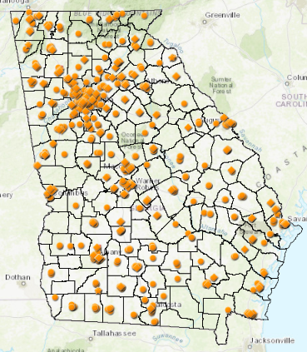
DCA 9% Housing Tax Credit Properties
Since 2000
751 9% allocated and in-service properties

Slide 15
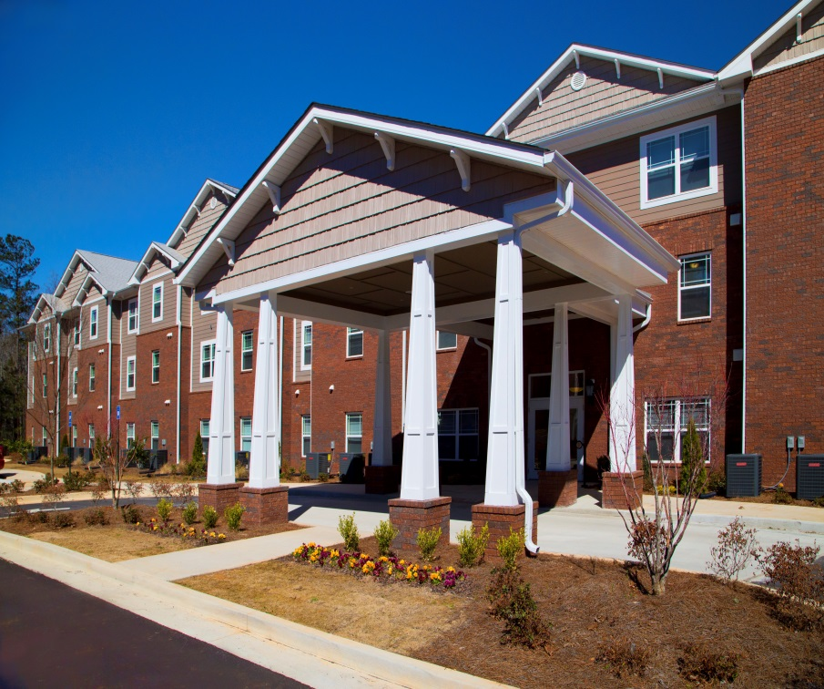
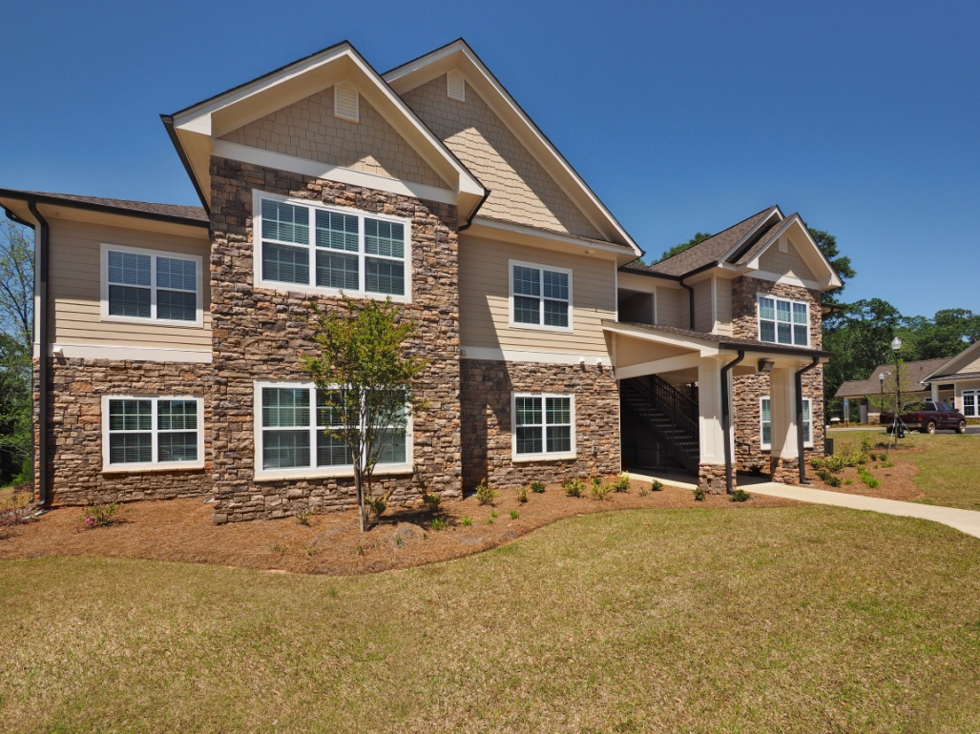
Snapshot: 2020 9% Funding Round
93 applications submitted
39 properties funded
2,699 units financed
Around 49% in rural areas
13% went to preservation
31% senior properties
Notes:
Pics – Brentwood Place (Forsyth – 79 units) and Forest at York (Newnan – 72 units)
Avg. units per development: 69
6 NP Set Aside
4 Rural HOME Preservation
4 General Set Aside
Rem 25 9% competitive round

Slide 16
GICH Advantages in QAP
Notes:
QAP includes required (threshold) and not required (scoring) sections. Developers use the scoring sections to create a competitive advantage. GICH is in scoring, so the team hold a good deal of influence over developers interested in receiving an extra point.
While GICH communities can directly influence 1 point, there are several other categories that a community could use to attract development

Slide 17
DCA Community Initiatives
Competitive advantage for GICH Community support for an Application within its jurisdiction
One letter for only one Application per GICH Community
Additional Local Government letter in support of decision is required
Notes:
GICH community must be on file with UGA/DCA as current participant or certified alumni) – important to maintain communication in years to come
Letter must identify boundaries of GICH community, identify the proposed housing development within those boundaries, and be executed by the primary or secondary contact on record with UGA

Slide 18
Community Transformation
Competitive advantage for Community-Based Developers assembling Community Quarterback Boards (CQB) and together committing to create a Community Transformation Plan targeting a defined neighborhood which includes site
Additional advantage for community being a GICH participant or certified alumni and appointing GICH Team member to CQB

Slide 19
Other Ways Local Governments Can Boost Application Competitiveness

Slide 20
Revitalization/Redevelopment Plans
Competitive advantage for site being within the targeted area of a Community Revitalization Plan
Additional advantages for:
Local government solicitation of public input and engagement during CRP creation
Local government demonstrates financial commitment to advancing CRP in form of funds raised or allocated, tax incentives, or fee waivers

Slide 21
Revitalization/Redevelopment
Third-Party Capital Investment
Competitive advantage for unrelated third party’s investment of resources that has resulted, or will result, in the development of a place-based improvement within .5-mile radius of site
Community assets
Infrastructure improvements

Slide 22
Community Designations
HUD Choice Neighborhood Implementation (CNI) Grant
Competitive advantage for sites located in areas that have received HUD CNI Grant
Grant awardee must select only one application to receive points
Development must be identified in CNI Grant application
Notes:
Choice Neighborhoods program leverages public and private dollars to support locally driven strategies to address struggling neighborhoods with distressed public or HUD-assisted housing through comprehensive approach to neighborhood transformation
- collab between: local leaders, residents, other stake holders (PHAs, cities, schools, business owners, NPs, developers)
- revitalize public/assisted housing and catalyze critical improvements – vacant properties, housing, businesses, services, schools
CNI Grants support those communities that have undergone a comprehensive local planning process and are ready to implement their “Transformation Plan” to redevelop the neighborhood.

Slide 23
Community Designations
Purpose Built Communities
Competitive advantage for applications designated by Purpose Built Communities as furthering one Community’s transformation
Notes:
Modeled after East Lake community revitalization - Purpose Built connects community leaders with resources and partner orgs to make holistic investments in defined neighborhoods to create greater racial equity, economic mobility, and improved health outcomes for residents
- currently 5 in GA: 3 in Atlanta, 1 Rome, 1 Columbus

Slide 24
Favorable Financing
Qualifying Sources of Favorable Financing
Competitive advantage for securing federal, state, or local funds or loans or foundation grants or loans
Long-Term Ground Lease
Competitive advantage for receiving long-term ground lease from PHA or government entity for nominal consideration and no other land costs
Notes:
Fav Financing Sources
Points based on amount per unit
Local govts can support by contributing:
- HOME
- SPLOST
- other local govt grant funds or loans
Long-Term Ground Lease
- at least 45 years
- nominal consideration = no more than $100 per year

Slide 25
Historic Preservation
If historic preservation is priority for local government, consider adaptive reuse through LIHTC
When thinking about where to do affordable housing in your locality, also keep in mind historic structures for adaptive reuse
Notes:
Historic – Historic tax credit proceeds or historic structure designation

Slide 26
Other Competitive Criteria

Slide 27
Location-Based
Proximity to desirable amenities
Proximity/access to public transit
Access to schools with above-average standardized test scores or “Beating the Odds” designation
Low-poverty communities
Local health and economic indicators
Lack of 9% LIHTC awards in area in recent years
Notes:
Desirable amenities - licensed childcare, medical care providers, grocery stores, etc.
Local health/econ indicators
- higher life expectance, health insurance rate, median income
- lower unemployment rate

Slide 28
Other Criteria
Deeper income targeting
Mixed income developments
Phased developments
Extended affordability
Exceptional nonprofit or PHA
Compliance performance
Notes:
Deeper targeting
- Units reserved for households with incomes below typical LIHTC rent level
- Government-funded project based rental assistance (PBRA)
Mixed income – either unrestricted units or income averaging
Extended affordability
– forego ability to get out of program at year 15
- plus right of first refusal to qualified NP or PHA if Owner elects to transfer all or some of interest in property during compliance (1st 15 years) and extended use period (years 15-30)
- resident ownership plan
Exceptional – must be on Project Team, nonprofit must be managing GP

Slide 29
Important Dates & Info
2021 9% Application
2022 Qualified Allocation Plan

Slide 30
Key Dates
GICH certification due March 31, 2021, 5 pm
2021 Applications due May 21, 2021, 4 pm
2022 and future QAPs will be developed year-round

Slide 31
2022 QAP Development
QAP policy is an annual, iterative process
Draft will be available in early October with a 30-day comment period
What to expect:
Listening Sessions
Public Hearings
Substantive Changes document
Redlined version of QAP
QAP Workshop
Ongoing Q&A
Submit QAP input throughout year
Notes:
If interested in influencing, learning, shaping DCA policies…
Substantive changes calls out which policies have changed substantially since the previous QAP (or any new policies) – what we want feedback on, expect to generate discussion. Ideally these are not surprises based on listening sessions (and forthcoming iterative process of soliciting feedback from partners)
Redlined version will contain all changes, even including language/editing/organizational changes that do not affect the policy content.

Slide 32
GICH Letter Requirements
Specifics and Common Mistakes

Slide 33
Team Contact and Leader Update Form
GICH community must be a current participant or a certified alumni – re-certify every 2 years
Ensure successful certification by checking list posted by UGA in April
Submit certification letter with LIHTC application
GICH letter must be signed by the Primary or Secondary Contact on file with the UGA Housing and Demographic Research Center
These roles can be officially re-designated
Notes:
Ensure you are certified if alumni – check list posted by UGA in April & to be extra safe for 9% round, submit letter confirming successful certification

Slide 34
Steps to Success with LIHTC
Case Study – Griffin, GA

Slide 35
Griffin’s Steps to Success
Partnerships
Public Housing Authority
City
Land Bank
Housing Council
Housing plan
Developer relationships
Alternate funding sources
Communication
Notes:
Partnerships
PHA
City
Land Bank
Housing Council
Housing plan
Had to have this in place to really know what they wanted from a developer
Code enforcement, slum/blight clearance baked in – to ensure projects were actually viable
Relationship with developer
Asked for communication about scoring process
Didn’t just give out GICH letter to someone who asked
Communicated their desire for a multi-year, multi-property relationship with a developer
Helpful to work with a developer that has had experience in the lihtc program previously – difficult to just jump in
Alternate funding sources
- HOME funds, city matched some funds, committed to infrastructure work, Section 18 demolition funds, federal home loan bank grants.
Communication
Housing council meetings
Ongoing communication with developer
Keeping city apprised of scoring decisions
Working to accept affordable housing not as a negative term. Working to communicate to community members and leaders what affordable means in your town. Who needs this housing so people don’t think of them as “others”
Held forums, conferences to get the word out and set the stage for acceptance in communities.

Slide 36
Steps to Success with LIHTC
Case Study – Rome, GA

Slide 37
Rome’s Steps to Success
Partnerships
City
South Rome Redevelopment Agency
South Rome Redevelopment Corporation
Purpose Built Communities
Public Housing Authority
Land ownership
Developer relationships
Additional Funding
Notes:
Partnerships
City wasn’t actually on the application, but worked with SRRA and SRRC
Trusted PBC to advise them
Worked hard on a difficult relationship with the NWGHA - PBVs
Land Ownership
Owning land brought the SRRC and SRRA to the table
Previous work made that land viable – went from 100 to 500 year floodplain
Developer relationships
- Relied on PBC suggestion
Relying on their expertise
Management needs
Communication regarding scoring/app
Legal necessities
Additional funding
CDBG
CHIP
TSPLOST – streetscapes, bridges, trails – specifically for application
Important to have in mind that you do want to be competition for current “slumlords” – Communication with community and expectation that their action would prompt private improvements – and they did. They also had code enforcement out more.

Slide 38
Steps to Success with LIHTC
Case Study – Thomasville, GA

Slide 39
Thomasville’s Steps to Success
GICH letter scoring criteria
Housing choice and diversity
Mixed use
Civic space
Connectivity to existing neighborhoods
Location
Streetscape
Architectural aesthetics
Economic and sociologic impact
Zoning overlay and design guidelines
Notes:
GICH letter scoring criteria
Multiple developers interested – designed criteria that all had to submit and then were scored on
Led by city planning department, signed off by local gov’t
Communicated to developers what Thomasville was looking for in a development rather than accepting the first GICH letter request
Housing choice and diversity
Mixed use
Civic space
Connectivity to existing neighborhoods
Location – infill/greenfield/suburban/sensitive land
Streetscape
Architectural aesthetics
Economic and sociologic impact
Zoning overlay and design guidelines
- Conditional use zoning applied to get a traditional neighborhood design outcome – resulted in high quality designed development that is resulting in complementary development in the area
Public engagement and communication
- Area for improvement – advice is to get ahead of negative perceptions and address them with the community

Slide 40
Wrap Up
To receive information on trainings, workshops, and general program updates, sign up on our email list at:
https://www.dca.ga.gov/safe-affordable-housing/rental-housing-development/housing-tax-credit-program-lihtc
Contact us at hfdround@dca.ga.gov

Slide 41
Additional Resources
From the Housing Tax Credit homepage, select QAPs and Related Documents, then the applicable year to:
Submit a Question
Submit Written Input
Join Policy Advisory Email List
Link to list of LIHTC developments (including developer name): https://www.dca.ga.gov/node/3814

Slide 42
Q&A

