Slide 1
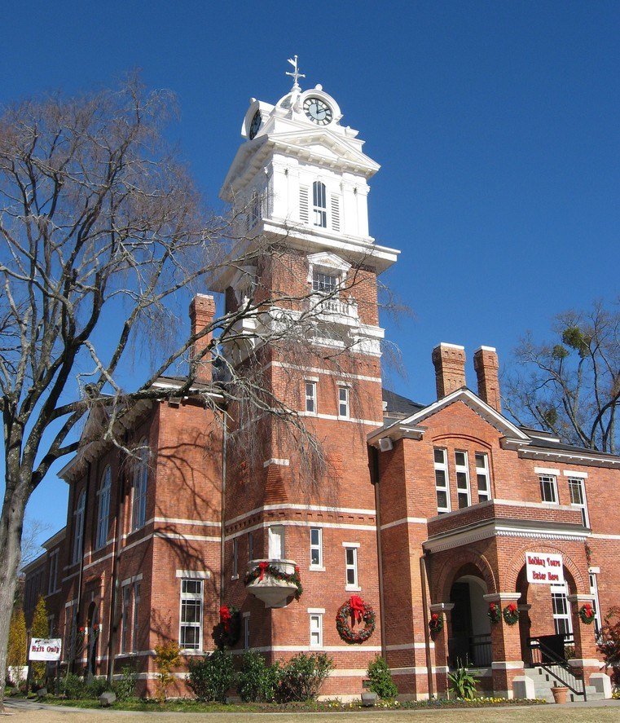
Lawrenceville Response Center -Collaboration During the Crisis-
Lejla Prljaca, Lawrenceville Housing Authority
This Photo by Unknown Author is licensed under CC BY-SA

Slide 2

Lawrenceville Response Center (A.K.A. Impact 46)
to respond to those in need of housing, financial resources, and food as a result of income loss from Covid-19.
Vision
A collaborative effort and coordinated approach to serving our residents in response to Covid-19 as we restore, restructure, and rebuild

Slide 3

Mission & Objectives
The purpose of the center is to have a city-specific place where Lawrenceville residents can contact a case manager for resources.
Responding to the immediate effects of Covid-19 with a long-term plan for sustainability
Homeless prevention
Income recovery
Family long term sustainability (RRH)
Local nonprofit capacity growth
Leveraging experience of others
LRC as community HUB for coordination and collaboration
Vision: A collaborative effort and coordinated approach to serving our residents in response to Covid-19 as we restore, restructure, and rebuild Lawrenceville towards long-term sustainability

Slide 4
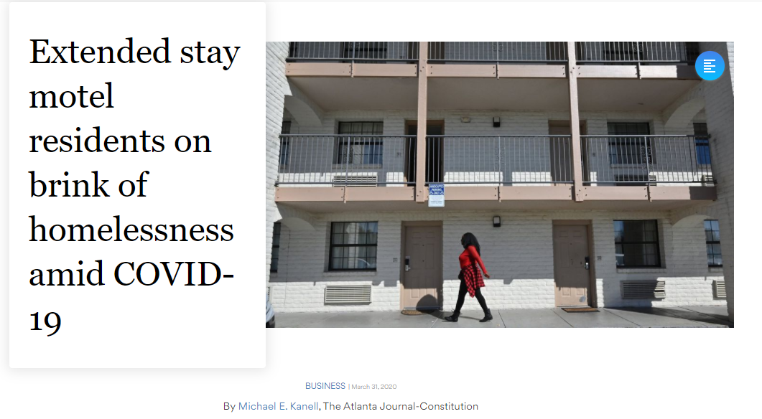
Why?
Vision: A collaborative effort and coordinated approach to serving our residents in response to Covid-19 as we restore, restructure, and rebuild Lawrenceville towards long-term sustainability
City of Lawrenceville was especially vulnerable to the economic fall-out caused by COVID-19:
Population: 30,834
Renter occupied housing units: 51%
Persons in poverty: 21.5%
5 extended stays that feed into one elementary school

Slide 5

Funding
(Prior to Cares Act funding)

Slide 6
City of Lawrenceville…
… proposal of $125k was approved contingent on raising matching funds…
Faith and individual
Nonprofit
Public
New Story Charity
$300,000
United Way
$25,000
NE GA Community Foundation
$30,000
City of Lawrenceville
$125,000
Gwinnett County
Cares Act: $200,000
$125,000 churches
$50,000 one individual
Opened virtual doors on April 14, 2020 with $500+K raised in one week

Slide 7

Program Structure
In response to Covid-19, Impact46, alongside strategic partner LHA and other nonprofits, seeks to operate an emergency intake center (Lawrenceville Response Center) as well as develop a long-term sustainability model for services to vulnerable families/residents in Lawrenceville. The LRC will refer residents to industry leaders in the following areas: Homelessness prevention, income loss recovery, and food distribution.

Slide 8

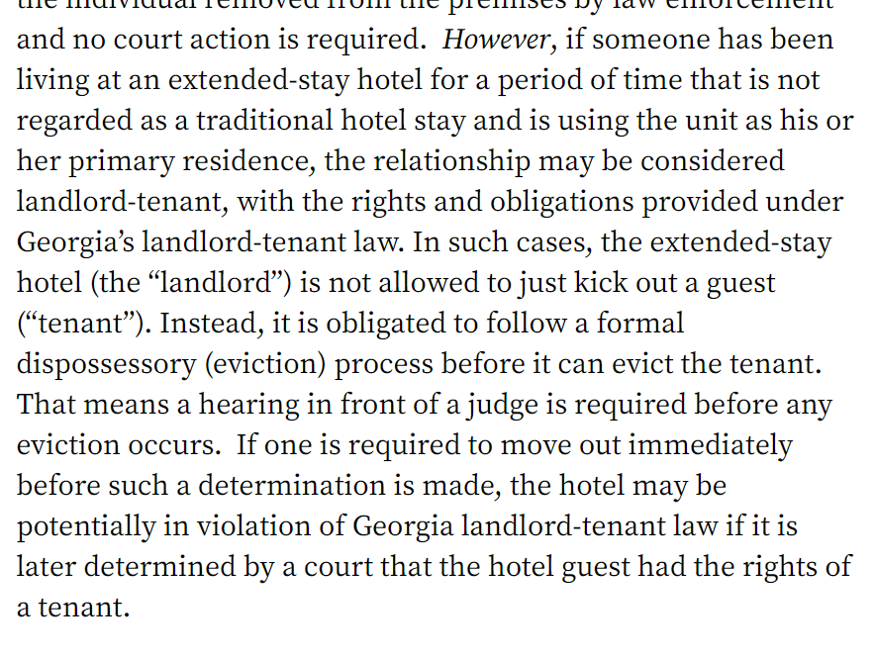
LRC model
Intake (Impact46) | Case Managers (Village of Hope) | Partners
Program oversight Collects online application Obtains verification documents Creates client file | Extended Stays | Lawrenceville Housing Authority
 |  | Georgia Center for Opportunity
 |  | Co-Op
 | Apartments
 |  | MMI-Clearpoint
 |  | Renasant Bank
 | Gwinnett County
 |  | Quality Care for Children
 |  | Padsplit

Slide 9
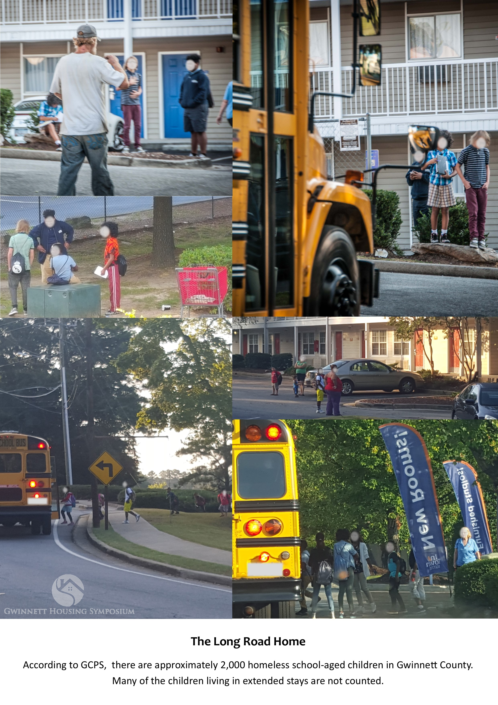
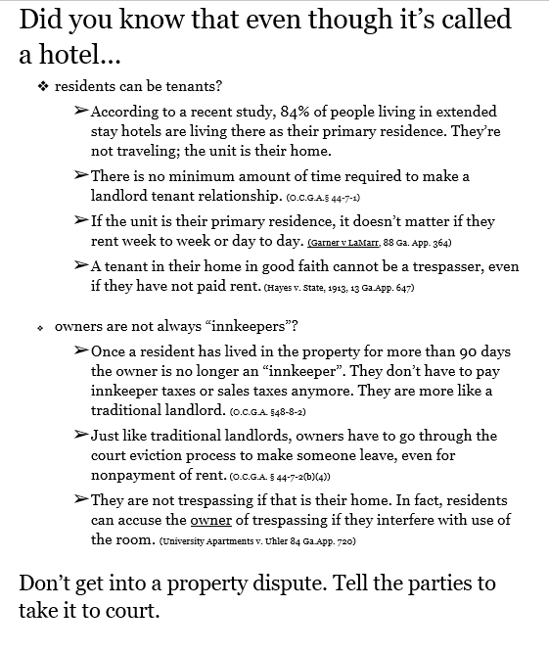
Large image

Slide 10

Accomplishments
(Prior to Cares Act funding)

Slide 11
City of Lawrenceville…
Partners
Technical Assistance
Housing options
Localized job search platform focused on living wage
Employment coaches/volunteers
Financial counseling (online platform for individualized learning)
Second chance banking
Child care assistance for 3 months
Affordable, safer, private sector alternative to extended stays
Nutrition assistance
Population served and services provided….
Individuals served
200+ households
436 individuals
213 of whom are children
Services provided
Up to 3 months housing assistance
Food distribution
Child care assistance
Housing options
Income recovery - $5-$6/hr higher wages
Employment coaches
Financial literacy

Slide 12
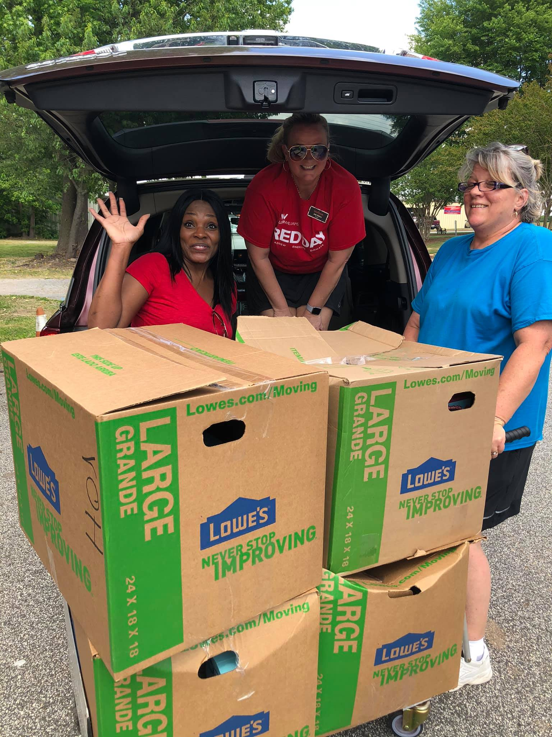
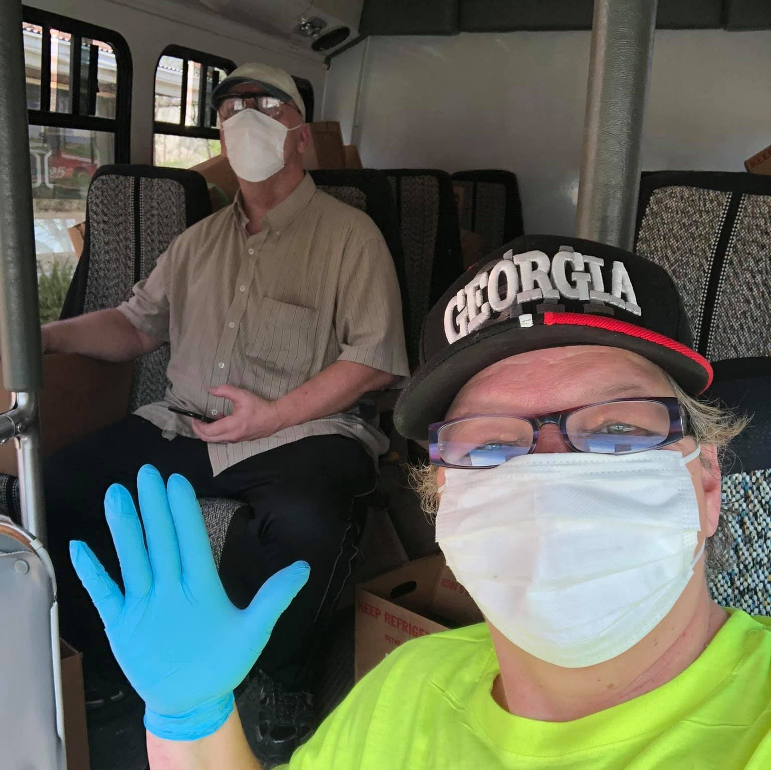
Importance of street outreach…
By Village of Hope
Relationships with extended stay managers
Negotiated rates
Client’s trust
On the ground presence

Slide 13

Challenges & Opportunities
“In the middle of every difficulty, lies an opportunity”
-Albert Einstein
This Photo by Unknown Author is licensed under CC BY

Slide 14
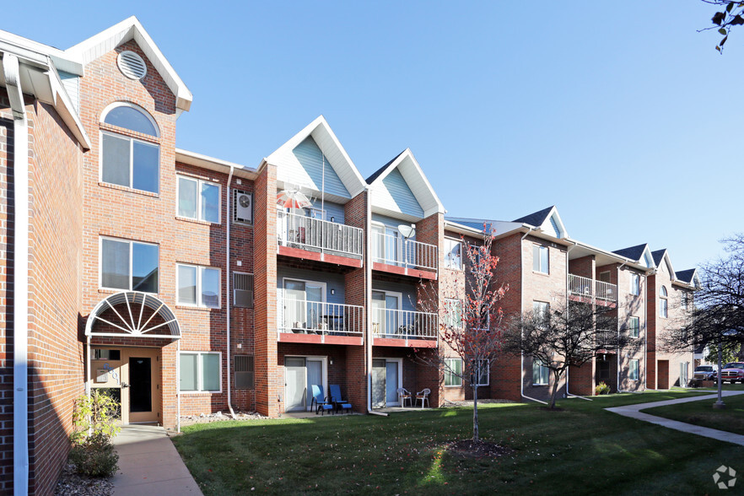
Challenges
Barriers to permanent housing
Despite advocacy and outreach efforts, many residing in extended stays not aware of their rights under the GA law
Increase in street homelessness
Lack of private sector engagement (despite investments)
Notes:
Post covid situation
$200K invested; symbiotic
Offered higher depsoits? Reasonable offer. In post covid world, these policeis won’t apply.

Slide 15


Opportunities
Long term sustainable model
County wide expansion
Additional funding: UW, Cares Act, Community Foundation
Build and sustain capacity of local non profits
Develop service delivery in an organized and planned manner

Slide 16

Recommendations
“The most valuable lessons aren’t taught; they are experienced”
-

Slide 17
Community Needs
Nutrition
Type of housing assistance
Supportive programs
Service Provider
Identify gaps
Identify Resources
Shared mission?
Inventory of nonprofits in your jurisdiction
Assess their capacity
Can your nonprofits handle higher volume?
Does your team address all of the community needs?
Financial
Volunteers (LEAP, St. Vincent de Paul)
Advocates, fundraisers, out of jurisdiction non profits
Do you need to bring in outside organizations?
Encourage your team to invest (Cares Act) funding in more affordable properties
Invest with owners willing to work with your clients (rent reduction (40/40/20), application standards, etc)
Negotiate
Advocate
Be strategic
Think Long-term
“Know Your Rights” flyer
Evictions (16% answered)
Motels
With landlords
With elected officials
“Hard-to-place” clients
Leverage your Cares Act funds
NOAH properties at risk of foreclosure
Families
Nonprofits
Housing sector
Community

Slide 18





Thank You
Lejla Prljaca
(770) 963-4900
Lejla@lhainfo.com
www.gwinnetthousing.org

