Slide 1
GA DCA

Slide 2
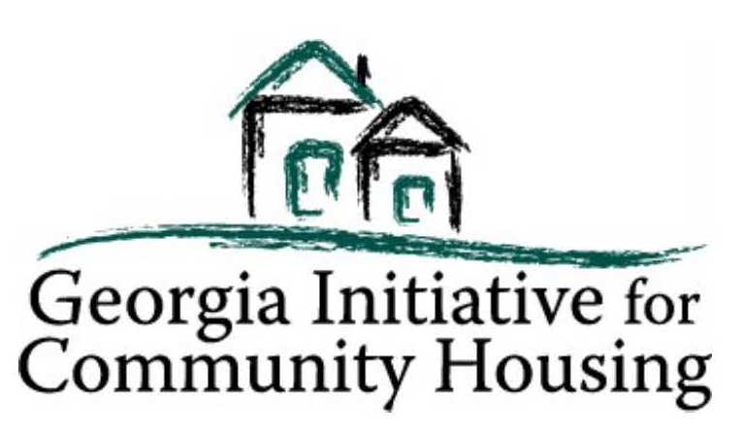
The Community Development Block Grant Program
March 29, 2022
Glenn Misner

Slide 3
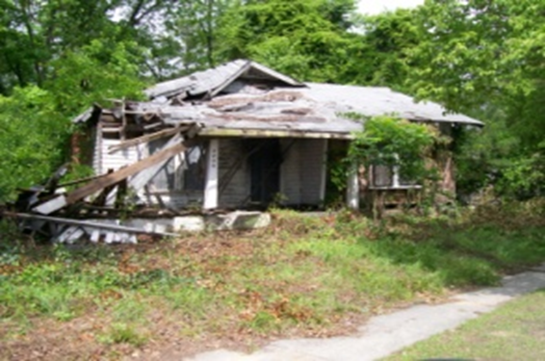
Look familiar???

Slide 4
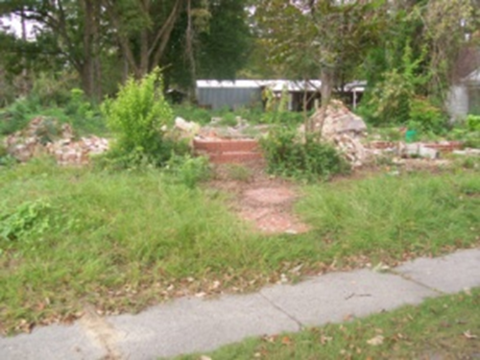

Slide 5
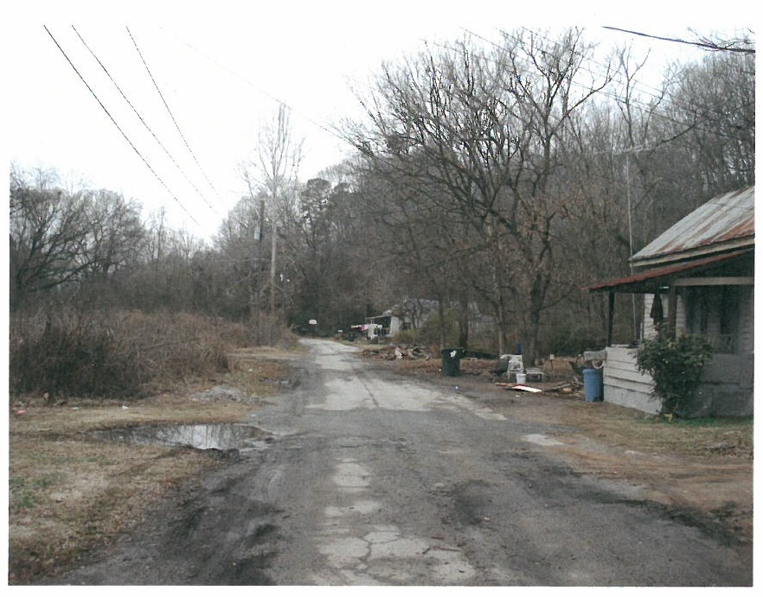

Slide 6
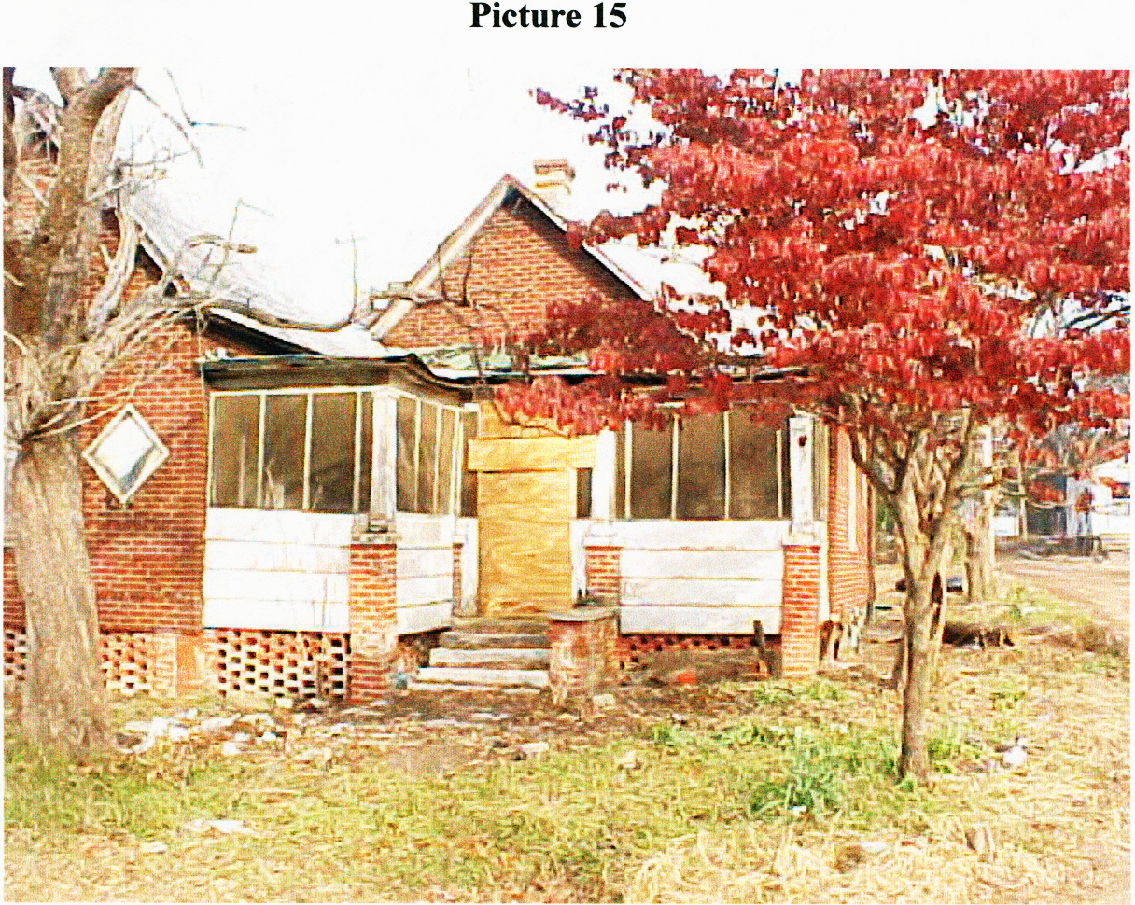

Slide 7
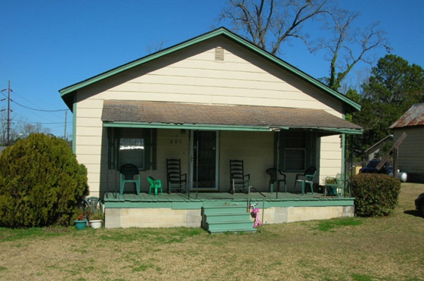

Slide 8
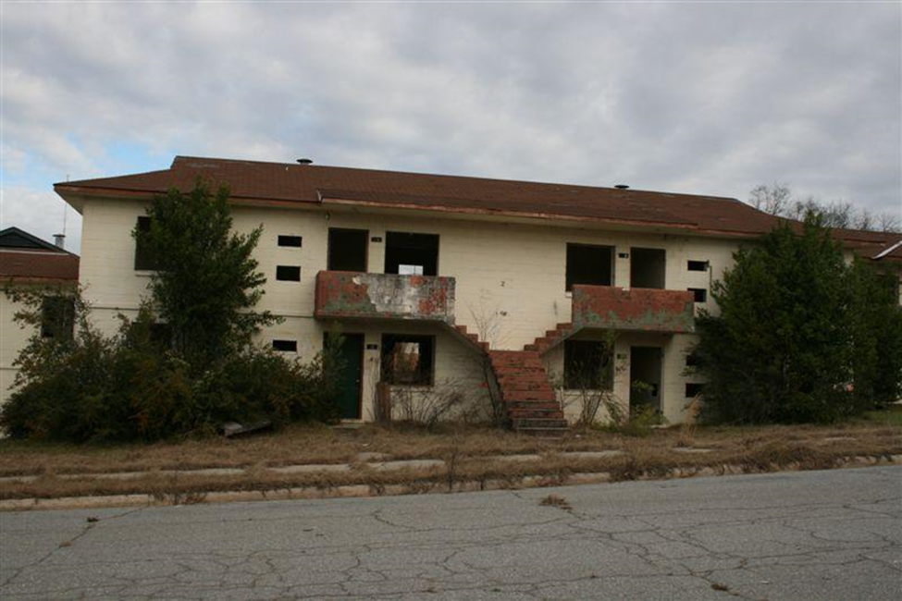

Slide 9
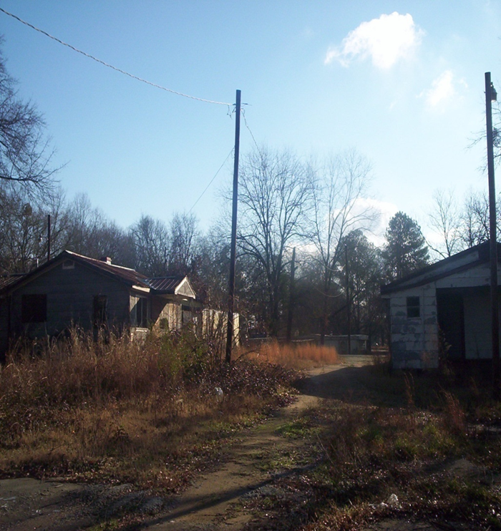

Slide 10
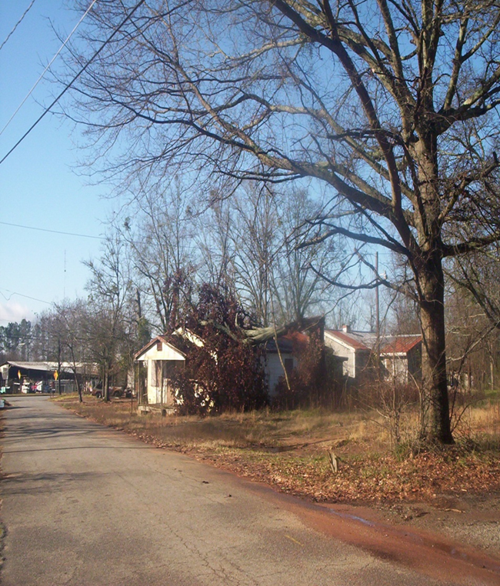

Slide 11
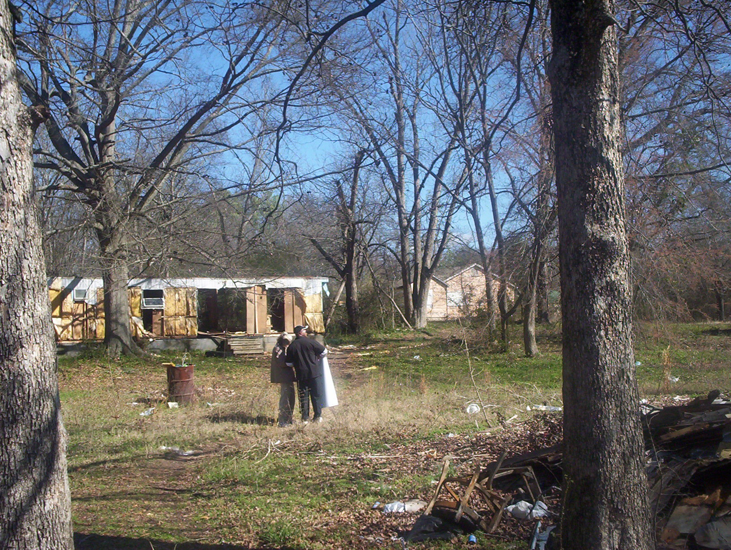

Slide 14
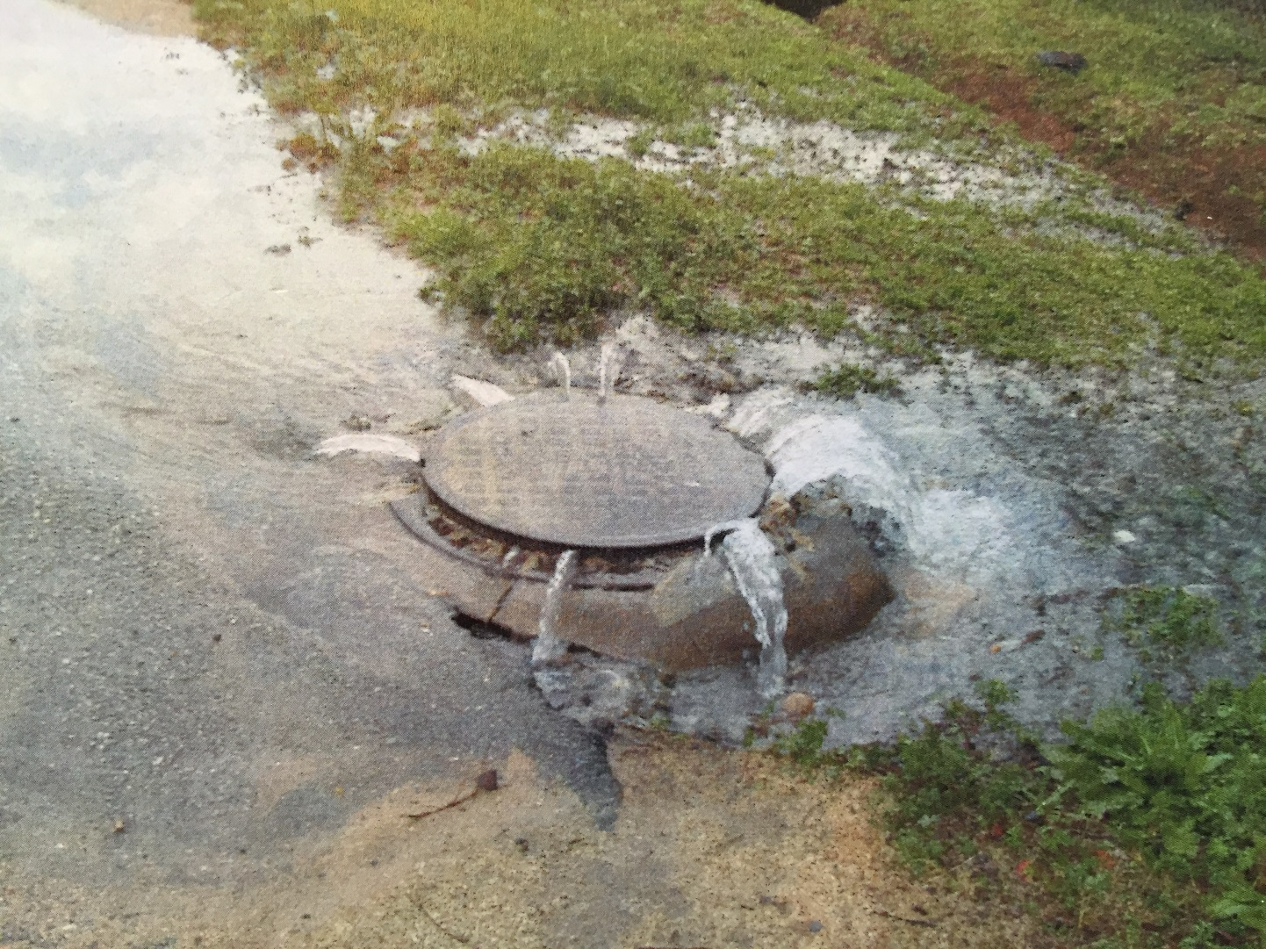

Slide 15
One tool that can help…….CDBG
Community Development Block Grant (CDBG) enacted by Congress as Title I of Housing and Community Development Act of 1974
The primary objective of CDBG is “the development of viable communities through improvement of living conditions, housing and the expansion of economic opportunities in cities and counties, principally for persons of low-and moderate income.”

Slide 16
State CDBG Program
Any NON-ENTITLEMENT local government (in good standing) may apply for funding through the state program
Local governments can implement a broad range of activities as long as they further the National Objectives of the Act
National Objectives are:
Majority benefit to low and moderate income persons through services and job creation
Prevention or elimination of slums and blight
Meeting urgent needs that pose a threat to the health and welfare of the community

Slide 17
CDBG Annual Competition
Funding Limits
Single Activity CDBG (Annual Competition) $1,000,000
Employment Incentive Program
Redevelopment Fund Program $750,000
Multi-Activity ------------------------------------ $1,250,000
Regional Cooperation Projects ------------ $2,000,000
Innovative Projects ---------------------------- $2,000,000

Slide 18
CDBG
Types of Grants – Annual Competition
Single Activity: up to $1,000,000
Neighborhood Revitalization
Rehabilitation
Reconstruction
Acquisition
Relocation
Demolition
Infrastructure Improvements
Sewer
Water
Streets
Drainage

Slide 19
CDBG
Types of Grants – Annual Competition
Single Activity: up to $1,000,000
Public Buildings
Health Departments
Senior Centers
Community Centers
Head start
Multi-Activity: up to $1,250,000
Neighborhood Revitalization PLUS Infrastructure/Building Activities

Slide 20
CDBG
Apply for Annual Competition
– Applications due June 3, 2022
Set–aside programs accept applications year-round
Applicant must be Local Government
Grant application writing/Administration
- Local Government
- RC’s
- Private Administrators
Funds may be channeled through Development Authorities, Non-Profits or other CBO’s

Slide 21
Eligible Activities Single Activity Neighborhood Revitalization Maximum $1,000,000.
Rehabilitation – To repair and/or bring to Code existing substandard housing unit – Owner or Renter*
*Requires 50/50 match from landlord & rental agreement
Reconstruction – Where unfeasible to Rehab, Demolish and construct new unit on same site – Owner Occupied ONLY.
Acquisition - of Real Property
Disposition – Costs Incidental to Disposing of Property Acquired with CDBG Funds
Code Enforcement – but…

Slide 22
Eligible Activities Single Activity Neighborhood Revitalization Maximum $1,000,000
Clearance – Of Dilapidated Structures, out-buildings, etc.
Interim Assistance
Relocation – Temporary or Permanent
Temp Relocation is NOT mandatory for Owner occupied units
Removal of Architectural Barriers
New construction generally is NOT Eligible unless undertaken by an approved Community Based Development Organization (CBDO)

Slide 23
Eligible Activities Single Activity Neighborhood Revitalization Maximum $1,000,000.
Home Buyer Assistance
Down Payment
Closing costs
Principle Reduction Payment
Interest buy-down
NOTE: DCA policy mandates use of fixed rate mortgages on all CDBG funded projects

Slide 24
Multi-Activity Maximum $1,250,000.
Multi-Activity
“Comprehensive Neighborhood Revitalization”
Includes Housing AND Public Facilities Activities
Limit of $1,250,000
Inter-related Activities
Same Target Area
Comprehensive (Meets all/most of the Needs in the Target Area)

Slide 25
View CDBG Applicants’ Workshop Presentations:
DCA.GA.Gov

Slide 26
Revitalization Area Strategies DCA designation that rewards efforts demonstrating:
Long-term vision for the area
Well-defined area that included comprehensive activities
Grassroots involvement from area residents
Commitment from other funding partners
Documented commitment from funders and stakeholders

Slide 27
Revitalization Area Strategies
Officially adopt a local Redevelopment Plan in accordance with the Urban Redevelopment Act O.C.G.A. 36-61
Eligible area of Census Block Group(s) of 20% or greater poverty level.
Develop strong local partnerships focusing local resources within the Revitalization Area.
CDBG Public Participation process
Submit application for designation to DCA.
Must be designated by DCA through application
Due at same time as CDBG Annual Competition

Slide 28
RAS Rewards:
Can apply for CDBG every year, provided that current CDBG project meets timeliness criteria
GICH PARTICIPANTS (Active or Certified Alumni) also qualify for this exemption if the project has a housing component
Provides up to 20 bonus points on CDBG Annual Competition applications that are proposed within the RAS area
Designation is effective for 3 years

Slide 29
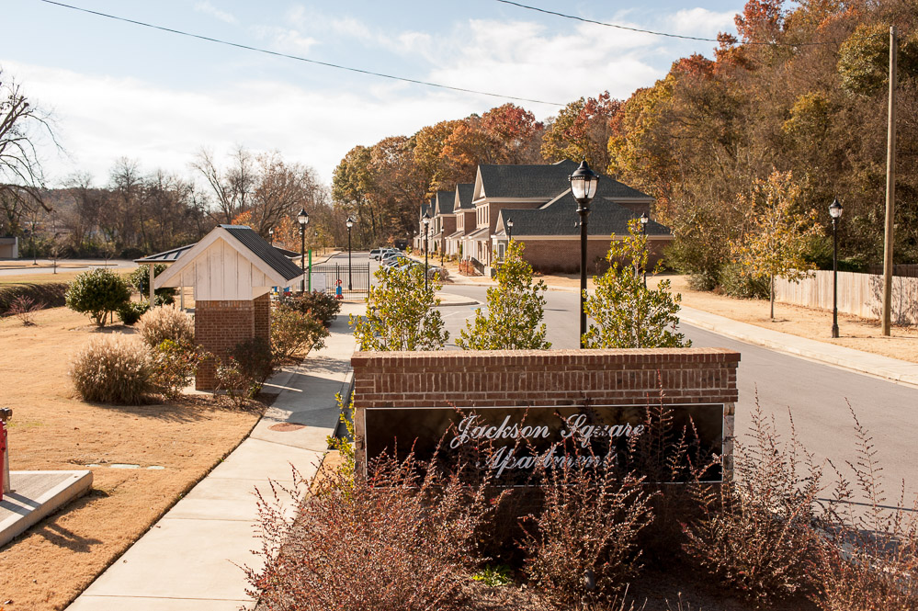
Results…………
Rockmart:
Jackson Square Apts.

Slide 30

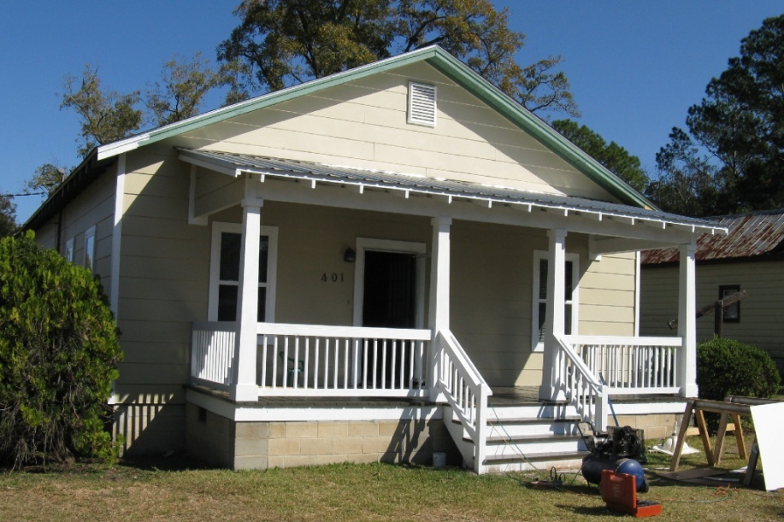
Thomasville: Victoria Place Revitalization Area

Slide 31

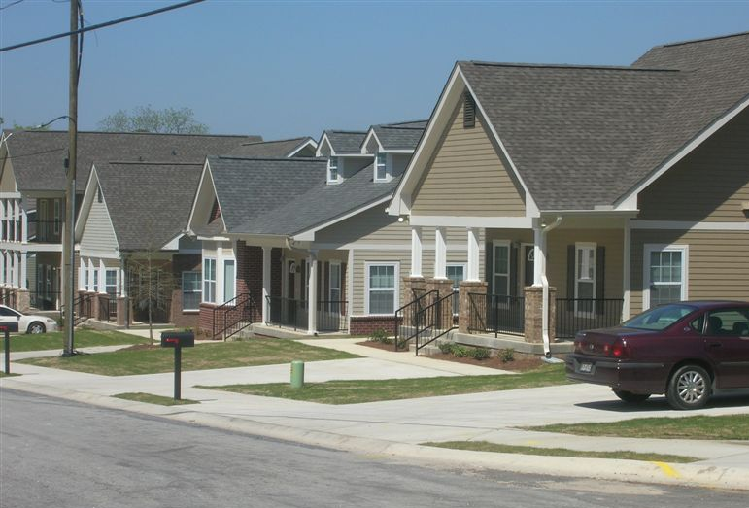
It CAN be done!
The former Macon Homes—now Bartlett’s Crossing

Slide 32
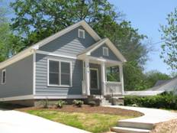
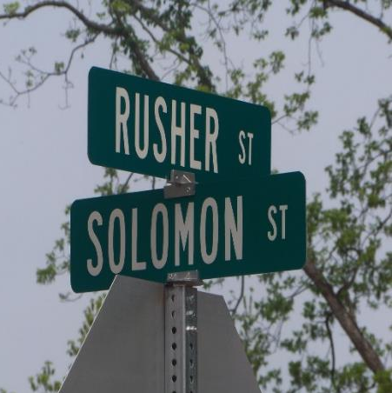
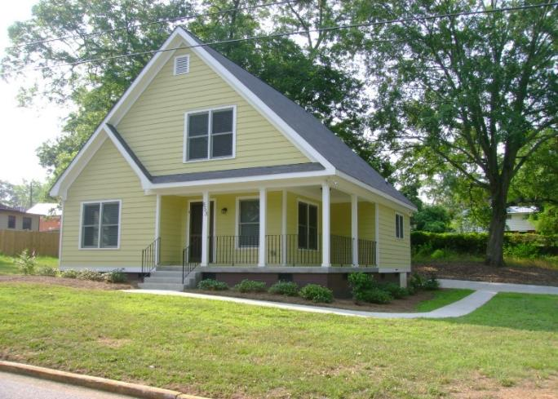
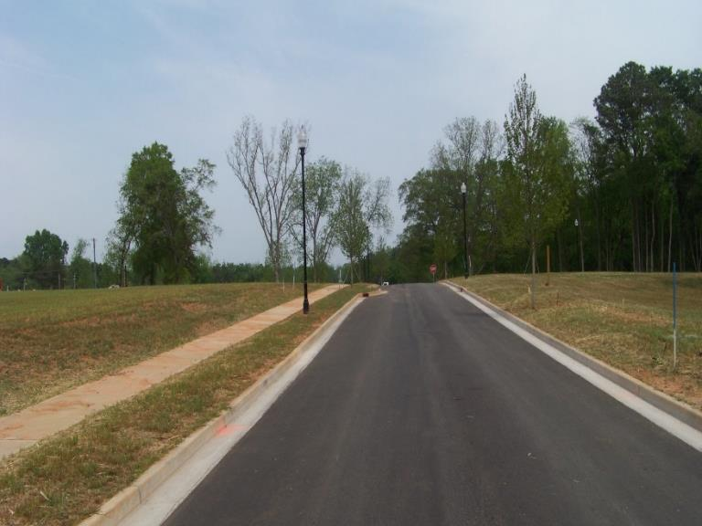
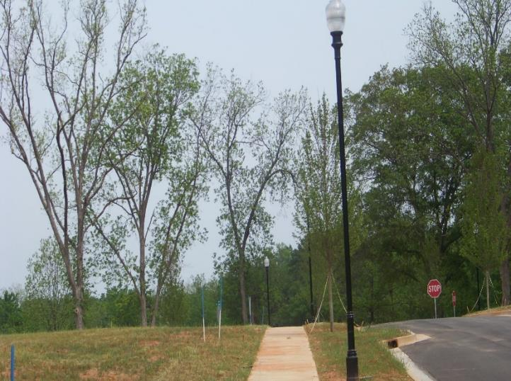
City of Washington - Rusher Street

Slide 33
Thank you!
Glenn Misner (404)679-3138
glenn.misner@dca.ga.gov

