Slide 1
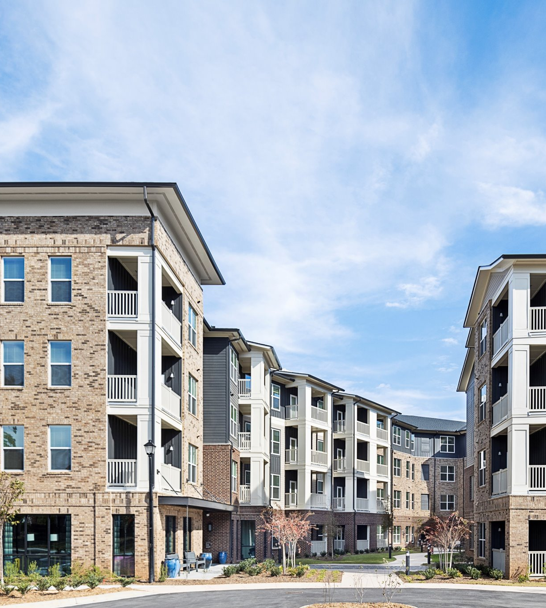

Housing Tax Credits
Hearthside Lawrenceville, Lawrenceville
OneStreet Residential & Lawrenceville Housing Authority
2024 GICH Retreat
April 16, 2024 | Tifton, Georgia
Mitch Kelly, Georgia DCA

Slide 2




DCA Organizational Flow
Commissioner
Christopher Nunn
Deputy Commissioner, Housing Assistance & Development
Philip Gilman
Division Director, Housing Finance & Development
Tommy Lowmon
Director, Office of Housing Finance
Mitch Kelly

Slide 3
Who is in the audience?

Slide 4

Reading the Room
You know about Housing Tax Credits

Slide 5
Reading the Room
You know about Housing Tax Credits
You don’t know about Housing Tax Credits

Slide 6
Reading the Room
You know about Housing Tax Credits
You don’t know about Housing Tax Credits
You have played a role in a Housing Tax Credit Development

Slide 7
Reading the Room
You know about Housing Tax Credits
You don’t know about Housing Tax Credits
You have played a role in a Housing Tax Credit Development
You would like to learn more about Housing Tax Credits

Slide 8
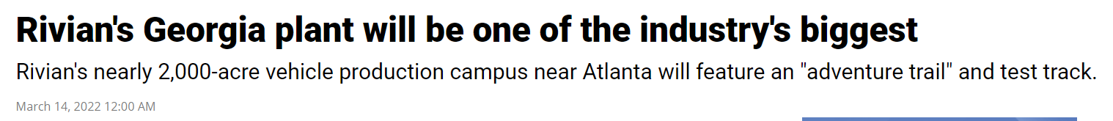




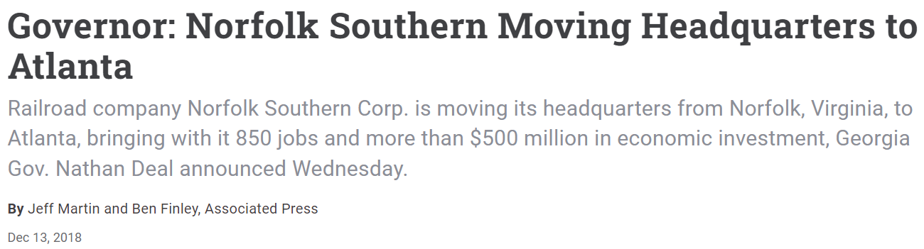



Slide 9
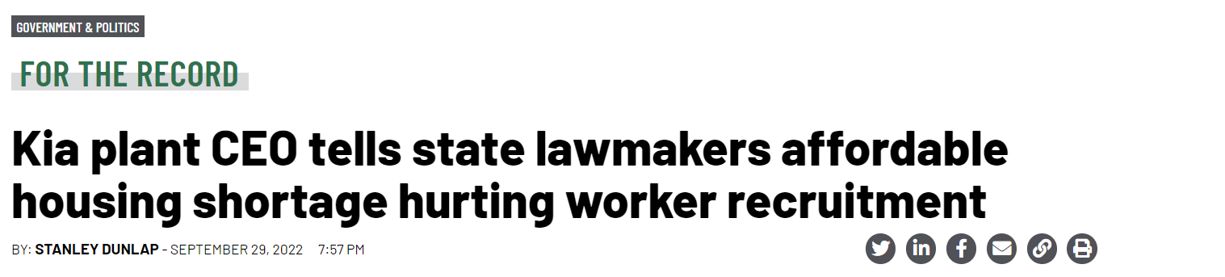

Slide 10
Housing Continuum
Temporary Housing | Supportive Housing | Rental (Workforce & Senior) | Homeownership
HOME-ARP
Housing Tax Credits
Rural Workforce Housing Initiative
CHIP

Slide 11
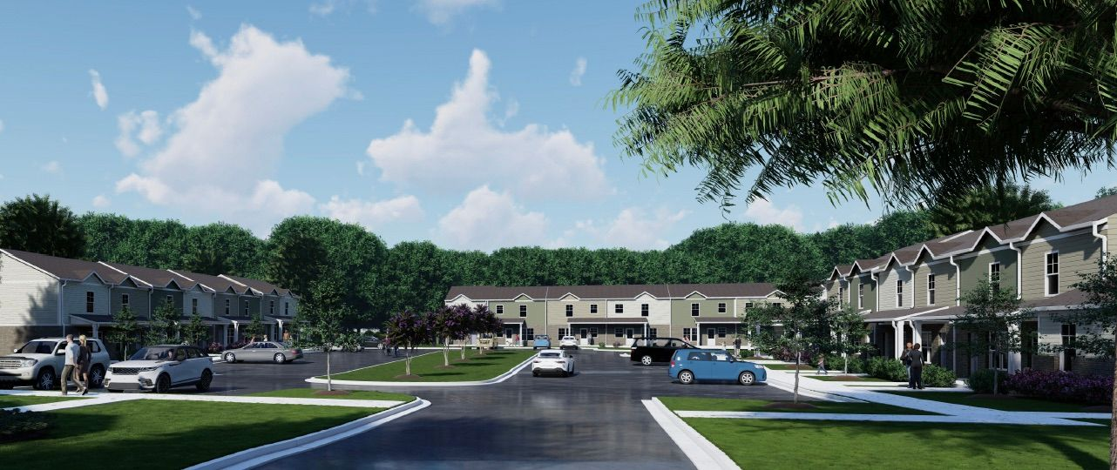
Basics
Carmichael Commons, Madison
Woda Cooper Development & Parallel Housing, Inc.

Slide 12
What is the Housing Tax Credit?
"an indirect federal subsidy used to finance the construction and rehabilitation of low-income affordable rental housing.”
- Novogradac

Slide 13
Housing Tax Credit Basics
Investor receives an annual tax credit for 10 Years
Equity investment → less debt → lower rents
Affordability for 30 years
4% or 9% Tax Credits
Since 1986, over 3 million affordable homes (~90,000 per year) have been built.
Bipartisan support

Slide 14


Example: Buying a House
Sale Price: $100,000
Down Payment: $20,000
Monthly Mortgage: $620
Annual Salary: ~$22,000/yr

Slide 15
Example: Buying a House
Sale Price: $100,000
Down Payment: $20,000
Down Payment: $70,000
Monthly Mortgage: $232
Annual Salary: ~$8,000/yr

Slide 16
Housing Tax Credit Effect
Monthly Rent:
$1,969
Monthly Rent:
$786

Slide 17
Who do we serve?
0-80% AMI
(Area Median Income)
60% AMI - $46,440
80% AMI - $61,920
4-person Household in Tift County
Notes:
4-person household in Tift County.

Slide 18
Important Dates
May
September- October
9%
9% Housing Tax Credit application deadline
9% Housing Tax Credit award announcements
October
January-February
4%
4% Housing Tax Credit/ Bonds application deadline
4% Housing Tax Credit/ Bonds award announcements

Slide 19
Important Dates
May
9%
9% Housing Tax Credit application deadline

Slide 20
QAP
IRS Requirement
Every state HFA has a QAP
“Rulebook” for how DCA allocates tax credits
DCA updates its QAP biannually
Three sections:
  1. Core Section (administrative topics)
  2. Threshold (minimum requirements)
  3. Scoring (points are king)

Slide 21

QAP

Slide 22
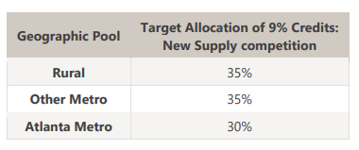
Geographic Spread
3 Geographic Locations: Rural, Atlanta Metro, and Other Metro
DCA ranks applications within each geographic pool
  Ex. Applications in Pooler will not be compared to applications in Atlanta

Slide 23
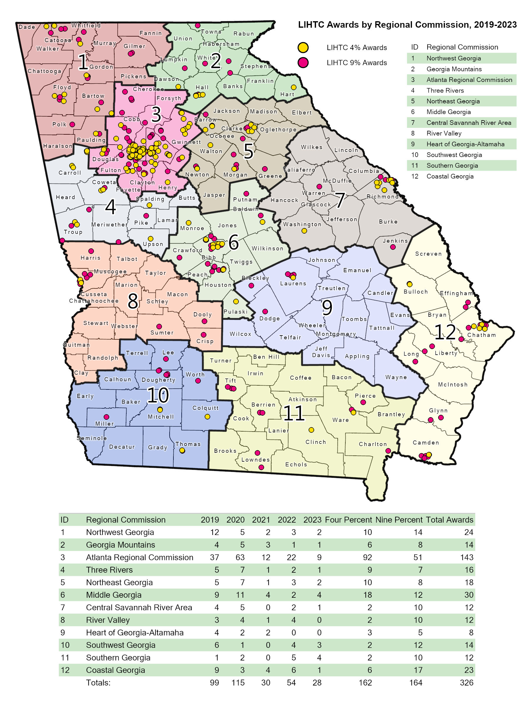
Geographic Spread

Slide 24
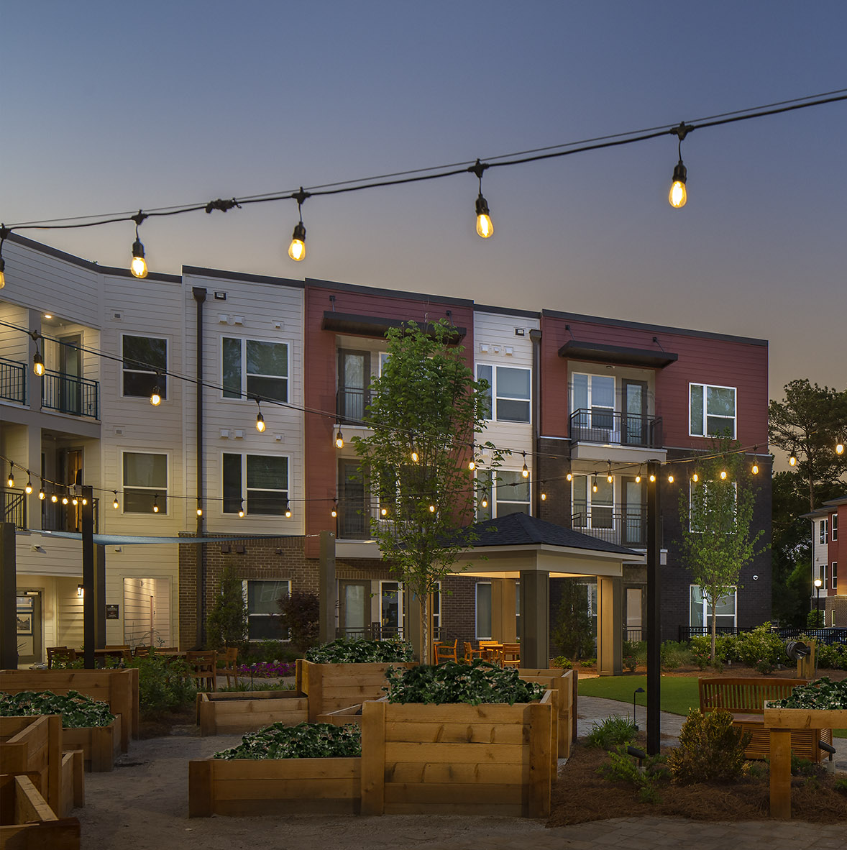
Columbia Canopy at Grove Park, Atlanta
Columbia Residential
Impact & Benefits

Slide 25
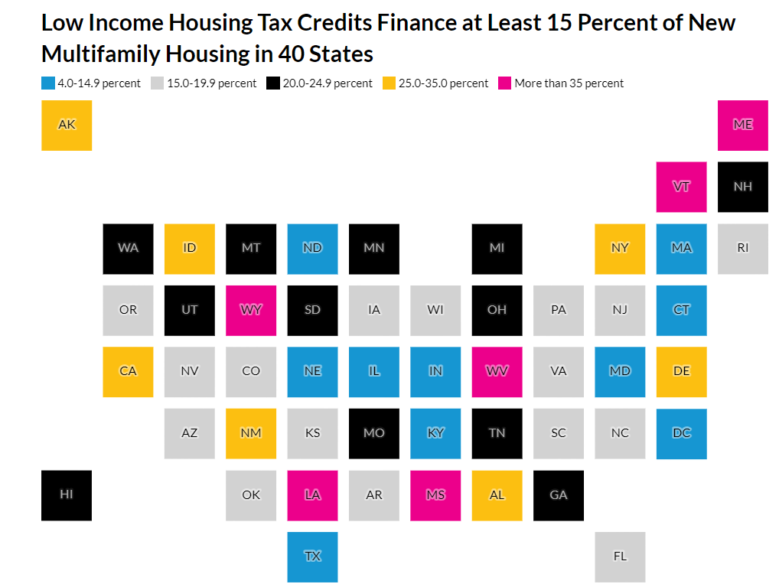
Impact in Georgia
LIHTC Provides Much-Needed Affordable Housing, But Not Enough to Address Today’s Market Demands
Urban Institute
Notes:
Housing Needs, GICH, Preservation ^ ?, Developer Fee,

Slide 26
Economic Impact and Research
Jobs
  100 newly constructed Housing Tax Credit units → 190 jobs
  (National Association of Home Builders for Enterprise Community Partners, 2023)
Taxation Revenue
  100 newly constructed Housing Tax Credit units → $7.9 Million in Tax Revenue
  (National Association of Home Builders for Enterprise Community Partners, 2023)
Economic Impact
  $1 in State Housing Tax Credits → $5.79 in Economic Activity
  (Center for Housing and Community Research, College of Family and Consumer Sciences Department of Agricultural and Applied Economics – University of Georgia for the Georgia Affordable Housing Coalition, 2023)
Property Performance
  Only ½ of 1% of Housing Tax Credit properties have faced foreclosure
  (CohnReznick, “Affordable Housing Credit Study,” 2021)
Notes:
Housing Needs, GICH, Preservation ^ ?, Developer Fee,

Slide 27
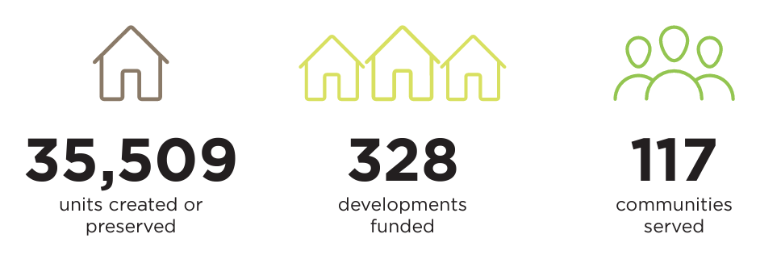
Impact in Georgia
5-Year Impact (2019-2023)

Slide 28
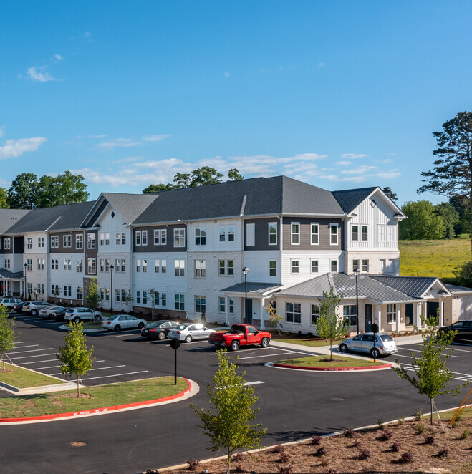
Sycamore Heights, Jefferson
OneStreet Residential and Tapestry Development Group
Getting Involved

Slide 29
Competition

Slide 30
Scoring
How to get a development funded – POINTS
Scoring sections (30+)
    GICH
    Community Transformation
    Revitalization Plan
    Favorable Financing
    Phased Developments
    PBRA Contracts
    Enriched Property Services
Planning
Participation

Slide 31
Scoring – Local Factors
Desirable/Undesirable Activities
Housing Needs Characteristics
Economic Development Proximity
Quality Education Areas
Notes:
Housing Needs, GICH, Preservation ^ ?, Developer Fee,

Slide 32
Scoring – Participation Factors
Revitalization/Redevelopment Plans
Favorable Financing
DCA Community Initiatives
Notes:
Housing Needs, GICH, Preservation ^ ?, Developer Fee,

Slide 33
Scoring – Getting Involved Early
What you control:
  Assessing community needs
  Issuing RFPs, RFQs, and RFIs
  Creating local incentives
  Reviewing and adjusting zoning
What you can influence:
  Organizing and garnering community buy-in
  Explaining plans and benefits
  Identifying and addressing potential concerns
  Learning from other communities

Slide 34
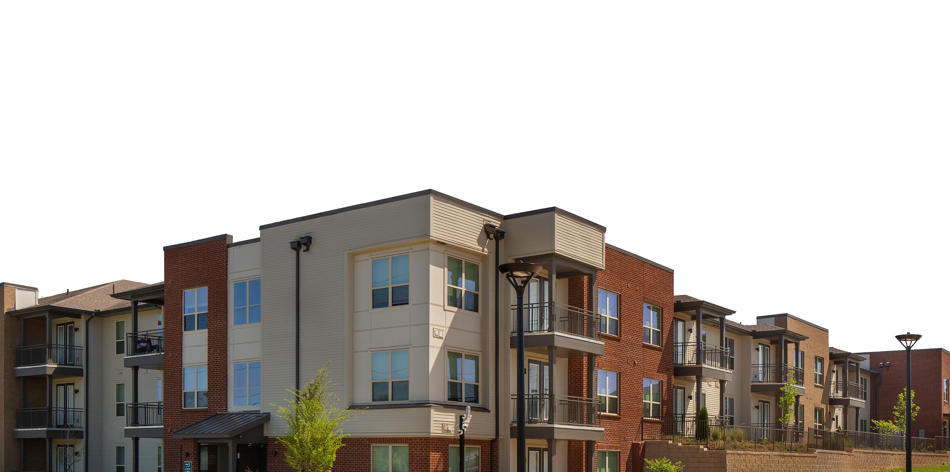
Thank you!
Banks at Mill Village, Columbus
Columbia Residential and Housing Authority of Columbus, Georgia

Slide 35
Mitch Kelly
Mitchell.Kelly@dca.ga.gov
Direct: 470-597-5352
Director, Office of Housing Finance

Slide 36
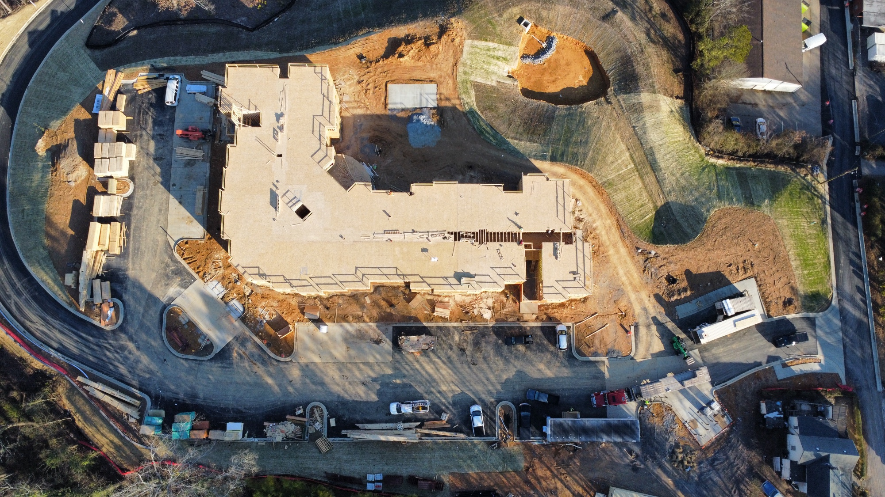
Sparrow Pointe, Rome
Birdsong Housing
Additional Information

Slide 37
2024 Policy Schedule
Jan. | Feb. | Mar. | Apr. | May | Jun. | Jul. | Aug. | Sep. | Oct. | Nov. | Dec. | ...
2019-2023 Analysis & Evaluation
HFA Outreach & Research
2024
Stakeholder Engagement & Individual Meetings
Listening Sessions & Focus Groups
2024 Analysis & Evaluation
2026-2027 Policy Priorities

Slide 38
2025 Policy Schedule
Jan. | Feb. | Mar. | Apr. | May | Jun. | Jul. | Aug. | Sep. | Oct. | Nov. | Dec. | ...
2026-2027 Policy Priorities & Public Comment
2026-2027 Policies Changes & Proposals
2025
‘26 – ’27 QAP Draft 1 & Public Comment
‘26 – ’27 QAP Draft 2 & Public Comment
‘26 – ’27 QAP
Final Draft
Housing Comm.
DCA Board

Slide 39
DCA Gap Financing (5-Years)

