Slide 1

“Understanding Fair Housing”
Georgia Initiative for Community Housing
(GICH)
Fall Retreat
October 5, 2021

Slide 2

GEORGIA DEPARTMENT OF COMMUNITY AFFAIRS
OFFICE OF LEGAL SERVICES
Christy Barnes
Director, Office of Legal Services
Christy.Barnes@dca.ga.gov
Joseph Collins
Staff Attorney, Office of Legal Services
Joseph.Collins@dca.ga.gov

Slide 3
GICH
Participating Communities
Freshmen | Sophomores | Juniors
Blakely | Adel | Arlington
Jonesboro | Hartwell | Centerville
Calhoun | Ocilla | Conyers
Covington | Rossville/LaFayette | Smyrna
East Point | Statesboro | Social Circle

Slide 4

GICH
&
Fair Housing

Slide 5
What is GICH?
Help community participants develop new ideas for meeting local housing needs and enhancing community development.
Provide community participants with tools to produce a community housing plan with objectives and goals.
Share with community participants best practices, available resources, and funding for housing as well as community development.
Facilitate community participants’ implementation of a housing and community development action plan.

Slide 6

What
is
Fair Housing?
Notes:
If the Equal Housing logo is included in advertising, it serves as an indication that the property can be bought or rent by anyone now matter what race, religion, national origin he or she has or whether he or she belongs to the sexual minorities.
This is the fair housing symbol; Landlords, banks, real estate agents and others use it to show that they will not discriminate against your family when you are looking for a home.

Slide 7
What is Fair Housing?
  Georgia residents have an equal opportunity to choose where they would like to live.
  Without being discriminated against or treated differently than other people.

Slide 8

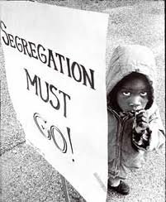
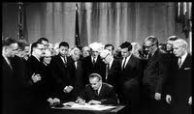
Fair Housing Act of 1968
Notes:
From 1965 to 1966, Dr. King co-led the Chicago Freedom Movement, a campaign which sought to challenge discrimination in employment, education, and housing in Chicago. The Chicago Freedom Movement is widely believed to have created momentum that led towards the passage of the Fair Housing Act of 1968.

Slide 9
Fair Housing Act Protected Classes
The Fair Housing Act prohibits discrimination in housing because of:
    Race
    Color
    Religion

Slide 10
Fair Housing Act Protected Classes cont.
The Fair Housing Act prohibits discrimination in housing because of:
    National Origin
    Sex
    Disability
    Familial Status ( including children under the age of 18 living with parents or legal custodians; pregnant women and people securing custody of children under 18)

Slide 11
Protections for Disabled Persons
Additional protections to those with a physical or mental disability that limits one or more life activities
Reasonable modifications to existing premises, occupied or to be occupied by a person with a disability, in order to afford such person full enjoyment of the premises.
People with disabilities are permitted to make reasonable modifications to their home, at their expense.
Housing providers must make reasonable accommodations Ex. A building with “no pets” policy must allow a visually impaired tenant to keep a guide dog.

Slide 12
Exemptions from the Fair Housing Act
Housing for Older Persons
    - Some senior housing facilities and communities from liability for familial status discrimination. All other discrimination protections remain in place.
Owner-occupied buildings with no more than four units
Single-family housing rented or sold without a broker
Housing for members only

Slide 13

Affirmatively Furthering
Fair
Housing

Slide 14
Affirmatively Furthering Fair Housing (AFFH)
The Fair Housing Act imposes an “affirmative” obligation to further fair housing...“[a]ction must be taken to fulfill, as much as possible, the goal of open, integrated residential housing patterns and to prevent the increase of segregation[.]”

Slide 15
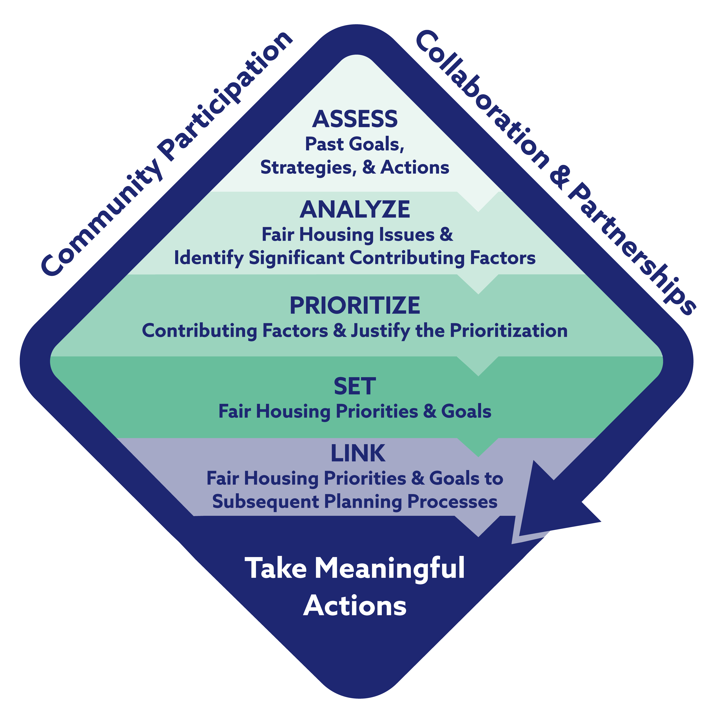
Affirmatively Furthering Fair Housing
Notes:
Community Participation, Collaboration, and Partnerships guide the path towards local communities taking meaningful actions to affirmatively further fair housing.

Slide 16
Assessment of Fair Housing
Initiate a process to identify and understand local fair housing issues.
Analyze fair housing issues in a local community.
Utilize the HUD-provided data, maps, and standard Assessment Tool.
- Build/locate an AFFH Map at: https://egis.hud.gov/affht/

Slide 17
Analyze Fair Housing Issues
Use the HUD-provided data, local data, and local community knowledge to undertake an analysis of fair housing issues.
The Assessment Tool will guide the local community through the required analysis.
Gather information through a community participation process and give the public reasonable opportunities for involvement

Slide 18
Analysis of Impediments to
Fair Housing Choice (AI)
Process for identifying fair housing concerns, existing conditions or barriers that limit housing choice and a plan for mitigating or remedying the impediments.
  AI must include:
    Clear analysis of collected information;
    Identify fair housing impediments, problems and concerns;
    Outline changes needed to remedy or overcome the impediments;
    Include a plan of action with a timeline; and
    Records showing actions taken.

Slide 19
Impediments Analysis
Use the contributing factor lists accompanied by descriptions of those potential factors
Gather information through your community participation process
Identify contributing factors from the lists provided or any other contributing factors not listed

Slide 20
Fair Housing Priorities and Goals
Set goals for improving fair housing choice and access.
Establish goals that will assist the local community in overcoming the contributing factors identified and related fair housing issues
Ensure plans to address fair housing impediments identified serve the overarching goal of affirmatively furthering fair housing.

Slide 21
              Affirmative Fair Housing Marketing Plan (AFHM)
Marketing strategy designed to attract buyers and renters of all majority and minority groups
Describes initial advertising, outreach (community contacts) and other marketing activities to inform potential buyers and renters.
No applicable HUD-assisted programs may be funded without an approved AFMH Plan
HUD Form 935.2a

Slide 22
Next Steps…
Implement strategies that contemplate the needs of the “Entire Community”.
Center fair housing goals in long-term community housing projections and plans.
Encourage housing developments that prioritize the integration of housing options to serve residents belonging to each of the Fair Housing Act protected classes.

Slide 23
Olmstead Decision
In 1999, the U.S. Supreme Court rendered a decision in Olmstead v. L.C., 527 U.S. 581 (1999), indicating that states have a legal obligation to administer programs and activities in the most integrated setting appropriate to the needs of qualified individuals with disabilities.
The Olmstead decision, and subsequent Department of Justice guidance, recognized that a state may satisfy this obligation through development of a comprehensive, effective working plan for placing qualified persons with disabilities in less restrictive settings.
These plans are known as Olmstead Plans and should serve as a guiding principle for local community planning.

Slide 24
Local Government Requirements

Slide 25
Local Government Requirements
Title I, Section 106, of the Housing and Community Development Act of 1974 requires:
No [funding] may be distributed by the State under the CDBG program to any unit of general local government in a non-entitlement area unless such unit of general local government certifies that it will comply with the Fair Housing Act.

Slide 26
Local Government Requirements
Each community is required to:
  Publish a phone number for residents to call who with fair housing questions or complaints
  Designate an employee of the unit of local government, to act as the Fair Housing Contact, who will generally be accessible Monday through Friday during regular business hours to receive phone calls and inquiries
  Establish a system to record the nature of the calls, the action taken and result of the action taken.
  Establish and implement a process to receive fair housing complaints and forward the complaints to the Georgia Commission on Equal Opportunity, which is charged with investigation and enforcement. Records must describe the type of referral, copies of housing discrimination complaint records, date of the referral, and any follow-up action.

Slide 27
Local Government Requirements
Communities are required to conduct training and provide education materials to:
  Residents of areas in which CDBG or HOME activities are being undertaken; or to special populations affected by the activities; and to three additional civic groups, organizations or schools.
  Training should address identified impediments to fair housing, if possible.
  Records must include an agenda, sign-in sheets or a description of the audience, marketing or promotional materials, meeting minutes, copy of training materials and any follow-up for each training.

Slide 28
Local Government Requirements
Communities are required to:
  Develop and distribute fair housing information and materials (posters, brochures, or materials) QUARTERLY to area agencies, organizations, or public events throughout program period.
  The telephone number (including a telephone number for use by the hearing impaired) of the local fair housing contact must be included in this information or materials.
  A list of the places of distribution, proof of distribution, dates of distribution, and quantities of material distributed must be maintained.

Slide 29
Local Government Requirements
Communities must also:
  Have process to identify special needs of women, disabled persons, and minorities.
  Ensure disadvantaged groups are adequately represented on policy-making bodies
  Maintain information on households displaced by CDBG activities.

Slide 30

Records, Records, Records!!!
Please document your Fair Housing and Non-discrimination actions.

Slide 31

Fair Housing Records
Fair Housing Records include:
  Analysis of Impediments to Fair Housing (AI) including:
  Action Plan and Evidence of Implementation;
  Implementation of Annual Fair Housing Program:
    Record of complaints and action taken or resolution;
    Administrative Contract, if applicable;
    Training documentation – includes sign-in sheet, agenda, minutes, copy of materials used and marketing information for each training; and
    Outreach documentation – evidence of quarterly distribution and copy of written educational materials used.
  A Copy of the local Fair Housing Resolution or Ordinance, news articles, etc. should also be in file.
Notes:
Sec. 808a. [42 U.S.C. 3608a] requires:
Collection of certain data To assess the extent of compliance with Federal fair housing requirements (including the requirements established under title VI… and title VIII …., the Secretary of Housing and Urban Development and the Secretary of Agriculture shall each collect, not less than annually, data on the racial and ethnic characteristics of persons eligible for, assisted, or otherwise benefiting under each community development, housing assistance, and mortgage and loan insurance and guarantee program administered by such Secretary.….

Slide 32

Limited-English Proficiency (LEP)
Notes:
The HUD web site located at:
http://portal.hud.gov/hudportal/HUD?src=/program_offices/fair_housing_equal_opp/promotingfh/lep
provides fair housing and other EEO materials in various languages for individuals whose first language is not English

Slide 33
Limited-English Proficiency (LEP)
Section 601 of Title VI the Civil Rights Act of 1964:
  “No person in the United States shall, on the grounds of race, color, or national origin, be excluded from participation in, be denied the benefits of, or be subjected to discrimination under any program or activity receiving Federal financial assistance.”

Slide 34
Limited-English Proficiency (LEP)
Many individuals living in the U.S. do not read, write, speak, or understand English.
Individuals with an inability to read, write, speak, or understand English face incredible impediments when attempting to obtain housing or other types of financial assistance.

Slide 35
Limited-English Proficiency (LEP) cont…
LEP applies to:
- All Federal Agencies (including HUD).
- All recipients of Federal Financial Assistance (FFA).
- FFA is broad and includes grants, training, use of equipment, donations of surplus property and more.
- Nearly all State and Local governments.
- Public Housing Authorities (PHAs).

Slide 36
Limited-English Proficiency (LEP) cont…
LEP applies to:
- Assisted Housing providers
- Fair Housing Initiative Program (FHIP)
- Fair Housing Assistance Program (FHAP)
- Other entities receiving funds directly, or indirectly, from HUD and other Federal agencies (i.e. sub-recipients, state grant recipients, etc.).

Slide 37
Limited-English Proficiency (LEP)
Entities that are recipients of Federal Financial Assistance must:
  - Develop a plan for persons of different national origins that cannot speak or read English.
  - Ensure that those individuals have meaningful access to all portions of their program or activity.

Slide 38
Limited-English Proficiency (LEP)
Local Communities are required to make reasonable efforts to provide language assistance to ensure meaningful access for LEP persons to the local community’s programs and activities.
To do this the local communities should:
- Conduct a four-factor analysis.
- Provide appropriate language assistance.
- Develop a written Language Assistance Plan (LAP).

Slide 39
Limited-English Proficiency (LEP)
LEP four (4) factor analysis that will assist in determining the reasonableness of language assistance based on:
1. Number or proportion of LEP persons in the population to be served.
2. Frequency with which LEP persons come into contact with the program activity or service.
3. Importance of the service, information, program, and/or activity.
4. Resources, financial and human, available to the recipient.

Slide 40
Language Access Plan (LAP)
Written plan is not required but is strong evidence of compliance.
Identify LEP persons who need assistance (after four factor analysis).
Adopt language assistance measures.
Training of staff, especially those who have frequent contact with the public.
Providing notice to LEP persons.
Monitoring & updating the LAP.

Slide 41
Language Access Plan (LAP)
LAP compliance includes:
  Vital and generic widely used written materials (intake forms, complaint/hearing forms, eviction notices, decrease in benefits, leases, etc.).
  In languages of targeted LEP groups.
  If a recipient provides written translations under these circumstances, it shall be considered strong evidence of compliance with its obligations.
  Failure to provide written translations DOES NOT necessarily mean there is noncompliance.

Slide 42
Language Access Plan (LAP)
LAP compliance includes:
  Written translations in each language that constitutes 5% or 1000 persons, whichever is less, of the population of eligible persons to be served or likely to be encountered.
  If there are fewer than 50 persons in a language group that reaches the 5% trigger, then recipient provides written notice of their right to receive competent oral interpretation of the written materials, free of cost.
  Reasonable availability is expected based on the four-factor analysis.

Slide 43
Language Access Plan (LAP)
LAP considerations:
  Competence of interpreter or translation services (certifications, age, relation to LEP person, etc.).
  Training of staff/Bilingual staff.
  Posting signs in common areas.
  Advertising language services in outreach documents.
  Partnering with LEP grassroots, faith-based organizations, and schools.
  Using telephone voicemail menu.
  Providing notice on Non-English radio and TV.

Slide 44
Language Access Plan (LAP)
Local Communities should have a process for:
  - Determining whether new documents, changes in programs, services and activities need to be made accessible to LEP persons.
  - Determining whether changes in demographics, services or needs require annual reevaluation of LAP.
  - Seeking feedback from the community the plan serves (advocacy groups serve vital role).

Slide 45
Language Access Plan (LAP)
HUD requires grantees:
  To extend reasonable efforts to afford persons with limited English proficiency meaningful access to its programs and services.
  To follow issued guidance in this area. While there is not a list of specific things that must be done in every circumstance.
*Key Question: Would a reasonable person believe that the grantee is seriously attempting to fulfill its obligations under Title VI?

Slide 46
For more information on
Fair Housing and Non-Discrimination
Community Development Block Grant
Toolkit on Crosscutting Issues
Module 5: Fair Housing and Non-Discrimination
includes
The statutes, regulations, forms and other documents that guide fair housing and non-discrimination practices in HUD programs.
This module also contains guidance on economic opportunities in contracting and employment, including the Section 3 job training and employment program, and Minority Business Enterprise and Women’s Business Enterprise requirements.
http://portal.hud.gov/hudportal/documents/huddoc?id=DOC_15955.pdf

Slide 47
What is Housing Discrimination?

Slide 48
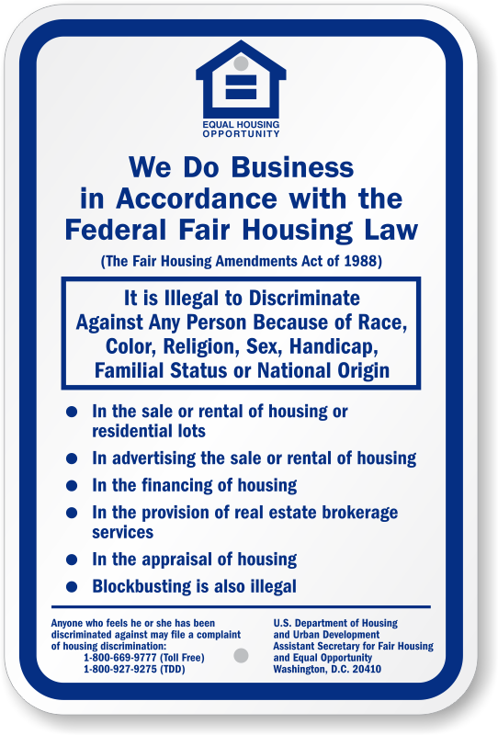
Housing Discrimination
Is
Illegal

Slide 49
A sign says “Vacancy”, but the manager says, “We just rented it”.
“You really wouldn’t have enough space with so many children”.
“I don’t think your wheelchair would fit through our doors”.
Housing Discrimination In Action

Slide 50
Only tenants of a certain race get eviction notices, etc.
Setting higher or lower rents, security deposit requirements or credit criteria for prospective tenants based on their race or other protected status.
Failing to respond to inquiries by prospective minority tenants.
Housing Discrimination In Action

Slide 51
Failing to inform prospective buyers about all available listings in their price range and desired locations.
Utilizing tactics to avoid showing a home or rental unit to an individual as a result of their status in one of the covered protected classes.
Exaggerating sales terms in order to discourage certain homebuyers or to price them out of the market.
Housing Discrimination In Action

Slide 52
Experience Housing Discrimination…
What Next?

Slide 53
If you think your rights have been violated, you will need the following information:
  - Your name and address
  - The name and address of the person your complaint is against
  - The address or other identification of the housing involved
  - A short description of the alleged violation
  - The date(s) of the alleged violation
  *Please note that the complaint must be filed within one (1) year of the alleged violation.
Reporting Housing Discrimination

Slide 54
Reporting Housing Discrimination
If you think your rights have been violated, you may file your complaint by one of the following:
  - Mailed Letter
  - Fax
  - Online submission
  - Telephone

Slide 55
Reporting Housing Discrimination
If you think your rights have been violated, you may file your complaint with one of the following:
Georgia Commission on Equal Opportunity
7 Martin Luther King Jr. Drive, SE
Suite 351 – Agriculture Bldg.
Atlanta, Georgia 30334
Phone: 404 – 656 – 1736
Toll Free: 1 – 800 – 473 – OPEN (6736)
Fax: 404 – 656 – 4399
https://gceo.georgia.gov/fair-housing-division
HUD Southeast Regional Office – Atlanta Regional Office
Fair Housing and Equal Opportunity (FHEO) Center
40 Marietta Street
16th Floor
Atlanta, Georgia 30303
Phone: 404 – 331 -5140
Toll Free: 1 – 800 – 440 – 8091 x 2493
Fax: 404 – 331 – 1021
*TTY 404 – 730 - 2654
Complaints_office_04@hud.gov
HUD – Washington D.C. Headquarters
Office of Fair Housing and Equal Opportunity
451 7th Street, S.W.
Room 5204
Washington, DC 20410
Toll Free: 1 – 800 – 669 -9777
Fax: 202 -708 - 1425
*TTY 1 - 800 – 927 - 9275
www.hud.gov/fairhousing

Slide 56
Once you file a
Fair Housing Complaint
HUD will:
    - Notify you in writing when your complaint is accepted
  - Notify the alleged violator of the filed complaint and allow the violator to submit a written answer
  - Conduct a reasonable cause investigation of the complaint
  - Notify you and the alleged violator if HUD cannot complete its reasonable cause investigation with 100 days of the complaint filing and provide reason(s) for the delay.

Slide 57
Once you file a Fair Housing Complaint
Once a complaint is filed, HUD will, alternatively:
    - During the reasonable cause investigation of the complaint, HUD is required to offer you and the respondent the opportunity to voluntarily resolve your complaint with a Conciliation Agreement.

Slide 58
Fair Housing Complaint Investigation Complete
Once a fair housing complaint is complete, HUD will:
    Prepare a Final Investigative Report summarizing the investigation findings.
        - If HUD determines that there is reasonable cause that discrimination against the complainant occurred, HUD will issue a Determination of Reasonable Cause and a Charge of Discrimination against the alleged violator.
    Both parties will have twenty (20) days after receiving HUD’s decision to decide whether the case will be heard by a HUD Administrative Law Judge or to have a civil trial in Federal District Court.

Slide 59
Georgia Department of Community
Affairs Assistance
For general inquiries or assistance, please contact:
fairhousing@dca.ga.gov

Slide 60

Thank You!

