Slide 1
GICH - Housing 101
Matt Forshee
Region Economic Development Manager
April 17, 2024

Slide 2
HOUSING IS ONE OF THE GREATEST CHALLENGES YOUR COMMUNITY WILL FACE OVER THE NEXT 25 YEARS!
Notes:
HOUSING IS ONE OF THE GREATEST CHALLENGES YOUR COMMUNITY WILL FACE OVER THE NEXT 25 YEARS!

Slide 3
SO, WHAT ARE YOU GOING TO DO ABOUT IT?!
Notes:
SO, WHAT ARE YOU GOING TO DO ABOUT IT?!

Slide 4
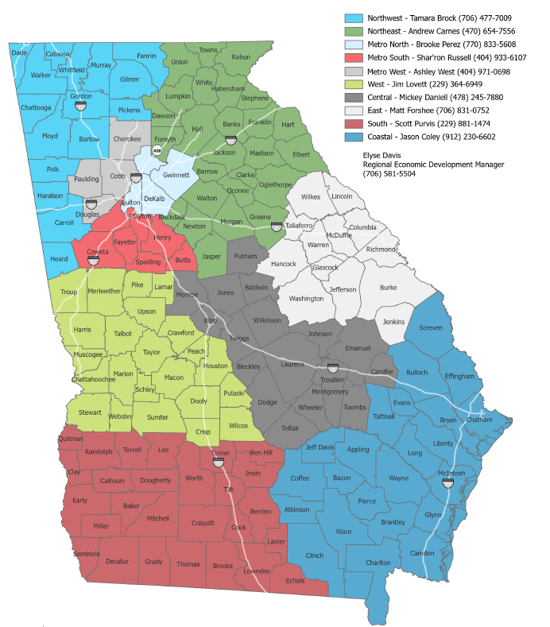
Georgia Power’s Region Economic Development Team
Notes:
Good afternoon. I’m Matt Forshee and I’m one of ten Georgia Power Regional Economic Development Managers who cove the state and work with communities on all manner of community development and economic development issues. My territory includes the area around Augusta known as the CSRA. I’m also our team’s lead on housing as it relates to workforce and economic development. I especially want to shoutout to the Freshmen communities of Augusta-Richmond County, Catoosa County, the City of Cornelia, the City of St. Mary's, and the City of Thomaston as you start on this GICH journey to address and fulfill your housing needs through collaboration and technical assistance.

Slide 5
Housing 101 Agenda
Housing Challenges
Types of Housing
Wrap Up & Q&A
Notes:
Housing 101 Agenda
Today, we'll embark on a journey through the basics of housing, a foundational topic that underpins the success of community development projects. We'll explore the current housing challenges that communities face, understand the various types of housing and their roles, delve into the housing development process, and finally, discuss the broader impact of housing on communities.
Why focus on housing? Because it's more than just buildings. It's about creating homes, fostering communities, and shaping the future of our cities and towns. The quality, affordability, and availability of housing affect economic stability, educational opportunities, and the overall well-being of our communities.
As we move forward, I encourage you to think about how these topics resonate with your own community's experiences. I look forward to a lively discussion and to hearing your insights and questions as we go along.

Slide 6
Understanding Housing Challenges
Notes:
Let's dive into the heart of the matter. Our communities are facing a trio of intertwined challenges when it comes to housing: affordability, availability, and quality. Each of these issues plays a critical role in shaping the living conditions and prospects of our residents.

Slide 7
Housing Affordability
Notes:
SO, WHAT ARE YOU GOING TO DO ABOUT IT?!

Slide 8
Generational Housing (Single Family Units)
 | Boomers | Gen X | Millennial | 2024
Born | 1946-1964 | 1965-1980 | 1981-1996
Married | 1978 | 1998 | 2018
First child/home | 1979 (1,600 sf) | 1999 | 2019 | 2024
Median Household Income | $16,530 ($1,377.5/mo) | $42,000 (2.54x) ($3,500/mo) | $68,703 (1.64x) ($5,725.25/mo) | $77,283 (1.12x) ($6,440.25/mo)
Median home price | $54,000 | $130,000 (2.41x) | $265,000 (2.04x) | $398,000 (1.50x)
20% Down | $10,800 | $26,000 | $53,000 | $79,600
Mortgage | $43,200 | $104,000 | $212,000 | $318,400
Interest Rates | 11.2% | 7.44% | 3.94% | 7.815%
Monthly Mortgage | $418 | $723 | $1,005 | $2,295
Monthly Tax & Insurance | $72 | $173 | $353 | $531
Total Payment | $490 | $896 | $1,358 | $2,826
Housing as % of income | 35% | 25% | 24% | 44%
Source: US Census; US Dept of Housing and Urban Development
Notes:
For many generations, America and home ownership got better for the next generation. Let’s look at three Generations of housing along with today’s numbers to see where there may be data.
For the Baby Boomer Generation (b between 1946 & 1964), our typical couple, Bill & Barb, were born in the early 1950s, married in 1978 and had had their first child, Beth, and bought their first house in 1979. At that time, the median household income was $16,530 per year ($11,377.50/month). They bought a home right at the median home price of $54,000 and had scrimped and saved the 20% downpayment of $10,800. They secured a 30-year mortgage for $43,200 at an interest rate of 11.2%, giving them a monthly mortgage payment of $418 plus monthly taxes and insurance of $72 for total monthly housing payment of $490, or about 35% of their monthly income before taxes.
Interest rates were high

Slide 9
Generational Housing (Single Family Units)
 | Boomers | Gen X | Millennial | 2024
Born | 1946-1964 | 1965-1980 | 1981-1996
Married | 1978 | 1998 | 2018
First child/home | 1979 (1,600 sf) | 1999 (2,223 sf) | 2019 | 2024
Median Household Income | $16,530 ($1,377.5/mo) | $42,000 (2.54x) ($3,500/mo) | $68,703 (1.64x) ($5,725.25/mo) | $77,283 (1.12x) ($6,440.25/mo)
Median home price | $54,000 | $130,000 (2.41x) | $265,000 (2.04x) | $398,000 (1.50x)
20% Down | $10,800 | $26,000 | $53,000 | $79,600
Mortgage | $43,200 | $104,000 | $212,000 | $318,400
Interest Rates | 11.2% | 7.44% | 3.94% | 7.815%
Monthly Mortgage | $418 | $723 | $1,005 | $2,295
Monthly Tax & Insurance | $72 | $173 | $353 | $531
Total Payment | $490 | $896 | $1,358 | $2,826
Housing as % of income | 35% | 25% | 24% | 44%
Source: US Census; US Dept of Housing and Urban Development
Notes:
For many generations, America and home ownership got better for the next generation

Slide 10
Generational Housing (Single Family Units)
 | Boomers | Gen X | Millennial | 2024
Born | 1946-1964 | 1965-1980 | 1981-1996
Married | 1978 | 1998 | 2018
First child/home | 1979 (1,600 sf) | 1999 (2,223 sf) | 2019 (2,473 sf) | 2024
Median Household Income | $16,530 ($1,377.5/mo) | $42,000 (2.54x) ($3,500/mo) | $68,703 (1.64x) ($5,725.25/mo) | $77,283 (1.12x) ($6,440.25/mo)
Median home price | $54,000 | $130,000 (2.41x) | $265,000 (2.04x) | $398,000 (1.50x)
20% Down | $10,800 | $26,000 | $53,000 | $79,600
Mortgage | $43,200 | $104,000 | $212,000 | $318,400
Interest Rates | 11.2% | 7.44% | 3.94% | 7.815%
Monthly Mortgage | $418 | $723 | $1,005 | $2,295
Monthly Tax & Insurance | $72 | $173 | $353 | $531
Total Payment | $490 | $896 | $1,358 | $2,826
Housing as % of income | 35% | 25% | 24% | 44%
Source: US Census; US Dept of Housing and Urban Development
Notes:
For many generations, America and home ownership got better for the next generation

Slide 11
Generational Housing (Single Family Units)
 | Boomers | Gen X | Millennial | 2024
Born | 1946-1964 | 1965-1980 | 1981-1996
Married | 1978 | 1998 | 2018
First child/home | 1979 (1,600 sf) | 1999 (2,223 sf) | 2019 (2,473 sf) | 2024 (2,411 sf)
Median Household Income | $16,530 ($1,377.5/mo) | $42,000 (2.54x) ($3,500/mo) | $68,703 (1.64x) ($5,725.25/mo) | $77,283 (1.12x) ($6,440.25/mo)
Median home price | $54,000 | $130,000 (2.41x) | $265,000 (2.04x) | $398,000 (1.50x)
20% Down | $10,800 | $26,000 | $53,000 | $79,600
Mortgage | $43,200 | $104,000 | $212,000 | $318,400
Interest Rates | 11.2% | 7.44% | 3.94% | 7.815%
Monthly Mortgage | $418 | $723 | $1,005 | $2,295
Monthly Tax & Insurance | $72 | $173 | $353 | $531
Total Payment | $490 | $896 | $1,358 | $2,826
Housing as % of income | 35% | 25% | 24% | 44%
Source: US Census; US Dept of Housing and Urban Development
Notes:
For many generations, America and home ownership got better for the next generation

Slide 12
Generational Housing (Single Family Units)
 | Boomers | Gen X | Millennial | 2024
Born | 1946-1964 | 1965-1980 | 1981-1996
Married | 1978 | 1998 | 2018
First child/home | 1979 (1,600 sf) | 1999 (2,223 sf) | 2019 (2,473 sf) | 2024 (2,411 sf)
Median Household Income | $16,530 ($1,377.5/mo) | $42,000 (2.54x) ($3,500/mo) | $68,703 (1.64x) ($5,725.25/mo) | $77,283 (1.12x) ($6,440.25/mo)
Median home price | $54,000 | $130,000 (2.41x) | $265,000 (2.04x) | $398,000 (1.50x)
20% Down | $10,800 | $26,000 | $53,000 | $79,600
Mortgage | $43,200 | $104,000 | $212,000 | $318,400
Interest Rates | 11.2% | 7.44% | 3.94% | 7.815%
Monthly Mortgage | $418 | $723 | $1,005 | $2,295
Monthly Tax & Insurance | $72 | $173 | $353 | $531
Total Payment | $490 | $896 | $1,358 | $2,826
Housing as % of income | 35% | 25% | 24% | 44%
Source: US Census; US Dept of Housing and Urban Development
Notes:
For many generations, America and home ownership got better for the next generation

Slide 13
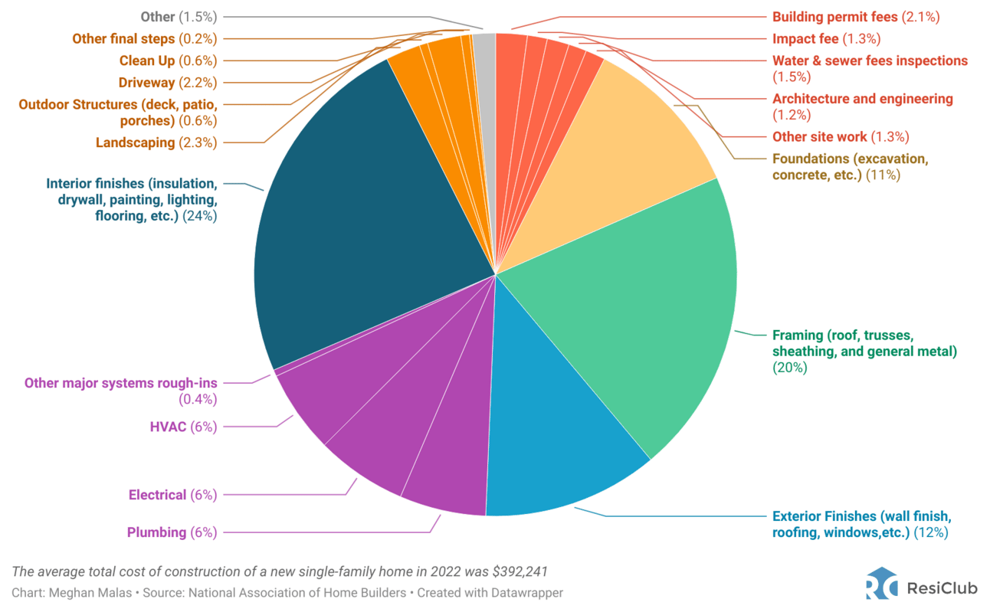
Sources of Costs for an Average New US Single Family Home, 2022

Slide 14
Golden Handcuffs
Source: Federal Housing Finance Agency’s National Mortgage Database, Q4 2023
Notes:
Considering that the vast majority of mortgage borrowers currently have an interest rate below the average 30-year fixed mortgage rate (6.91%), it implies that the "switching costs" associated with selling and buying another property are very high at the moment. The question isn't whether these "golden handcuffs" will suppress existing home sales, but rather by how much.

Slide 15
Golden Handcuffs
86.6% of outstanding mortgages had an interest rate below 6.00% in Q4 2023. People don’t want to leave a low-cost mortgage unless they have no choice, so existing home sales are limited. Low, low inventory!
Source: Federal Housing Finance Agency’s National Mortgage Database, Q4 2023
Notes:
Considering that the vast majority of mortgage borrowers currently have an interest rate below the average 30-year fixed mortgage rate (6.91%), it implies that the "switching costs" associated with selling and buying another property are very high at the moment. The question isn't whether these "golden handcuffs" will suppress existing home sales, but rather by how much.

Slide 16
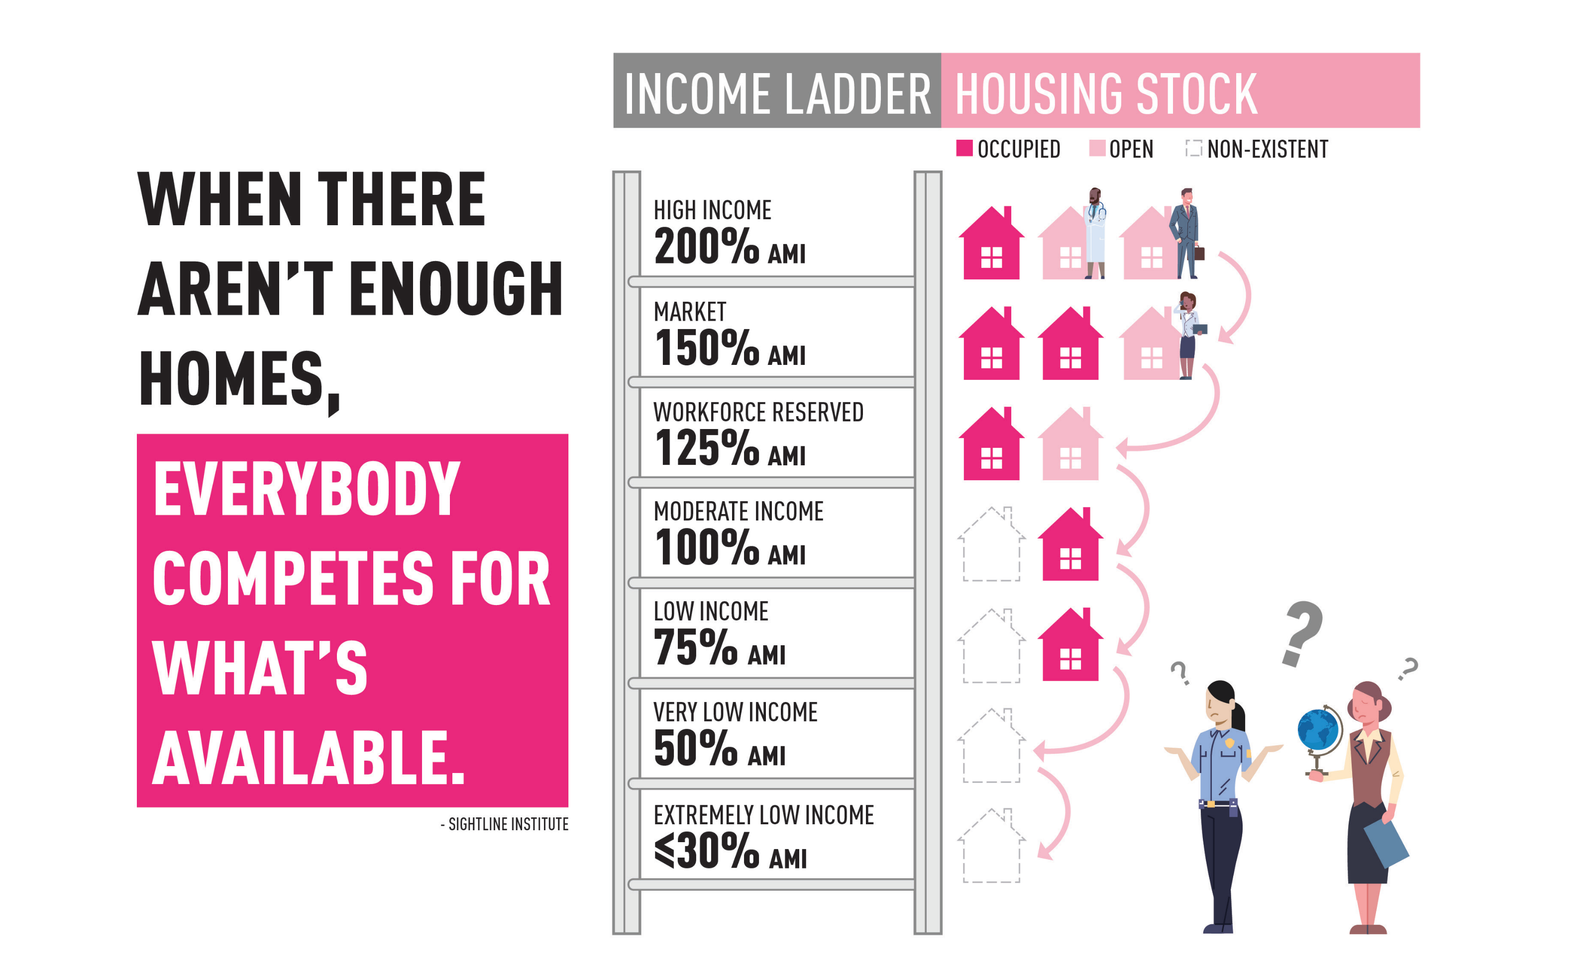
THE HOUSING LADDER
Notes:
Summary: An illustration showing the effects of mismatched housing on affordability. This points in particular to the impacts on households suffering from an undersupply of smaller, more affordable homes.
Suggested Dialogue:
“When you don’t have adequate housing supply, you are not only unable to cater to the lifestyles of certain households but also to their budgets. When there aren’t enough homes, everybody competes for what’s available. Lower income households are out of affordable options.”
Speaker’s Notes:
This illustration describes the situation where there are not enough homes available at price points affordable to lower income brackets.
Keep in mind that those lower income brackets incorporate many of our service workers, teachers, firefighters, police offers, and a slew of essential professions. We are not talking about only severely impoverished populations.
Takeaway: When there are not enough homes, especially in more affordable ranges, lower-income households are become priced out.

Slide 17
Area Median Income (AMI)
The area median income is the midpoint of a region's income distribution, meaning that half of the households in a region earn more than the median and half earn less than the median. A household's income is calculated by its gross income, which is the total income received before taxes and other payroll deductions.
Find Your AMI at: https://ami-lookup-tool.fanniemae.com/

Slide 18
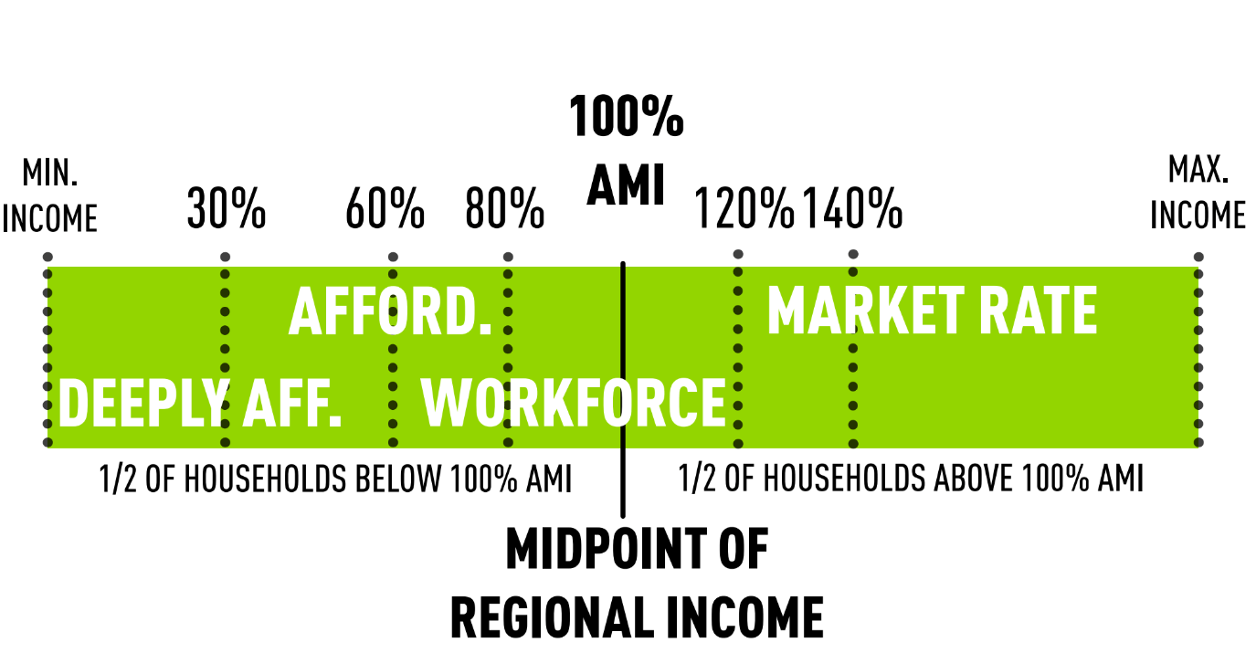
Area Median Income (AMI)

Slide 19
County | Area Median Income
Camden County | $79,200
Catoosa County | $90,700
Habersham County | $77,900
Richmond County | $77,600
Upson County | $69,100

Slide 20
Area Median Income (AMI) – Augusta Region
$46,560
Augusta AMI $77,600
$108,640
$23,280
$62,080
$93,120

Slide 21
AMI % | AMI | 28% for Housing Costs/12 | How Much House Can You Afford?
140% | $108,640 | $2,535/mo | $337,034 (with 10% down @7.44% Interest)
120% | $93,120 | $2,173/mo | $279,479 (with 10% down @7.44% Interest)
100% | $77,600 | $1,811/mo | $221,924 (with 10% down @7.44% Interest)
80% | $62,080 | $1,449/mo | $164,369 (with 10% down @7.44% Interest)
60% | $46,560 | $1,086/mo | $94,420 (with 10% down @7.44% Interest)
30% | $23,280 | $543/mo | $67,700 (with 10% down @7.44% Interest)
#
*
# - Median Home Price in Georgia $367,000 (Realtor.com, 2023)
* - Average Home Price in Georgia $317,789 (Zillow, 2023)

Slide 22
Housing Availability

Slide 23
Active For Sale Listings, July 2016 - Mar 2024
Source: Realtor.com
Notes:
Catoosa County, the City of Cornelia, the City of St. Mary's, and the City of Thomaston

Slide 24
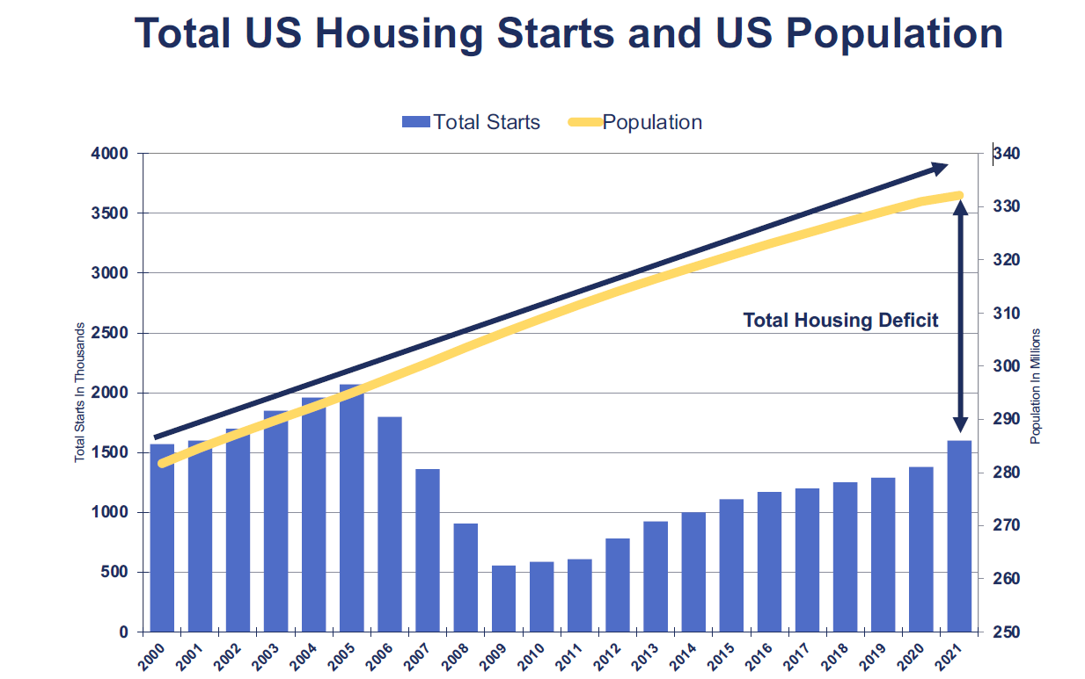
Why is Georgia Power focused on Housing?
Housing Bubble Burst
First Millennials are now 25
First Millennials are now 30
Great Recession

Slide 25
Understanding Types of Housing
Notes:
Let's dive into the heart of the matter. Our communities are facing a trio of intertwined challenges when it comes to housing: affordability, availability, and quality. Each of these issues plays a critical role in shaping the living conditions and prospects of our residents.

Slide 26
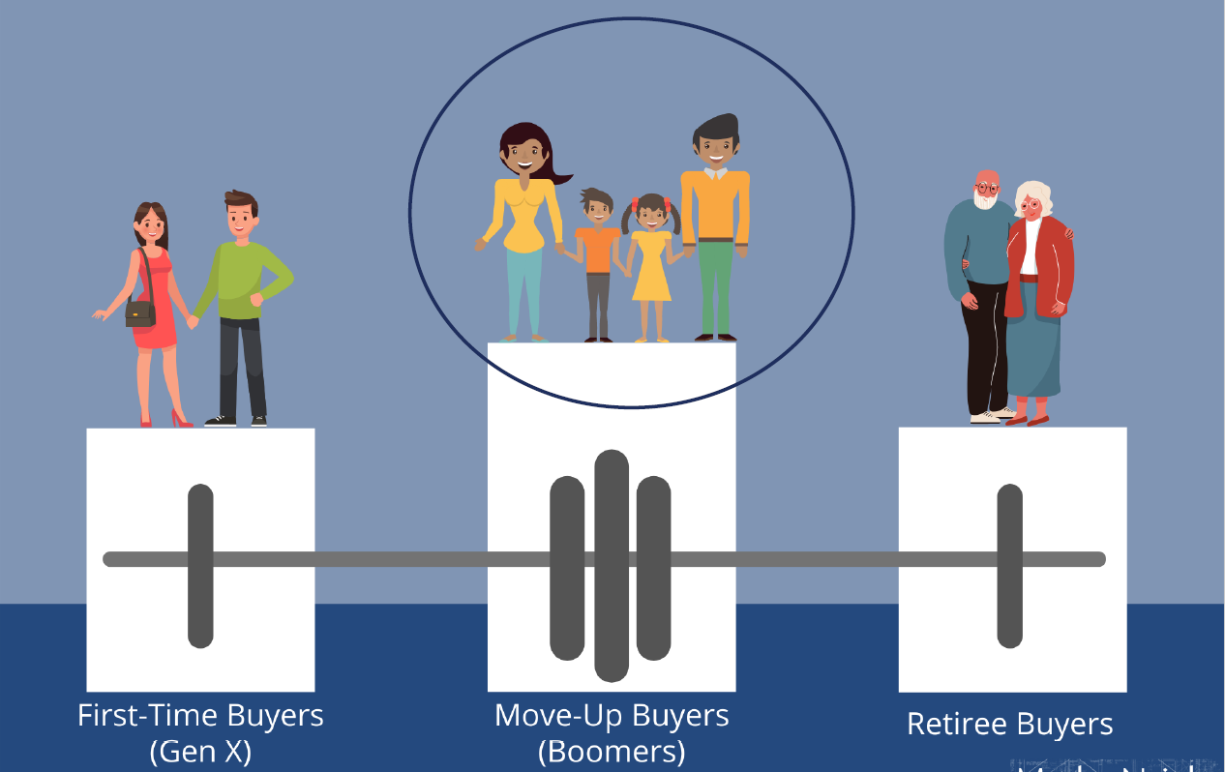
Housing Demand in 2000

Slide 27
SUPPLY vs DEMAND: HOUSING TYPE

Slide 28
CHANGING DEMOGRAPHICS: HOUSEHOLD COMPOSITION
83%
of households in the us will have no children by 2030
Data source:
Arthur C. Nelson, Reshaping Metropolitan America
Notes:
Summary: The share of households with children will continue to decline.
Suggested Dialogue:
“The number of households with children as a share of all households is expected to decrease further.”
Speaker’s Notes:
The speaker should state that this trend is not disappearing and reinforce its implications in relation to housing.

Slide 29
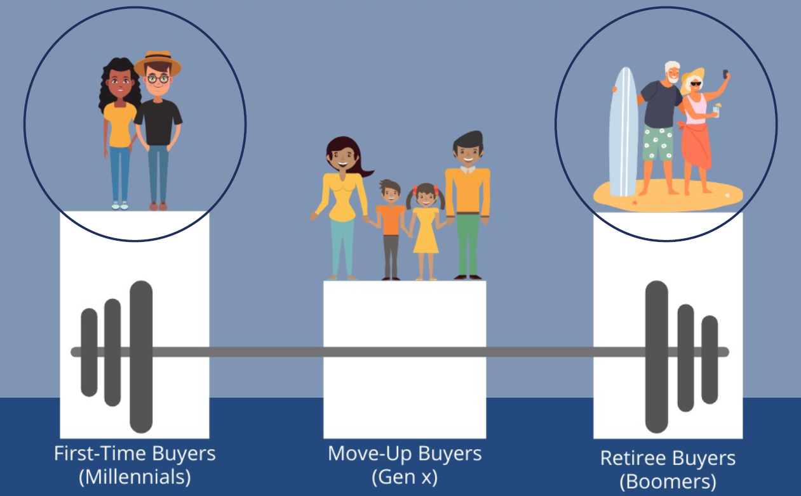
Housing Demand in 2024

Slide 30
Housing Types

Slide 31
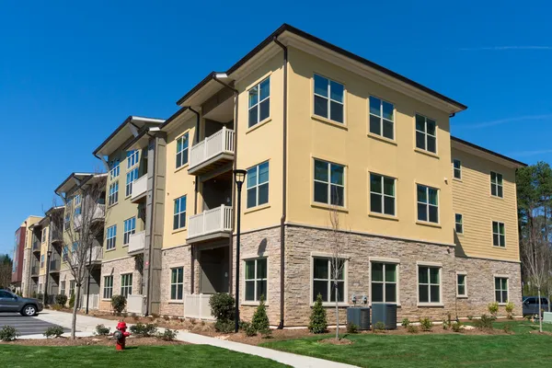

Basic Homes… Single Family to Garden Apartment

Slide 32
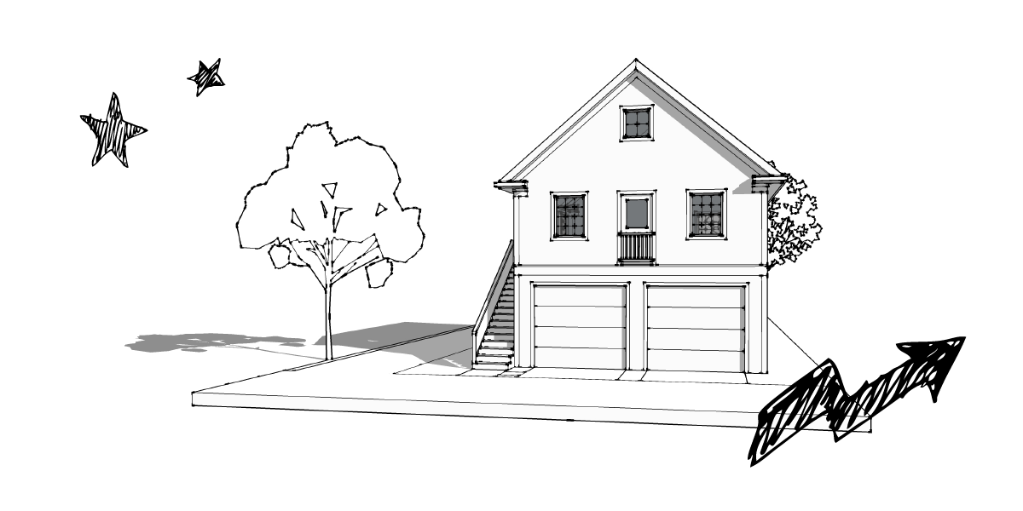
Accessory Dwelling Units
Source: https://mml.org/resources-research/publications/pattern-book-homes-for-21st-century-michigan/

Slide 33
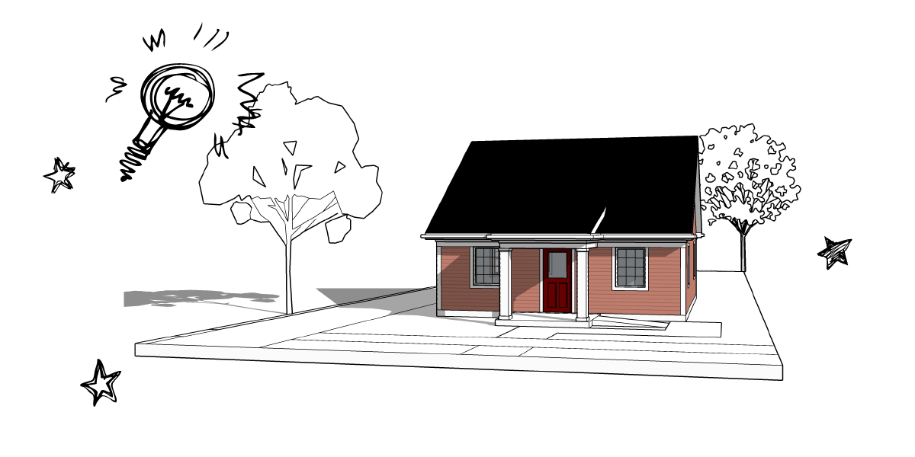
Cottages
Source: https://mml.org/resources-research/publications/pattern-book-homes-for-21st-century-michigan/

Slide 34
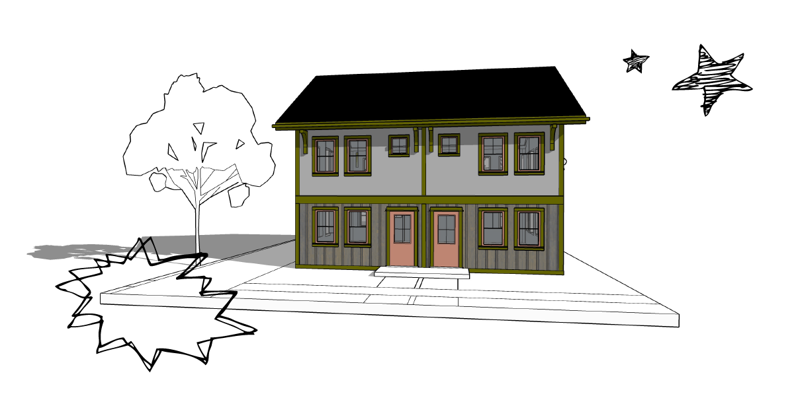
Row Homes
Source: https://mml.org/resources-research/publications/pattern-book-homes-for-21st-century-michigan/

Slide 35
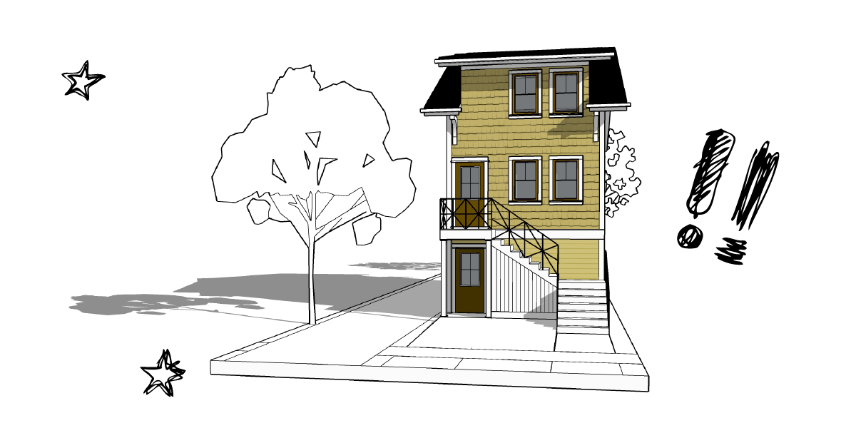
Stacked Homes
Source: https://mml.org/resources-research/publications/pattern-book-homes-for-21st-century-michigan/

Slide 36
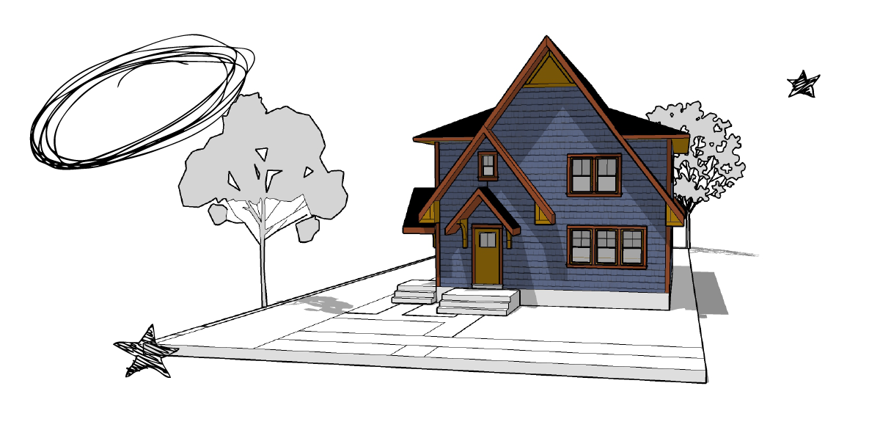
Duplex aka Two-Family
Source: https://mml.org/resources-research/publications/pattern-book-homes-for-21st-century-michigan/

Slide 37
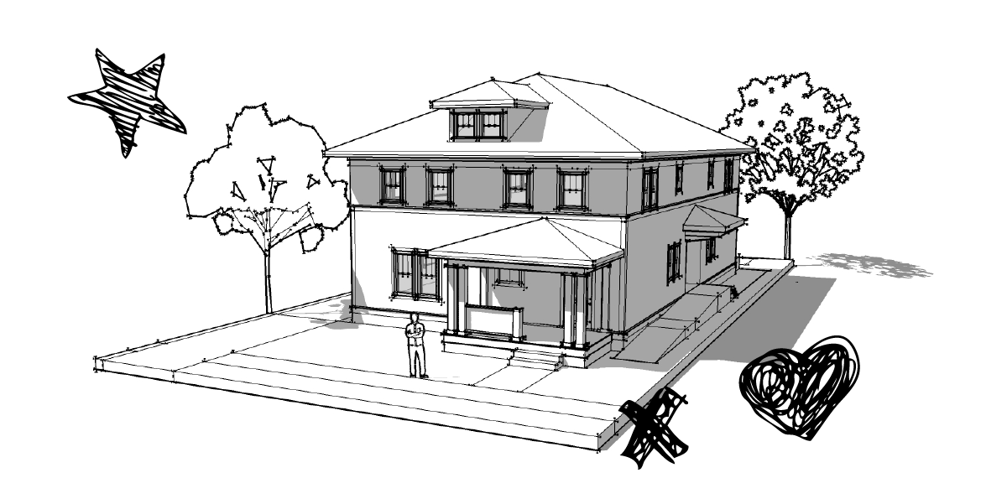
Quad-Plex aka Four-Unit
Source: https://mml.org/resources-research/publications/pattern-book-homes-for-21st-century-michigan/

Slide 38
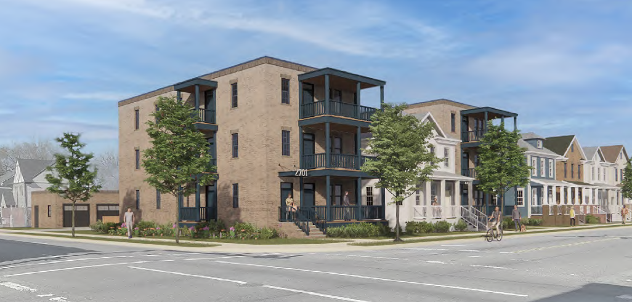
Stacked Flats mixed with single family

Slide 39
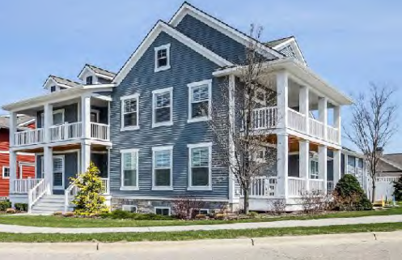
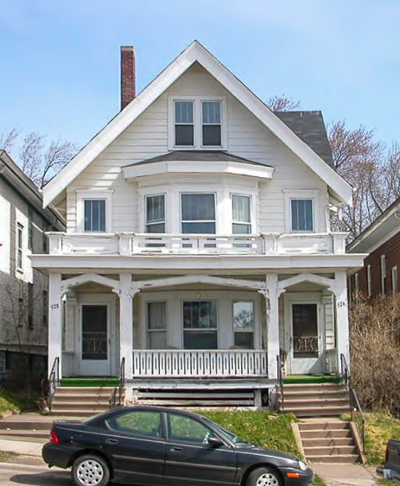
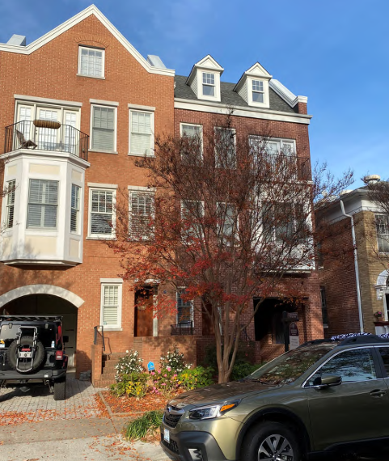
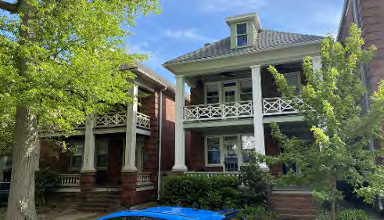
Two-Units

Slide 40
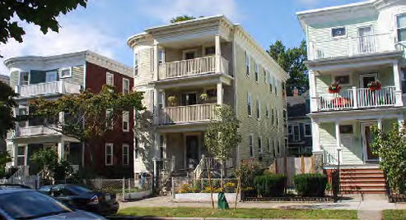
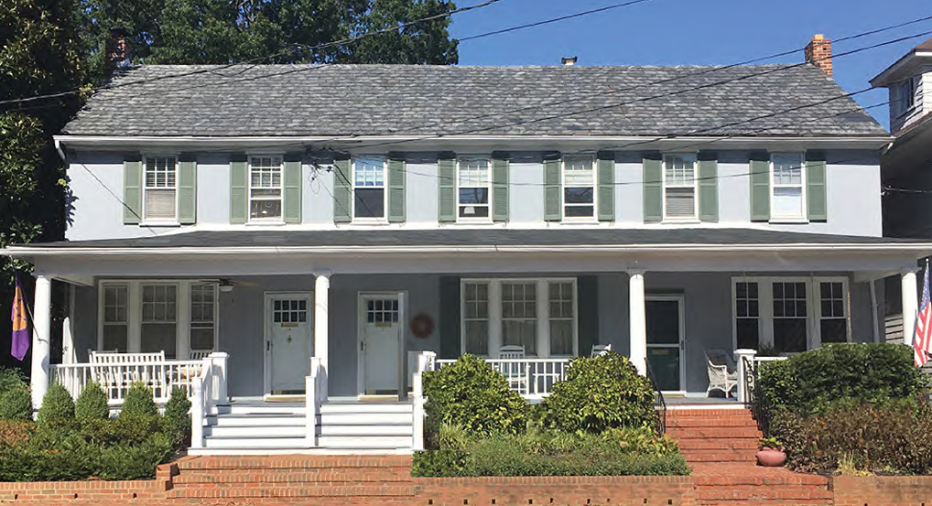
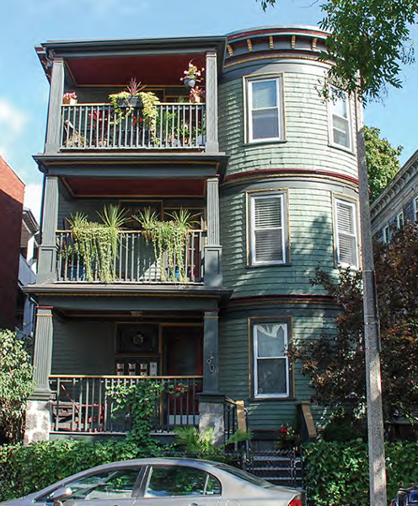
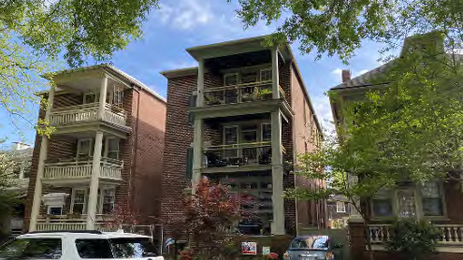
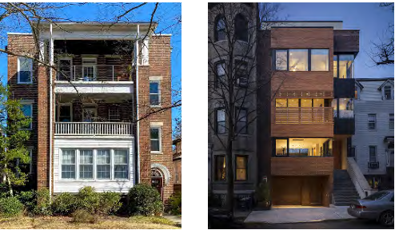
Three-Unit

Slide 41
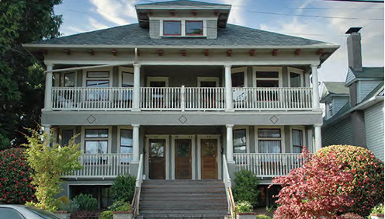
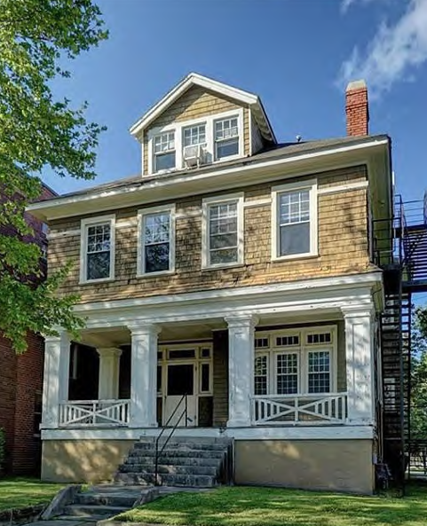
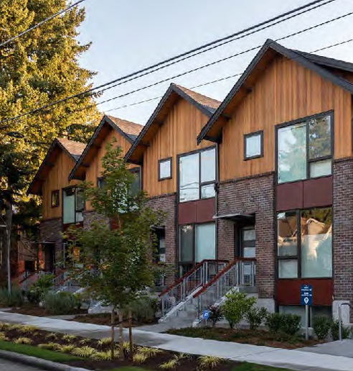
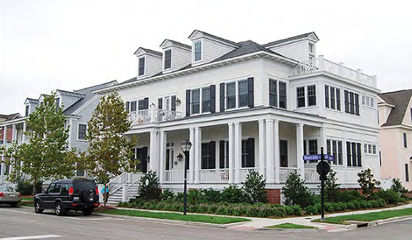
Four-Unit

Slide 42
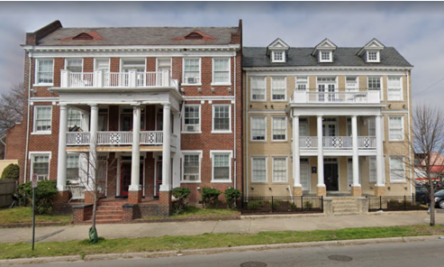
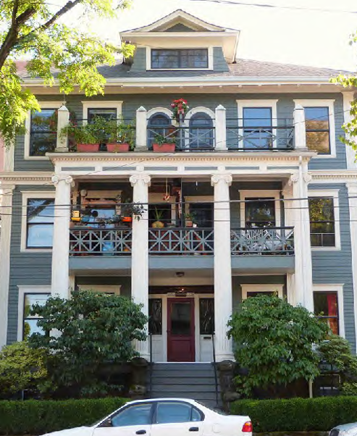
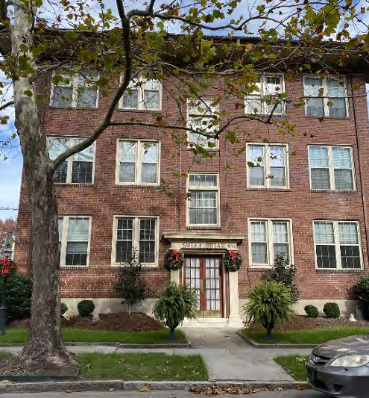
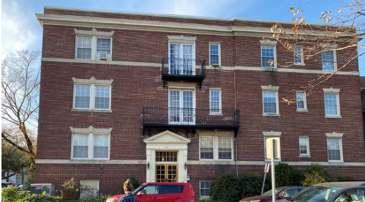
Six-Unit

Slide 43
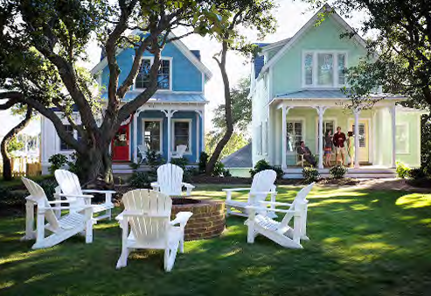
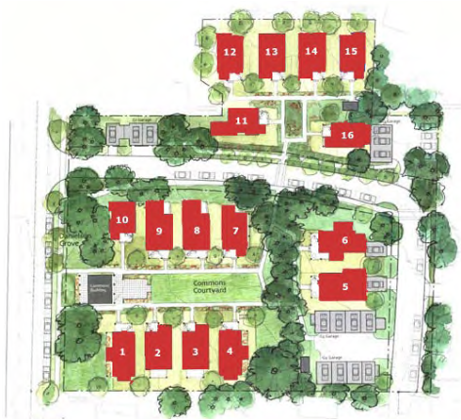
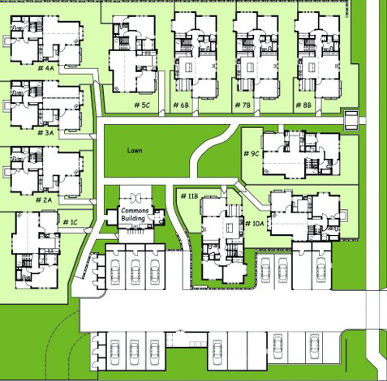
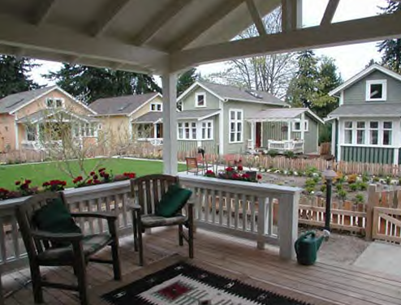
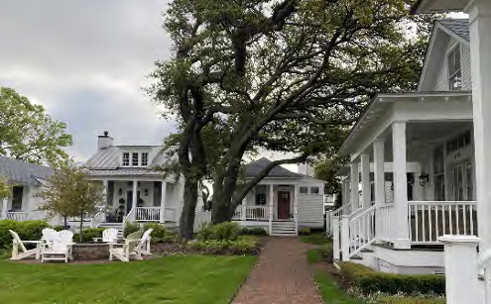
Cottage Courts

Slide 44
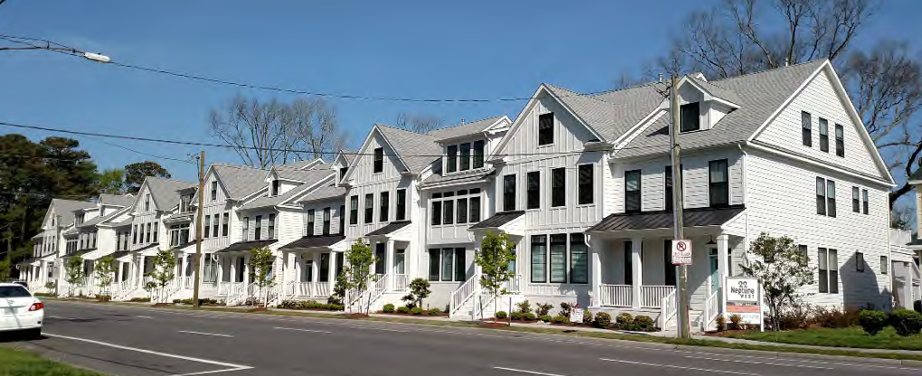
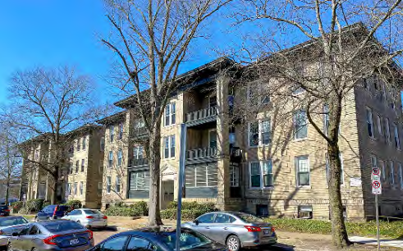
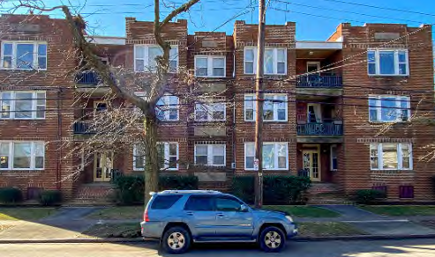
Townhouses & Multi-plexes

Slide 45

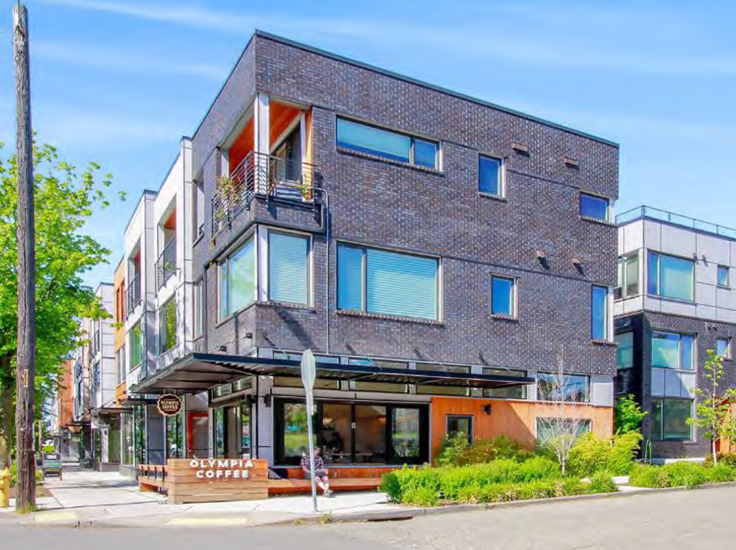
Live/Work and Mixed Use

Slide 46
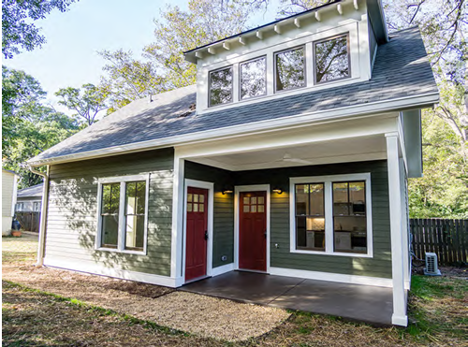
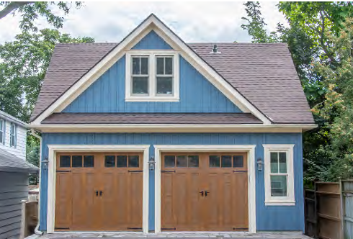
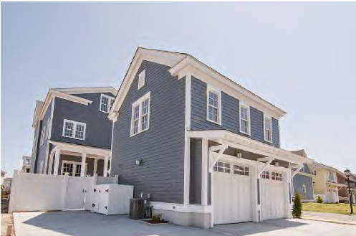
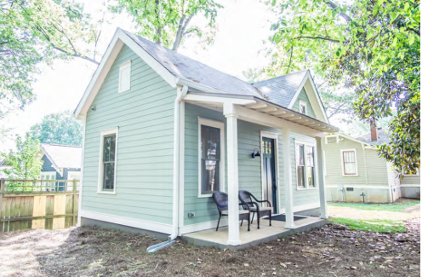
Accessory Dwelling Units

Slide 47
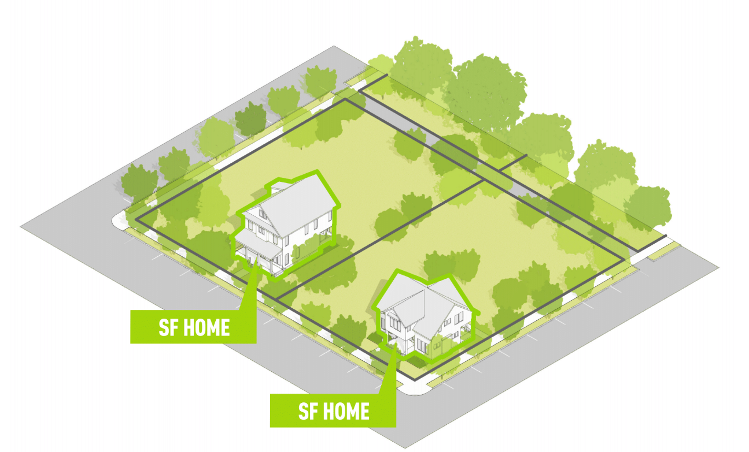
Is it possible in your town to go from this:

Slide 48
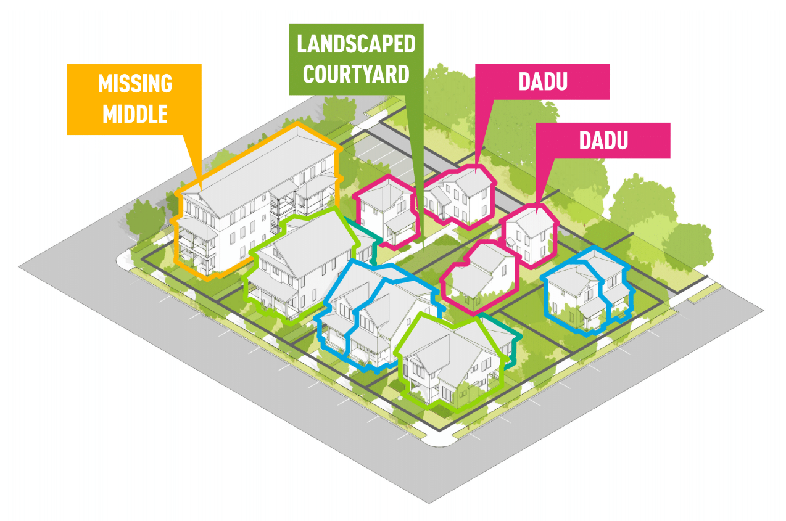
To this? Yes! With Zoning Code Adaptations that allow for Missing Middle Infill Housing and ADUs

Slide 49
Other Topics
(if we have time)

Slide 50
Steps Local Governments Can Take to Encourage More Housing
Zoning Updates
Simplify!
Mix residential types in residential districts (4-unit by right)
Allow ADUs by right, establish a grant program to help cover costs.
Eliminate minimum building square footage
Eliminate parking requirements
Incentives, cut red tape
Pre-approved plans
Hold a Local Small Builder Training Program
Identify unutilized public land
Utilize Development Authorities/Land Bank Authorities
Public Private Partnerships
Consider establishing a local housing accelerator fund (like a revolving loan fund) to help capitalize developers

Slide 51
References:
The Michigan Municipal League’s Pattern Book Homes for 21st Century Michigan
https://mml.org/resources-research/publications/pattern-book-homes-for-21st-century-michigan/
Norfolk, Virginia’s Missing Middle Pattern Book
https://www.norfolk.gov/DocumentCenter/View/66555/MissingMiddlePatternBook
Kronberg Urbanists & Architects – Great ideas for zoning and housing
https://www.kronbergua.com/
Microlife Institute – Cottage Courts
https://www.microlifeinstitute.org/
Incremental Development Alliance – Tools for small and infill devleopment
https://www.incrementaldevelopment.org/
Guerrilla Development – Pro formas for development projects
https://guerrilladev.co/

