Slide 1

Karama Neal, PhD
Southern Bancorp Community Partners
Heirs Property Information Project
Land and Opportunity:
Heirs Property and Select Topics in Housing Equity
February 24, 2021
Georgia Initiative for Community Housing

Slide 2






Real Property Uses
Six Fs
Notes:
Ask audience to name the six Fs using the chat.

Slide 3
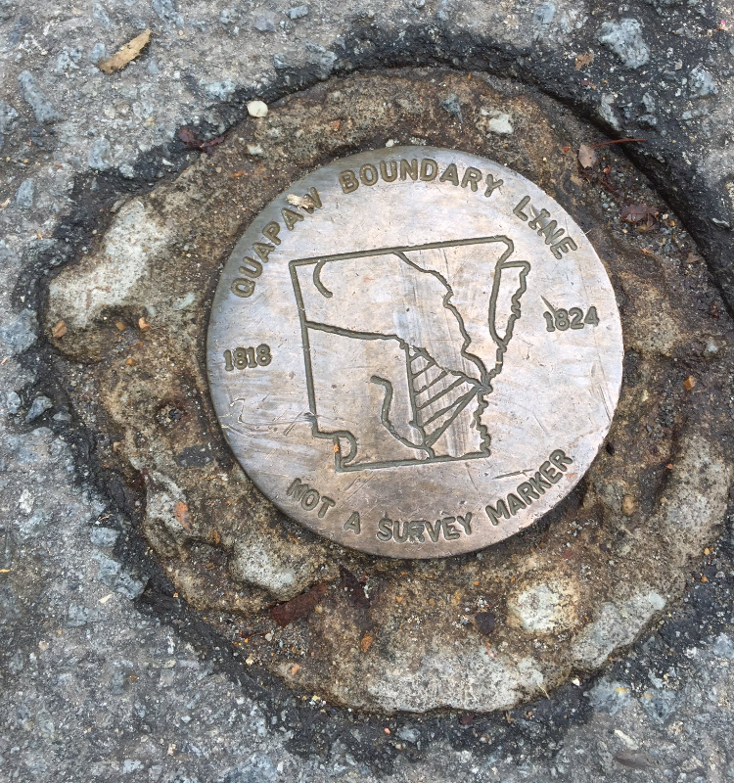
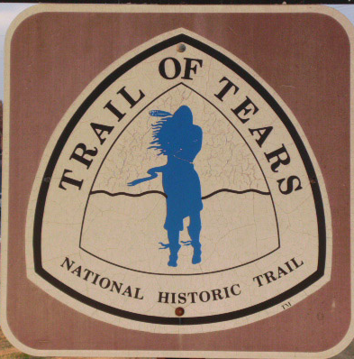
Select historical context
Colonization of the Americas
1824 US Treaty with the Quapaw
1833 US Treaty with the Quapaw
1887 General Allotment Act (“Dawes Act”)

Slide 4
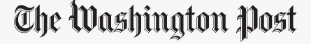
Select historical context
Feb 18, 1986
Under the old law, speculators or neighbors could pay delinquent taxes on any property—often unbeknownst to the owner—and receive a deed to the land after two years. In other cases, counties auctioned off delinquent properties at midnight sales or through a system that gave political favorites first chance at the best land.
“These abuses happened predominantly to blacks. In my four years as state land commissioner, all the contact I ever had about problems came from blacks,” said W.J. (Bill) McCune, now Secretary of State in Little Rock.
“We even had some county officials who would rake off the best land for themselves.” In fact, after he became land commissioner, McCune discovered that his predecessor had surreptitiously set up a corporation—with a telephone in his state office—to acquire and resell properties that came up on the delinquent list.
Notes:
Thumbs up (down) if you know a family who involuntarily lost their property?

Slide 5

Heir Property
Is family-owned, inherited land (real property) owned by multiple heirs with undivided interest.
Is land informally passed down from generation to generation.
Is not protected from sale simply because the taxes are paid.
Is not protected from sale simply because family members live on the land.
Is co-owned and undivided so any heir (or tenant) can assert her/his rights, no matter how small or recent the investment, involvement, or interest.
Notes:
Poll Q1: Do you have heir property in your family or do you know someone who does?
Chat: Q: If you call it something besides heirs/heir property please note in the chat.

Slide 6
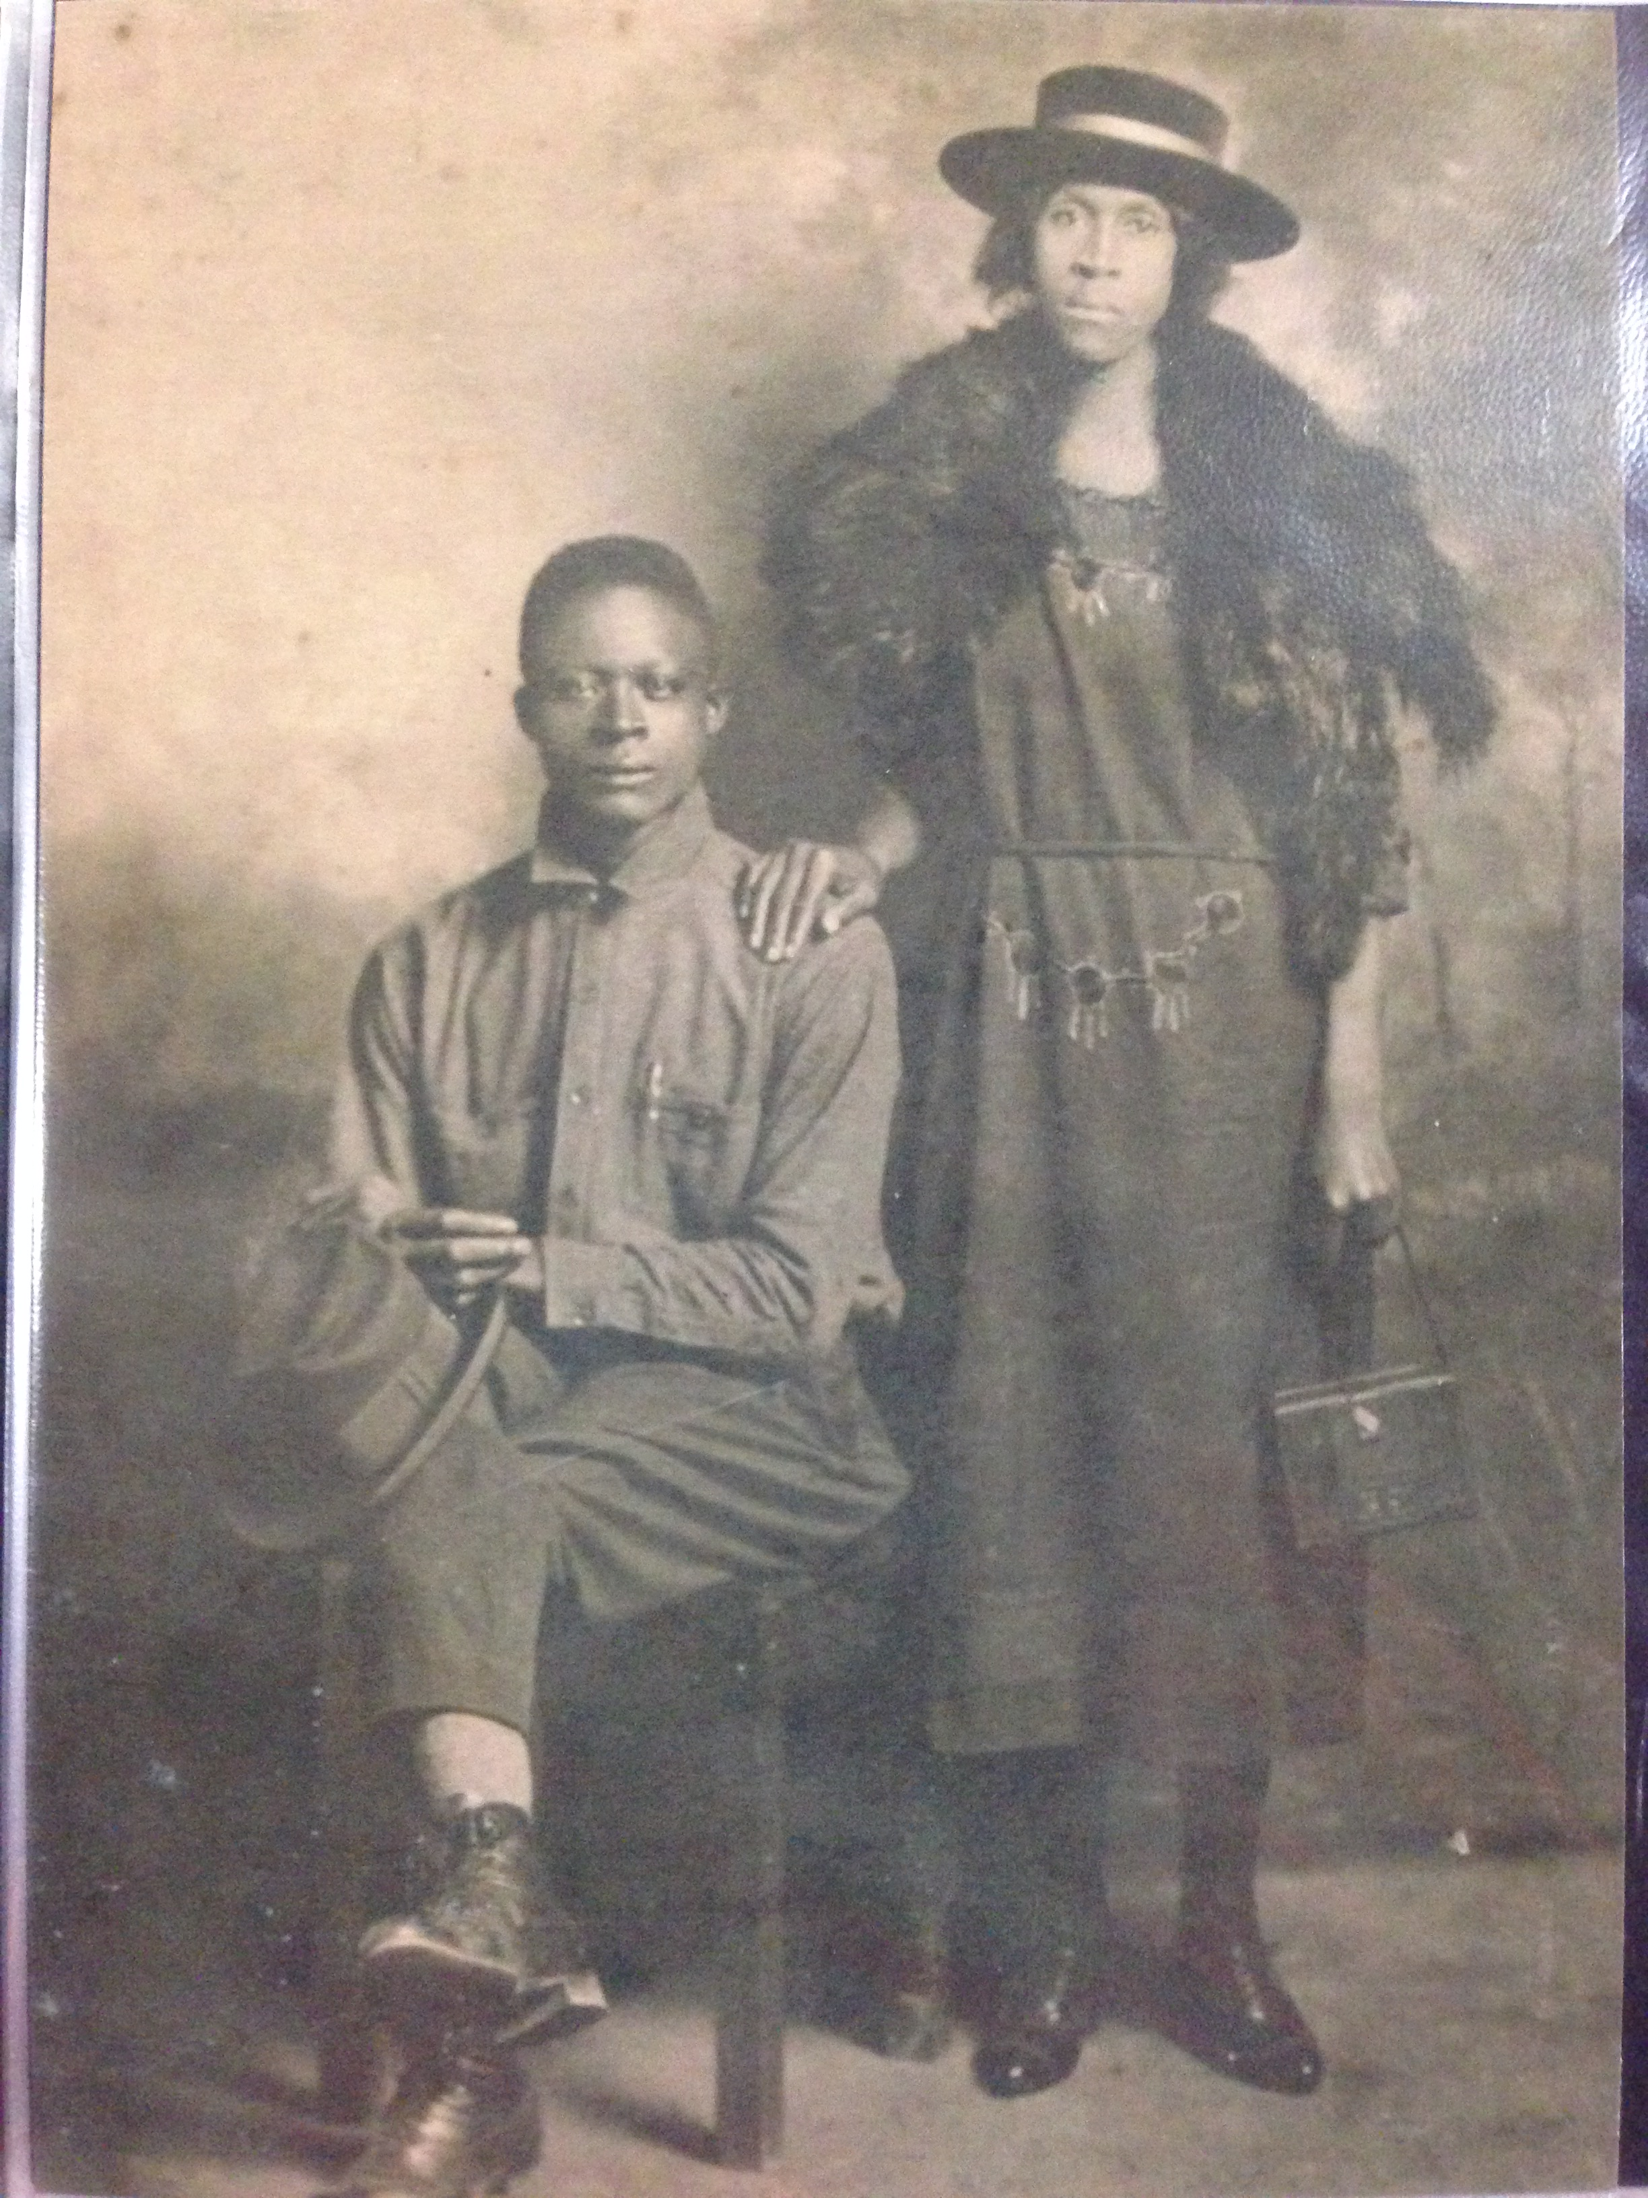



Griffin Henry Belk b. ~1848
Joe ‘Man’ Suttles
Vashti Belk Suttles ~1909
Fanilla Suttles Cobb b. 1910
Janet Cobb b. 1941
Notes:
.

Slide 7

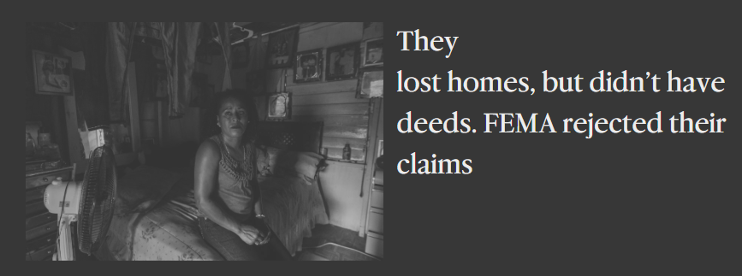
Heir Property Challenges
Property does not have a clear title, so owners have difficulty:
  Fully developing property
  Receiving disaster or other federal assistance
  Obtaining financing for property improvements
  Using as collateral
  Leasing property
  Selling property
2017, re Hurricane Maria
Notes:
Chat: Other challenges?
Thumbs up: If any of these are familiar though your direct or indirect work.

Slide 8
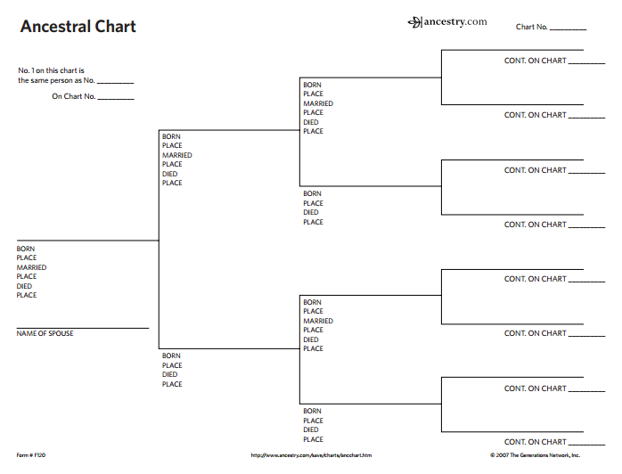
Heir Property Challenges
Two common remedies if an heir (or other cotenant) wants the monetary value of their land:
  Divide the property and sell a portion
  Sell the property and divide the proceeds
Notes:
Poll Q: Which of these is easier?

Slide 9
Uniform Partition of Heir Property Act
“Save the Family Farm Act”
Balances the rights of family members who want to retain their land with the rights of family members who want to sell.
Affects only heir property, a small subset of parcels in Georgia
Gives heirs the right to buy out other heirs who want to sell, keeping the land in the family.
Provides a means to realize full market value of the land, if sold.
Facilitates sound property management.
Has already been passed by 17 states and VI.
Preserves the independent right to contract.
Was drafted by the nonprofit Uniform Law Commission.

Slide 10
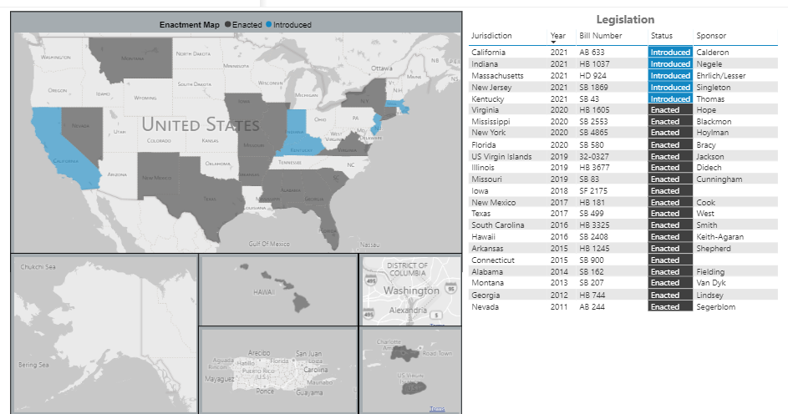
Uniform Partition of Heirs Property Act
Save the Family Farm Act
Passed in 17 states, and VI.
Introduced in 5 other states.
GA was the 2nd state to pass the Act.

Slide 11

Heir property matters
Breadth and scale
  Urban, rural, suburban
  African Americans,
  Asian Americans,
  European Americans,
  Latinx Americans, and
  Native Americans
Hawaii estate of Mark Zuckerberg -- https://www.theguardian.com/us-news/2019/jan/17/

Slide 12
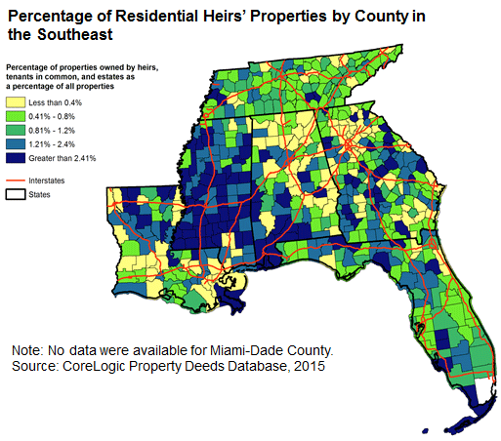
Heir property matters
Improved economic outcomes at scale
  Conner Bailey, Auburn University estimates: 2.1 million acres of heir property worth $5.95 billion in just 365 counties in the U.S. Black Belt.
https://www.frbatlanta.org/community-development/
Also see https://gaappleseed.org/media/docs/unlocking-heir-property.pdf

Slide 13
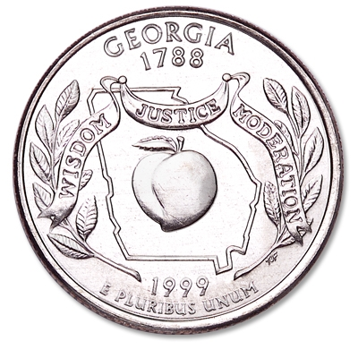
Heir property matters
Wealth retention and reclamation for families
  Through active property management
  Through property development
  Through sale of personal interest
  Families may not live in the region or state where their property is located.

Slide 14

Heir property matters
Wealth creation for communities
  Increased property tax base
  More vibrant economy
  Neighborhood and community improvements
  https://gaappleseed.org/media/docs/unlocking-heir-property.pdf

Slide 15

Heir property – What’s needed
Prevention
  Access to paid legal services
  Access to low/pro bono legal services
  Wills clinics
Notes:
Thumbs up if you know how to find low bono or pro bono legal services in your community?

Slide 16

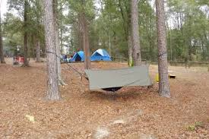
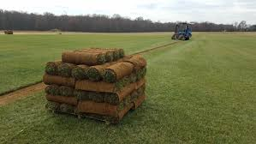
Heir property – What’s needed
Title clearance
  Number and location of heirs
  Variety and alignment of family goals
  Experienced family-focused attorneys

Slide 17
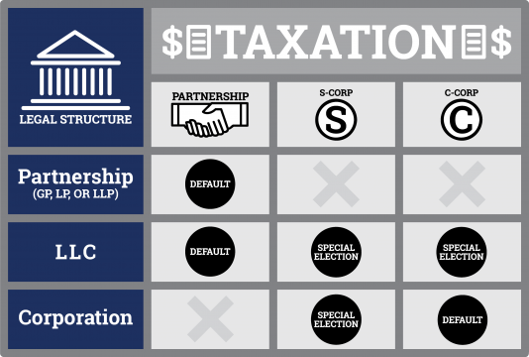
Heir property – What’s needed
Property management and ownership structures
  To facilitate business management
  To facilitate family engagement
  To facilitate ongoing family ownership
  To facilitate transparency
  To provide clarity on taxation, dividend, and other financial goals.

Slide 18
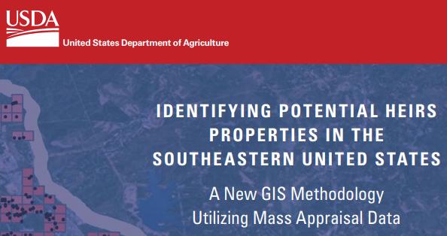
Heir property – What’s needed
Research and education
  Prevalence of heir property
  Distribution of heir property
  Potential value of heir property
  Impact of heir property resolution
  Location of heirs
  Policy innovation and impact
  Cost benefit analyses of programs and services
  Gender and heir property
  Etc.

Slide 19
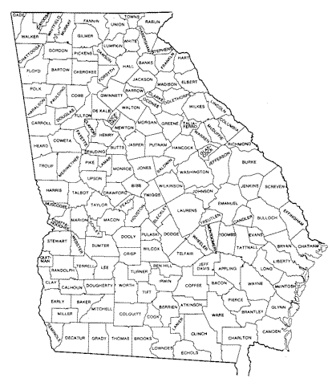
Heir property – Key takeaways
Property is urban, rural, and suburban.
Property is agricultural, residential, etc.
Property in in every state.
Owners are of every ethnicity.
Owners are often out of state.
Heir Property Act (Save the Family Farm Act) facilitates title clearance and other positive outcomes.

Slide 20
Zoning – brief historical context
1908 – First zoning law protects residential neighborhoods from industry, Los Angeles
1910 – First racial zoning law, Baltimore
1917 – Supreme Court declares Louisville racial zoning law unconstitutional.
Later - Expulsive zoning and other racially-informed zoning and planning
https://www.asu.edu/courses/aph294/total-readings/silver%20--%20racialoriginsofzoning.pdf

Slide 21
Zoning & housing affordability – 3 approaches
Facilitate building accessory dwelling units
  https://nhc.org/policy-guide/zoning-and-affordable-housing/
Regulation of parcel merges
  “residential small lot areas allow smaller, denser multifamily housing that preserves the neighborhood’s look and feel while providing more affordable options.”
  https://www.urban.org/urban-wire/how-communities-are-rethinking-zoning-improve-housing-affordability-and-access-opportunity
Reduce or eliminate single family zoning
  “Local zoning regulations prohibit building anything other than single-family detached houses on three-quarters of land in most U.S. cities.”
  https://www.brookings.edu/policy2020/bigideas/to-improve-housing-affordability-we-need-better-alignment-of-zoning-taxes-and-subsidies/

Slide 22
Three key questions
What are all the intended/desired outcomes?
What are the unintended outcomes?
Who else should I ask?

Slide 23

Thank you!
Karama Neal, PhD www.karamaneal.com www.heirspropertyinfo.com karamaneal@gmail.com

